Slide 1
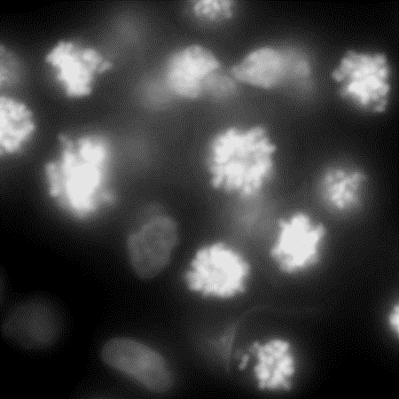
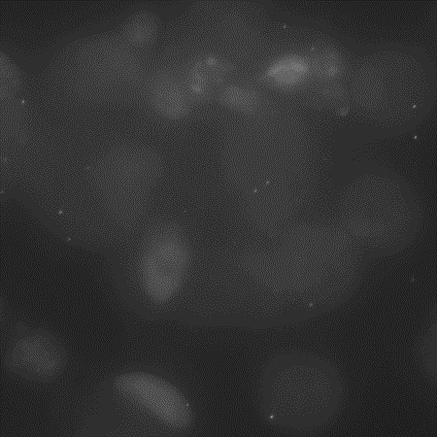
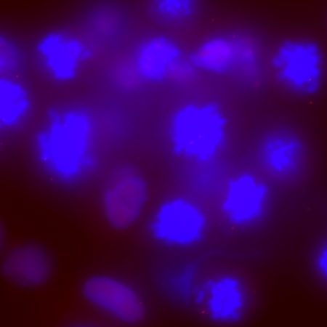
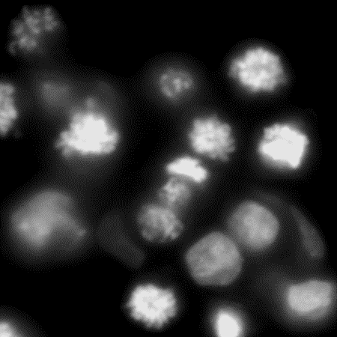
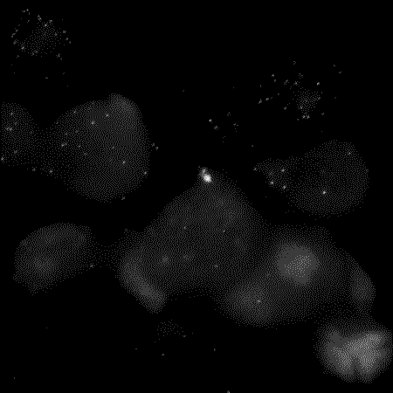
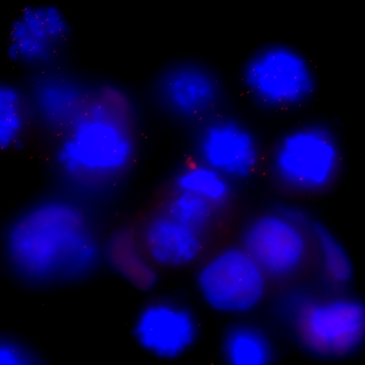
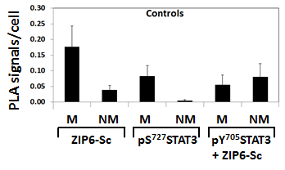
Supplementary Figure S1
A
DAPI
ZIP6-Y only
Merge
PLA
DAPI
ZIP10 only
Merge
PLA
B
0.30
0.25
0.20
0.15
0.10
0.05
0.00
Control
Signal per cell
M NM M NM M NM
ZIP6-SC
pS⁷²⁷STAT3
pY⁷⁰⁵STAT3
+ ZIP6-SC
Supplementary Figure S1.
Control PLA, using either our ZIP6-Y or our ZIP10 antibodies alone, in nocodazole-treated MCF-7 cells produces only a few dots in mitotic cells (arrow), compared to Figure 1D. Scale bar, 10 μm.
PLA using ZIP6-SC and pY⁷⁰⁵STAT3 antibodies together as well as individual control ZIP6-SC and pS⁷²⁷STAT3 antibodies in nocodazole-treated MCF-7 cells produces few dots, compared to Fig. 3D. Results of three independent experiments are demonstrated as mean ± SD. M=mitotic cells, NM= non-mitotic cells.
Notes:
FACS cell cycle 2014-10-24.xlsx

Slide 2
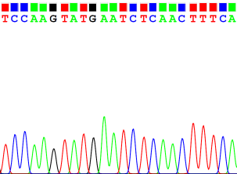
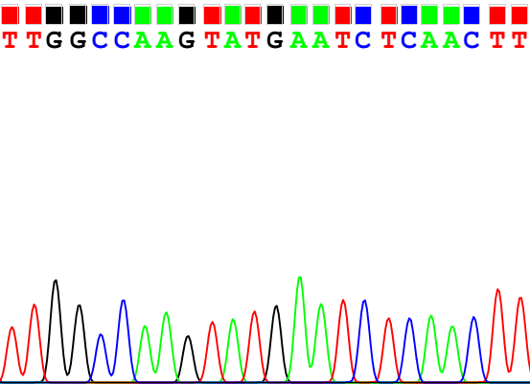
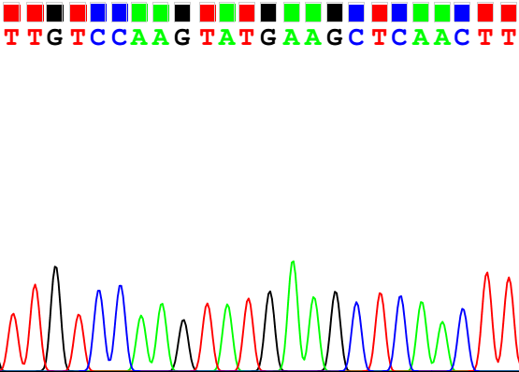
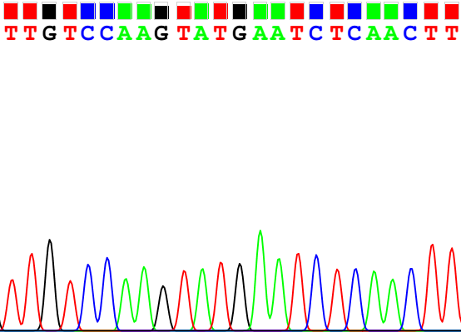
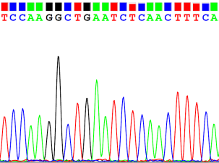
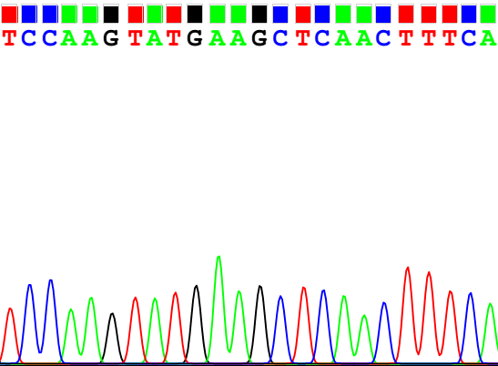
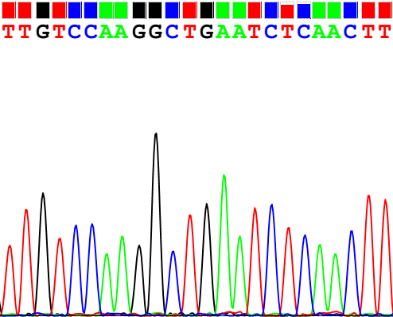
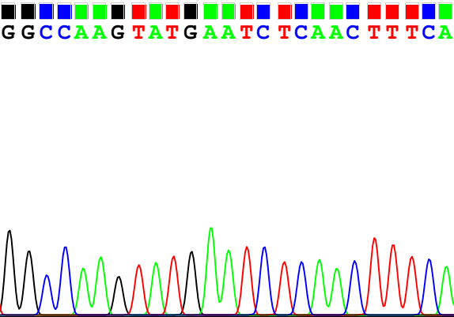
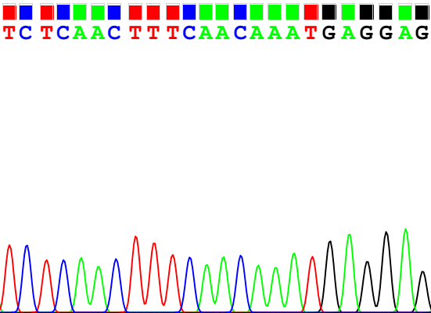
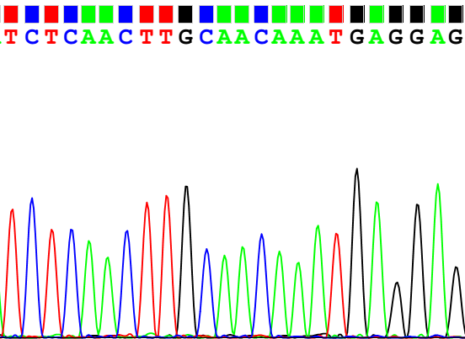
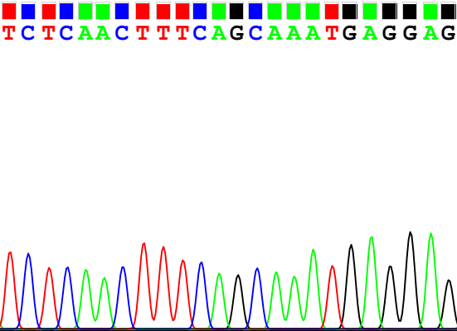
Supplementary Figure S2
A
WT
L S K Y E S Q L
TTGTCCAAGTATGAATCTCAACTT
AESQ (Y473A)
L S K A E S Q L
TTGTCCAAGgcTGAATCTCAACTT
S471A
L A K Y E S Q L
TTGgCCAAGTATGAATCTCAACTT
S475A
L S K Y E A Q L
TTGTCCAAGTATGAAgCTCAACTT
B
WT
S Q L S T N E E
TCTCAACTTTCAACAAATGAGGAG
S478A
S Q L A T N E E
TCTCAACTTgCAACAAATGAGGAG
T479A
S Q L S A N E E
TCTCAACTTTCAgCAAATGAGGAG
Supplementary Figure S2.
Confirmatory sequencing of the different ZIP6 mutants around two different sites. A. shows mutants Y473A, S471A and S475A. B. shows mutants S478A and S479A.
Notes:
From thesis result collections

Slide 3
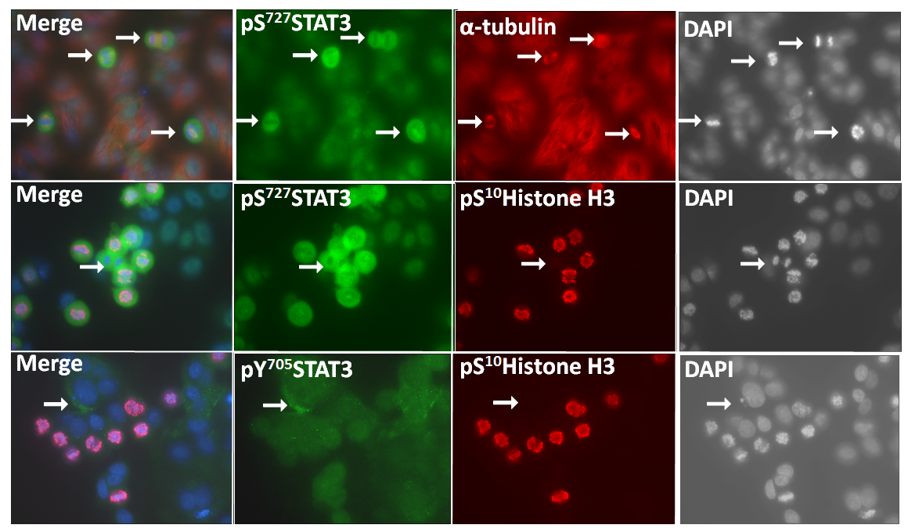
Supplementary Figure S3
A
Ser727
Ser727
B
pS¹⁰HistoneH3
pS⁷²⁷STAT3
pY⁷⁰⁵STAT3
Supplementary Figure S3.
Cells were immunostained for pS⁷²⁷STAT3 (green), pY⁷⁰⁵STAT3 (green), α-tubulin (red) and pS¹⁰HistoneH3 (red), and counterstained with DAPI (blue). Top panel: Mitotic cells (arrows) are positive for pS⁷²⁷STAT3. Middle panel: Arrow shows a cell in cytokinesis that is negative for pS¹⁰HistoneH3, yet still positive for pS⁷²⁷STAT3. Bottom Panel: Mitotic cells are negative for pY⁷⁰⁵STAT3. Arrow indicates pY⁷⁰⁵STAT3 staining on the plasma membrane. Scale bar, 10 μm.
Densitometric data for pS⁷²⁷STAT3, pY⁷⁰⁵STAT3 and pS¹⁰HistoneH3 normalised to GAPDH values from Figure 4D are demonstrated as mean ± SD.
Notes:
From previous manuscript
From previous manuscript
From previous manuscript
Data of PLA for figures.xlsx

Slide 4
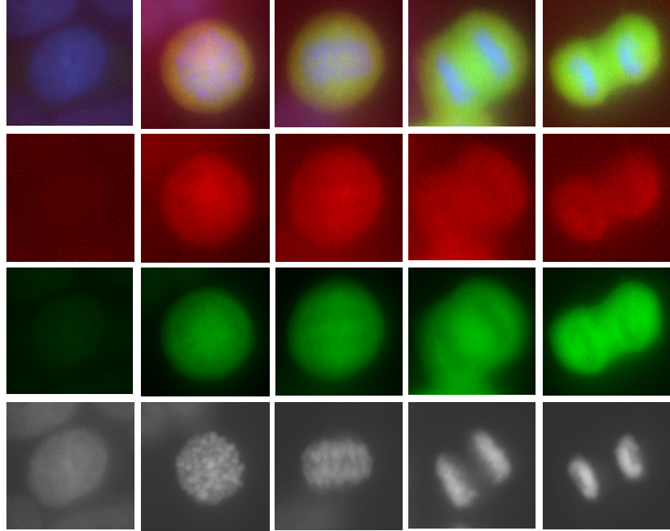
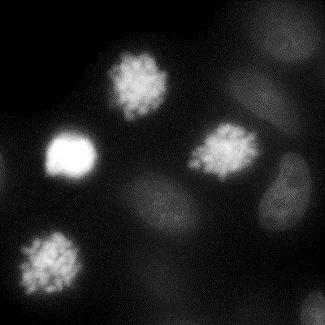
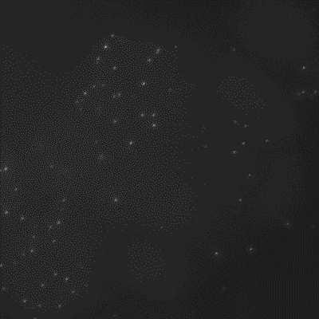
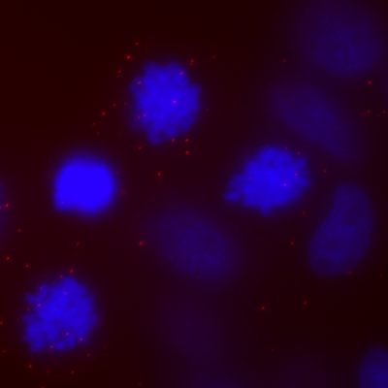
Supplementary Figure S4
A
Interphase
Prophase
Metaphase
Anaphase
Telophase
Merge
pS⁷²⁷STAT3
p³⁸Stathmin
DAPI
B
p³⁸Stathmin alone control
DAPI
PLA
Merge
pS³⁸Stathmin only
Supplementary Figure S4.
Fluorescence microscopy shows co-localisation of p³⁸Stathmin and pS⁷²⁷STAT3 during mitotic cell cycle phases, but not interphase. Scale bar, 10 μm.
PLA using pS³⁸Stathmin antibody alone as negative control for Figure 4F, producing only few dots in mitotic cells (arrows).. Scale bar, 10 μm..

Slide 5
Supplementary Figure S5
Supplementary Figure S5.
Probing for pS⁷²⁷STAT3 in cells immunoprecipitated with V5 in cells transfected with both wild-type ZIP6 and other ZIP6 mutants showed reduced presence in the Y473A mutant. These data are consistent with STAT3 binding to ZIP6 involving residue Y473. This figure represents the full blot details of one of the replicates shown in Figure 4I.

