Slide 1
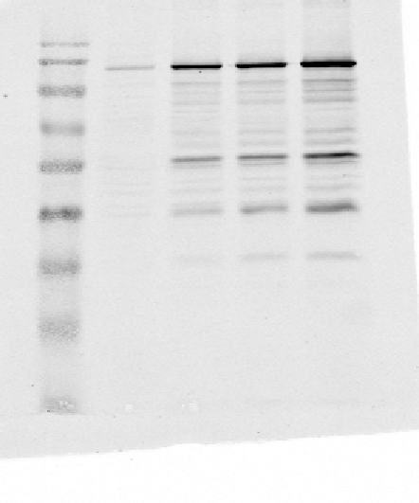

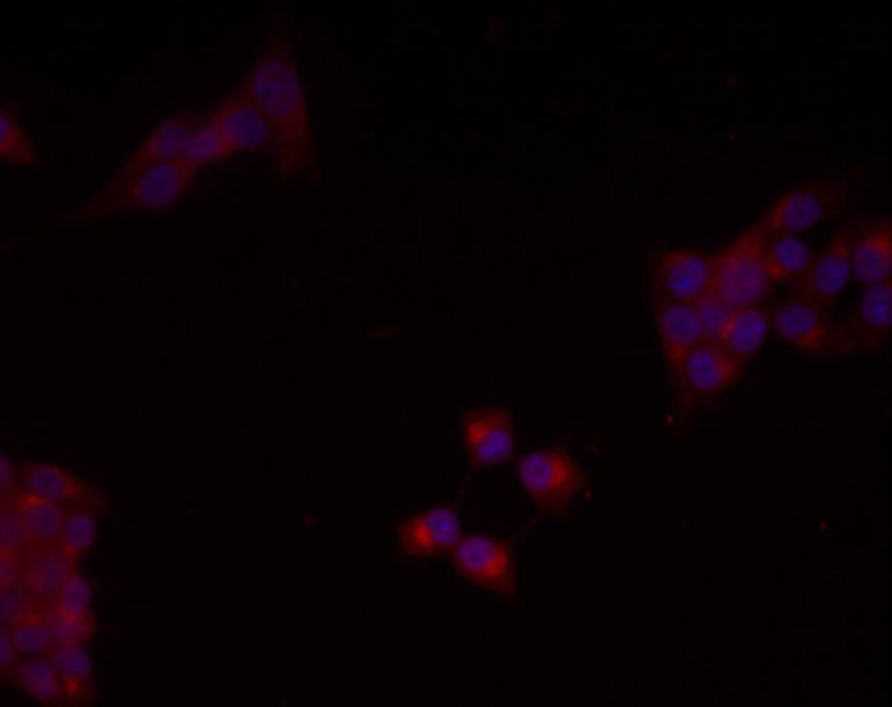
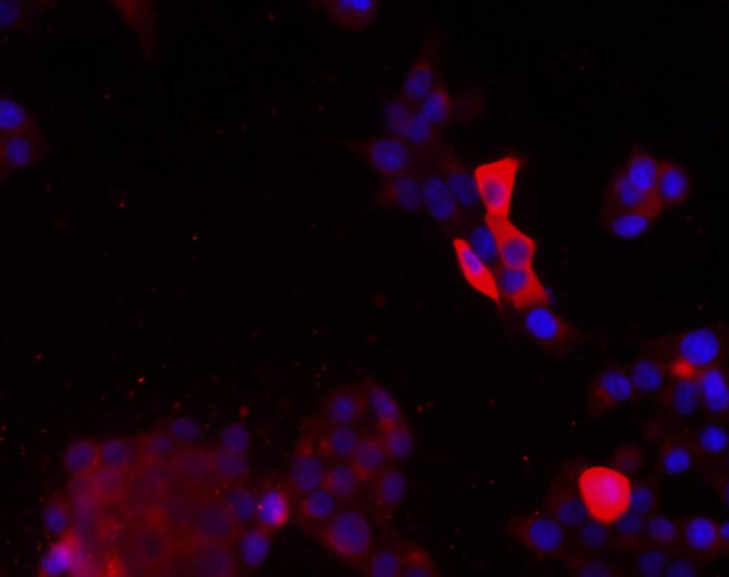
Fig. S1
a
pcDlk
-
+
++
+++
Dlk
αTubulin
b
% of pyknotic nuclei
6
*
4
2
pcDlk
0
-
+
++
+++
c
Ctrl
Dlk
DAPI
Dlk
pcDlk+++
DAPI

Slide 2
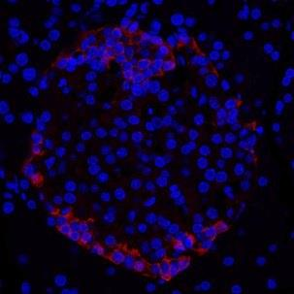
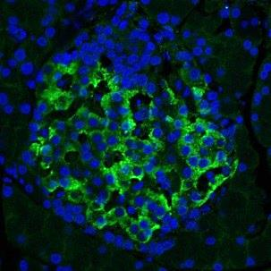
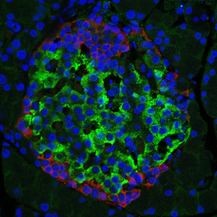
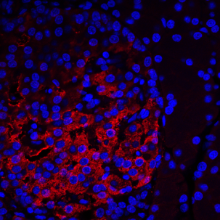
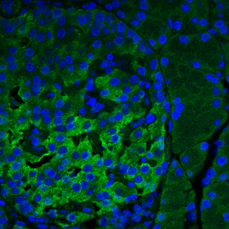
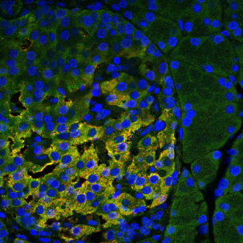
Fig. S2
a
b
c
Glucagon
Dlk
merge
d
20 μm
e
f
Insulin
Dlk
merge
20 μm

Slide 3
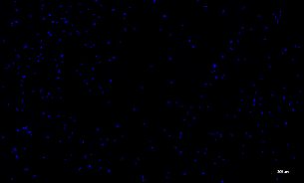
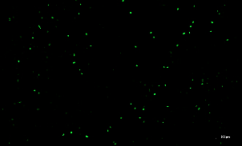
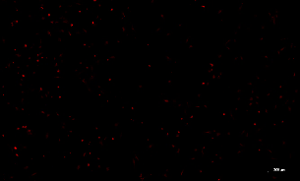
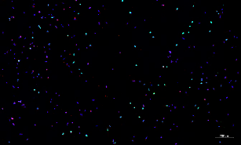
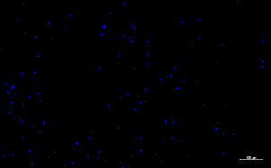
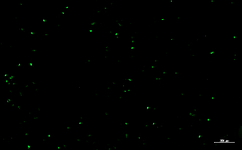
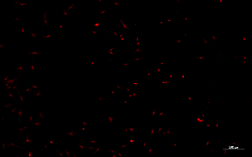
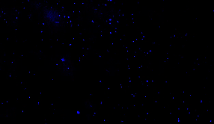
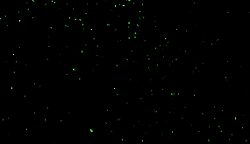

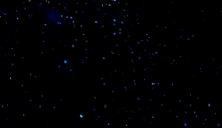
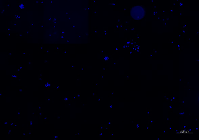
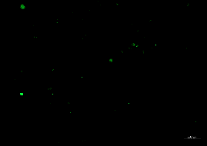
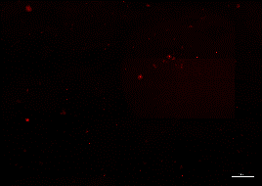
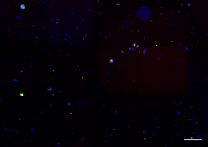
Fig. S3
a
DAPI
ki67
Insulin
Merge
Ctrl
200 μM
DAPI
ki67
Insulin
Merge
siDlk
200 μM
b
DAPI
BrdU
Insulin
Merge
Ctrl
200 μM
DAPI
BrdU
Insulin
Merge
siDlk
200 μM

Slide 4
Fig. S4
NS
NS
NS
NS
NS
siCtl
siDlk
mRNA/Tbp mRNA
(% siGFP)
Fos
Jun
Bcl2
Bcl2l11
Bad

Slide 5
Fig. S5
siCtl
mRNA/Tbp mRNA
(% siGFP)
siDlk
Pdx1
Mafa
Kir6.2
Nkx6.1
Znt8
Gck
Glut2
Ins2

Slide 6
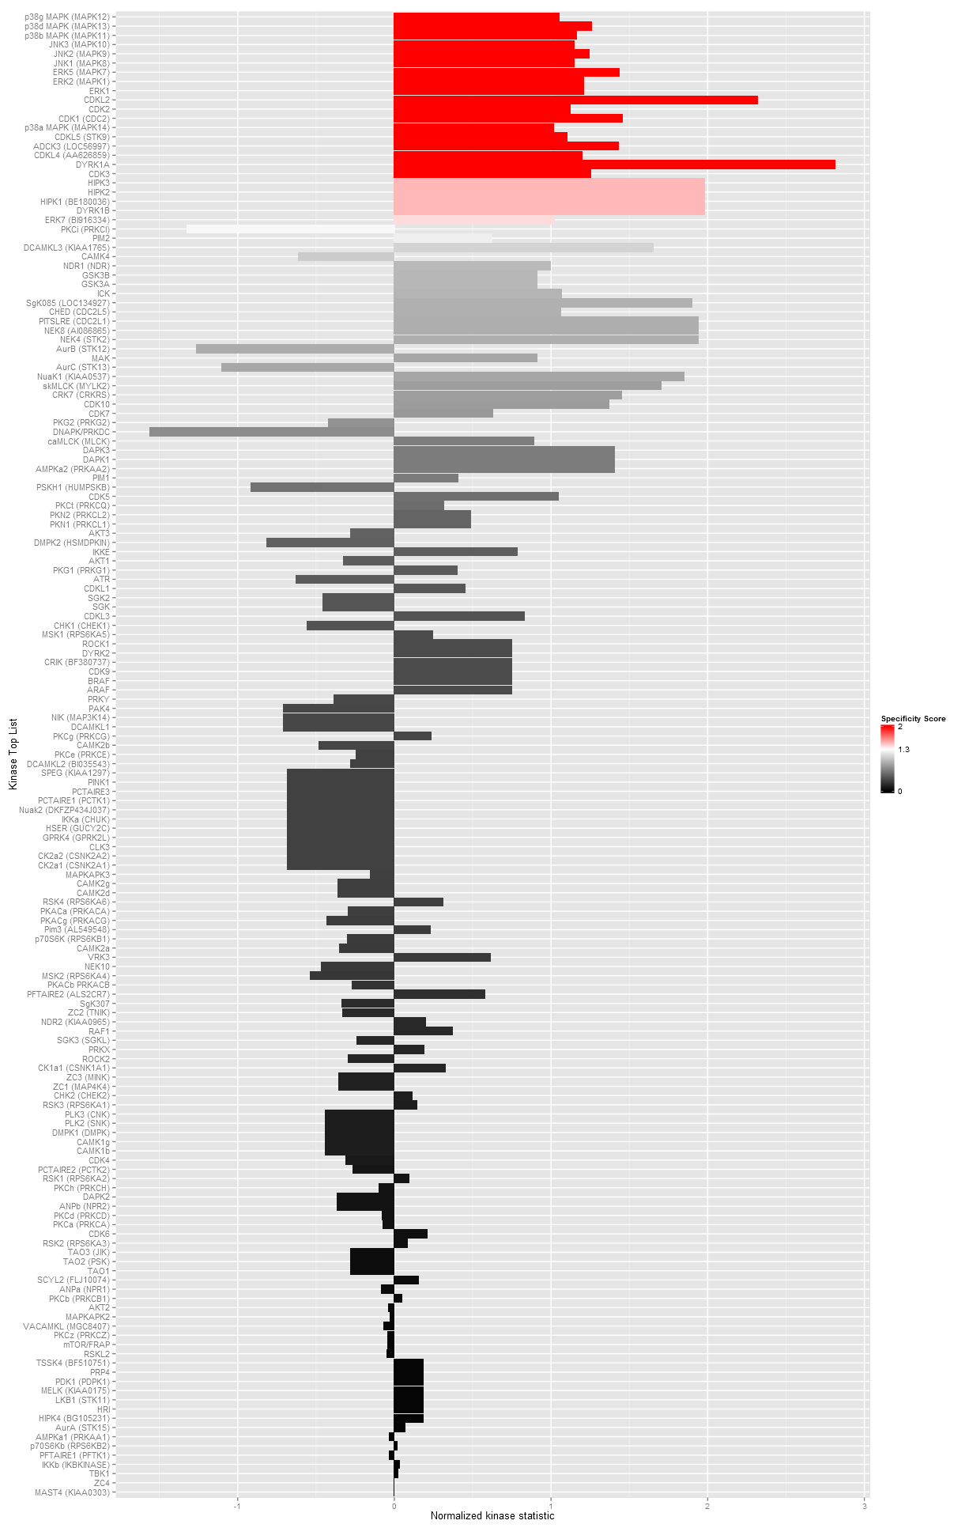
Fig. S6
Jnk3

Slide 7
Fig. S7
NS
% TUNEL+ Ins+ /
Total Ins +
p10
p32

Slide 8
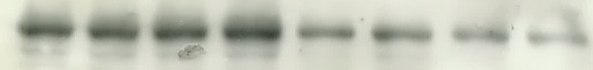
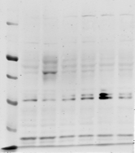
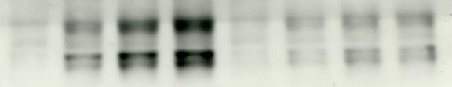
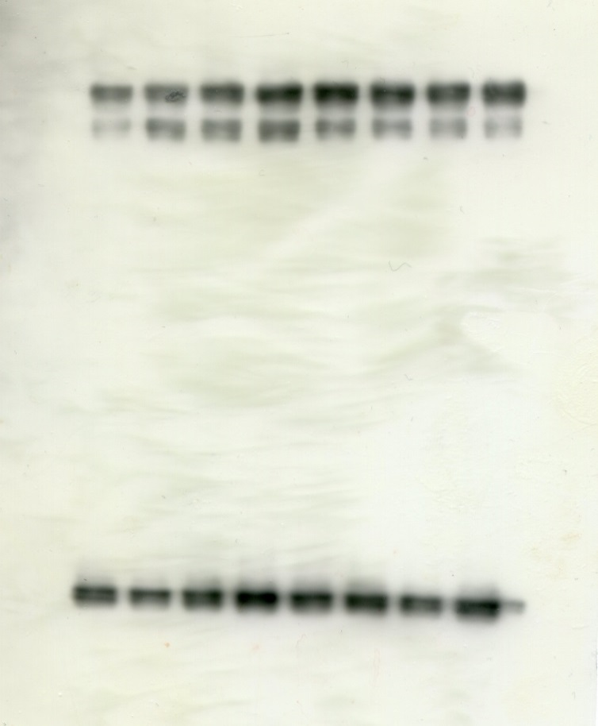
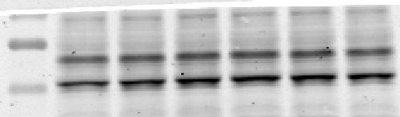
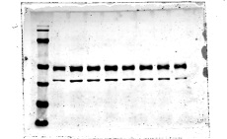
Fig. S8
a
b
siCtl
siDlk
IL (min)
0
15
30
60
0
15
30
60
Ctrl
pcDLK
Dlk
Total p-Jnk
(Jnk1/2/3)
Total p-Jnk
(Jnk1/2/3)
Total Jnk
Total Jnk
αTubulin

Slide 9
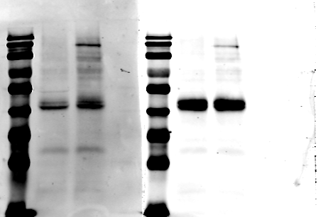
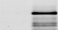
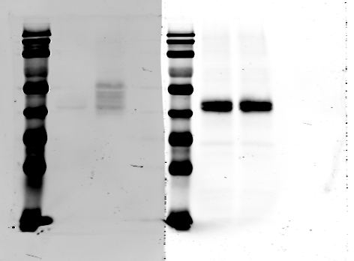
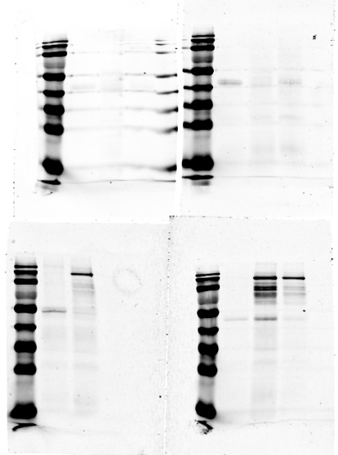
Fig. S9
IP: Jnk3
IP: Dlk
Ctrl
J+D
Ctrl
J+D
Dlk
IB
Jnk3

Slide 10
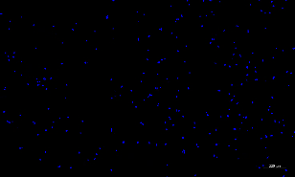
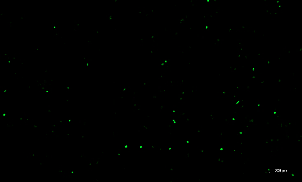
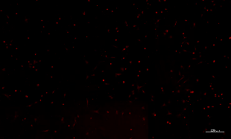
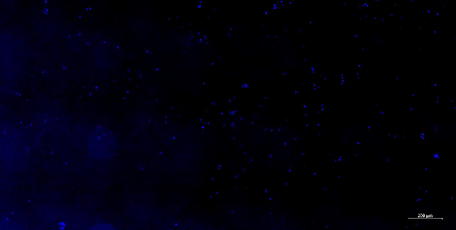
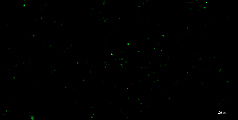
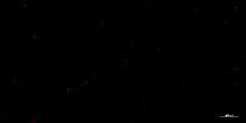
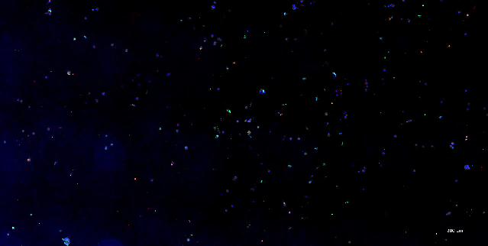
Fig. S10
a
DAPI
ki67
Insulin
Merge
Ctrl
200 μM
DAPI
ki67
Insulin
Merge
siJnk3
200 μM
b
DAPI
BrdU
Insulin
Merge
Ctrl
200 μM
DAPI
BrdU
Insulin
Merge
siJnk3
200 μM

Slide 11
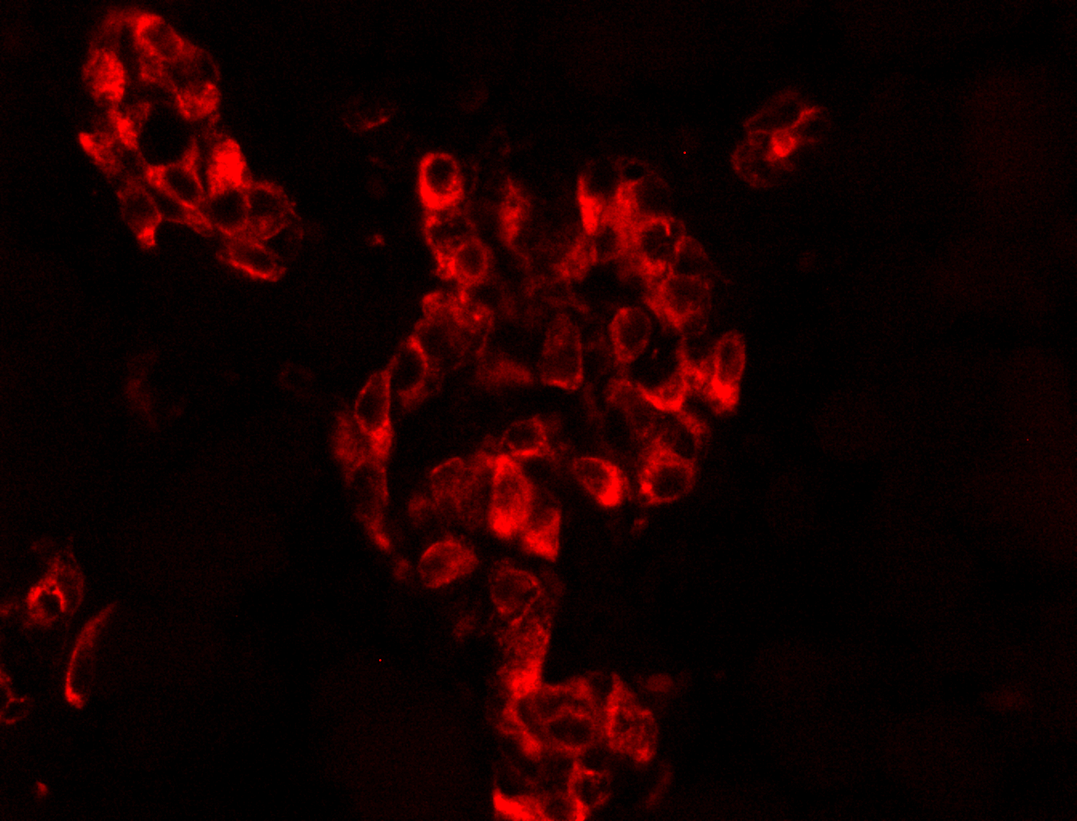
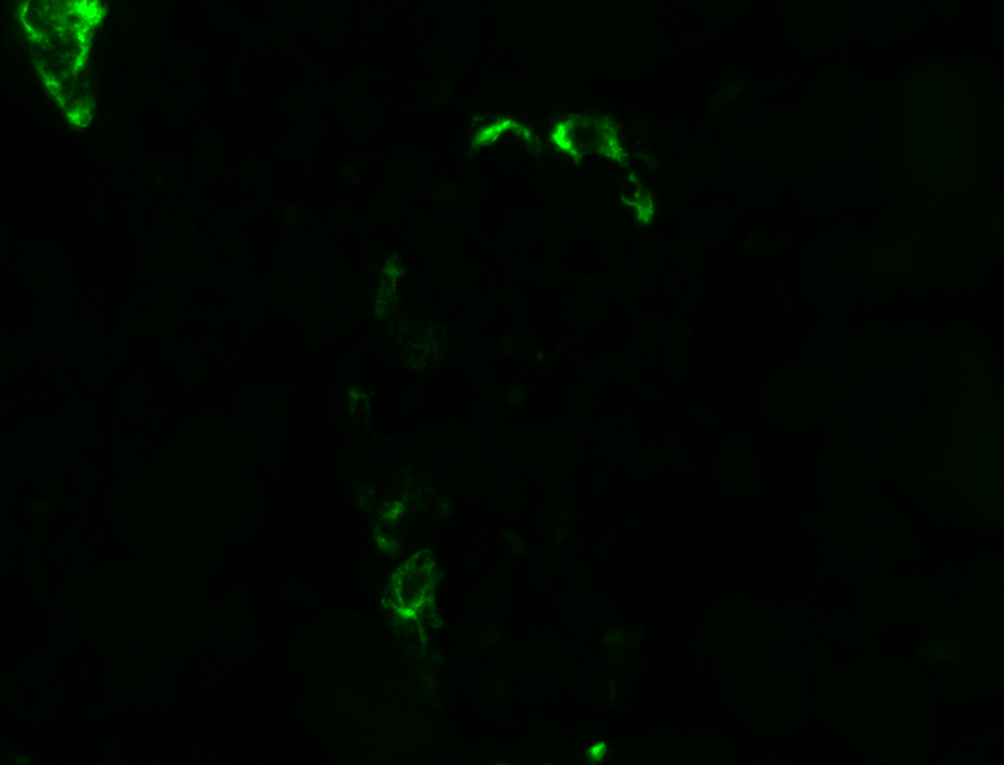
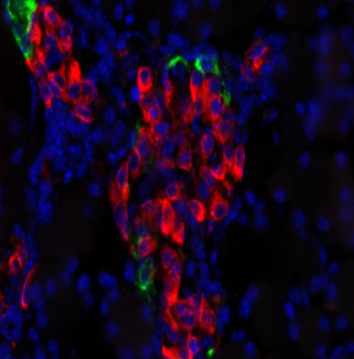
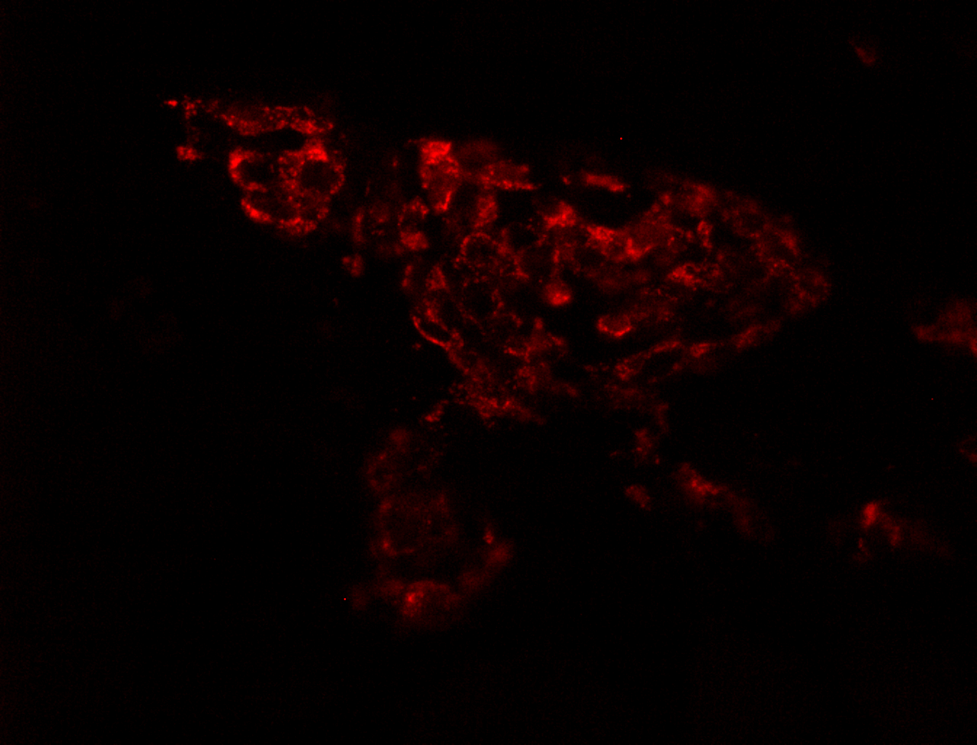
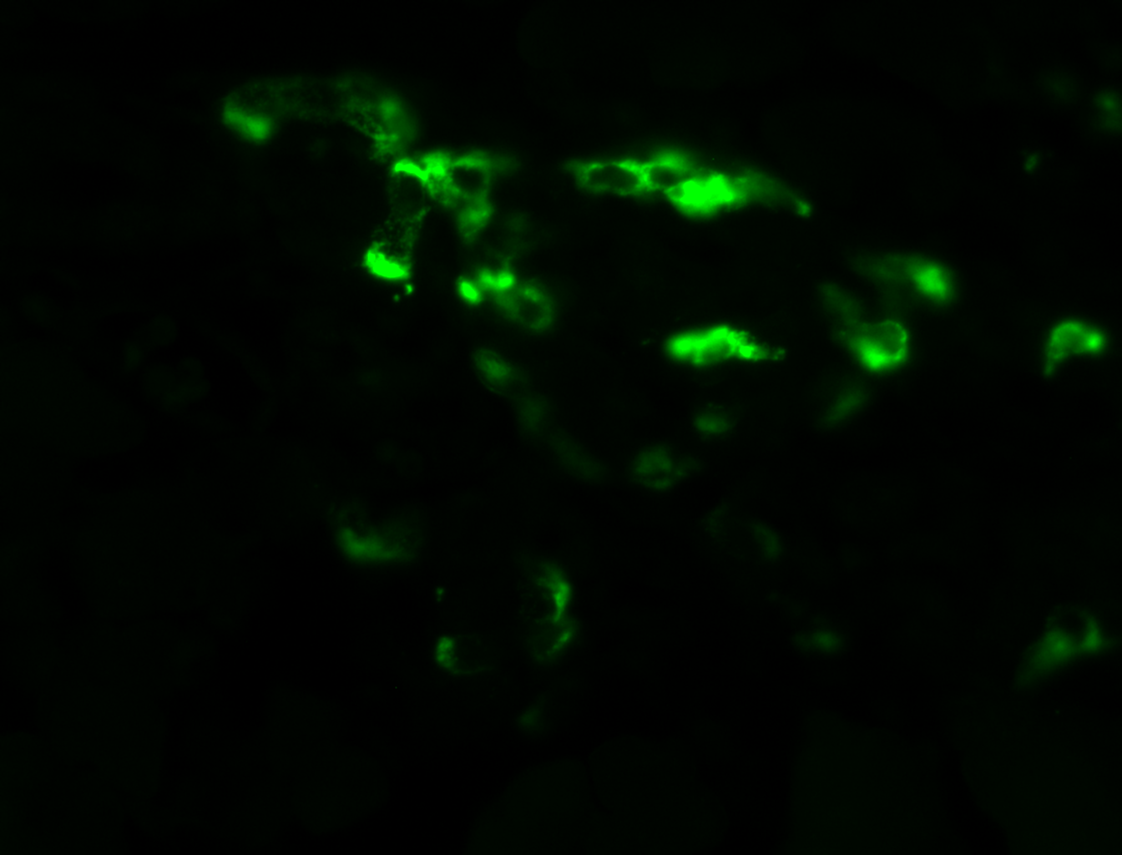
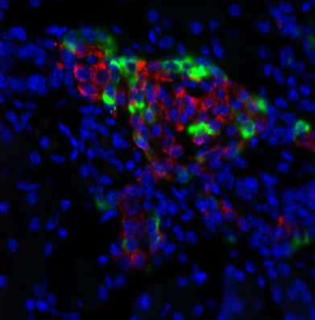
Fig. S11
a
b
c
Ctl
Insulin
Glucagon
merge
d
e
f
x40
Dlk^{-/-}
Insulin
Glucagon
merge
g
h
i
Ctl
DLK^{-/-}
Fluorescence intensity/ number of beta-cells
Fluorescence intensity/ number of alpha-cells
Hormone positive area/ pancreas area
***
*
Ctl
DLK^{-/-}
DLK^{-/-}
Ctl
Insulin
glucagon

Slide 12
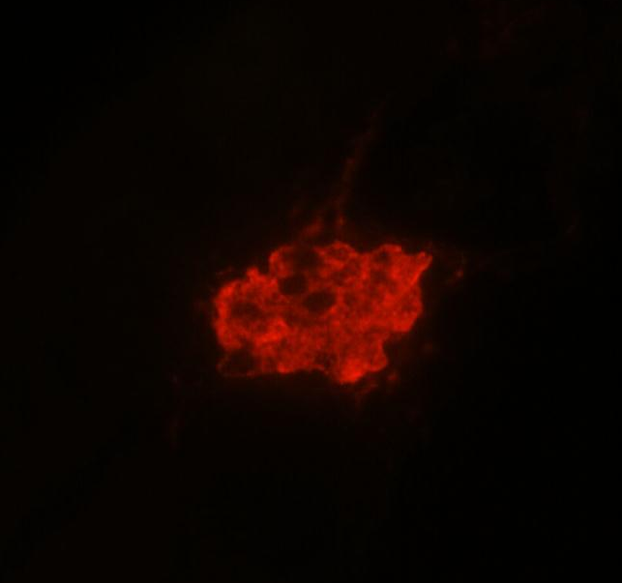
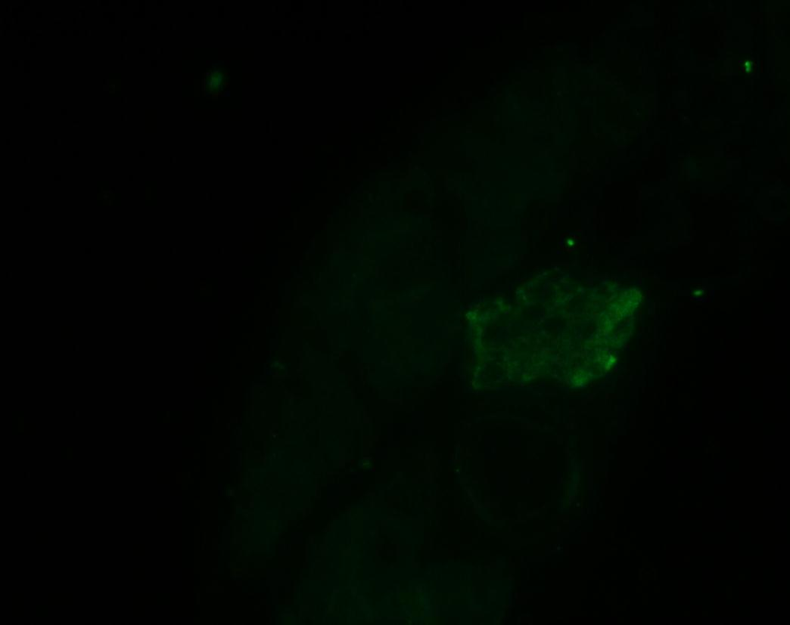
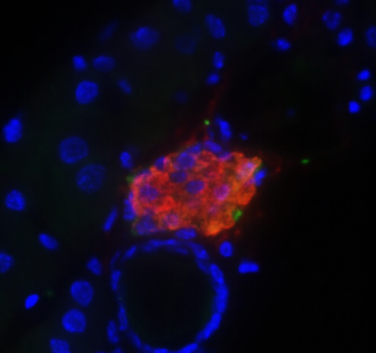



Fig. S12
Ctrl
Insulin
Dlk
Merge + DAPI
20 μm
ob/ob (8 weeks)
Insulin
Dlk
Merge + DAPI
20 μm

Slide 13
Fig. S13
NS
NS
NS
NS
NS
mRNA/Tbp mRNA
(% siCtl)
siCtl
siDlk
Atf4
Atf6
Dnajc3
Edem1
Ero1

Slide 14












Fig. S14
non Diabetes
DLK
Insulin
20 μm
Merge
Merge + DAPI
20 μm
T2D patient
DLK
Insulin
20 μm
Merge
Merge + DAPI
20 μm

