Slide 1
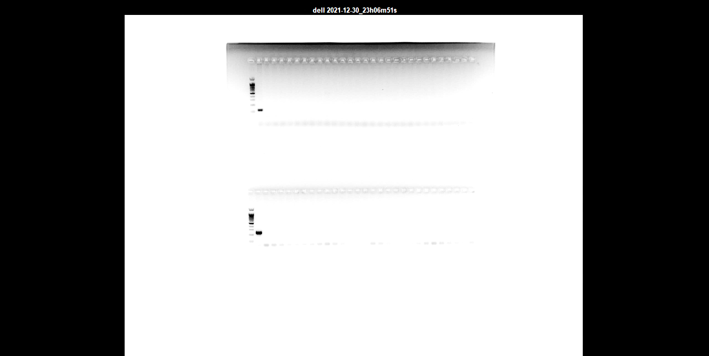
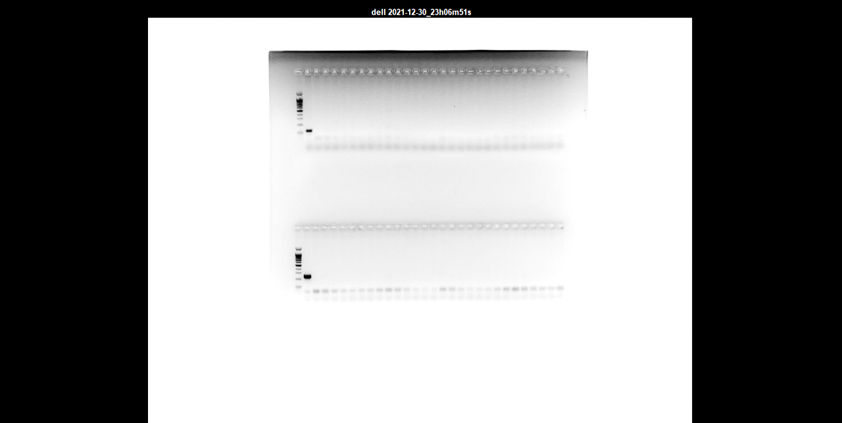
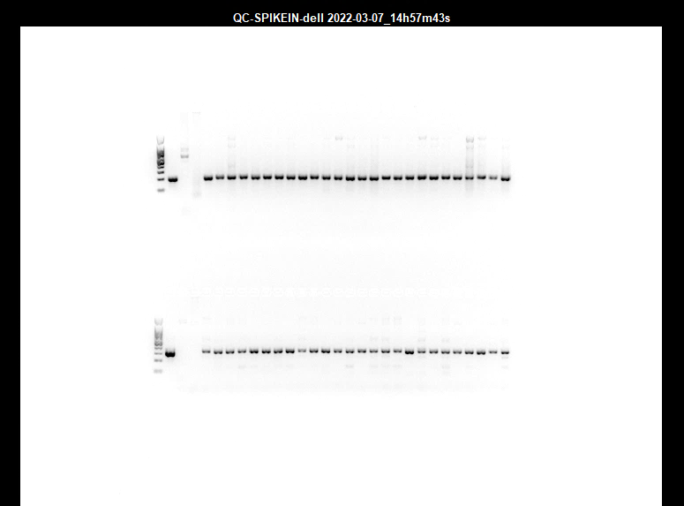

Fig. S1
A
-
M
+
1
2
3
4
5
6
7
8
9
10
11
12
13
14
15
16
17
18
19
20
21
22
23
24
25
26
100 bp-
- COX5b PCR band
200 bp-
- 7 kb PCR band
B
NTC
M
+
-
1
2
3
4
5
6
7
8
9
10
11
12
13
14
15
16
17
18
19
20
21
22
23
24
25
26
200 bp-
- Spike in Plasmid 1
PCR band
300 bp-
- Spike in Plasmid 2
PCR band

