Slide 1
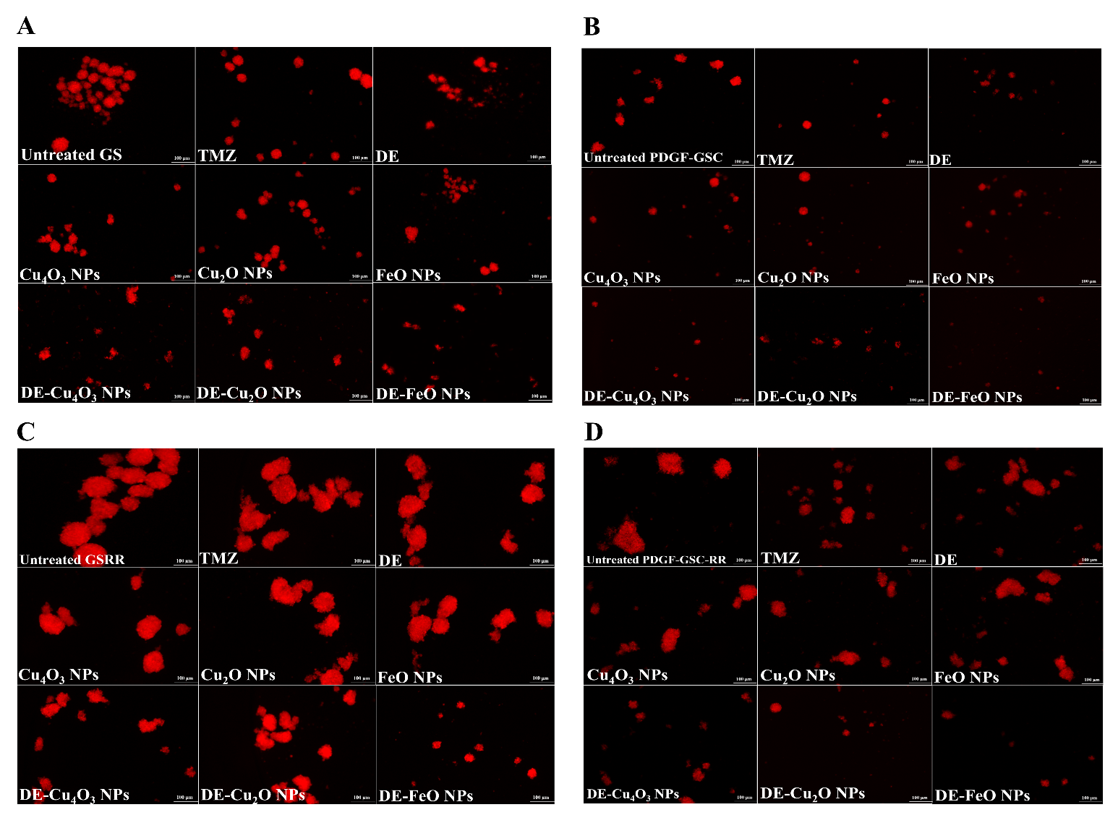
Supplementary Figure 1 Morphological changes of the treated mouse glioma stem cells (GSCs) and radioresistance GSCs-RR in the term of diminishing mCherry fluorescence. (A) GS, (B) PDGF-GSC, (C) GSRR, and (D) PDGF-GSC-RR after treatment with temozolomide (TMZ), diethyldithiocarbamate (DE), metal oxides (Cu₄O₃ NPs, Cu₂O NPs, and FeO NPs), and nanocomplexes (DE-Cu₄O₃ NPs, DE-Cu₂O NPs, and DE-FeO NPs) using fluorescence microscopy. (Magnification 200X, scale bar 100 µm).

