Slide 1
Supplemental Materials
Comparative and Integrated Analysis of Plasma Extracellular Vesicle Isolation Methods in Healthy Volunteers and Patients Following Myocardial Infarction.
Daan Paget et al.

Slide 2
Supplemental Figure 1
A
B

Slide 3
Supplemental Figure 2

Slide 4
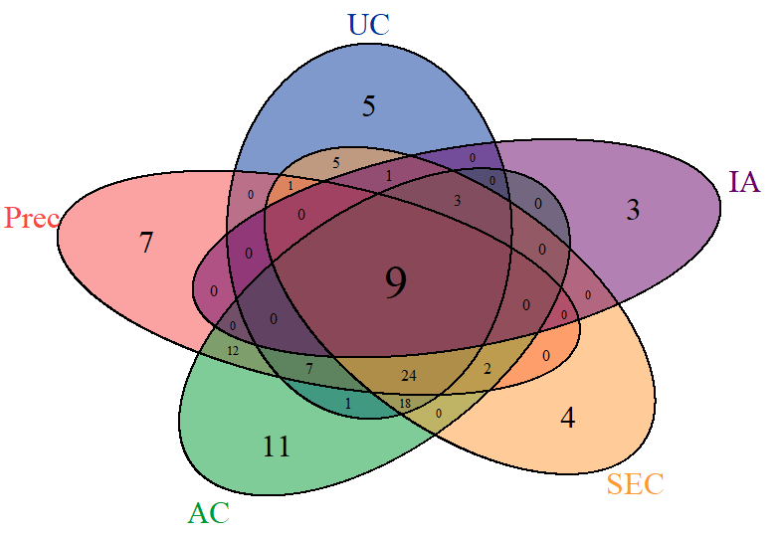
Supplemental Figure 3
UC
Precipitation
Immunoaffinity
SEC
Acoustic trapping

Slide 5
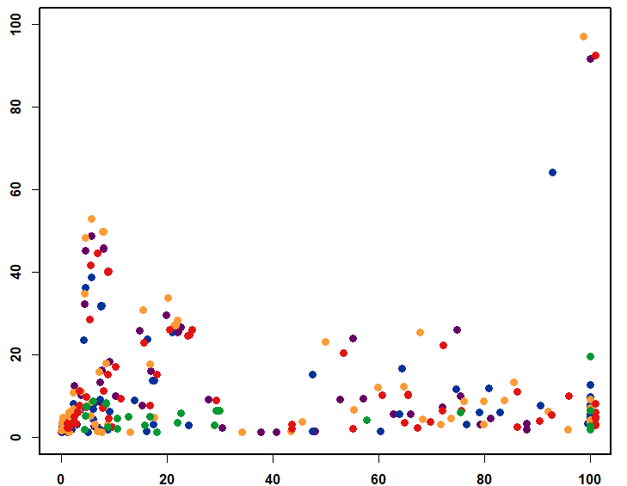
Supplemental Figure 4
UC - GO term | GO Enrichment Score | False discovery rate
1. Blood microparticle | >100 | 1.46E-92
2. Extracellular space | 5.77 | 1.29E-49
3. Extracellular membrane-bounded organelle | 7.97 | 1.11E-46
4. Extracellular exosome | 8.05 | 1.17E-46
5. Extracellular organelle | 7.97 | 1.33E-46
A
- log (false discovery rate corrected p-value)
Precipitation - GO term | GO Enrichment Score | False discovery rate
1. Blood microparticle | 92.92 | 4.79E-65
2. Extracellular space | 5.79 | 1.86E-39
3. Extracellular region | 4.64 | 3.87E-37
4. Extracellular membrane-bounded organelle | 7.52 | 1.19E-32
5. Extracellular exosome | 7.6 | 1.29E-32
Acoustic trapping - GO term | GO Enrichment Score | False discovery rate
1. Blood microparticle | 98.81 | 5.76E-98
2. Extracellular space | 5.73 | 9.74E-54
3. Extracellular exosome | 7.99 | 1.17E-50
4. Extracellular membrane-bounded organelle | 7.91 | 1.18E-50
5. Extracellular organelle | 7.91 | 1.41E-60
Gene Ontology (GO) enrichment score
SEC - GO term | GO Enrichment Score | False discovery rate
1. Blood microparticle | >100 | 9.45E-93
2. Extracellular space | 5.82 | 9.30E-45
3. Extracellular region | 4.64 | 9.04E-42
4. Extracellular exosome | 7.97 | 2.61E-40
5. Extracellular membrane-bounded organelle | 7.88 | 2.62E-40
UC
Precipitation
Acoustic trapping
SEC
Immunoaffinity
Immunoaffinity - GO term. | GO Enrichment Score | False discovery rate
1. Blood microparticle | >100 | 1.88E-20
2. Extracellular space | 6.08 | 1.77E-9
3. Extracellular membrane-bounded organelle | 8.42 | 4.30E-9
4. Extracellular organelle | 8.42 | 5.16E-9
5. Extracellular vesicle | 8.43 | 6.38E-9
B
EVpedia |  | Exocarta |  | Vesiclepedia
% in common | P-value | % in common | P-value | % in common | P-value
16.2 | 5.6E-12 | 6.8 | 7.8E-04 | 12.2 | 3.9E-08
9.7 | 3.1E-05 | 4.8 | 2.3E-02 | 4.8 | 2.3E-02
10.3 | 1.6E-07 | 5.7 | 1.6E-03 | 6.9 | 2.1E-04
16.4 | 3.9E-11 | 9.0 | 4.8E-05 | 10.4 | 3.9E-06
31.3 | 3.4E-07 | 18.8 | 4.8E-04 | 25.0 | 1.5E-05
Ultracentrifugation
Precipitation
Acoustic trapping
SEC
Immunoaffinity

Slide 6
Supplemental Figure 5
Acoustic trapping
UC
SEC
Precipitation
Immunoaffinity
De Menezes-Neto et al. 2015 – ExoSpin
55 / 74 | 43 / 62 | 61 / 87 | 52 / 67 | 10 / 16
21 / 74 | 18 / 62 | 21 / 87 | 24 / 67 | 10 / 16
56 / 74 | 47 / 62 | 66 / 87 | 50 / 67 | 10 / 16
51 / 74 | 40 / 62 | 59 / 87 | 47 / 67 | 10 / 16
39 / 74 | 28 / 62 | 41 / 87 | 41 / 67 | 9 / 16
55 / 74 | 45 / 62 | 65 / 87 | 50 / 67 | 10 / 16
55 / 74 | 46 / 62 | 66 / 87 | 50 / 67 | 10 / 16
De Menezes-Neto et al. 2015 – SEC
Veerman et al. 2021 – ExoQuick
Veerman et al. 2021 – Izon35
Veerman et al. 2021 – Izon70
Veerman et al. 2021 - Optiprep
Veerman et al. 2021 – Exo-Easy

Slide 7

Supplemental Figure 6
UC
Immunoaffinity
Precipitation
Acoustic trapping
SEC

Slide 8
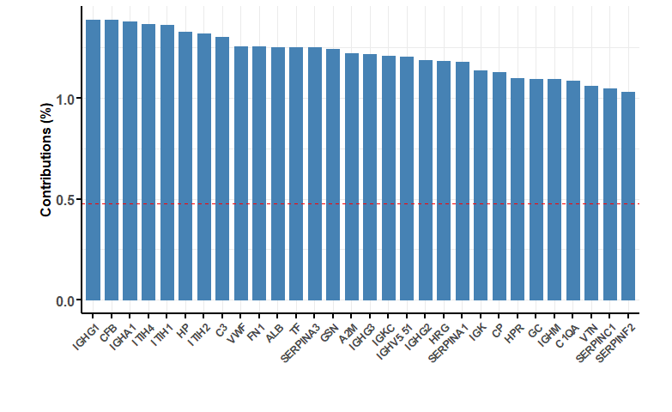
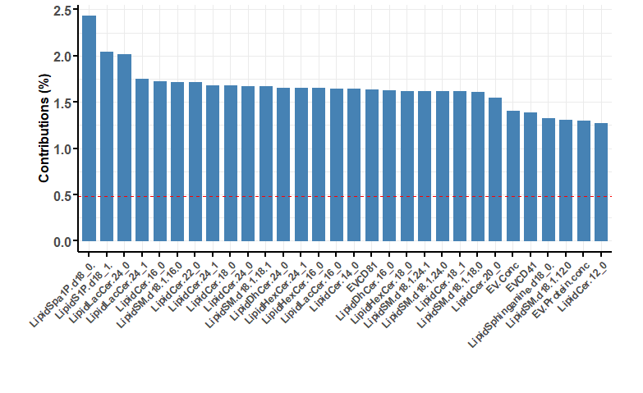
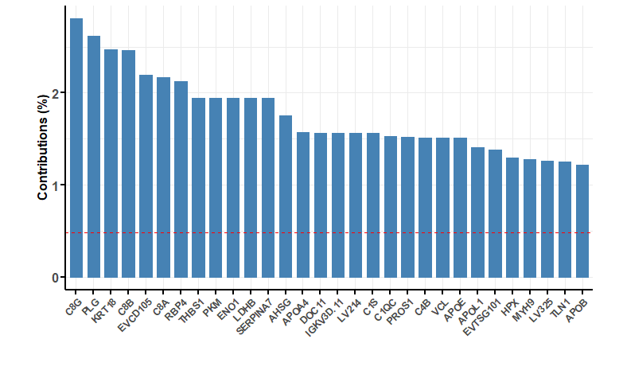
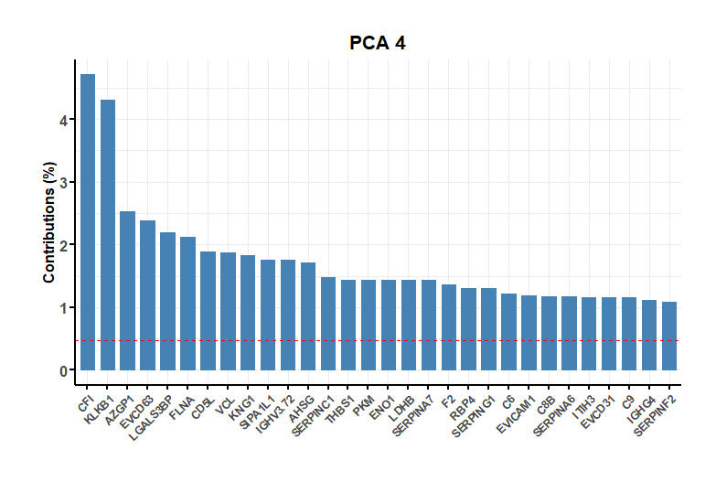
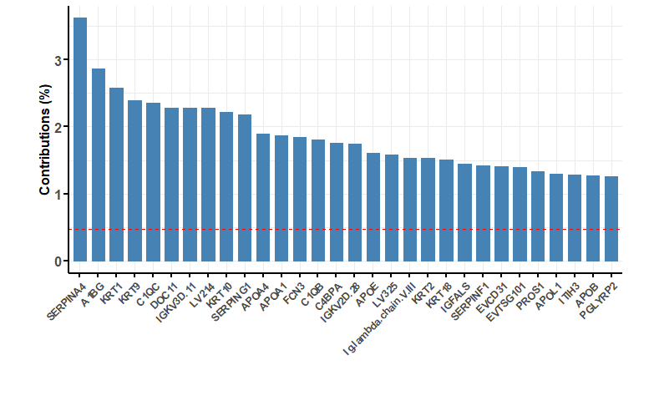
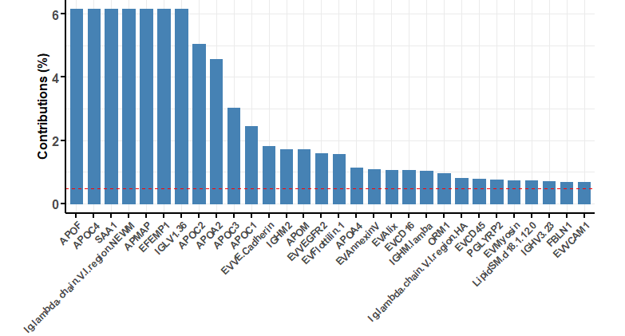
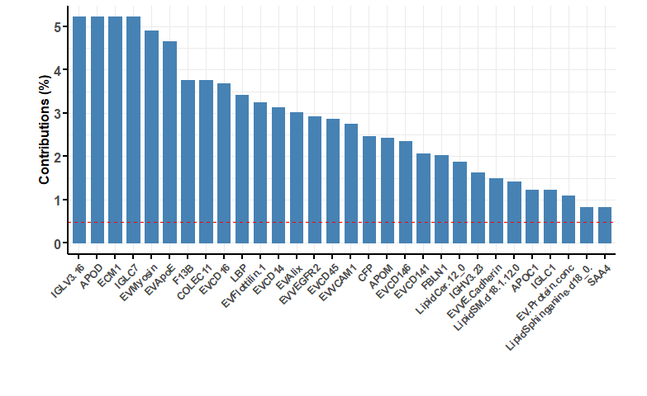
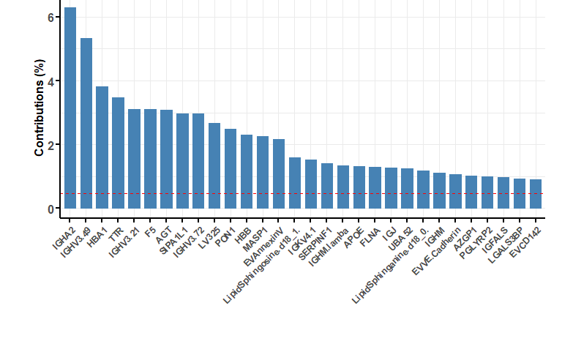
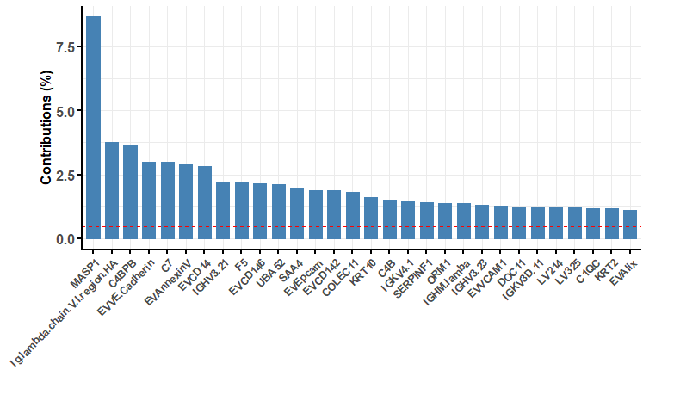
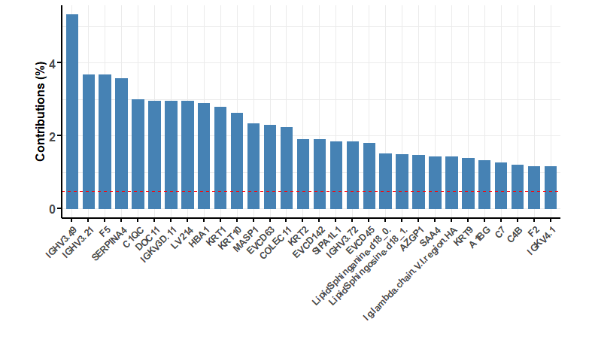
Supplemental Figure 7
PCA 1 (30.4%)
PCA 2 (16.8%)
PCA 3 (9.4%)
PCA 4 (8.4%)
PCA 5 (7.1%)
PCA 6 (5.5%)
PCA 7 (5.0%)
PCA 8 (3.1%)
PCA 9 (2.6%)
PCA 10 (2.3%)

Slide 9
Supplemental Figure 8
A
B
C

Slide 10
Supplemental Figure 9
Cer(d18:0/24:0)
SM(d18:1/18:0)
SM(d18:1/24:0)
Cer(d18:0/22:0)
SM(d18:1/24:1)
SM(d18:1/18:1)

Slide 11
Supplemental Figure 10
A
Cer(d18:0/22:0)
B
Sphingoanine (d18:0)
C
SM(d18:1/18:1)

