Slide 1
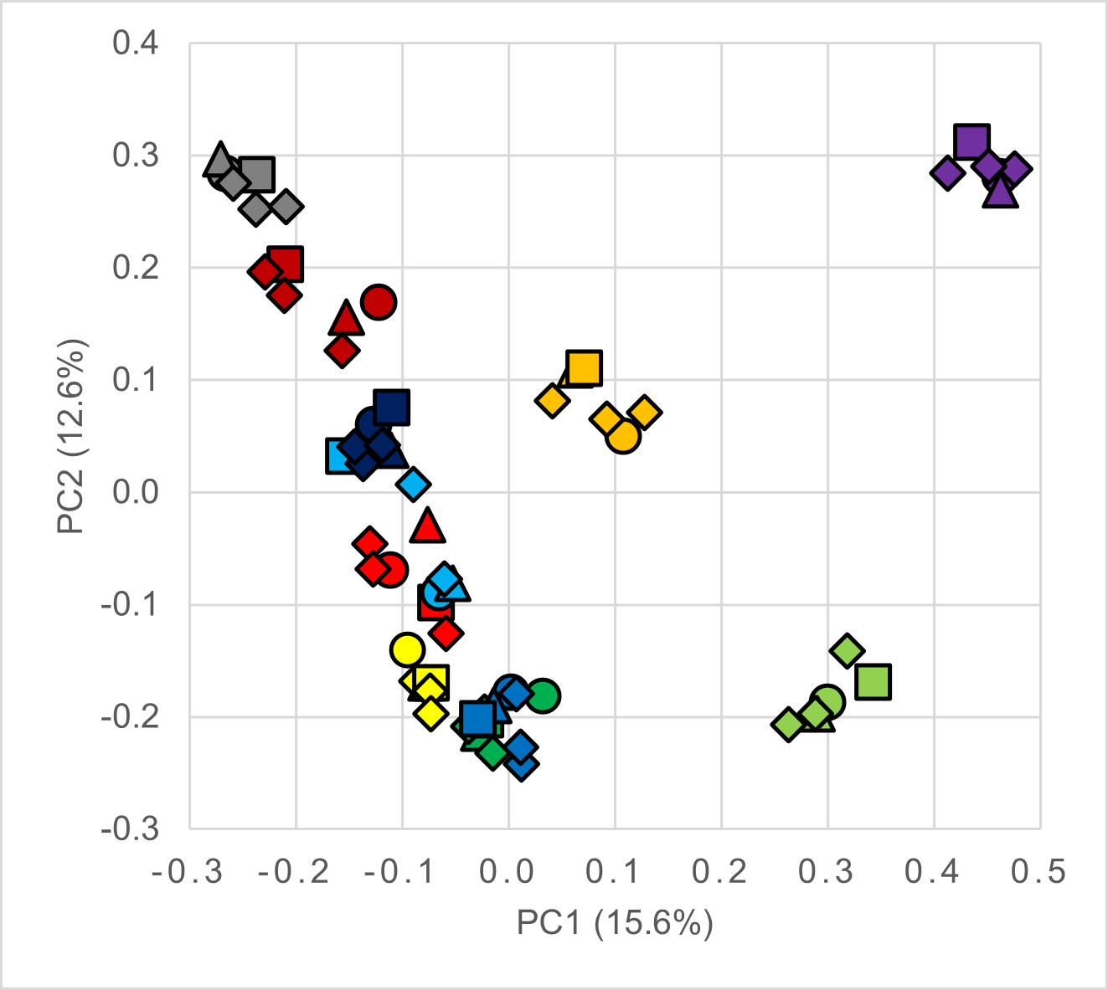
Supplemental Figure 1: PcoA plot demonstrating inter-individual variability observed in participant gut microbiota
S05
S06
S07
S08
S10
S11
S13
S14
S15
S16
S17

