Slide 1
Table S1 Genome data used in this study
Strain | Accession number | Sizes (Mbp) | G + C content (%) | Completeness (％) | Contamination (％)
Aquabacterium commune DSM 11901^{T} | GCF_004362855.1 | 4.2 | 66.36 | 100 | 0.07
Ideonella dechloratans CCUG 30977^{T} | GCF_021049305.1 | 4.54 | 69.23 | 100 | 0.28
Inhella inkyongensis IMCC 1713^{T} | GCF_005952805.1 | 4.08 | 66.24 | 100 | 0.06
Roseateles depolymerans KCTC 42856^{T} | GCF_001483865.1 | 5.68 | 66.57 | 100 | 0.2
Leptothrix cholodnii SP-6 | GCF_000019785.1 | 4.91 | 68.9 | 99.98 | 0.14
Leptothrix discophora CCM 2812^{T} | GCF_030705305.1 | 4.65 | 70.12 | 100 | 0.12
Sphaerotilus mobilis DSM 10617^{T} | GCF_004216565.1 | 4.65 | 69 | 100 | 0.14
Sphaerotilus hippei DSM 566^{T} | GCF_003201595.1 | 4.43 | 70.03 | 100 | 0.05
Sphaerotilus montanus DSM 21226^{T} | GCF_013410775.1 | 5.07 | 68.16 | 100 | 0.01
Sphaerotilus natans subsp. natans ATCC 13338^{T} | GCF_900156335.1 | 4.63 | 69.94 | 100 | 0.16
Sphaerotilus natans subsp. sulfidivorans D-501^{T} | GCF_013426975.1 | 4.39 | 69.88 | 99.95 | 0.06
Strain FB-5^{T} | GCF_023734135.1 | 6.06 | 69.16 | 99.99 | 0.26
Methylibium rhizosphaerae C1-9^{T} | GCF_006386545.1 | 6.17 | 68.57 | 100 | 0.02
Rivibacter subsaxonicus DSM 19570^{T} | GCF_004217215.1 | 3.94 | 69.36 | 99.91 | 0.03
Methylibium petroleiphilum PM1^{T} | GCF_000015725.1 | 4.64 | 68.78 | 100 | 0.34
Caldimonas tepidiphila YIM 730274^{T} | GCF_003569765.1 | 5.47 | 70.67 | 99.69 | 1.89
Caldimonas thermodepolymerans DSM 15344^{T} | GCF_015476235.1 | 3.86 | 70.28 | 100 | 0.01
Caldimonas brevitalea DSM 7029^{T} | GCF_001017435.1 | 6.48 | 67.51 | 100 | 0.77
Caldimonas caldifontis BCRC 80649^{T} | GCF_002930615.1 | 3.64 | 67.68 | 100 | 0.01
Caldimonas manganoxidans ATCC BAA-369^{T} | GCF_000381125.1 | 3.53 | 65.96 | 100 | 0.08
Piscinibacter gummiphilus NS21^{T} | GCF_002116905.1 | 6.4 | 69.72 | 100 | 0.42
Piscinibacter sakaiensis 201-F6^{T} | GCF_001293525.1 | 6.14 | 72.92 | 100 | 1.02
Piscinibacter defluvii SH-1^{T} | GCF_004011805.1 | 7.09 | 70.69 | 99.73 | 1.46
Azohydromonas sediminis SYSU G00088^{T} | GCF_003574675.1 | 3.76 | 71.77 | 99.98 | 0
Azohydromonas australica DSM 1124^{T} | GCF_000430725.1 | 8.79 | 68.76 | 100 | 6.68
Azohydromonas lata NBRC 102462^{T} | GCF_001571085.1 | 7.18 | 68.98 | 99.79 | 1.26
Rubrivivax pictus W35^{T} | GCF_005403045.1 | 6.14 | 70.48 | 99.98 | 0.06
Rubrivivax albus ICH-3^{T} | GCF_004016515.1 | 5.31 | 70.31 | 99.98 | 0.08
Rubrivivax rivuli KYPY4^{T} | GCF_004016505.1 | 4.93 | 70.05 | 100 | 0.1
Rubrivivax gelatinosus DSM 1709^{T} | GCF_016583525.1 | 5.1 | 71.36 | 100 | 1.12
Rubrivivax benzoatilyticus JA2^{T} | GCF_000420125.1 | 4.16 | 71.56 | 100 | 0.31
Comamonas terrigena NBRC 13299^{T} | GCF_006740045.1 | 4.67 | 65.01 | 100 | 0.17

Slide 2
Table S2 Pairwise identities of the 16S rRNA gene sequences among strains used in this study
No. | Strain | 1 | 2 | 3 | 4 | 5 | 6 | 7 | 8 | 9 | 10 | 11 | 12 | 13 | 14 | 15 | 16 | 17 | 18 | 19 | 20 | 21 | 22 | 23 | 24 | 25 | 26 | 27 | 28 | 29 | 30 | 31 | 32
1 | Aquabacterium commune DSM 11901^{T} | 100.0 | 97.1 | 95.3 | 96.2 | 97.2 | 96.9 | 96.6 | 95.3 | 95.4 | 95.5 | 95.5 | 95.5 | 96.4 | 96.3 | 96.4 | 97.3 | 95.7 | 96.9 | 95.7 | 96.2 | 96.3 | 96.2 | 96.5 | 97.0 | 95.0 | 96.9 | 98.0 | 95.4 | 97.0 | 96.1 | 96.9 | 92.5
2 | Ideonella dechloratans CCUG 30977^{T} | 97.1 | 100.0 | 96.5 | 96.7 | 96.9 | 97.6 | 97.3 | 95.9 | 95.8 | 96.4 | 96.5 | 96.2 | 96.3 | 95.8 | 96.1 | 97.2 | 96.2 | 97.2 | 96.5 | 97.0 | 95.6 | 98.1 | 96.9 | 97.1 | 96.3 | 97.7 | 97.9 | 97.1 | 96.7 | 97.8 | 98.6 | 93.0
3 | Inhella inkyongensis IMCC 1713^{T} | 95.3 | 96.5 | 100.0 | 96.6 | 95.0 | 96.1 | 96.0 | 94.9 | 95.0 | 95.1 | 95.3 | 95.1 | 95.0 | 94.0 | 93.8 | 94.8 | 94.8 | 95.0 | 94.1 | 95.4 | 94.3 | 95.5 | 94.6 | 95.4 | 94.7 | 96.1 | 95.5 | 94.8 | 92.9 | 95.3 | 97.0 | 91.4
4 | Roseateles depolymerans KCTC 42856^{T} | 96.2 | 96.7 | 96.6 | 100.0 | 96.8 | 96.5 | 96.3 | 95.6 | 95.7 | 96.1 | 96.0 | 95.6 | 95.7 | 94.6 | 95.0 | 95.7 | 95.0 | 95.9 | 95.2 | 96.3 | 95.7 | 96.4 | 96.0 | 96.1 | 96.1 | 97.2 | 96.1 | 95.4 | 95.2 | 96.4 | 97.8 | 92.6
5 | Leptothrix cholodnii SP-6 | 97.2 | 96.9 | 95.0 | 96.8 | 100.0 | 97.7 | 97.9 | 96.6 | 97.0 | 96.4 | 96.6 | 96.9 | 95.8 | 95.5 | 95.7 | 96.3 | 95.1 | 96.3 | 95.8 | 96.7 | 95.7 | 96.5 | 95.7 | 96.2 | 96.1 | 97.6 | 97.0 | 95.9 | 95.2 | 97.1 | 98.0 | 92.4
6 | Leptothrix discophora CCM 2812^{T} | 96.9 | 97.6 | 96.1 | 96.5 | 97.7 | 100.0 | 99.7 | 96.7 | 96.8 | 97.1 | 97.3 | 96.6 | 96.7 | 95.6 | 95.7 | 96.3 | 96.1 | 97.0 | 96.3 | 96.8 | 95.9 | 96.7 | 96.3 | 96.7 | 96.1 | 97.5 | 97.0 | 96.3 | 95.0 | 97.5 | 98.6 | 92.4
7 | Sphaerotilus mobilis DSM 10617^{T} | 96.6 | 97.3 | 96.0 | 96.3 | 97.9 | 99.7 | 100.0 | 96.7 | 96.9 | 96.9 | 97.0 | 96.5 | 96.4 | 95.5 | 95.5 | 96.1 | 95.9 | 96.7 | 96.2 | 96.8 | 95.8 | 96.5 | 96.1 | 96.6 | 96.1 | 97.5 | 96.7 | 96.0 | 94.8 | 97.4 | 98.5 | 92.5
8 | Sphaerotilus hippei DSM 566^{T} | 95.3 | 95.9 | 94.9 | 95.6 | 96.6 | 96.7 | 96.7 | 100.0 | 98.7 | 97.8 | 97.8 | 97.8 | 94.8 | 94.9 | 94.7 | 95.3 | 94.1 | 95.2 | 94.6 | 96.2 | 94.3 | 95.4 | 94.8 | 95.2 | 95.6 | 97.0 | 95.7 | 94.4 | 93.5 | 95.9 | 97.2 | 92.7
9 | Sphaerotilus montanus DSM 21226^{T} | 95.4 | 95.8 | 95.0 | 95.7 | 97.0 | 96.8 | 96.9 | 98.7 | 100.0 | 97.6 | 97.8 | 97.2 | 94.7 | 94.7 | 94.6 | 94.6 | 93.9 | 95.2 | 94.4 | 96.0 | 94.3 | 95.3 | 94.8 | 95.2 | 95.6 | 97.1 | 95.4 | 94.6 | 93.9 | 95.8 | 97.2 | 92.6
10 | Sphaerotilus natans subsp. natans ATCC 13338^{T} | 95.5 | 96.4 | 95.1 | 96.1 | 96.4 | 97.1 | 96.9 | 97.8 | 97.6 | 100.0 | 99.8 | 97.8 | 95.3 | 94.5 | 94.4 | 94.9 | 94.2 | 95.7 | 95.0 | 96.3 | 94.7 | 95.7 | 94.6 | 95.0 | 95.7 | 96.5 | 95.7 | 94.8 | 93.9 | 95.9 | 97.3 | 92.4
11 | Sphaerotilus natans subsp. sulfidivorans D-501^{T} | 95.5 | 96.5 | 95.3 | 96.0 | 96.6 | 97.3 | 97.0 | 97.8 | 97.8 | 99.8 | 100.0 | 98.0 | 95.2 | 94.5 | 94.4 | 95.0 | 94.3 | 95.6 | 94.9 | 96.2 | 94.6 | 95.7 | 94.6 | 95.0 | 95.6 | 96.6 | 95.6 | 95.0 | 93.8 | 96.1 | 97.6 | 92.2
12 | Strain FB-5^{T} | 95.5 | 96.2 | 95.1 | 95.6 | 96.9 | 96.6 | 96.5 | 97.8 | 97.2 | 97.8 | 98.0 | 100.0 | 95.1 | 94.5 | 94.6 | 95.2 | 94.4 | 95.4 | 94.9 | 96.3 | 94.3 | 95.3 | 94.8 | 95.3 | 95.7 | 97.2 | 95.7 | 95.0 | 93.2 | 96.5 | 97.9 | 92.2
13 | Methylibium rhizosphaerae C1-9^{T} | 96.4 | 96.3 | 95.0 | 95.7 | 95.8 | 96.7 | 96.4 | 94.8 | 94.7 | 95.3 | 95.2 | 95.1 | 100.0 | 97.3 | 96.9 | 95.9 | 95.8 | 97.3 | 97.2 | 96.3 | 96.9 | 95.6 | 96.0 | 96.5 | 95.5 | 96.6 | 96.7 | 96.3 | 94.9 | 96.3 | 97.3 | 92.2
14 | Rivibacter subsaxonicus DSM 19570^{T} | 96.3 | 95.8 | 94.0 | 94.6 | 95.5 | 95.6 | 95.5 | 94.9 | 94.7 | 94.5 | 94.5 | 94.5 | 97.3 | 100.0 | 97.9 | 95.7 | 95.2 | 96.9 | 96.7 | 95.8 | 96.8 | 96.1 | 95.7 | 96.5 | 95.3 | 96.6 | 96.2 | 95.1 | 95.7 | 95.4 | 96.0 | 92.8
15 | Methylibium petroleiphilum PM1^{T} | 96.4 | 96.1 | 93.8 | 95.0 | 95.7 | 95.7 | 95.5 | 94.7 | 94.6 | 94.4 | 94.4 | 94.6 | 96.9 | 97.9 | 100.0 | 95.9 | 95.2 | 97.2 | 96.6 | 95.9 | 97.4 | 96.0 | 96.9 | 96.7 | 95.0 | 97.1 | 96.5 | 95.7 | 96.0 | 95.9 | 96.4 | 92.6
16 | Caldimonas tepidiphila YIM 730274^{T} | 97.3 | 97.2 | 94.8 | 95.7 | 96.3 | 96.3 | 96.1 | 95.3 | 94.6 | 94.9 | 95.0 | 95.2 | 95.9 | 95.7 | 95.9 | 100.0 | 96.8 | 97.2 | 96.7 | 97.0 | 95.4 | 96.6 | 97.0 | 97.2 | 96.1 | 97.1 | 97.4 | 95.5 | 95.7 | 96.5 | 96.7 | 93.0
17 | Caldimonas thermodepolymerans DSM 15344^{T} | 95.7 | 96.2 | 94.8 | 95.0 | 95.1 | 96.1 | 95.9 | 94.1 | 93.9 | 94.2 | 94.3 | 94.4 | 95.8 | 95.2 | 95.2 | 96.8 | 100.0 | 97.1 | 96.8 | 97.5 | 94.7 | 95.4 | 96.1 | 97.1 | 95.9 | 96.7 | 95.8 | 95.8 | 94.9 | 96.0 | 96.6 | 92.4
18 | Caldimonas brevitalea DSM 7029^{T} | 96.9 | 97.2 | 95.0 | 95.9 | 96.3 | 97.0 | 96.7 | 95.2 | 95.2 | 95.7 | 95.6 | 95.4 | 97.3 | 96.9 | 97.2 | 97.2 | 97.1 | 100.0 | 97.4 | 97.7 | 97.1 | 96.9 | 97.3 | 97.4 | 96.4 | 97.4 | 97.1 | 95.9 | 96.5 | 96.8 | 97.5 | 93.0
19 | Caldimonas caldifontis BCRC 80649^{T} | 95.7 | 96.5 | 94.1 | 95.2 | 95.8 | 96.3 | 96.2 | 94.6 | 94.4 | 95.0 | 94.9 | 94.9 | 97.2 | 96.7 | 96.6 | 96.7 | 96.8 | 97.4 | 100.0 | 99.1 | 96.4 | 96.1 | 96.3 | 96.7 | 96.9 | 97.3 | 96.0 | 97.0 | 95.8 | 96.3 | 96.7 | 93.2
20 | Caldimonas manganoxidans ATCC BAA-369^{T} | 96.2 | 97.0 | 95.4 | 96.3 | 96.7 | 96.7 | 96.7 | 96.1 | 96.0 | 96.3 | 96.2 | 96.3 | 96.3 | 95.8 | 95.9 | 97.0 | 97.5 | 97.7 | 99.1 | 100.0 | 95.6 | 96.7 | 96.4 | 97.5 | 96.8 | 97.3 | 96.8 | 97.2 | 97.1 | 97.0 | 97.1 | 94.4
21 | Piscinibacter gummiphilus NS21^{T} | 96.3 | 95.6 | 94.3 | 95.7 | 95.7 | 95.9 | 95.8 | 94.3 | 94.3 | 94.7 | 94.6 | 94.3 | 96.9 | 96.8 | 97.4 | 95.4 | 94.7 | 97.1 | 96.4 | 95.6 | 100.0 | 96.3 | 96.9 | 96.5 | 94.8 | 96.4 | 96.0 | 95.3 | 95.9 | 95.6 | 96.0 | 91.6
22 | Piscinibacter sakaiensis 201-F6^{T} | 96.2 | 98.1 | 95.5 | 96.4 | 96.5 | 96.7 | 96.5 | 95.4 | 95.3 | 95.7 | 95.7 | 95.3 | 95.6 | 96.1 | 96.0 | 96.6 | 95.4 | 96.9 | 96.1 | 96.7 | 96.4 | 100.0 | 97.4 | 97.4 | 96.1 | 97.4 | 96.8 | 96.3 | 96.7 | 97.5 | 98.0 | 92.2
23 | Piscinibacter defluvii SH-1^{T} | 96.5 | 96.9 | 94.6 | 96.0 | 95.7 | 96.3 | 96.1 | 94.8 | 94.8 | 94.6 | 94.6 | 94.8 | 96.0 | 95.7 | 96.9 | 97.0 | 96.1 | 97.3 | 96.3 | 96.4 | 96.9 | 97.4 | 100.0 | 98.1 | 95.3 | 96.9 | 96.9 | 95.5 | 96.2 | 96.9 | 97.1 | 91.8
24 | Azohydromonas sediminis SYSU G00088^{T} | 97.0 | 97.1 | 95.4 | 96.1 | 96.2 | 96.7 | 96.6 | 95.2 | 95.2 | 95.0 | 95.0 | 95.3 | 96.5 | 96.5 | 96.7 | 97.2 | 97.1 | 97.4 | 96.7 | 97.5 | 96.5 | 97.4 | 98.1 | 100.0 | 95.9 | 97.5 | 97.4 | 95.7 | 96.7 | 96.8 | 97.2 | 92.0
25 | Azohydromonas australica DSM 1124^{T} | 95.0 | 96.3 | 94.7 | 96.1 | 96.1 | 96.1 | 96.1 | 95.6 | 95.6 | 95.7 | 95.6 | 95.7 | 95.5 | 95.3 | 95.0 | 96.1 | 95.9 | 96.4 | 96.9 | 96.8 | 94.8 | 96.1 | 95.3 | 95.9 | 100.0 | 97.5 | 95.7 | 96.3 | 95.8 | 96.3 | 96.1 | 93.9
26 | Azohydromonas lata NBRC 102462^{T} | 96.9 | 97.7 | 96.1 | 97.2 | 97.6 | 97.5 | 97.5 | 97.0 | 97.1 | 96.5 | 96.6 | 97.2 | 96.6 | 96.6 | 97.1 | 97.1 | 96.7 | 97.4 | 97.3 | 97.3 | 96.4 | 97.4 | 96.9 | 97.5 | 97.5 | 100.0 | 96.9 | 97.4 | 97.7 | 97.9 | 98.0 | 94.6
27 | Rubrivivax pictus W35^{T} | 98.0 | 97.9 | 95.5 | 96.1 | 97.0 | 97.0 | 96.7 | 95.7 | 95.4 | 95.7 | 95.6 | 95.7 | 96.7 | 96.2 | 96.5 | 97.4 | 95.8 | 97.1 | 96.0 | 96.8 | 96.0 | 96.8 | 96.9 | 97.4 | 95.7 | 96.9 | 100.0 | 96.0 | 97.3 | 96.8 | 97.6 | 93.2
28 | Rubrivivax albus ICH-3^{T} | 95.4 | 97.1 | 94.8 | 95.4 | 95.9 | 96.3 | 96.0 | 94.4 | 94.6 | 94.8 | 95.0 | 95.0 | 96.3 | 95.1 | 95.7 | 95.5 | 95.8 | 95.9 | 97.0 | 97.2 | 95.3 | 96.3 | 95.5 | 95.7 | 96.3 | 97.4 | 96.0 | 100.0 | 95.0 | 97.6 | 97.9 | 92.4
29 | Rubrivivax rivuli KYPY4^{T} | 97.0 | 96.7 | 92.9 | 95.2 | 95.2 | 95.0 | 94.8 | 93.5 | 93.9 | 93.9 | 93.8 | 93.2 | 94.9 | 95.7 | 96.0 | 95.7 | 94.9 | 96.5 | 95.8 | 97.1 | 95.9 | 96.7 | 96.2 | 96.7 | 95.8 | 97.7 | 97.3 | 95.0 | 100.0 | 95.2 | 94.7 | 90.8
30 | Rubrivivax gelatinosus DSM 1709^{T} | 96.1 | 97.8 | 95.3 | 96.4 | 97.1 | 97.5 | 97.4 | 95.9 | 95.8 | 95.9 | 96.1 | 96.5 | 96.3 | 95.4 | 95.9 | 96.5 | 96.0 | 96.8 | 96.3 | 97.0 | 95.6 | 97.5 | 96.9 | 96.8 | 96.3 | 97.9 | 96.8 | 97.6 | 95.2 | 100.0 | 99.9 | 92.2
31 | Rubrivivax benzoatilyticus JA2^{T} | 96.9 | 98.6 | 97.0 | 97.8 | 98.0 | 98.6 | 98.5 | 97.2 | 97.2 | 97.3 | 97.6 | 97.9 | 97.3 | 96.0 | 96.4 | 96.7 | 96.6 | 97.5 | 96.7 | 97.1 | 96.0 | 98.0 | 97.1 | 97.2 | 96.1 | 98.0 | 97.6 | 97.9 | 94.7 | 99.9 | 100.0 | 93.6
32 | Comamonas terrigena NBRC 13299^{T} | 92.5 | 93.0 | 91.4 | 92.6 | 92.4 | 92.4 | 92.5 | 92.7 | 92.6 | 92.4 | 92.2 | 92.2 | 92.2 | 92.8 | 92.6 | 93.0 | 92.4 | 93.0 | 93.2 | 94.4 | 91.6 | 92.2 | 91.8 | 92.0 | 94.0 | 94.6 | 93.2 | 92.4 | 90.8 | 92.2 | 93.6 | 100.0

Slide 3
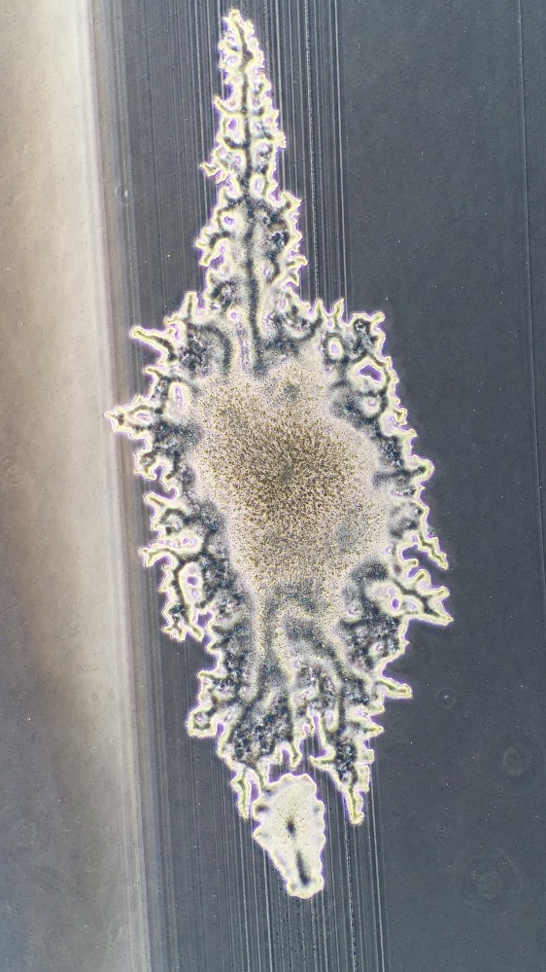
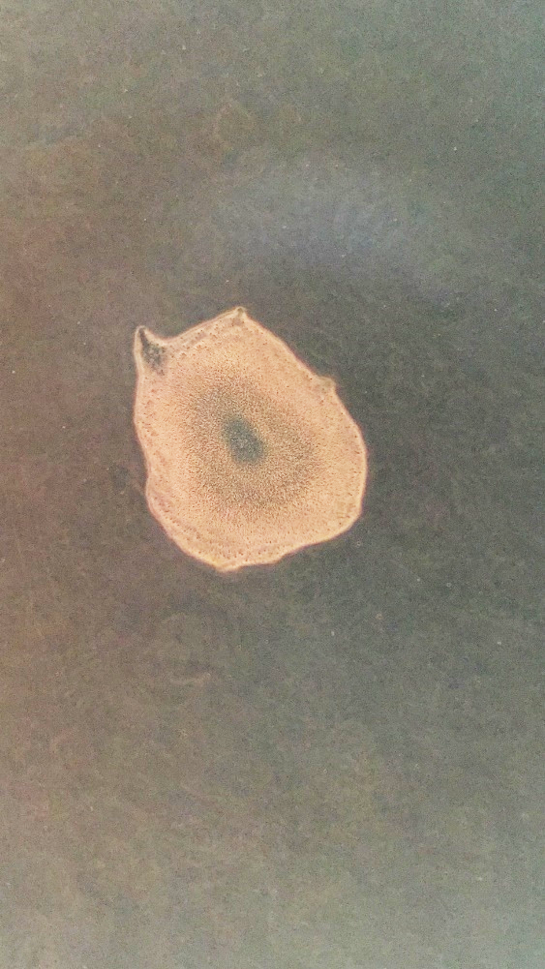
a
b
1 mm
1 mm
Fig. S1 Phase-contrast microscopy images of rough (a) and smooth (b) colonies formed on APP medium.

Slide 4
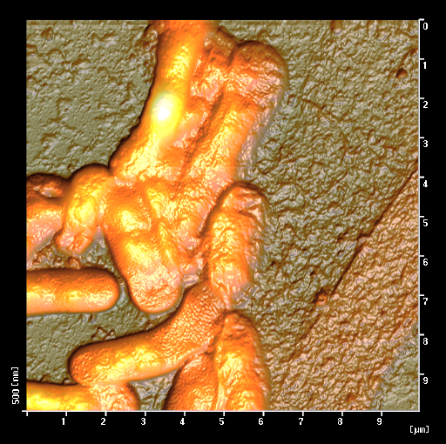
Fig. S2 Scanning probe microscopy images of strain FB-5^{T}. Strain FB-5^{T} was statically cultivated at 25 ºC for 4 days using GPPY medium. The culture was centrifuged to recover the cells, which were then washed with water, followed by air-drying on a silicon wafer for scanning probe microscopy. Note the empty sheath is indicated by arrow.

Slide 5
Table S3 Carbon source utilization of strain FB-5^{T} and strains of the genus Sphaerotilus
Carbon source | FB-5^{T} | S. natans subsp. natans DSM 6575^{T}* | S. natans subsp. sulfidvorans D-501^{T}* | S. hippei DSM 566^{T}* | S. montanus HS^{T}* | S. mobilis Fox-1^{T}**
Acetate | −*** | − | +*** | + | − | −
Aconitate | − | + | − | − | + | nd***
Alanine | − | + | + | − | + | nd
Arginine | − | ND | ND | ND | ND | ND
Arabinose | − | − | + | + | + | nd
Asparagine | − | + | + | − | − | nd
Aspartate | + | ND
Benzoate | − | − | + | − | + | nd
Butanol | − | − | + | + | + | nd
Citrate | − | − | − | + | + | nd
Cysteine | − | − | − | − | − | nd
Ethanol | − | + | + | + | + | nd
Formate | − | − | − | − | − | +
Fructose | − | + | + | + | + | −
Fumarate | − | + poor growth | − | − | + | nd
Galactose | − | + | + | − | − | −
Glucose | − | + | + | + | + | −
Glutamine | − | ND | ND | ND | ND | ND
Glutamate | + | ND | ND | ND | ND | ND
Glycine | − | ND | ND | ND | ND | ND
Glycerol | − | + | + | + | + | −
Glycolate | − | − | − | − | − | nd
Histidine | − | − | − | + | − | nd
iso-Butanol | − | − | + | + | − | nd
Isoleucine | − | ND | ND | ND | ND | ND
Lactate | − | + | + | + | + | −
Lactose | − | − | − | − | + | nd
Leucine | − | ND | ND | ND | ND | ND
Lysine | − | − | − | − | − | nd
Malate | − | + | + | + | + | −
Malonate | − | + | + | + | + | nd
Maltose | − | + | + | + | + | nd
Mannose | − | − | − | + | + | Nd
Methionine | + | − | − | − | − | nd
Oxalate | − | + | + | − | + | nd
Oxaloacetate | − | + | + | + | + | nd
2-Oxoglutarate | − | + | + | + | + | nd
Phenylalanine | − | + | + | − | + | nd
Proline | − | + | + | + | + | −
Propanol | − | − | − | + | + | nd
Pyruvate | − | + | + | + | + | −
Raffinose | − | − | + | − | − | nd
Serine | − | − | − | − | − | nd
Sorbitol | − | + | + | − | + | nd
Sorbose | − | − | + | + | + | nd
Succinate | − | + | + | + | + | nd
Threonine | − | ND | ND | ND | ND | ND
Sucrose | − | + | + | + | + | −
Tryptophan | − | + | − | − | + | ND
Tyrosine | + | + | − | − | − | ND
Valine | − | ND | ND | ND | ND | ND
Peptone | + | + | + | + | + | ND
Yeast extract | + | + | + | + | + | ND
Tryptone | + | ND | ND | ND | ND | ND
Proteose peptone No. 3 | + | ND | ND | ND | ND | ND
Casamino acids | + | ND | ND | ND | ND | ND
*: Data from Gridneva et al. (2011).
**: Data from Spring et al. (1996).
***: + Supported growth; - did not support growth; ND not determined.

Slide 6
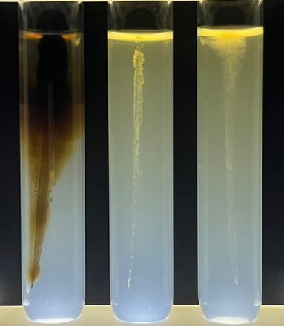
L. cholodnii
Strain FB-5^{T}
S. natans
Fig. S3 Stab culture in the presence of Mn²⁺. Strain FB-5^{T}, L. cholodnii ATCC 51168, and S. natans JCM 20382 were cultivated at 25 ºC for 1 month in MSVP agar containing 1 mM Mn²⁺ (manganese sulfate). Note that dark brown manganese oxide formation by L. cholodnii while no oxide formation by strain FB-5^{T} or S. natans. It should be also noted that poor growth of strain FB-5^{T} in the uppermost part of the medium.

Slide 7
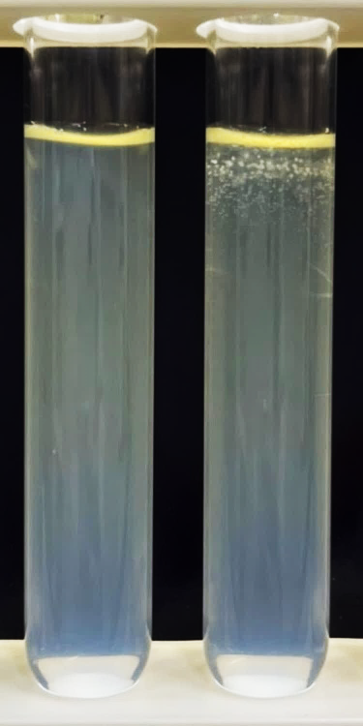
Day 1
Day 10
Fig. S4 Semi-solid-state culture of strain FB-5^{T}. Appearance of the cultures just after inoculation (Day 1) and after incubation for 10 days at 25 ºC using GPPY medium semi-solidified with 0.5% agar.

Slide 8
Table S4 Cellular fatty acid composition of strain FB-5^{T} and related strains
Fatty acid | FB-5^{T} | S. natans subsp. natans DSM 6575^{T}* | S. natans subsp. sulfidvorans D-501^{T}* | S. hippei DSM 566^{T}* | S. montanus HS^{T}* | S. mobilis Feox-l^{T}** | L. discophora LMG 8141^{T}** | L. cholodnii LMG 7171**
C_{12:0} | 10.8 | 1.4 | 0.9 | 2.0 | 1.0 | 2.4 | 6.8 | 5.0
C_{10:0} 3-hydroxy | 1.4 | 1.2 | 1.2 | 0.6 | 0.6 | 4.5 | 3.71 | 4.1
C_{14:1}ω5 | −*** | 0.7 | 0.6 | tr*** | 5.4 | − | − | −
C_{14:1}ω3 | − | − | − | tr | − | − | − | −
C_{14:0} | 1.9 | tr | tr | 1.8 | − | 0.8 | − | 0.7
C_{15:1}ω6 | − | tr | − | tr | − | − | − | −
C_{15:0} | − | tr | − | tr | 0.8 | − | − | 0.4
C_{16:1}ω7 | 49.8 | 58.2 | 68.6 | 56.2 | 52.2 | 53.0 | 58.9 | 54.9
C_{16:1}ω5 | − | tr | 0.8 | tr | 0.8 | − | − | -
C_{16:1} blanched | − | − | − | − | − | − | − | 0.79
C_{16:0} | 25.4 | 18.6 | 12.0 | 32.0 | 30.7 | 30.3 | 19.7 | 24.2
C_{17:1}ω6 | − | − | − | − | tr | − | − | −
C_{18:1}ω9 | − | tr | tr | tr | tr | 7.0**** | 4.2**** | 7.4****
C_{18:1}ω7 | 5.5 | 18.6 | 14.2 | 6.0 | 5.6
C_{18:0} | 2.9 | tr | 0.8 | 0.6 | tr | 1.2 | 0.8 | −
11-Me-C_{18:1} | − | 0.7 | 0.5 | tr | 2.6 | − | − | −
C_{19:0} cis 9,10***** | − | − | − | − | − | 0.8 | − | −
unknown | − | − | − | − | − | − | − | 1.7
*: Data from Gridneva et al. (2011). **: Data from Spring et al. (1996). ***: −, Not detected; tr, trace. ****: Sum of C_{18:1}ω9 and C_{18:1}ω7. *****: cis-9,10-Methyleneoctadecanoic acid.

Slide 9
Table S5 Genes responsible for sulfur metabolism in the genomes of strain FB-5^{T} and closely related Sphaerotilus strains
Gene | Protein | RefSeq (GeneBank) ID |  |  | RefSeq (GeneBank) ID
 |  |  | Strain FB-5^{T} | S. natans subsp. sulfidvorans D-501^{T}* | S. natans subsp. natans DSM 6575^{T}*
fccA | Cytochrome subunit of sulfide dehydrogenase |  | WP_251970119.1 (BDI06880.1) | WP_149502409.1 (NZD44989.1) | ‒**(‒)
fccB | Flavocytochrome c sulfide dehydrogenase |  | WP_251972070.1 (BDI03819.1), WP_251970118.1 (BDI06879.1), WP_251971043.1 (BDI07892.1), WP_251973333.1 (BDI05288.1), WP_251970861.1 (BDI07694.1) | WP_149502408.1 (NZD44988.1) | WP_037477475.1 (KDB54092.1)
soxA | Sulfur oxidation C-type cytochrome |  | WP_251973888.1 (BDI07898.1) | WP_149502403.1 (NZD44983.1) | ‒ (‒)
soxB | Thiosulfohydrolase |  | WP_251971047.1 (BDI07896.1) | WP_149502405.1 (NZD44985. 1) | ‒ (‒)
soxC | Sulfite dehydrogenase |  | WP_251971052.1 (BDI07902.1) | WP_149505114.1 (NZD44979.1) | ‒ (‒)
soxD | Sulfite dehydrogenase cytochrome subunit |  | WP_251971051.1 (BDI07901.1) | WP_149502401.1 (NZD44980.1) | ‒ (‒)
soxX | Sulfur oxidation C-type cytochrome subunit |  | WP_251971048.1 (BDI07897.1) | WP_149502404.1 (NZD44984.1) | ‒ (‒)
soxY | Thiosulfate oxidation carrier protein |  | WP_251971050.1 (BDI07900.1) | WP_149502402.1 (NZD44981. 1) | WP_037477471.1 (KDB54090.1)
soxZ | Thiosulfate oxidation carrier complex protein |  | WP_251971049.1 (BDI07899.1) | WP_180692780.1 (NZD44982.1) | WP_037479529.1 (KDB53190.1)
sqr | Sulfide quinone oxidoreductase |  | WP_251971083.1 (BDI07935.1) | WP_149503483.1 (NZD45377.1) | ‒ (‒)
*: Deta from Grabovich et al. (2021). **: Not found.

Slide 10
Table S6 Genes responsible for Calvin–Benson–Bassham cycle in the genomes of strain FB-5^{T} and closely related Sphaerotilus strains
Gene | Protein | RefSeq (GeneBank) ID |  | RefSeq (GeneBank) ID
 |  | Strain FB-5^{T} | S. natans subsp. sulfidvorans D-501^{T}* | S. natans subsp. natans DSM 6575^{T}*
cbbX | RuBisCo-expression protein | ‒**(‒) | WP_149504648.1 (NZD46665. 1) | ‒ (‒)
fba | Fructose-bisphosphate aldolase class II | WP_251970990.1 (BDI07830.1) | WP_149504644.1 (NZD46659.1), WP_149504873.1 (NZD45272.1) | WP_037481836.1
fbp | Fructose-1,6-bisphosphatase type I | WP_251969449.1 (BDI06139.1) | WP_149504111.1 (NZD46456.1), WP_149504647.1 (NZD46664.1), WP_149505360.1 (NZD46662.1), WP_149504729.1 (NZD45519.1) | WP_037483818.1
gapA | NAD-dependent glyceraldehyde-3-phosphate dehydrogenase | WP_251971530.1 (BDI03225.1) | WP_149504728.1 (NZD45520.1) | WP_037476934.1
pgk | Phosphoglycerate kinase | WP_251971400.1 (BDI03076.1) | WP_149504876.1 (NZD45269.1) | WP_037481823.1
prkB | Phosphoribulokinase | WP_251970993.1 (BDI07833.1) | WP_149504646.1 (NZD46663.1) | ‒ (‒)
rbcS | Ribulose bisphosphate carboxylase small chain | ‒ (‒) | WP_149504649.1 (NZD46666. 1) | ‒ (‒)
rbcL | Ribulose bisphosphate carboxylase large chain | WP_251971011.1 (BDI07852.1) | WP_149504650.1 (NZD46667.1) | ‒ (‒)
rpe | Phosphopentose epimerase | WP_251970995.1 (BDI07835.1), WP_251972182.1 (BDI03940.1) | WP_149502160.1 (NZD46132.1) | WP_037482498.1
rpiA | Ribose 5-phosphate isomerase A | WP_251972598.1 (BDI04483.1) | WP_149502689.1 (NZD47241.1) | WP_037479153.1
tktA | Transketolase | WP_251971245.1 (BDI08115.1), WP_251971529.1 (BDI03224.1), WP_251970992.1 (BDI07832.1), WP_251971244.1 (BDI08114.1) | WP_149505685.1 (NZD45967. 1), WP_149505686.1 (NZD45966. 1), WP_180692862.1 (NZD45974. 1) | WP_162177996.1
tpi | Triosephosphate isomerase | WP_251972702.1 (BDI04591.1) | WP_037482745.1 (NZD44595.1) | WP_037482745.1 (KDB51796.1)
*: Deta from Grabovich et al. (2021). **: Not found.

Slide 11
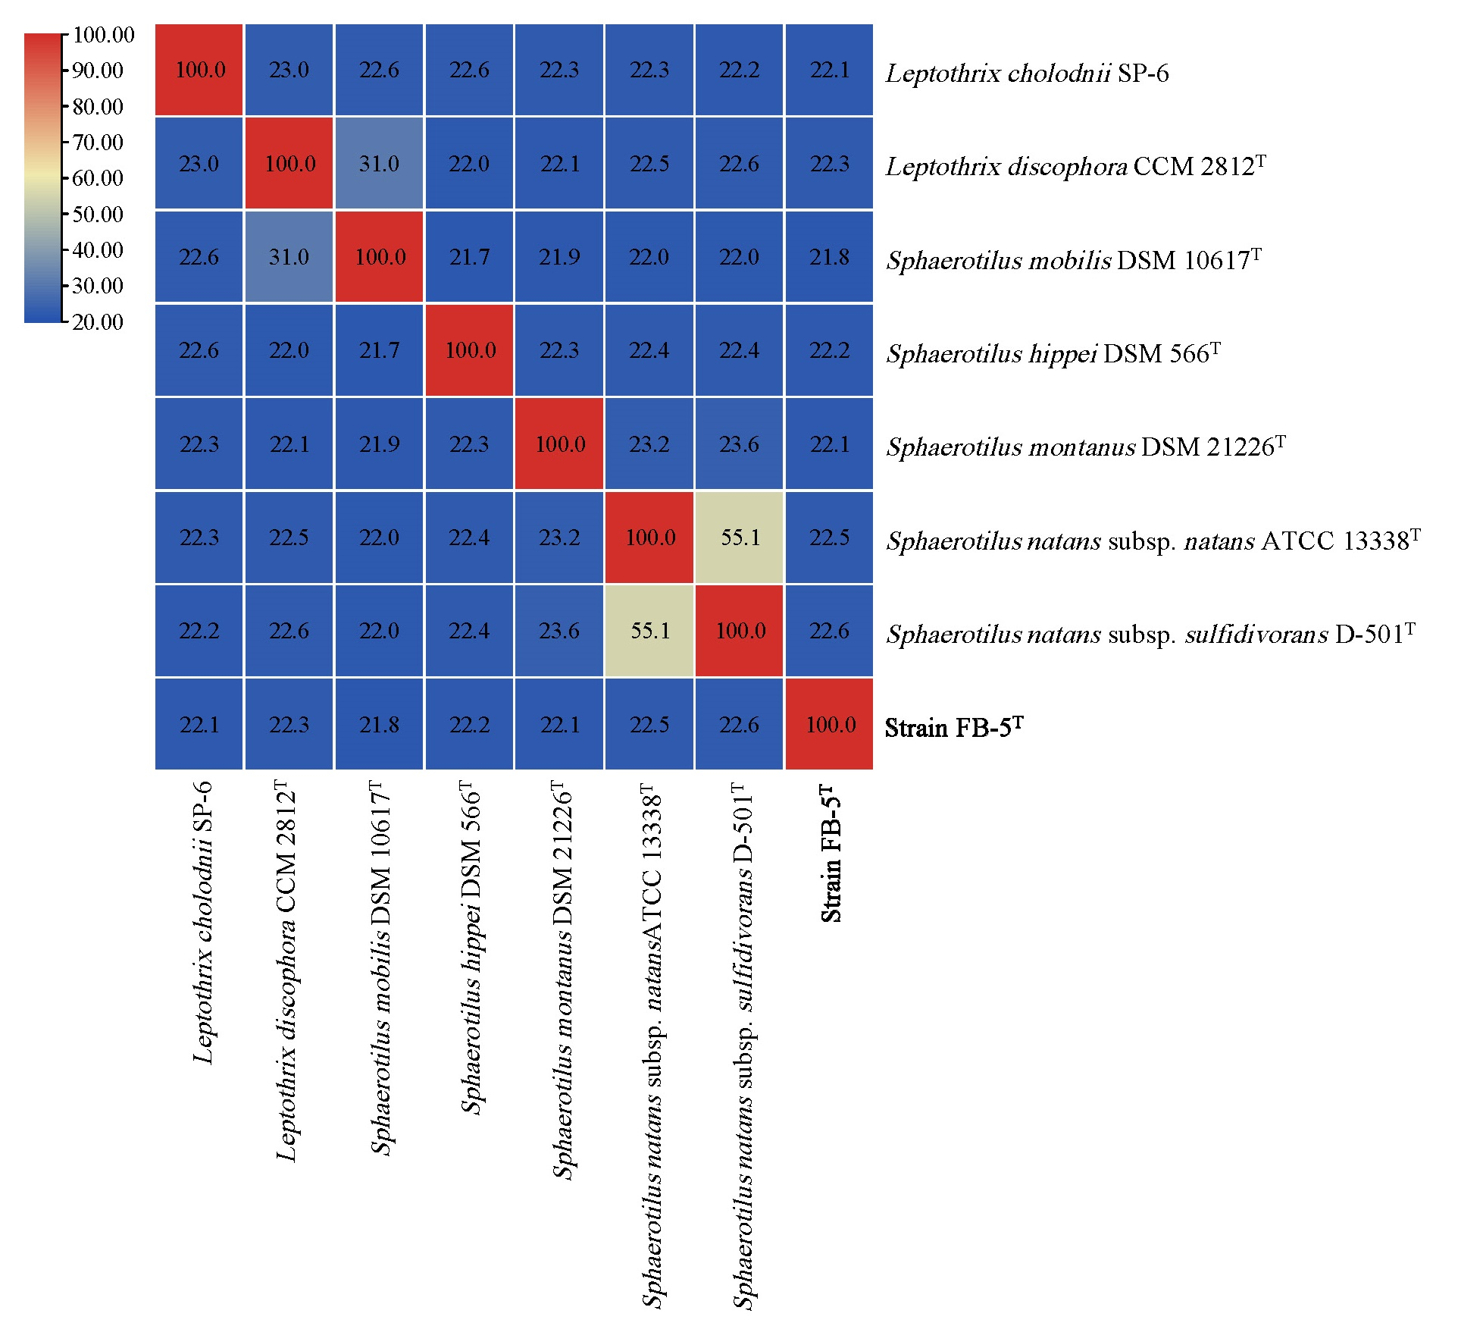
Fig. S5 Digital DNA-DNA hybridization (dDDH) values between strain FB-5^{T} and the strains of the Sphaerotilus-Leptothrix group

Slide 12
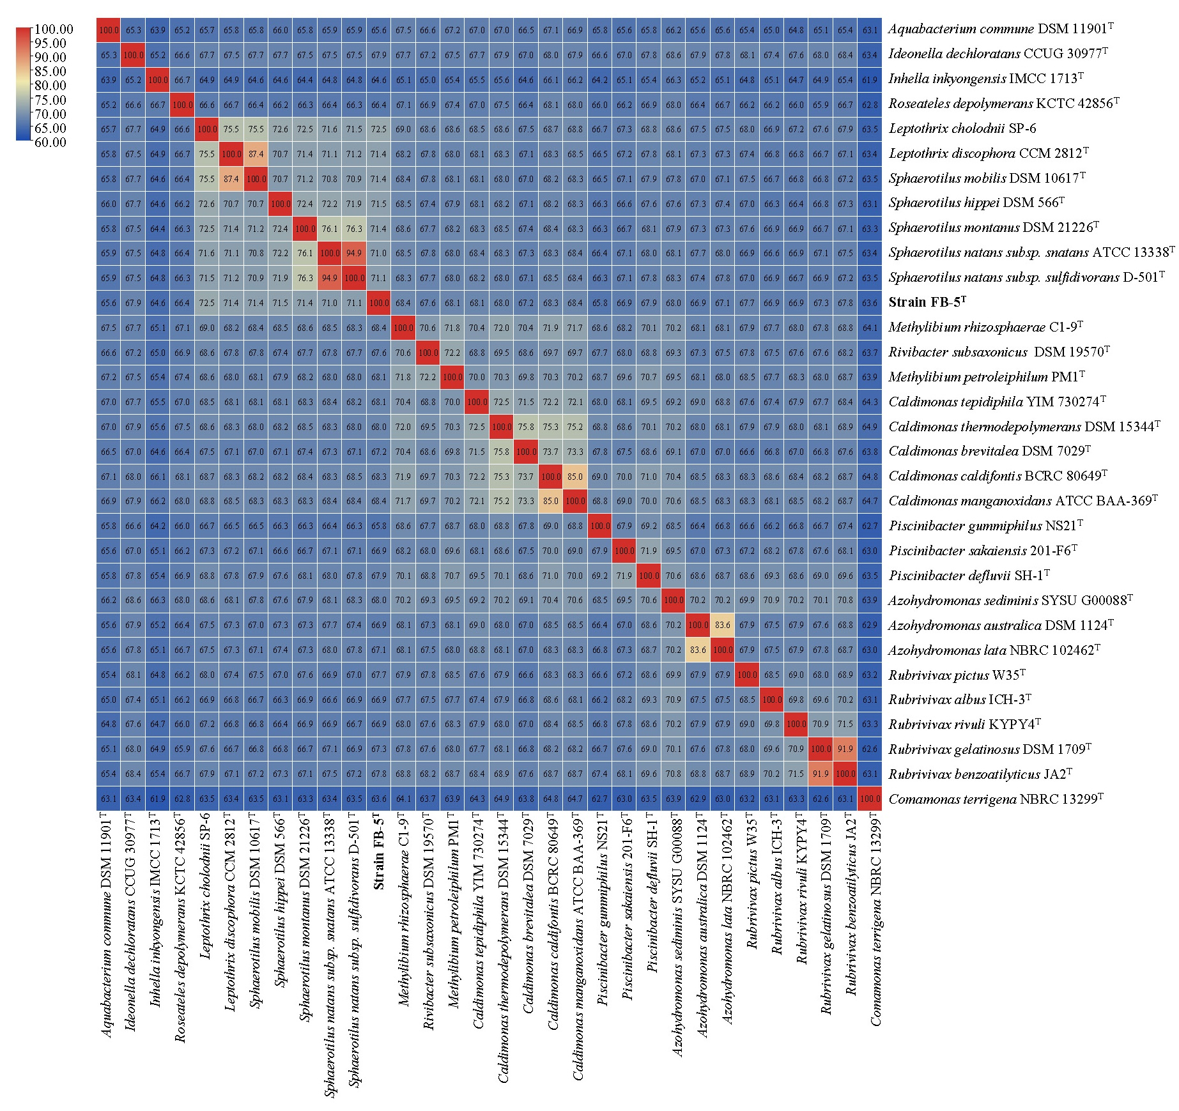
Fig. S6 Pairwise AAI comparisons of strain FB-5^{T} and related strains

Slide 13
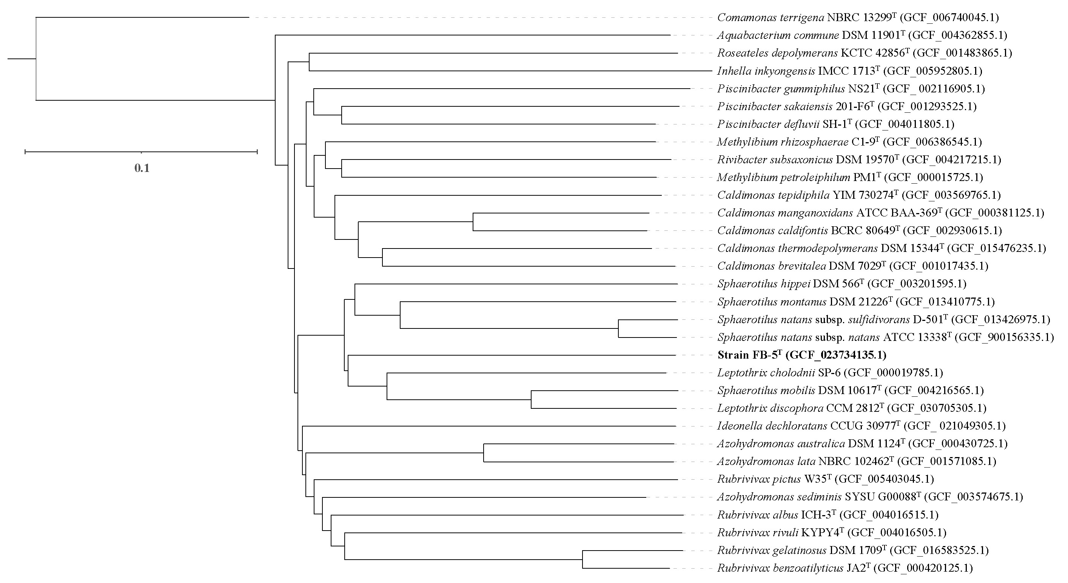
Fig. S7 AAI plot (NJ) based on the corresponding symmetrical matrix (Fig. S10) showing the relationship between strain FB-5^{T} and the related strains. The scale represents 0.1 substitutions per site.

Slide 14
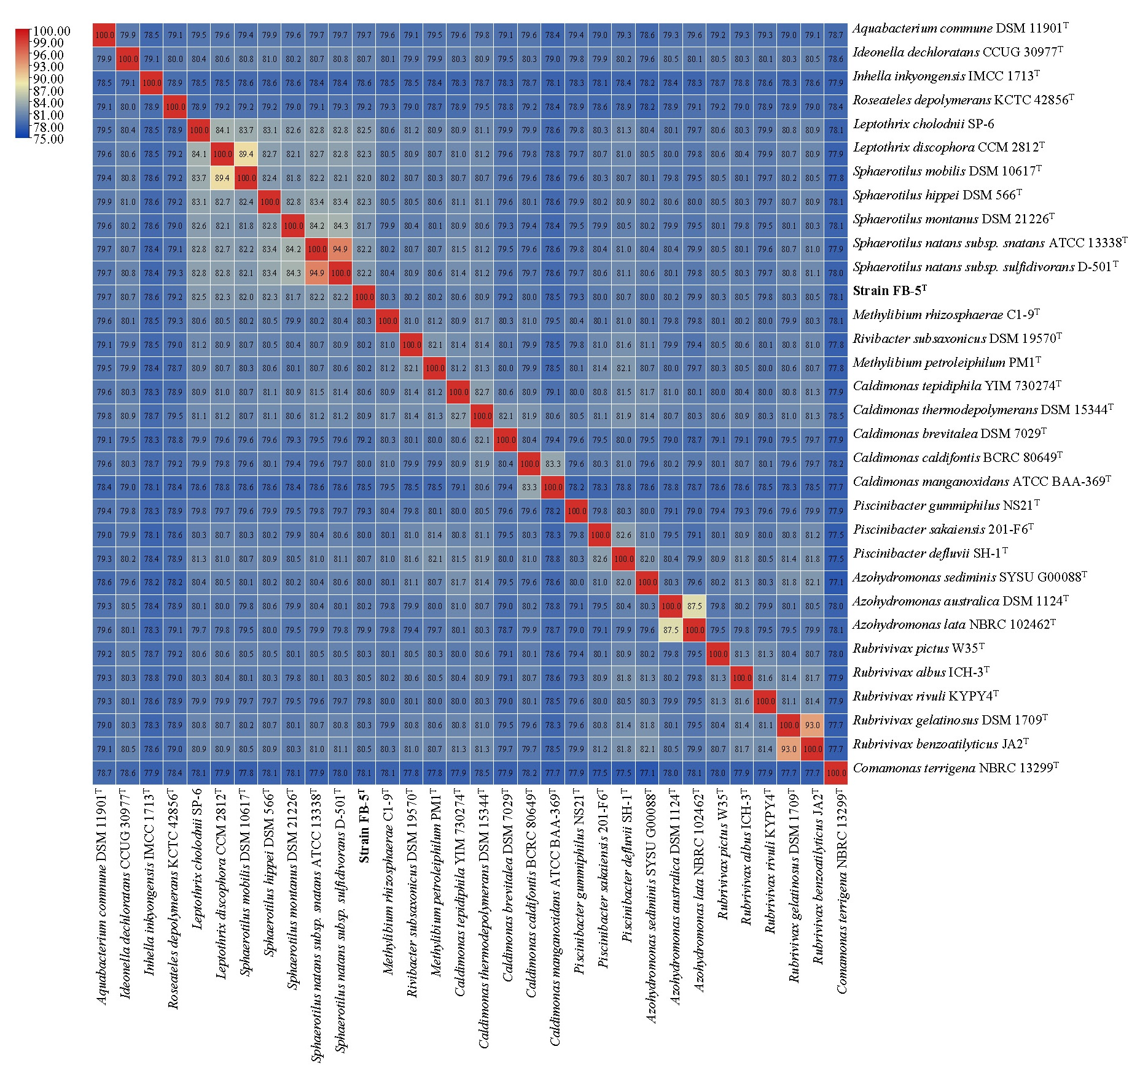
Fig. S8 Pairwise ANI comparisons of strain FB-5^{T} and related strains

Slide 15
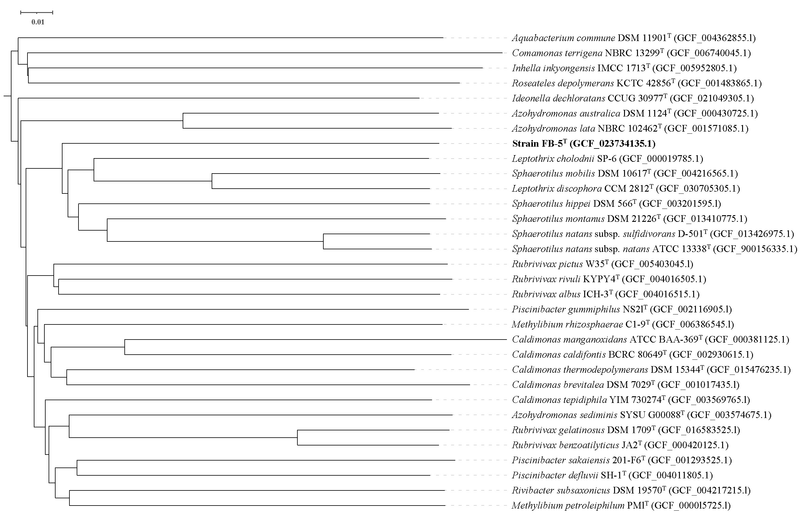
Fig. S9 ANI plot (NJ) based on the corresponding symmetrical matrix (Fig. S12) showing the relationship between strain FB-5^{T} and the related strains. The scale represents 0.01 substitutions per site.

