Slide 1
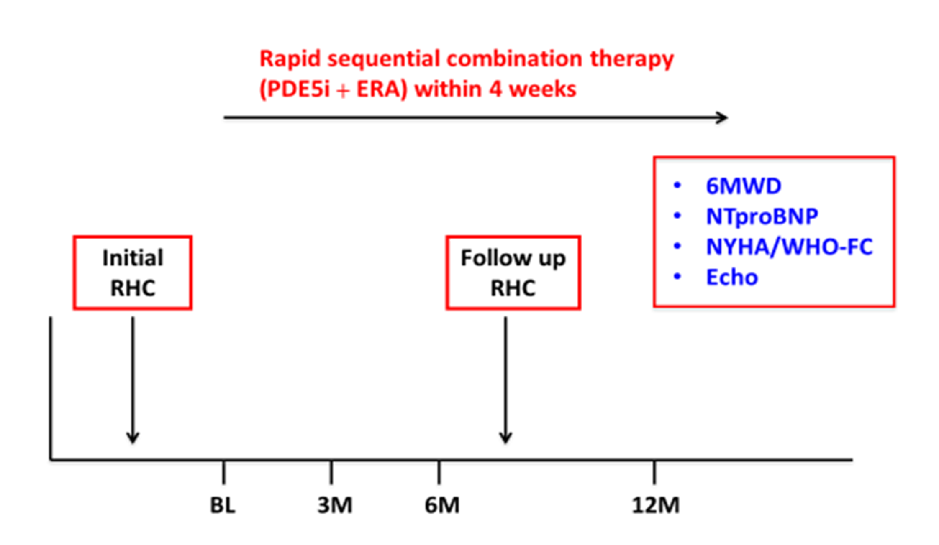
Supplementary Figure 1. Schematic depicting the flow of 50 patients with a new diagnosis of PAH undergoing rapid sequential combination therapy with PDE5i and ERA, including index RHC, repeat RHC, and non-invasive follow-up variables up to 12 months.

Slide 2
Patients with newly diagnosed PAH
deemed for rapid sequential DOCT:
n=68
ERA not tolerated: n=8
PDE5i not tolerated: n=1
Lost to follow-up: n=1
no escalation: n=1
multiple drug intolerabilities: n=1
escalation delayed: n=1
died: n=2
repeat RHC denied: n=3
12 month follow-up on dual oral combination therapy: n=50
Supplementary Figure 2. Subject distribution and treatment pattern of patients with newly diagnosed PAH, and eligibility for the current analysis. DOCT, double oral combination therapy

