Slide 1
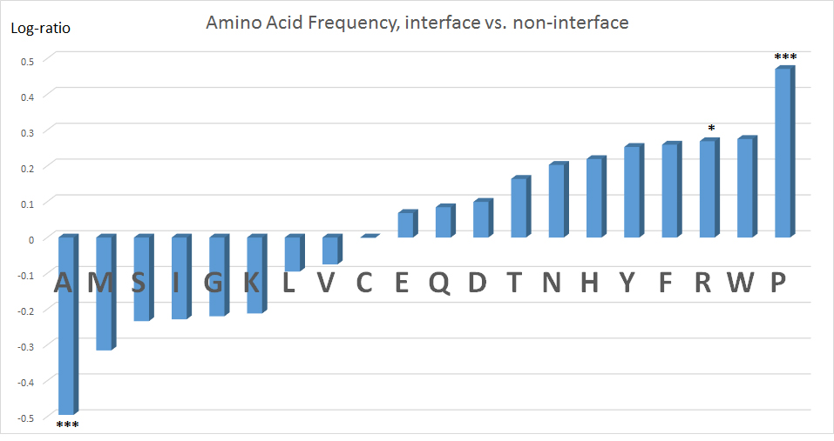
Harrus et al. Supplement Figure 1

