Slide 1
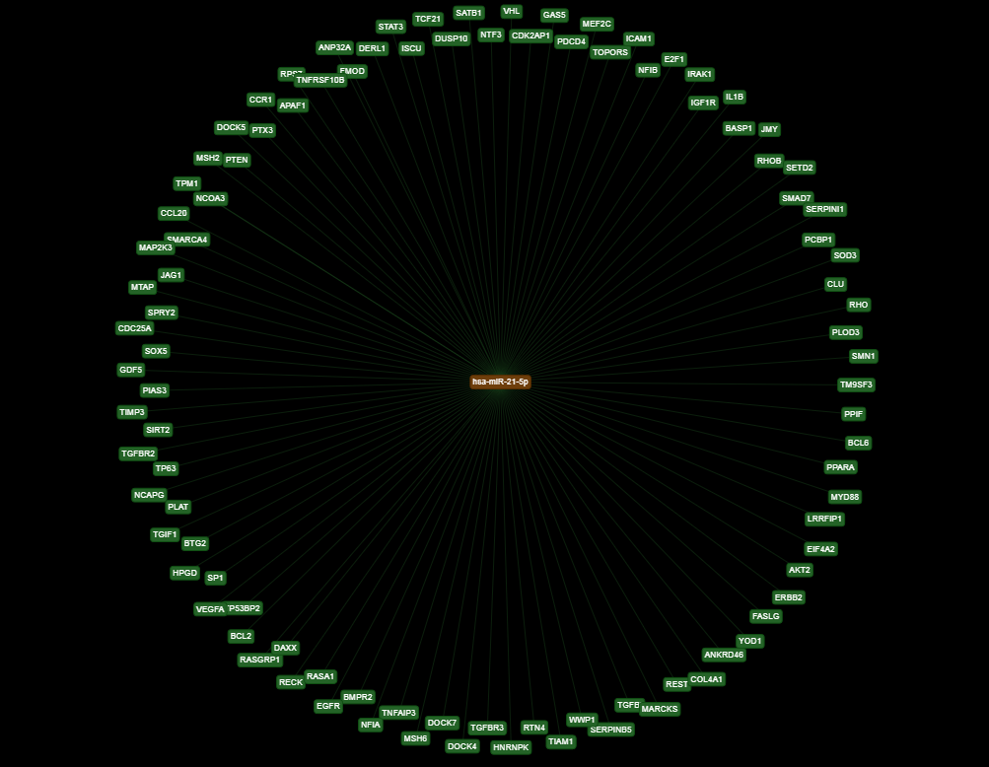
miR-21 target genes based on strong evidences
Data retrieved from miRTarget Link Human

