Slide 1
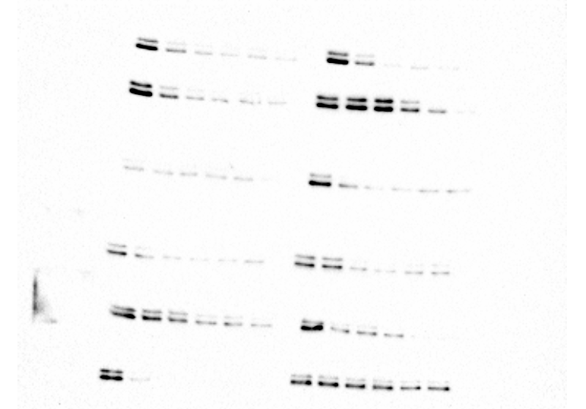
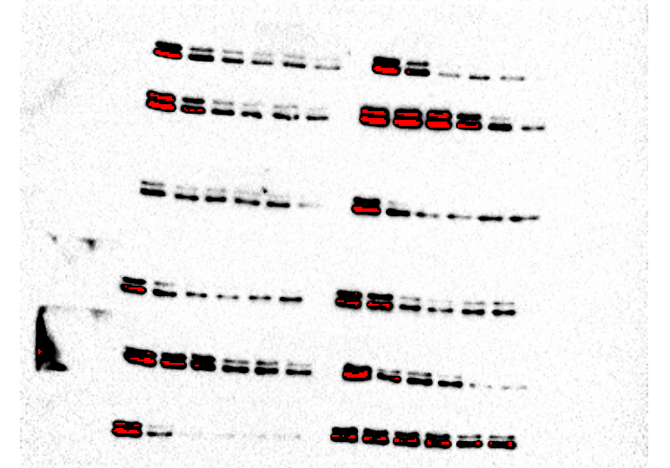
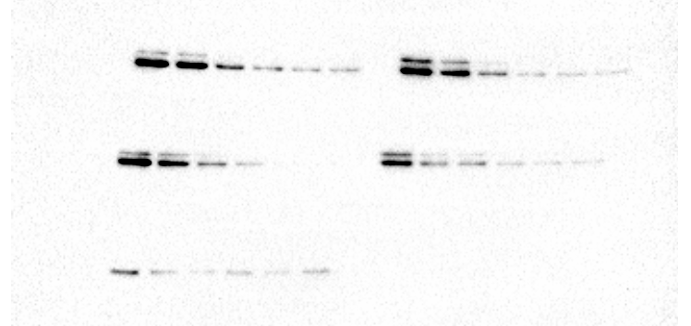
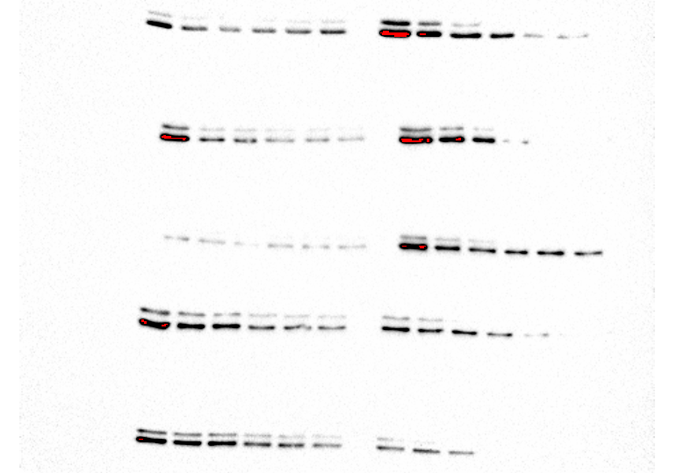
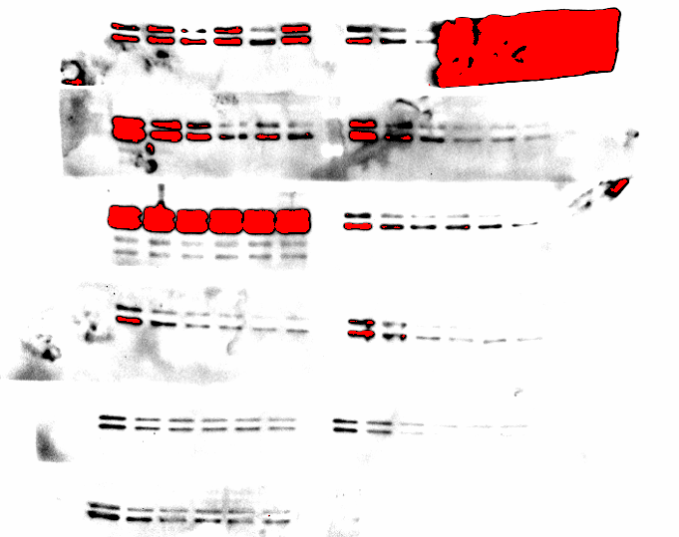
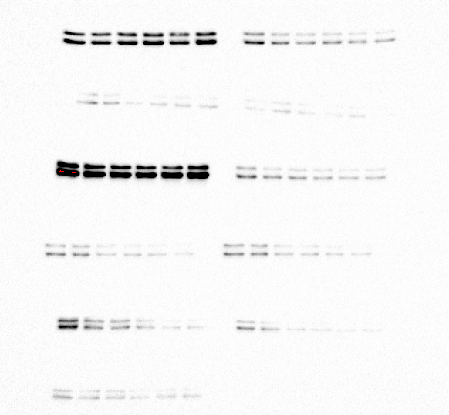
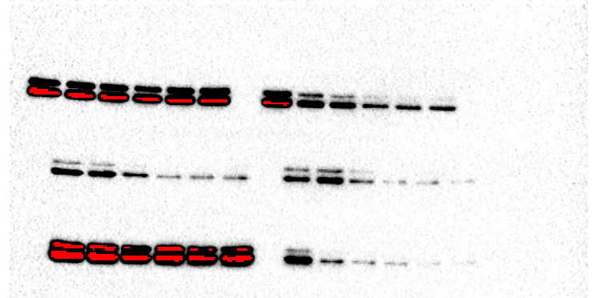
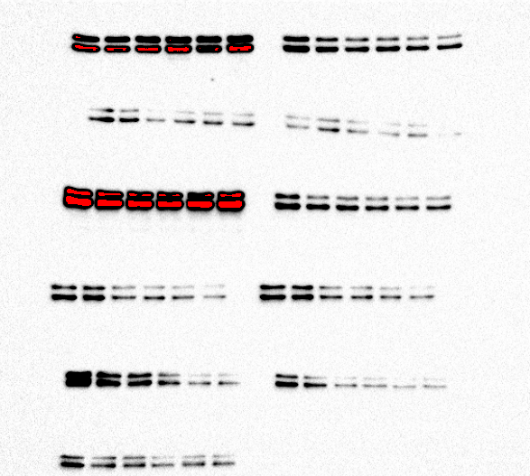
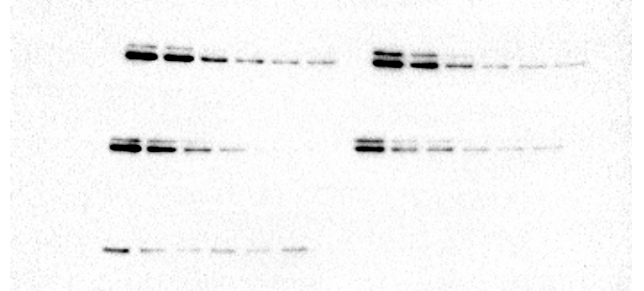
Figure 2e pERK
KRAS^{G12C}
KRAS^{G12V}
37
37
KRAS^{A146T}
37
KRAS^{A146T}
37
KRAS^{G12R}
KRAS^{G12A}
37
37
KRAS^{G12D}
37
KRAS^{G12S}
37
BRAF^{V600E}
37
KRAS^{G13D}
37
KRAS^{Q61H}
KRAS WT
37
37
37
KRAS^{Q61R}

Slide 2
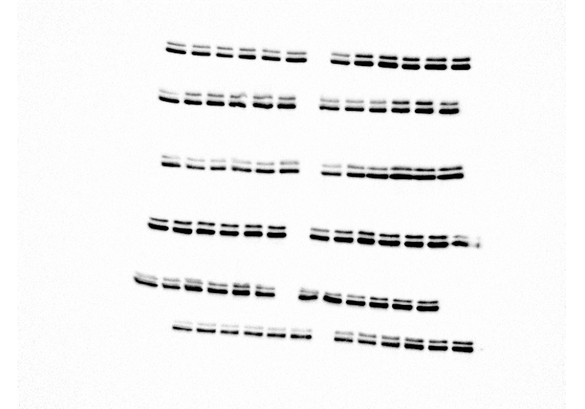
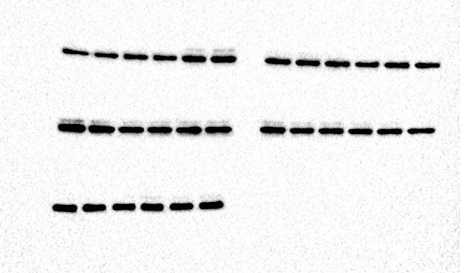
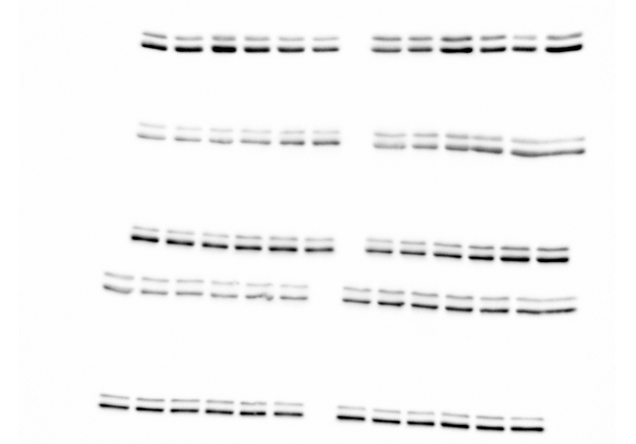
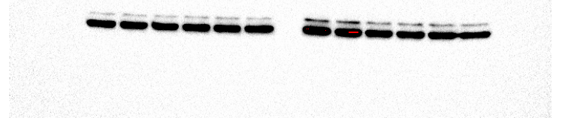
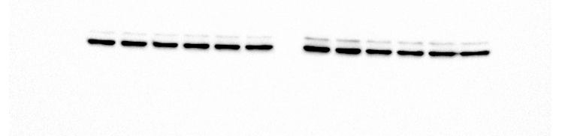
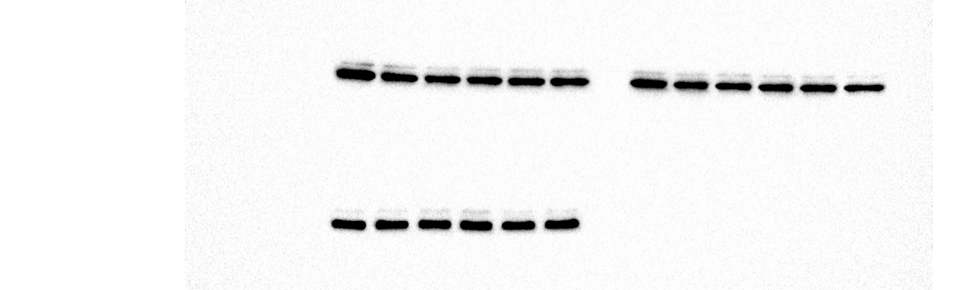
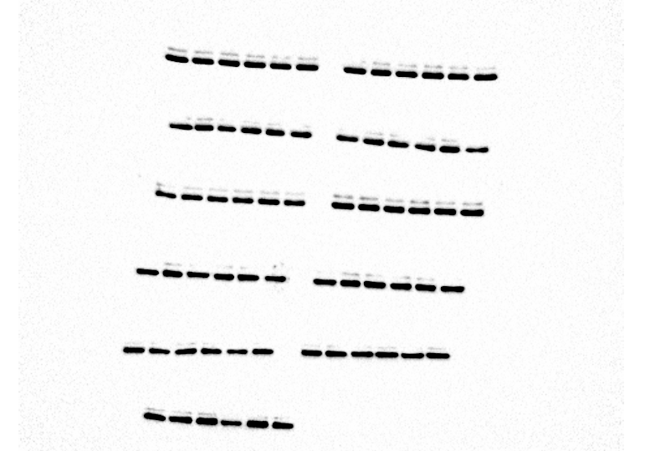
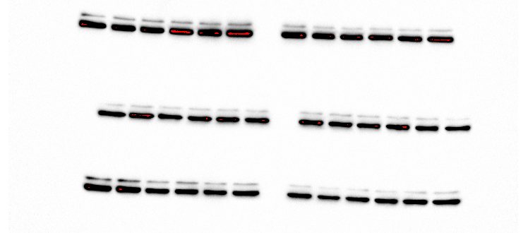
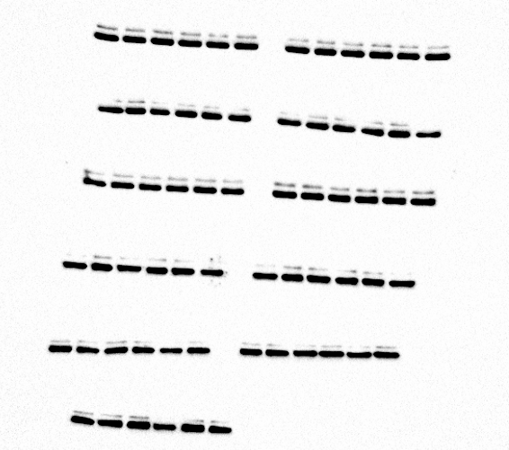
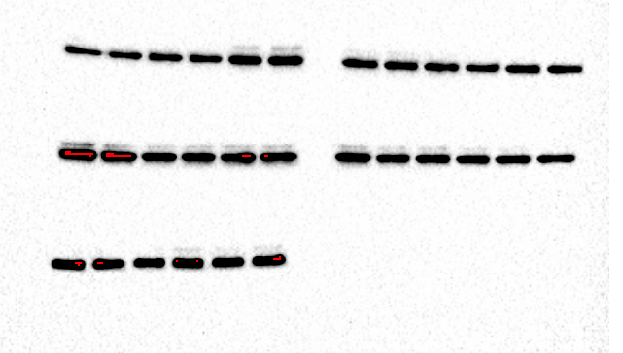
Figure 2e Total ERK
KRAS^{G12C}
KRAS^{G12V}
37
37
KRAS^{A146T}
KRAS^{G12R}
37
37
KRAS^{G12D}
KRAS^{G12A}
37
37
KRAS^{G12S}
37
BRAF^{V600E}
37
KRAS^{G13D}
37
KRAS^{Q61H}
37
KRAS WT
37
37
KRAS^{Q61R}

Slide 3
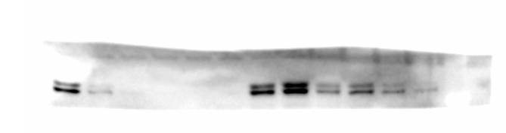
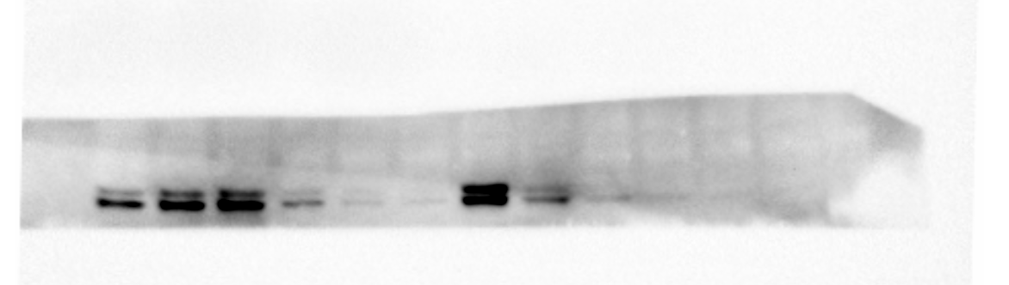
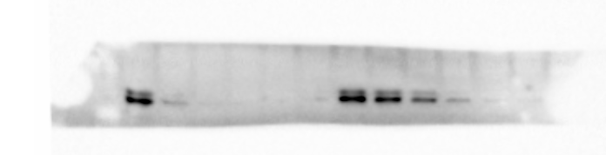
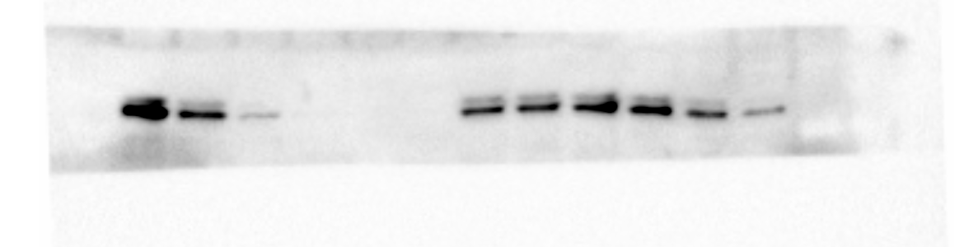
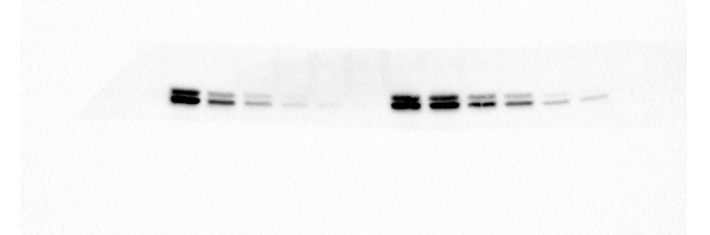
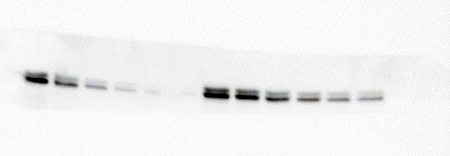

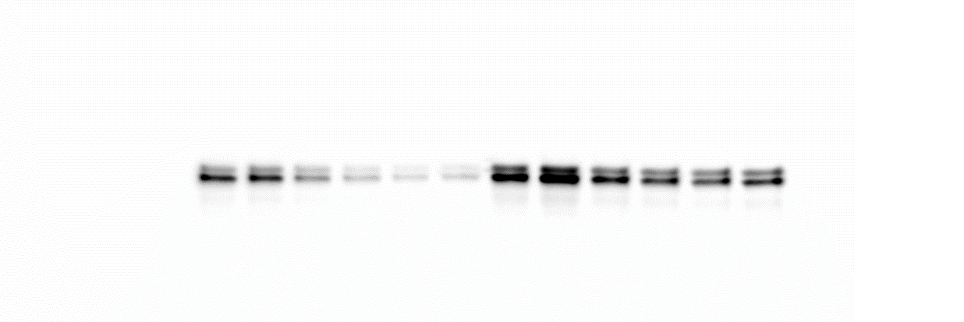
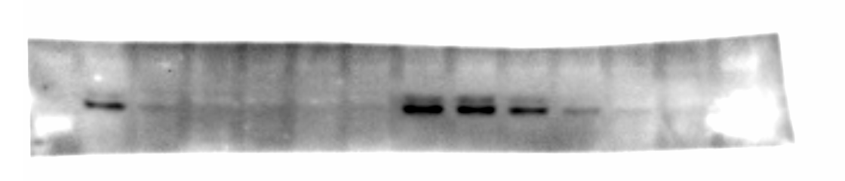
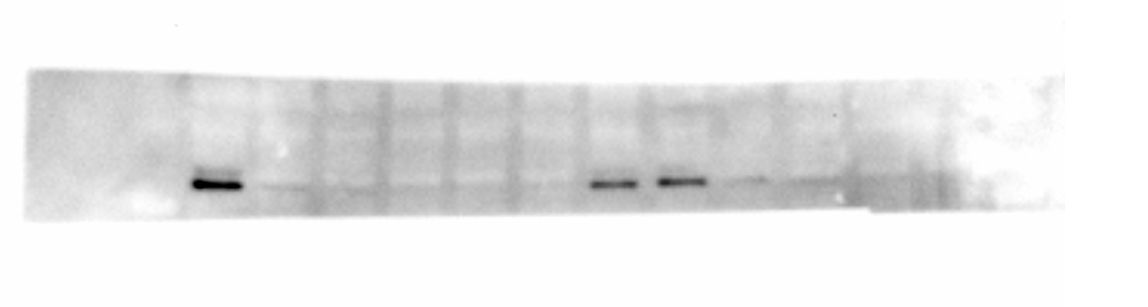
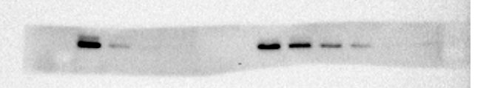
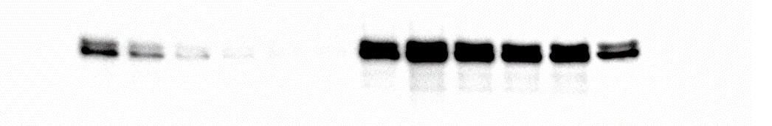
Figure 4a
PA14C pERK
PA16C pERK
2 hr
50
50
37
37
4 hr
50
50
37
37
24 hr
50
50
37
37
48 hr
50
37
37
PANC-1 pERK
2 hr
50
37
4 hr
50
37
24 hr
37
48 hr
50
37

Slide 4
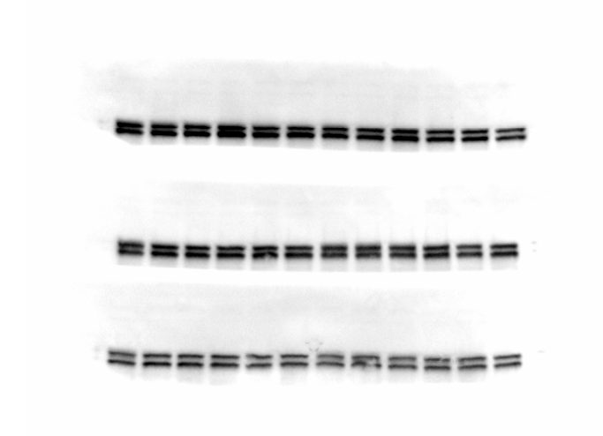
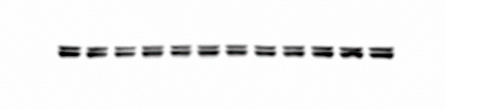
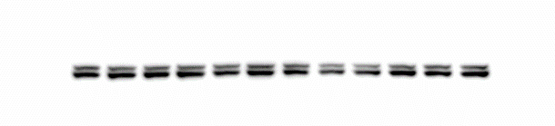
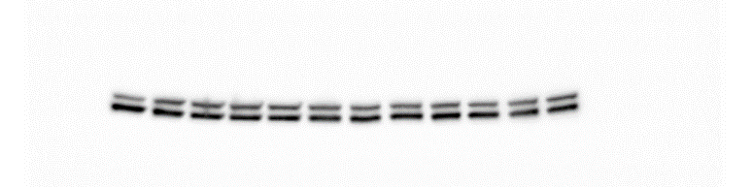
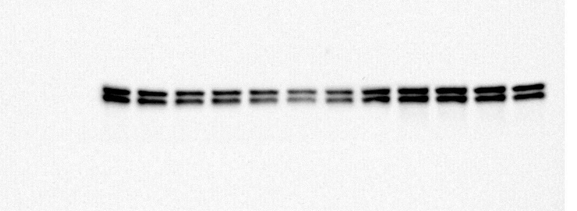
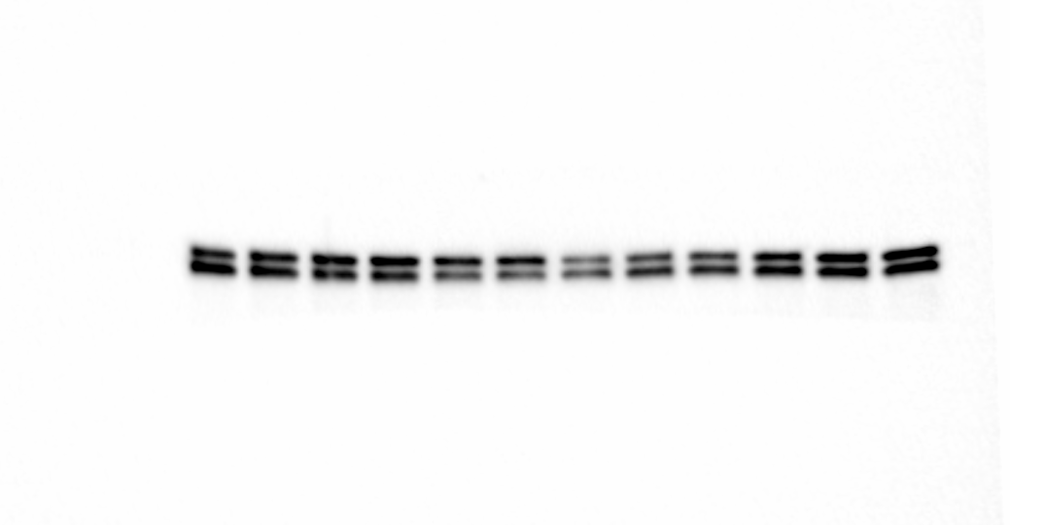
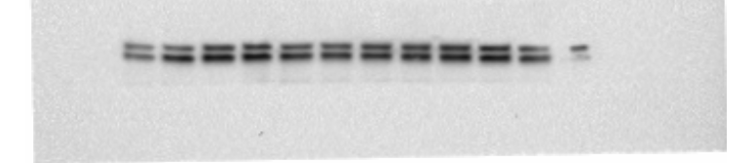
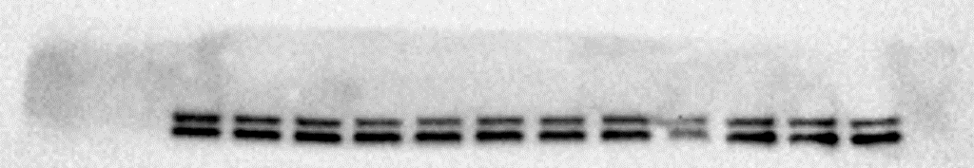
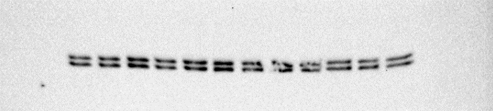
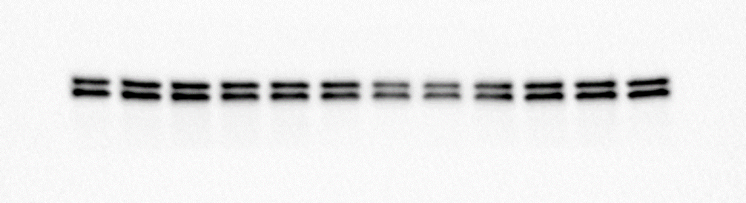
Figure 4a
PA14C ERK
PA16C ERK
2 hr
37
37
4 hr
37
37
24 hr
37
37
48 hr
37
37
PANC-1 ERK
2 hr
37
4 hr
50
37
24 hr
37
48 hr
37

Slide 5
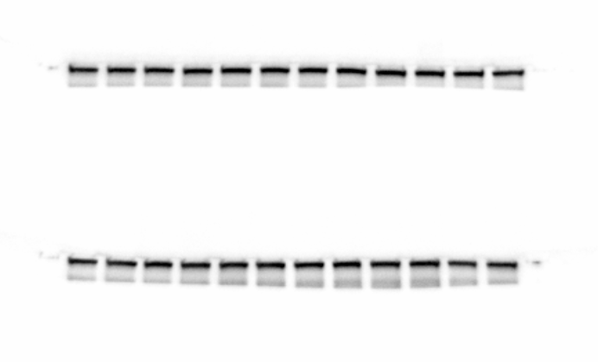
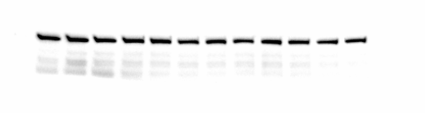
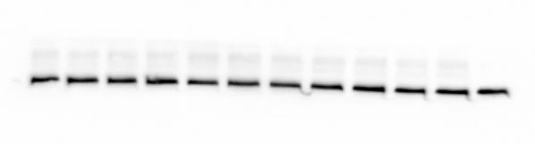
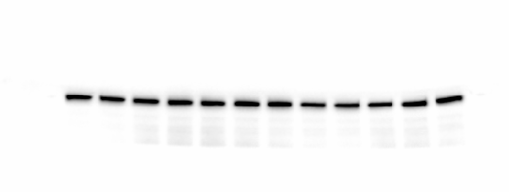
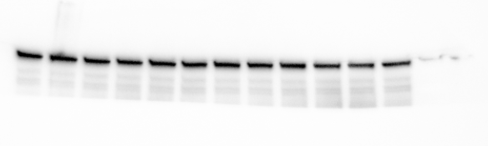
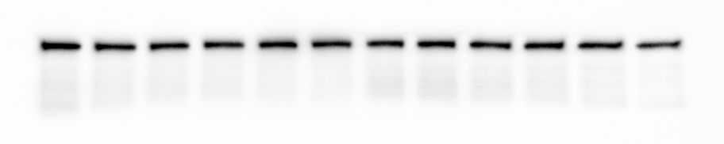
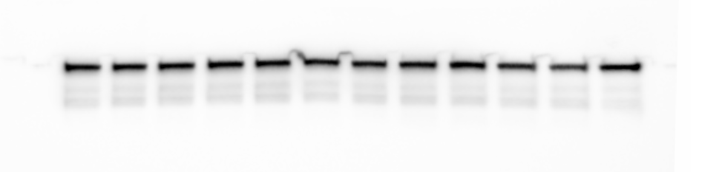
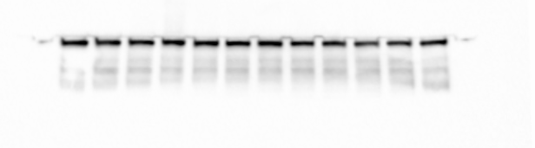
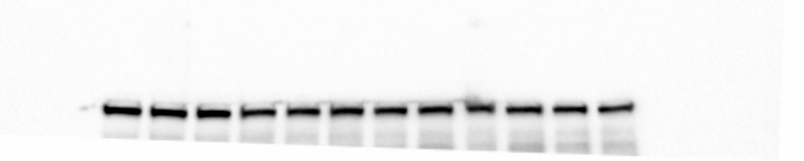
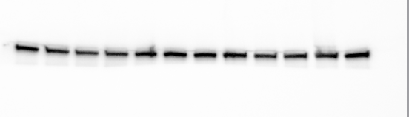

Figure 4a
PA14C vinculin
PA16C vinculin
2 hr
100
100
4 hr
100
100
24 hr
100
100
48 hr
100
100
PANC-1 vinculin
2 hr
100
4 hr
100
24 hr
100
48 hr
100

Slide 6












Extended Data Fig. 6a pERK
KRAS G12C
50
KRAS G13D
50
37
37
KRAS G12V
50
KRAS Q61H
50
37
37
KRAS G12R
50
KRAS Q61R
50
37
37
KRAS G12D
50
KRAS A146T
50
37
37
KRAS G12S
50
KRAS WT
37
50
37
KRAS G12A
50
BRAF V600E
50
37
37

Slide 7












Extended Data Fig. 6a Total ERK
KRAS G12C
50
KRAS G13D
50
37
37
KRAS G12V
KRAS Q61H
37
37
KRAS G12R
KRAS Q61R
37
50
37
KRAS G12D
50
KRAS A146T
37
37
KRAS G12S
KRAS WT
50
50
37
37
KRAS G12A
BRAF V600E
37
50
37

Slide 8








Extended Data Fig. 6b
SW620
H358
50
pERK
38
SW620
H358
ERK
50
38
30
260
160
SW620
H358
125
pCRAF
90
70
50
260
CRAF
160
SW620
H358
125
90
70
260
SW620
H358
160
pRSK
125
90
70
260
SW620
H358
160
RSK
125
90
70
SW620
H358
RAS
25
15
Actin
50
SW620
H358
38

Slide 9



Extended Data Fig. 6c
50
SW620
H358
pERK
38
50
SW620
H358
ERK
38
90
SW620
H358
pCRAF
70
50
90
SW620
H358
CRAF
70
50
260
SW620
H358
160
pRSK
125
90
70
160
SW620
H358
125
RSK
90
70
SW620
H358
260
160
PARP and cleaved PARP
125
90
25
SW620
H358
RAS

Slide 10








Extended Data Fig. 10c
pERK
pERK
50
H358
adagrasib-R
38
50
H358 Parental
38
ERK
ERK
50
H358
adagrasib-R
50
38
38
H358 Parental
pRSK
90
H358
adagrasib-R
70
90
H358 Parental
70
RSK
90
H358
adagrasib-R
70
90
H358 Parental
70
Vinculin
160
H358
adagrasib-R
125
160
H358 Parental
125

