Slide 1
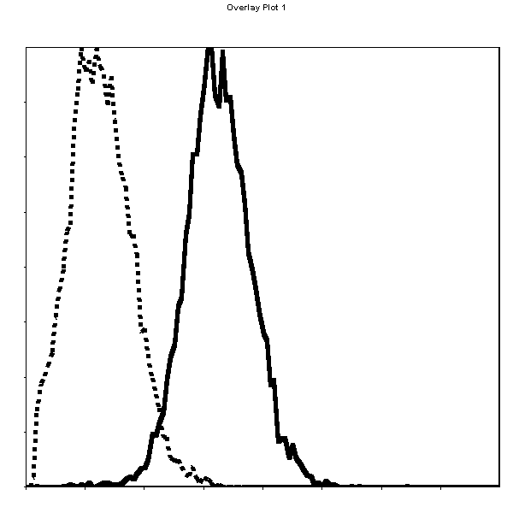
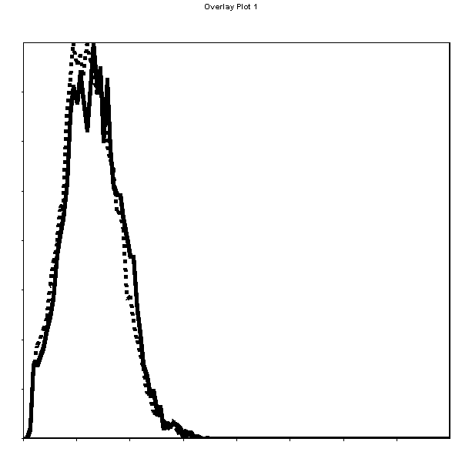
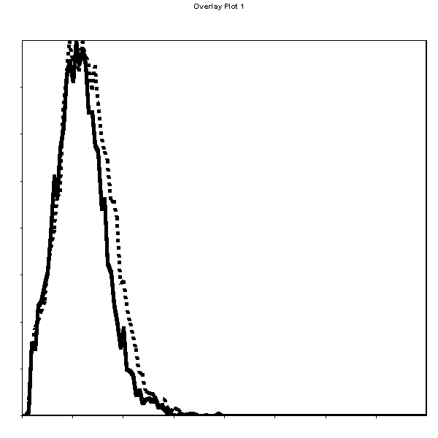
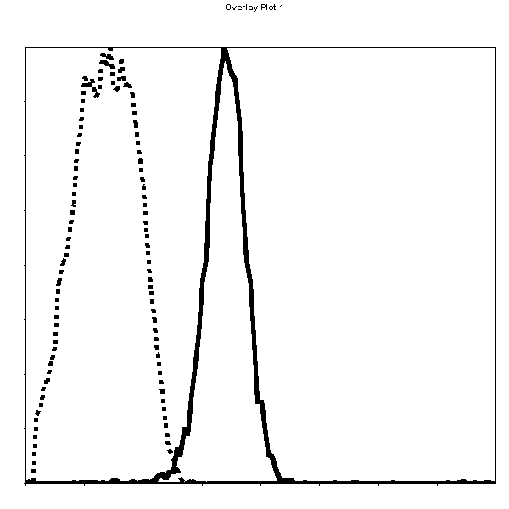
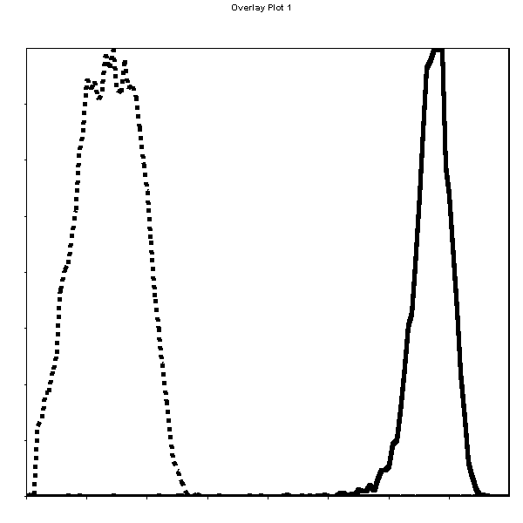
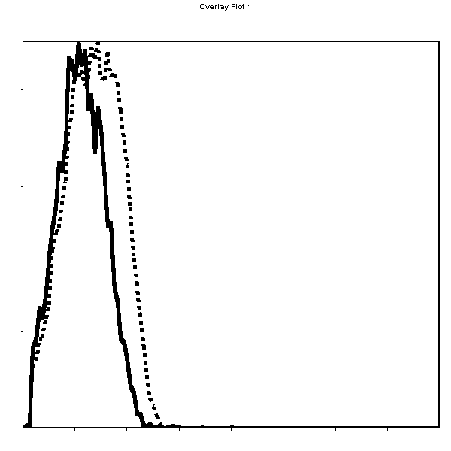
HoWangYin et al, Supplemental Figure 1
ILT2
ILT4
HLA-G
MFI=9
MFI=1
MFI=0.8
NKL-ILT2⁺
93%
0%
0%
MFI=10
MFI=332
MFI=0.5
98%
99%
0%
NKL-ILT2⁺ILT4⁺

