Slide 1
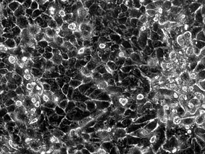
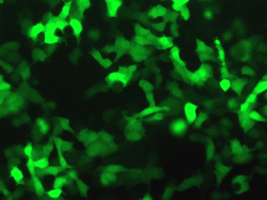
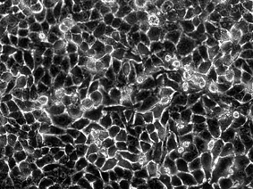
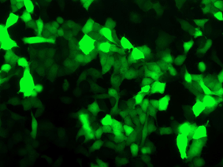
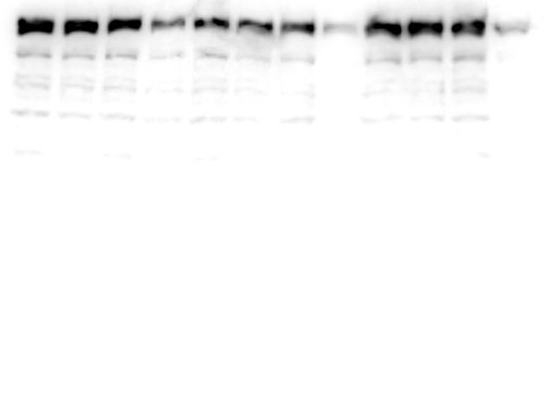
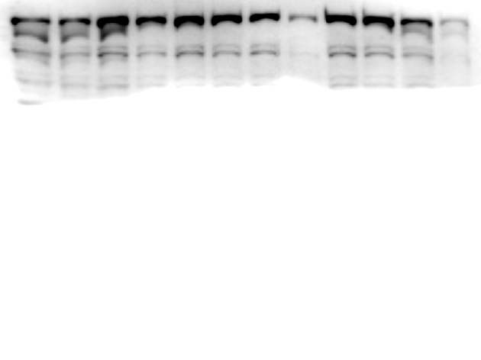


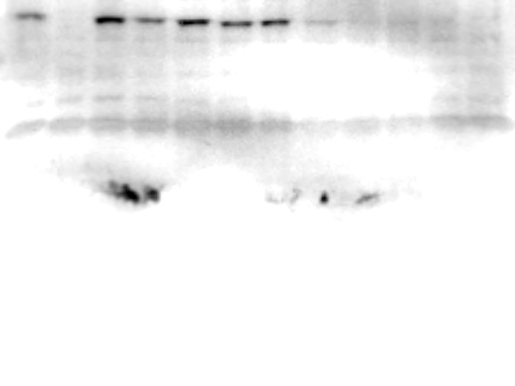


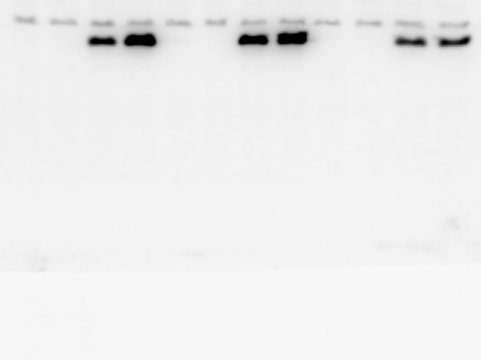
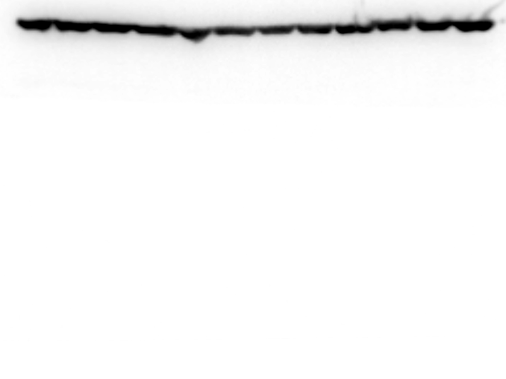
Supplemental Fig. 2
a
b
rAAV2-Cont shRNA
1. rAAV2-Cont shRNA (Cont shRNA)
2. rAAV2-mTOR shRNA (mTOR shRNA)
shRNA
pH1
pCMV
GFP
pol A
rAAV2-mTOR shRNA
Bi-directional
promoter
d
2 days
4 days
Cont
mTOR
Cont
mTOR
c
mTOR
P-mTOR
(S2448)
*
P-mTOR
(S2481)
**
P- p70S6K
(T389)
P- AKT
(S473)
GFP
actin

