Slide 1
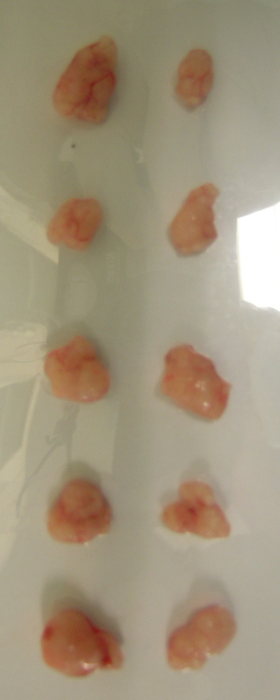
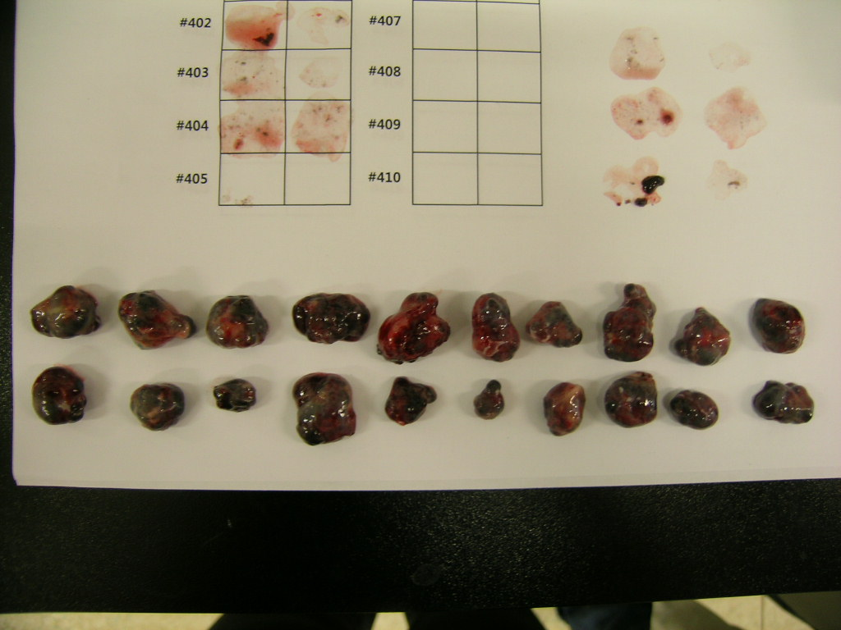
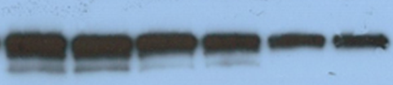


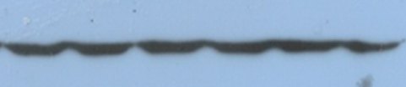


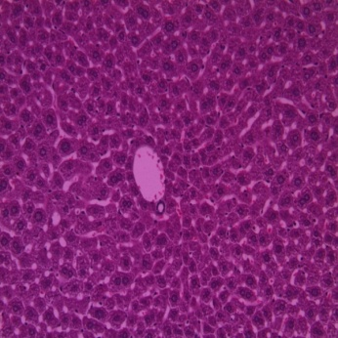
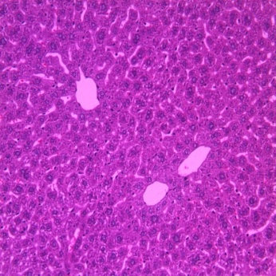
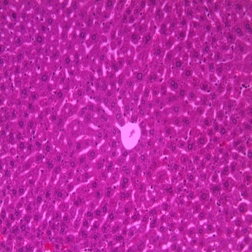
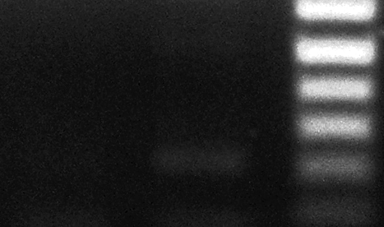
Supplemental Fig. 3
a
Cont shRNA
mTOR shRNA
b
Cont shRNA
mTOR shRNA
#1
#2
#3
#1
#2
#3
#1
#2
#3
#1
#2
#3
mTOR
mTOR
actin
actin
c
mTOR shRNA
Cont shRNA
d
Liver
210 bp
Mock
Cont shRNA
mTOR shRNA

