Slide 1
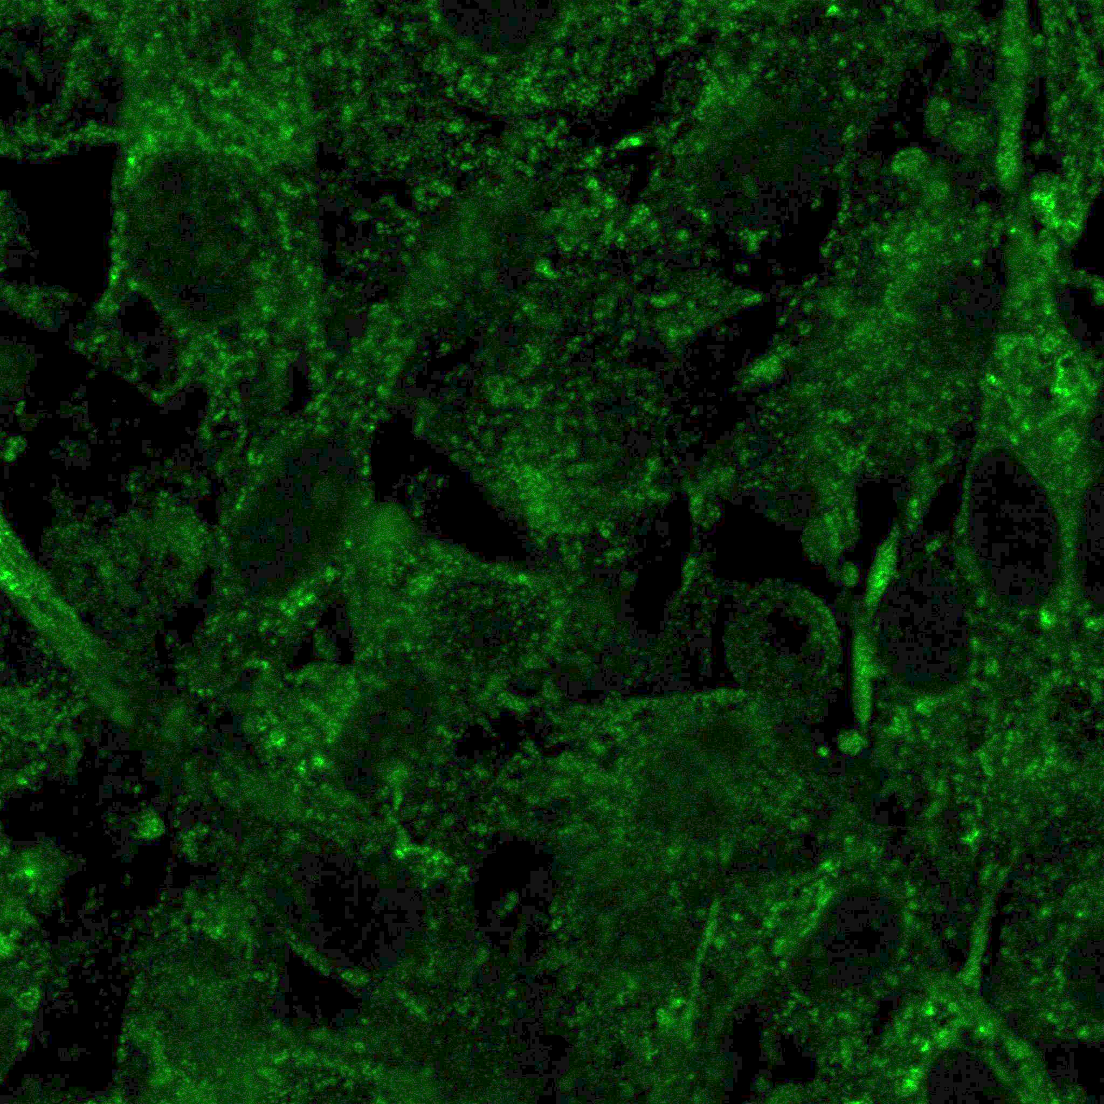

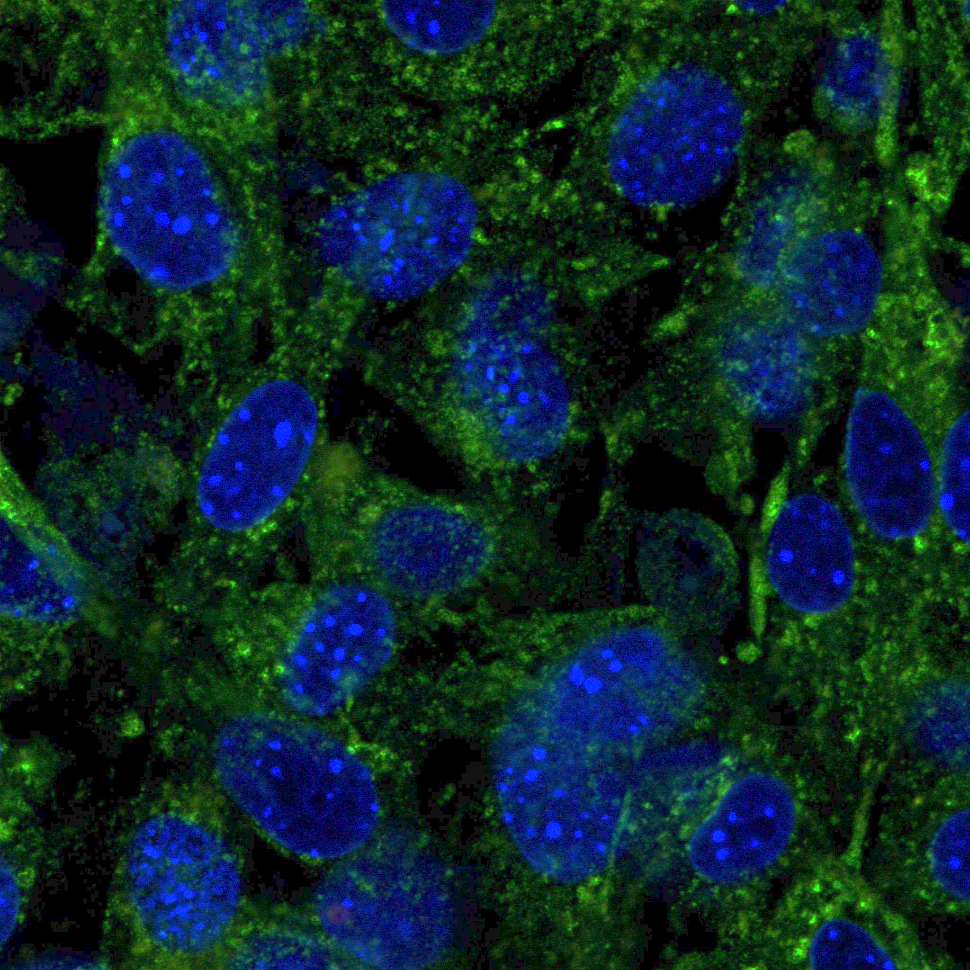
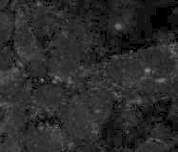
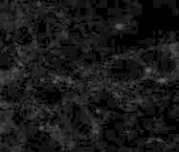
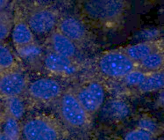
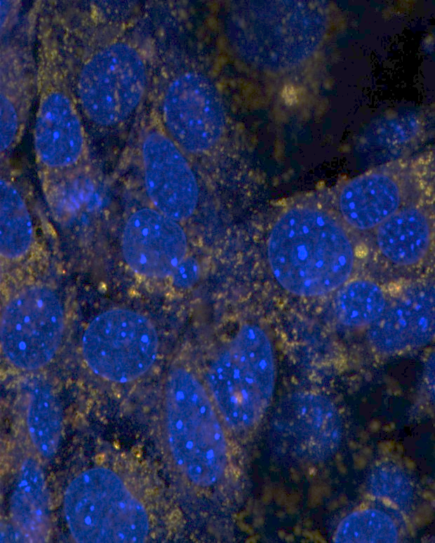
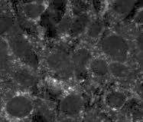
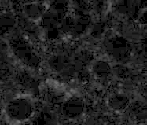
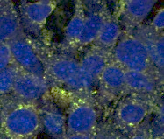
A
LAMP1
TSC2
LAMP1/TSC2
Zoom
MEF TSC2 -/-
B
LAMP1
TSC2
LAMP1/TSC2
Zoom
c
MEF SIRT1 -/-
Manders´colocalization coefficient M1 (TSC2-LAMP1)
Resv
50 µM
c
Resv
50 µM
Supplementary Figure 1

Slide 2
P-p70 (Thr 389)
p70
Actin
Acetyl-CoA (µM)
30 min
- 3 10 30 100 - 10 30
Resveratrol 50 µM
4 h
**
***
P-p70/p70 ratio
#
#
Supplementary Figure 2

Slide 3
MIN6 scr
MIN6 TSC2 shRNA
P-Drp1
Drp1
HADHA
PINK1
PARKIN
Tubulin
CCCP 20 µM (h)
- 2 4 8 15 24 48
- 2 4 8 15 24 48
***
***
##
**
#
**
*
HADHA/Tubulin ratio
*
*
##
P-Drp-1/Drp-1 ratio
#
**
***
***
*
***
**
**
***
PINK-1/Tubulin ratio
Parkin/Tubulin ratio
Supplementary Figure 3

