Slide 1
Supplementary Table 1.
 |  | zebrafish |  | mouse | human
 |  | CVP | CCM
pathology | Multi-cavernous Malformations | yes | yes | yes | yes
 | Perilesional Iron Deposition | yes1 | yes | yes | yes
 | Sluggish Blood Flow | yes | ? | yes | yes
 | Widely Distribution in Brain | _ | yes | only in cerebellum in acute model; yes in chronic model | yes
 | Extracranial lesions | _ | yes | Not reported | yes
Genetics | Mosaic inactivation of CCM genes | yes | yes | Pan-endothelial inactivation in acute model; yes in chronic model | yes
 | Dependent on mekk3-klf2 | yes | yes | yes | ?
Response to chemicals | ROCK inhibitor | yes | ? | yes | ?
 | propranolol | yes | yes | yes | ?

Slide 2
Supplementary Table 2.
 | DNA | Chromosome | Position | Direction | Forward Primer (5'-3') | Reverse Primer (5'-3')
1 | ACTgTAAA-GCGCCAaGGGGG | 1 | 42371490 | - | GTTTCTGCAGACCCTATGACT | GCGGAAACTACAATTCCCAT
2 | ACTCTAAACGCaCC-tGGGGG | 1 | 39767245 | - | GGATCCTTCTTCATCAGTGT | ATAGGTCTGCCTGCCACAAT
3 | ACgCTAAA-GgGCCACGGGGG | 7 | 16408417 | - | AGCCCAGGTAATAGGCTAT | ACCACCTCACGACCATCTGT
4 | ACTgTAAACGgGCCA-GGCGG | 5 | 17418058 | + | AAAGCCTCCAACTCCAGCT | AAGGGCGAAATGAAAGCGGT
5 | ACTgTAAACGgGCCA-GGCGG | 10 | 15691003 | + | AACTCCAGCTGACGCAGCTT | GGCGAAATGAAAGCGGTGCT
6 | ACTCTAAATaGgGCCACGGTGG | 15 | 5533276 | - | GAAAACAGTGCTGCCTGCCT | CTTATCTAGCGCTCACGGAT
7 | ACTCTAAATaGgGCCACGGGGG | 18 | 7108733 | - | AGAGCAGCAGATGGCTCTGT | AGCCTTTACGATAGCCAGCT
8 | ACTCTAAACTGCagCACGGCGG | 15 | 1799001 | - | GTGCGTTTATATGAGACGGT | AAGAGGATCTTGTTCCCGT
9 | gCT-TAAACcCGCCACGGTGG | 15 | 22123610 | - | TCGCAAACTCCTTCAGGCGT | TTCTGTCCTCTGCGTGTAT
10 | ACTgTAAACGgGCCA-GGCGG | 18 | 21555757 | - | AAGGGCGAAATGAAAGCGGT | AGCTGACGCAGCTTCACCT
11 | ACTgTAAACGgGCCA-GGCGG | 18 | 31307010 | + | AAGGTGGTTGAGGTTGGAT | GAAGGCAAGCCAACACTGT
12 | ACTgTAAACGgGCCA-GGCGG | 18 | 39397336 | + | CTGACGCAGCTTCACCTCTT | GCAAGCCAACACTGTCACCT
13 | AtTCTAAACGaGCCACGAGAGG | 23 | 9285575 | - | ACTGACTCACAGTGCATCT | TCATACACCTCTAGTGTCCA
14 | ACTgTAAA-GCtCCACGGTGG | 21 | 45129846 | - | CTGTAGTTCTTGTGGTACCT | GCTTCTCCATGTCTCTGTAT
15 | ACTCTAAACG-GCCAtGtTGG | 21 | 14360517 | - | GGGCTCTCCAAATTTGACT | TCTCAGAAGGTCGAACTCT
16 | ACTgTAAACGgGCCA-GGCGG | 19 | 23345537 | - | CAAGCCAACACTGTCACCT | AAAGCCTCCAACTCCAGCT
17 | ACTgTAAACGgGCCA-GGCGG | 23 | 24565926 | + | GAAGGTGGTTGAGGTTGGAT | GCGAAATGAAAGCGGTGCT
18 | ACTCTAAAC-aGCCAgGGGGG | 25 | 33888849 | + | GATCCTGGTTGAAGTCAGAT | TCACTTTGGCAGGACACACT
19 | ACTCTAAAaG-GCCACaGAGG | 25 | 7580951 | + | TGGAAGGAAGCCTGGAGACT | GACACCAAACTTTGATCGGT
20 | ACTgTAAACGgGCCA-GGCGG | 25 | 25111696 | + | AAAGCCTCCAACTCCAGCT | AAGGGCGAAATGAAAGCGGT

Slide 3
Supplementary Figure 1.
A
B
*
adrb1^{-/-}
wild type
adrb1^{-/-}
wild type

Slide 4
Supplementary Figure 2.
***
2,3-BDM
control

Slide 5
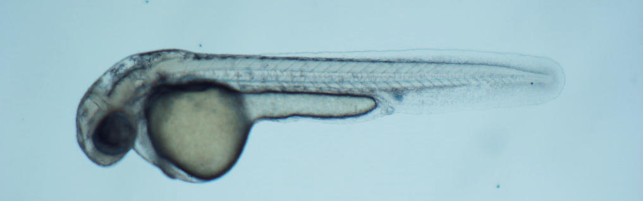
Supplementary Figure 3.
adrb1^{-/-}
wild type
A
B
C
D

