Slide 1
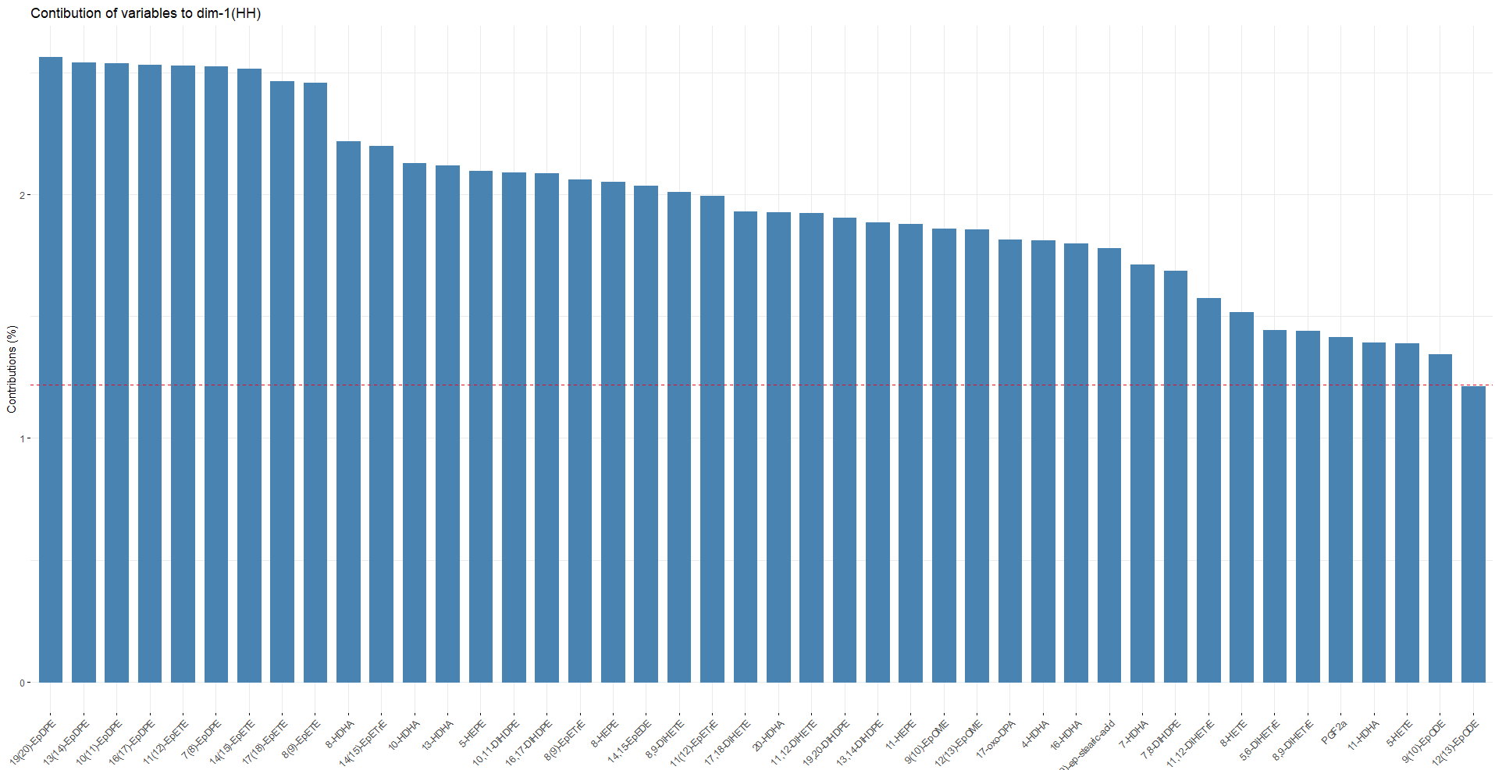
Supplemental Figure 1

Slide 2
