Slide 1
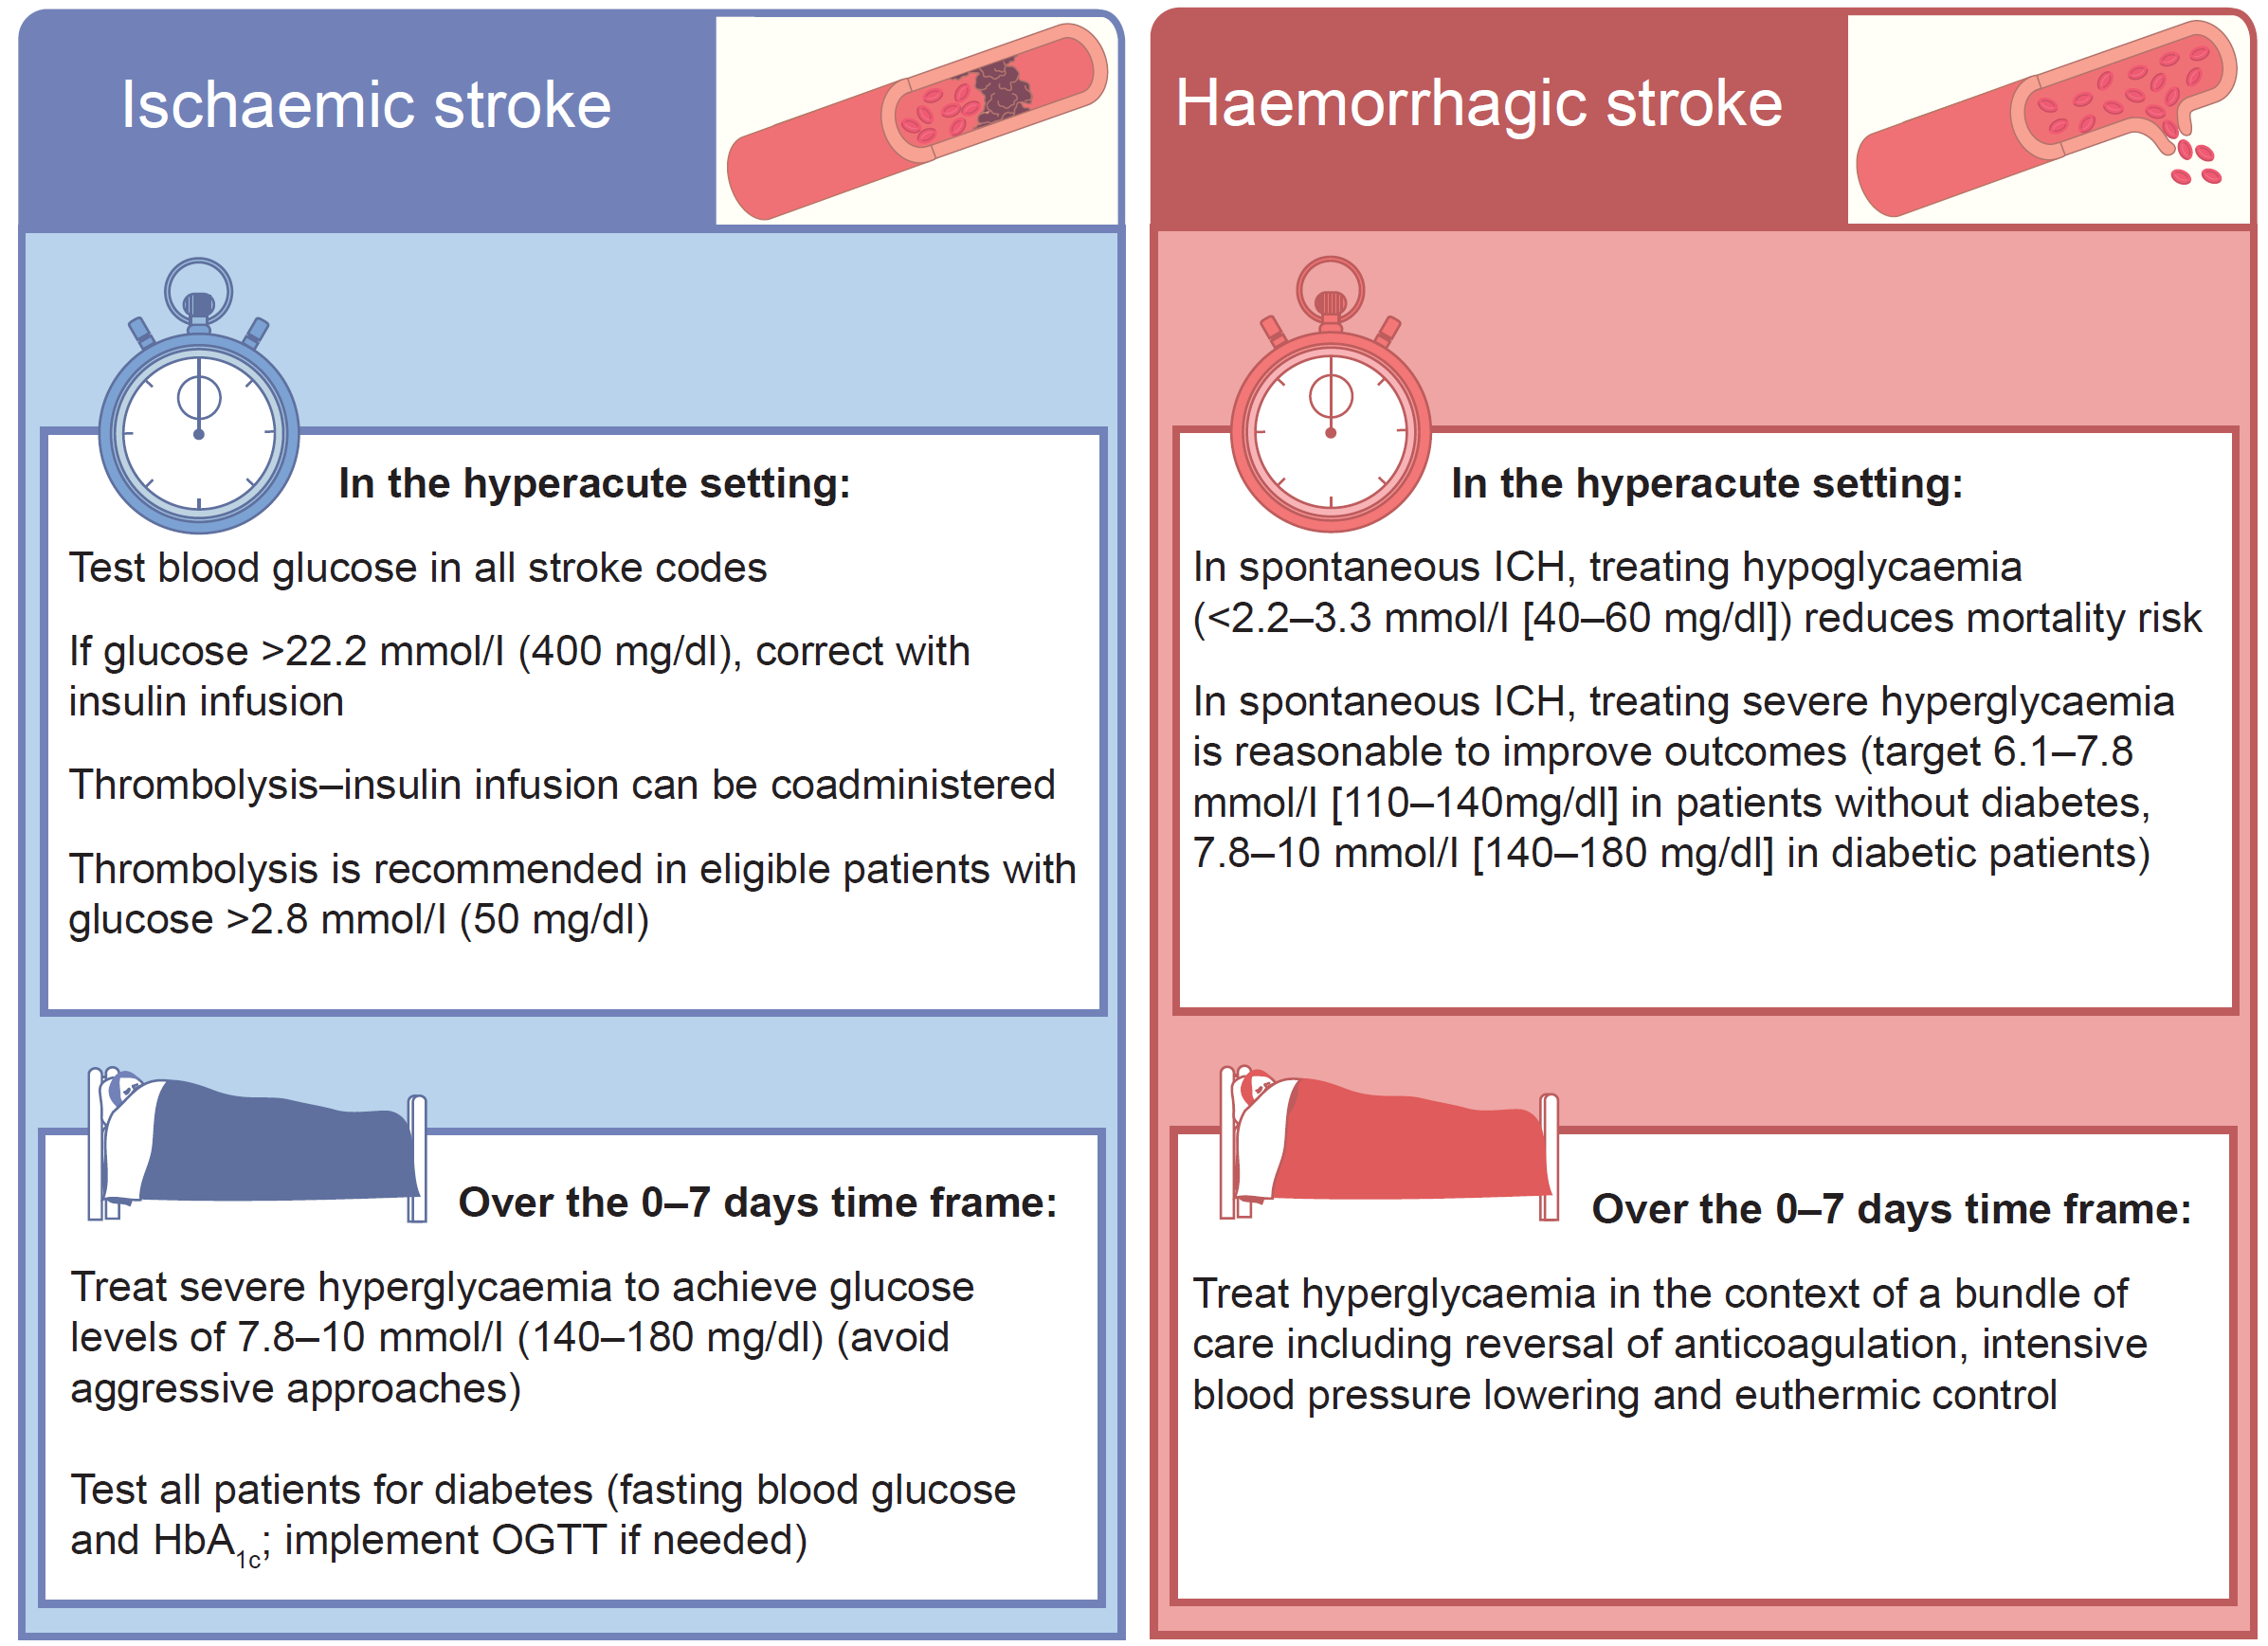
Main recommendations for the management of hyperglycaemia in acute and subacute ischaemic and haemorrhagic stroke
Sacco et al (2024) Diabetologia DOI 10.1007/s00125-024-06146-z
©The Authors 2024. Distributed under the terms of the CC BY 4.0 Attribution License (http://creativecommons.org/licenses/by/4.0/)

Slide 2
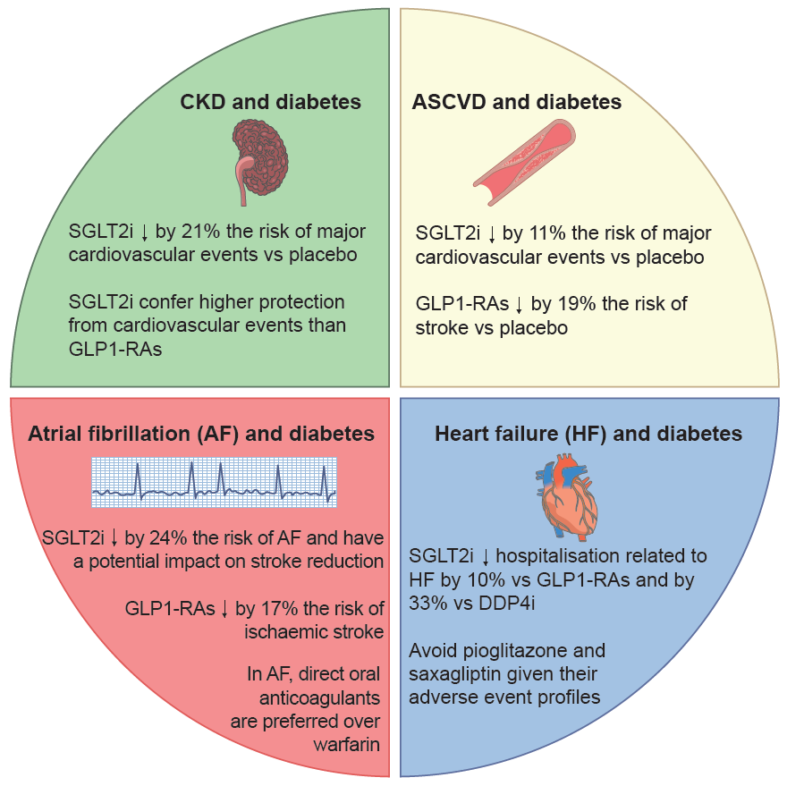
Special considerations for the management of diabetes with glucose-lowering medications in vulnerable subgroups of people
Sacco et al (2024) Diabetologia DOI 10.1007/s00125-024-06146-z
©The Authors 2024. Distributed under the terms of the CC BY 4.0 Attribution License (http://creativecommons.org/licenses/by/4.0/)

Slide 3
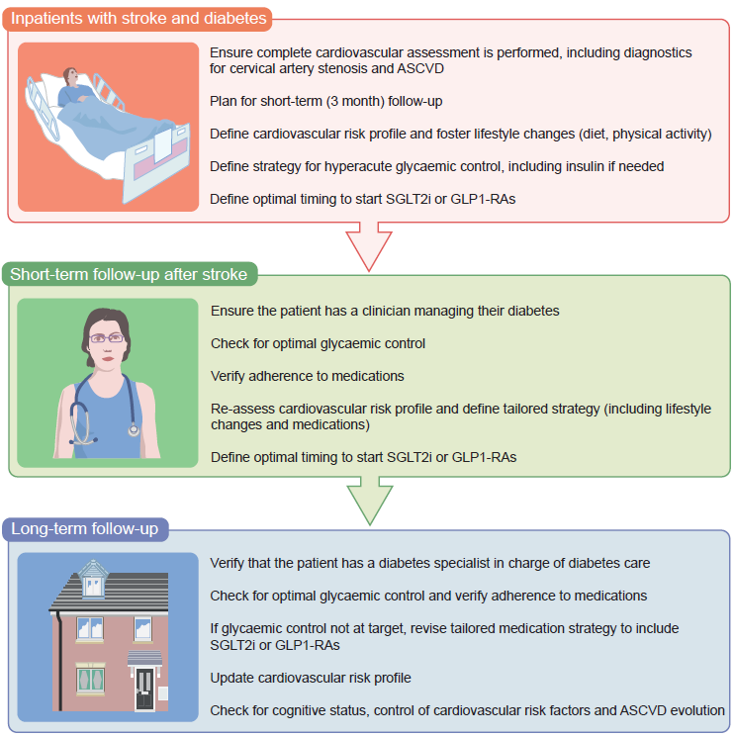
Pragmatic multidisciplinary approach to the care of people with ischaemic or haemorrhagic stroke and diabetes
Sacco et al (2024) Diabetologia DOI 10.1007/s00125-024-06146-z
©The Authors 2024. Distributed under the terms of the CC BY 4.0 Attribution License (http://creativecommons.org/licenses/by/4.0/)

