Slide 1
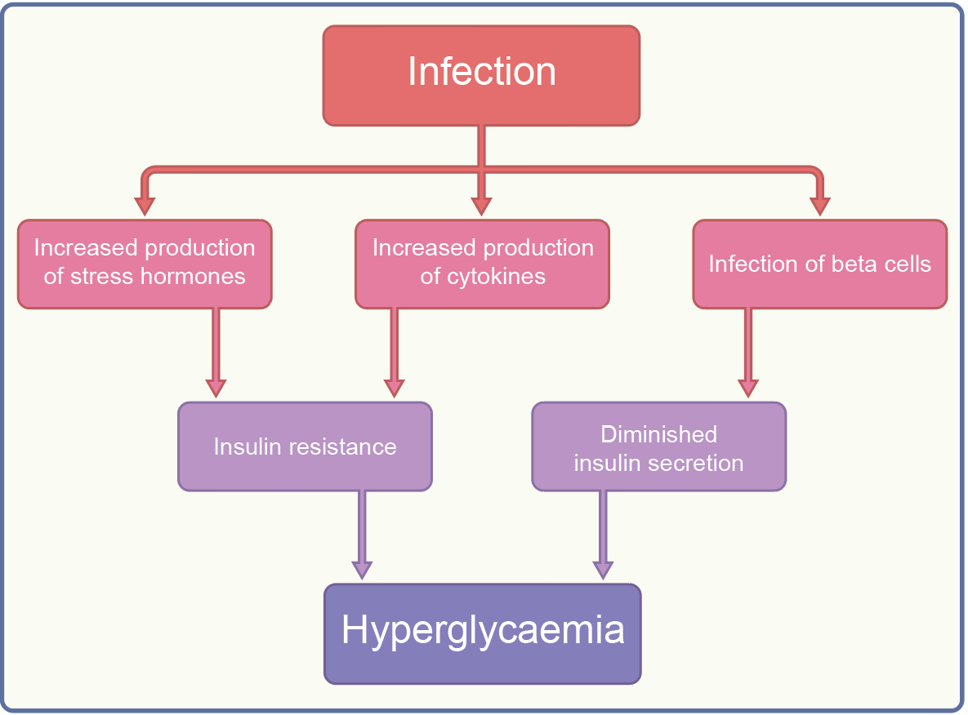
Mechanisms by which infection may worsen glycaemia
Holt et al (2024) Diabetologia DOI 10.1007/s00125-024-06102-x
©The Authors 2024. Distributed under the terms of the CC BY 4.0 Attribution License (http://creativecommons.org/licenses/by/4.0/)

Slide 2
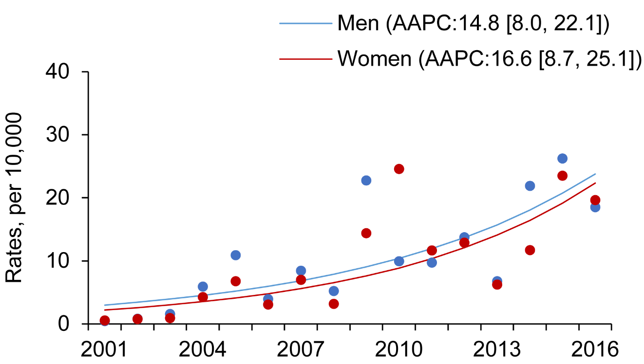
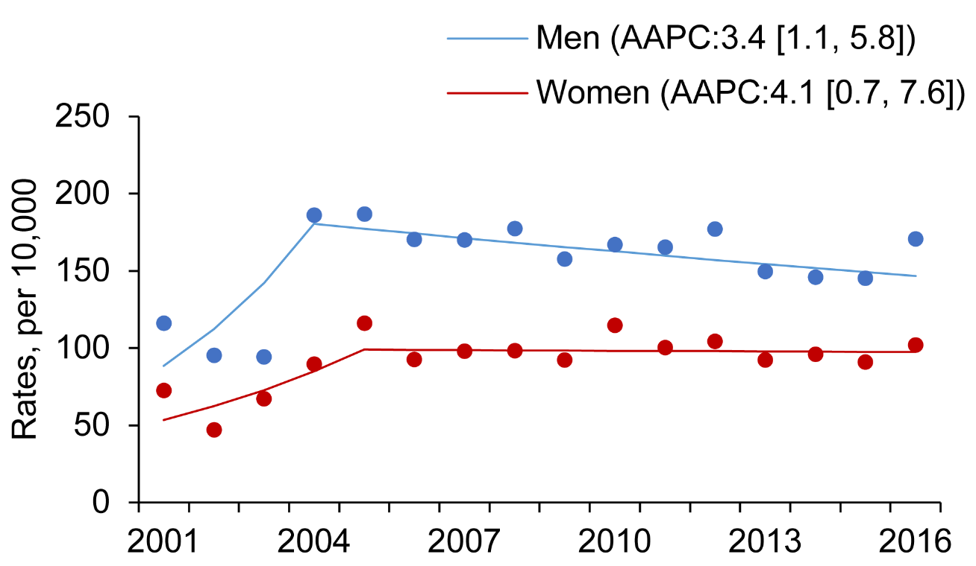
Age-standardised rates of hospitalisation (per 10,000 people) for influenza (a) and community-acquired pneumonia (b) in men and women with diabetes in Hong Kong between 2001 and 2016
a
b
Holt et al (2024) Diabetologia DOI 10.1007/s00125-024-06102-x
©The Authors 2024. Distributed under the terms of the CC BY 4.0 Attribution License (http://creativecommons.org/licenses/by/4.0/)

Slide 3
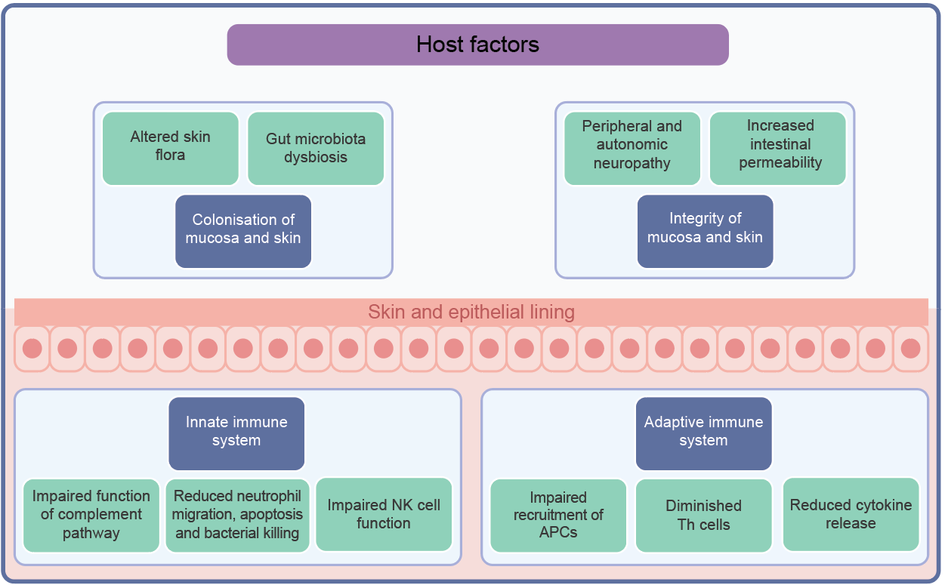
Mechanisms that increase the risk of infection in people with diabetes
Holt et al (2024) Diabetologia DOI 10.1007/s00125-024-06102-x
©The Authors 2024. Distributed under the terms of the CC BY 4.0 Attribution License (http://creativecommons.org/licenses/by/4.0/)

