Slide 1
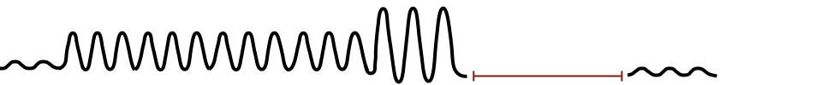
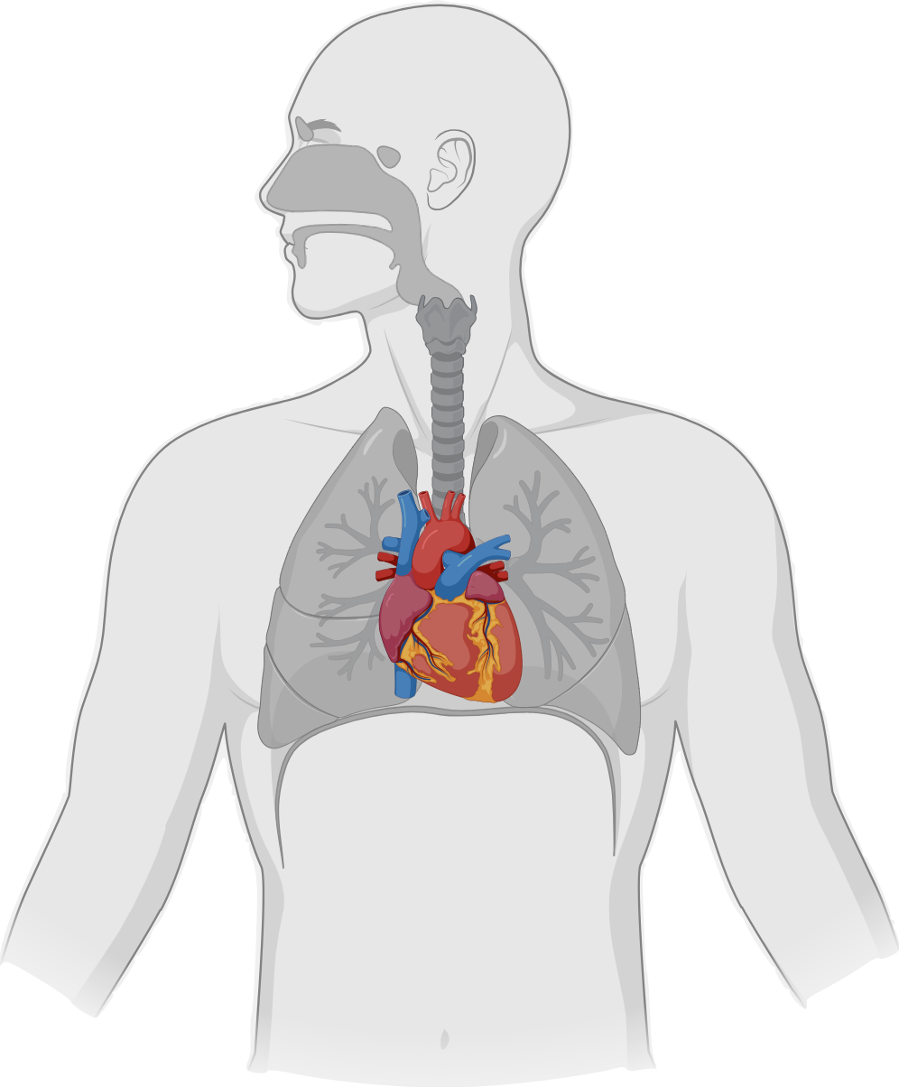
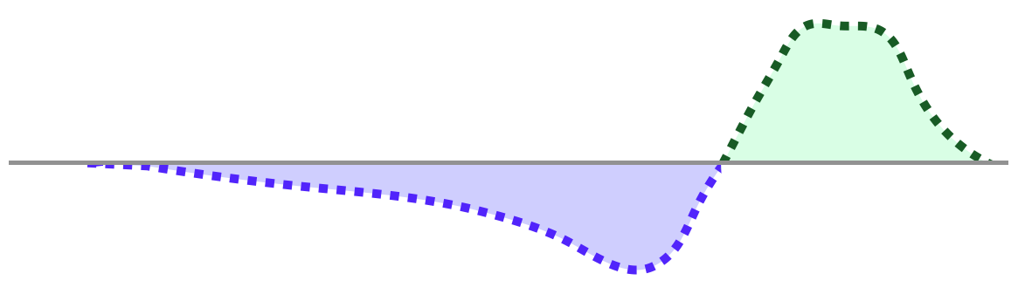

Introducing a Free-Breathing MRI Method to Assess Perioperative Myocardial Oxygenation and Function
RATIONALE
Text
Induction of general anaesthesia (GA) bears many potential triggers for perioperative myocardial ischaemia including acute perturbations of blood gases that occur with alterations in breathing and ventilation patterns.
Breathing Patterns Simulating GA Induction
Myocardial oxygen-supply mismatch can now be spatially mapped – continuously and non-invasively - using free-breathing oxygenation-sensitive cardiovascular magnetic resonance imaging.
Baseline
Paced Breathing
(RR=14, 150s)
5 Deep Breaths
Apnoea
Recovery
Myocardial Oxygenation (%)
STUDY
Luxury
Oxygenation
32 healthy awake controls were prospectively recruited to perform a voluntary breathing manoeuvre simulating the induction of GA in an MRI consisting of paced breathing for 180s, followed by five deep breaths, then apnoea.
Deoxygenation
KEY FINDINGS
Breathing manoeuvres simulating induction of GA cause dynamic alterations of myocardial oxygenation. It is warranted to implement these new imaging techniques to investigate perioperative perturbations of myocardial tissue oxygenation.
Guensch et al. Eur J Anaesthesiol. Month Year
@EJA_Journal, @DGuensch
Copyright © 2021 Copyright © European Society of Anaesthesiology and Intensive Care. Unauthorized reproduction of this abstract is prohibited.

