Slide 1
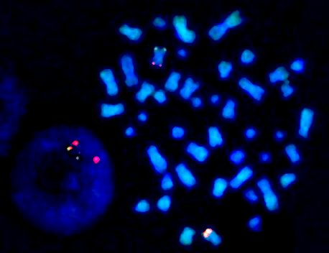

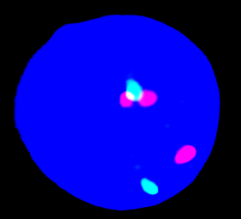
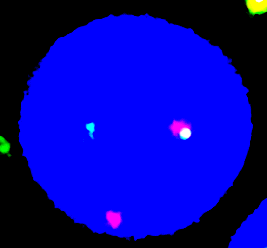
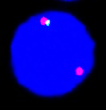
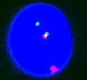
Supplemental Figure 1
A
B
C
D
Patient 6: NUP98::KMT2A
Patient 1: NUP98::NSD1
Patient 3: NUP98::NSD1
Patient 4: NUP98::NSD1
derChr11
derChr11
KMT2A chr11
E
F
G
Patient 5: NUP98::NSD1
Patient 7: NUP98::KDM5A
Patient 8: NUP98::KMT2A
H
NSD1 (5)
EMX1 (1)
KDM5A (1)
KMT2A (1)
Cen
Tel
11
12
13
14
15

Slide 2
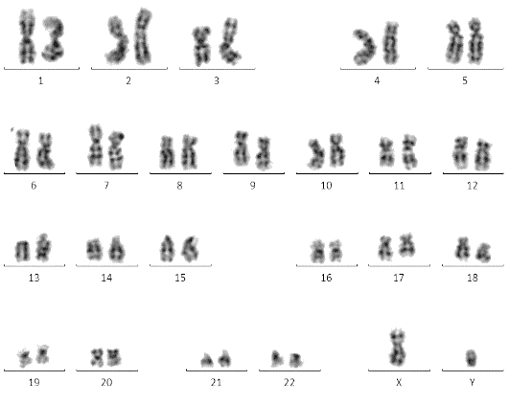
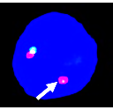
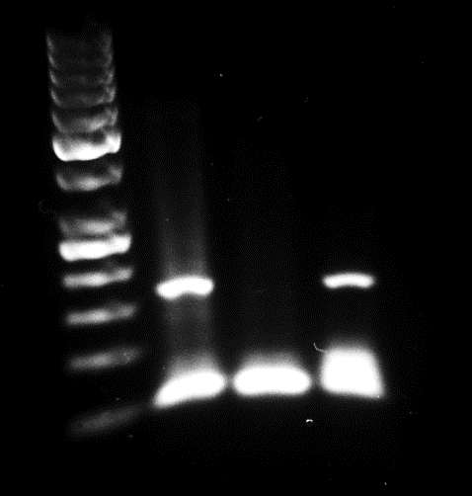
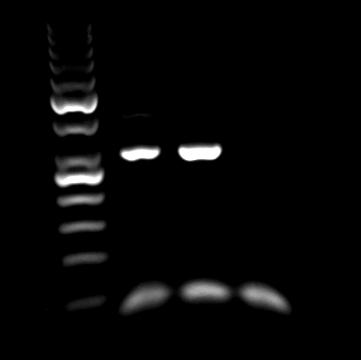
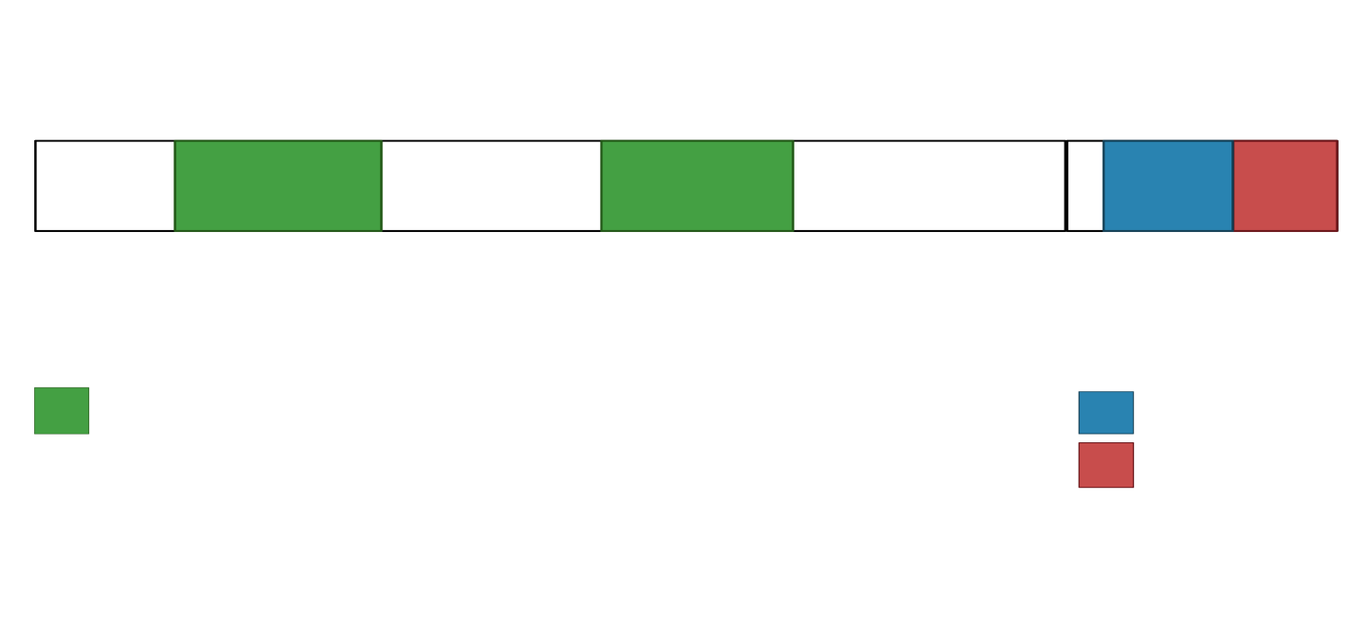
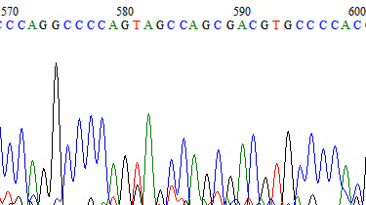
Supplemental Figure 2
A
B
C
NUP98::EMX1
GAPDH
NE+
NE-
NE+
NE-
300bp
250bp
200bp
150bp
D
E
NUP98 exon 12
EMX1 exon 2
NUP98 exons 1-12
EMX1 exons 2-3
1
469
192
290
NUP98 NM_016320
EMX1 NM_004097
FG repeats
Homeobox
Disordered

Slide 3
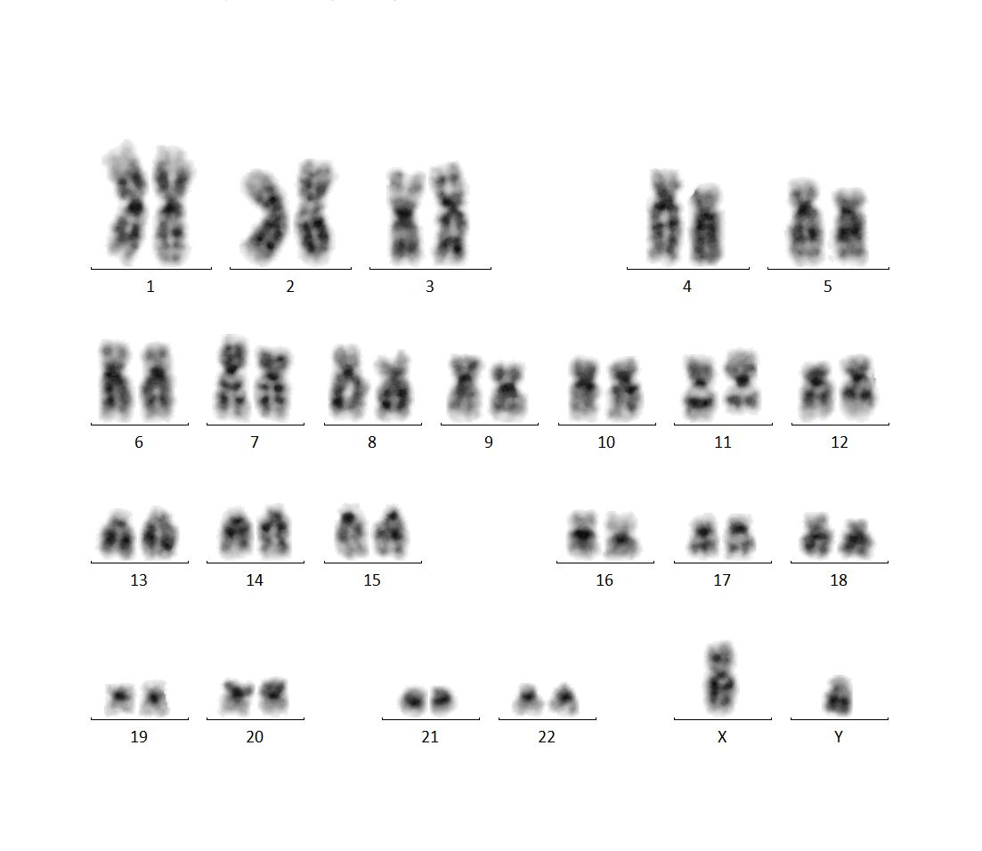
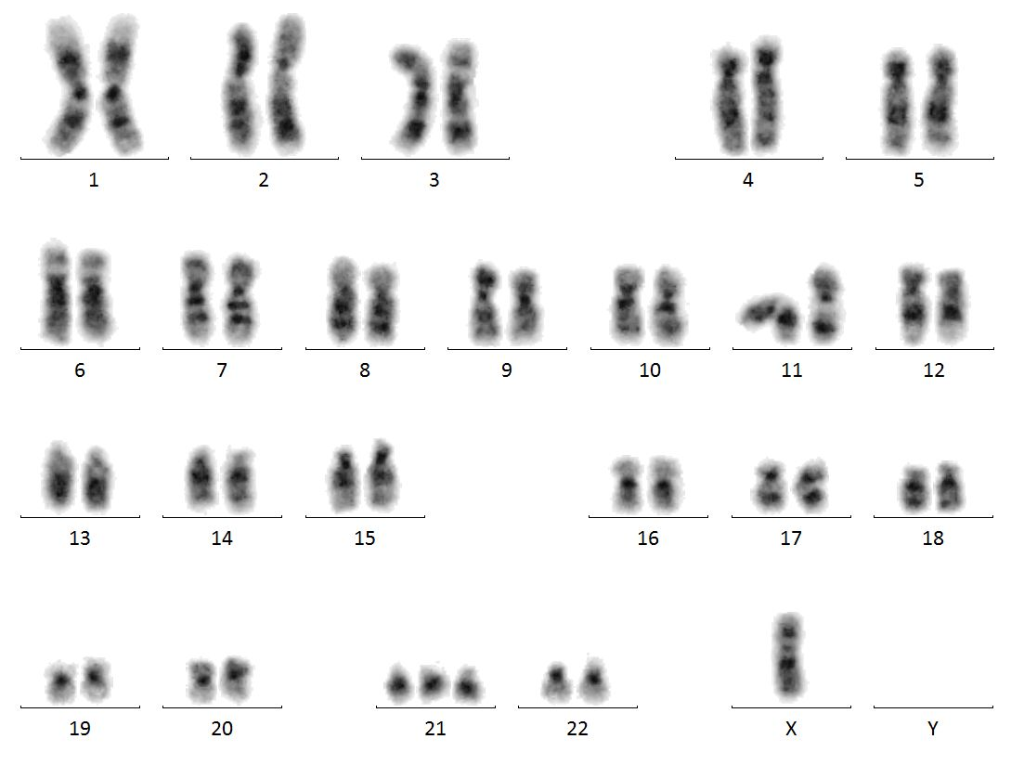
Supplementary Figure 3
A
B
Patient 7: 47,XY,inv(11)(q13.5q25),del(12)(p13),+21c[2]/46,X,-Y,inv(11)(q13.5q25),del(12)(p13),+21c[18]
Patient 6: 46,XY,inv(11)(p15q23)[18]/46,XY[2]
NUP98::KMT2A
NUP98::KDM5A

