Slide 1
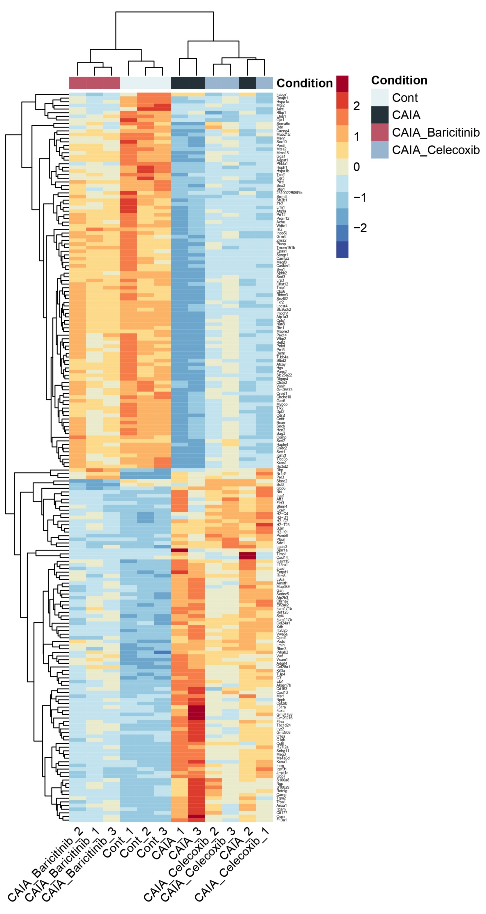
Supplementary Figure 1. Heatmap of top-200 significantly altered genes among the four groups. The heatmap without gene names was shown in Fig. 3B.

