Slide 1
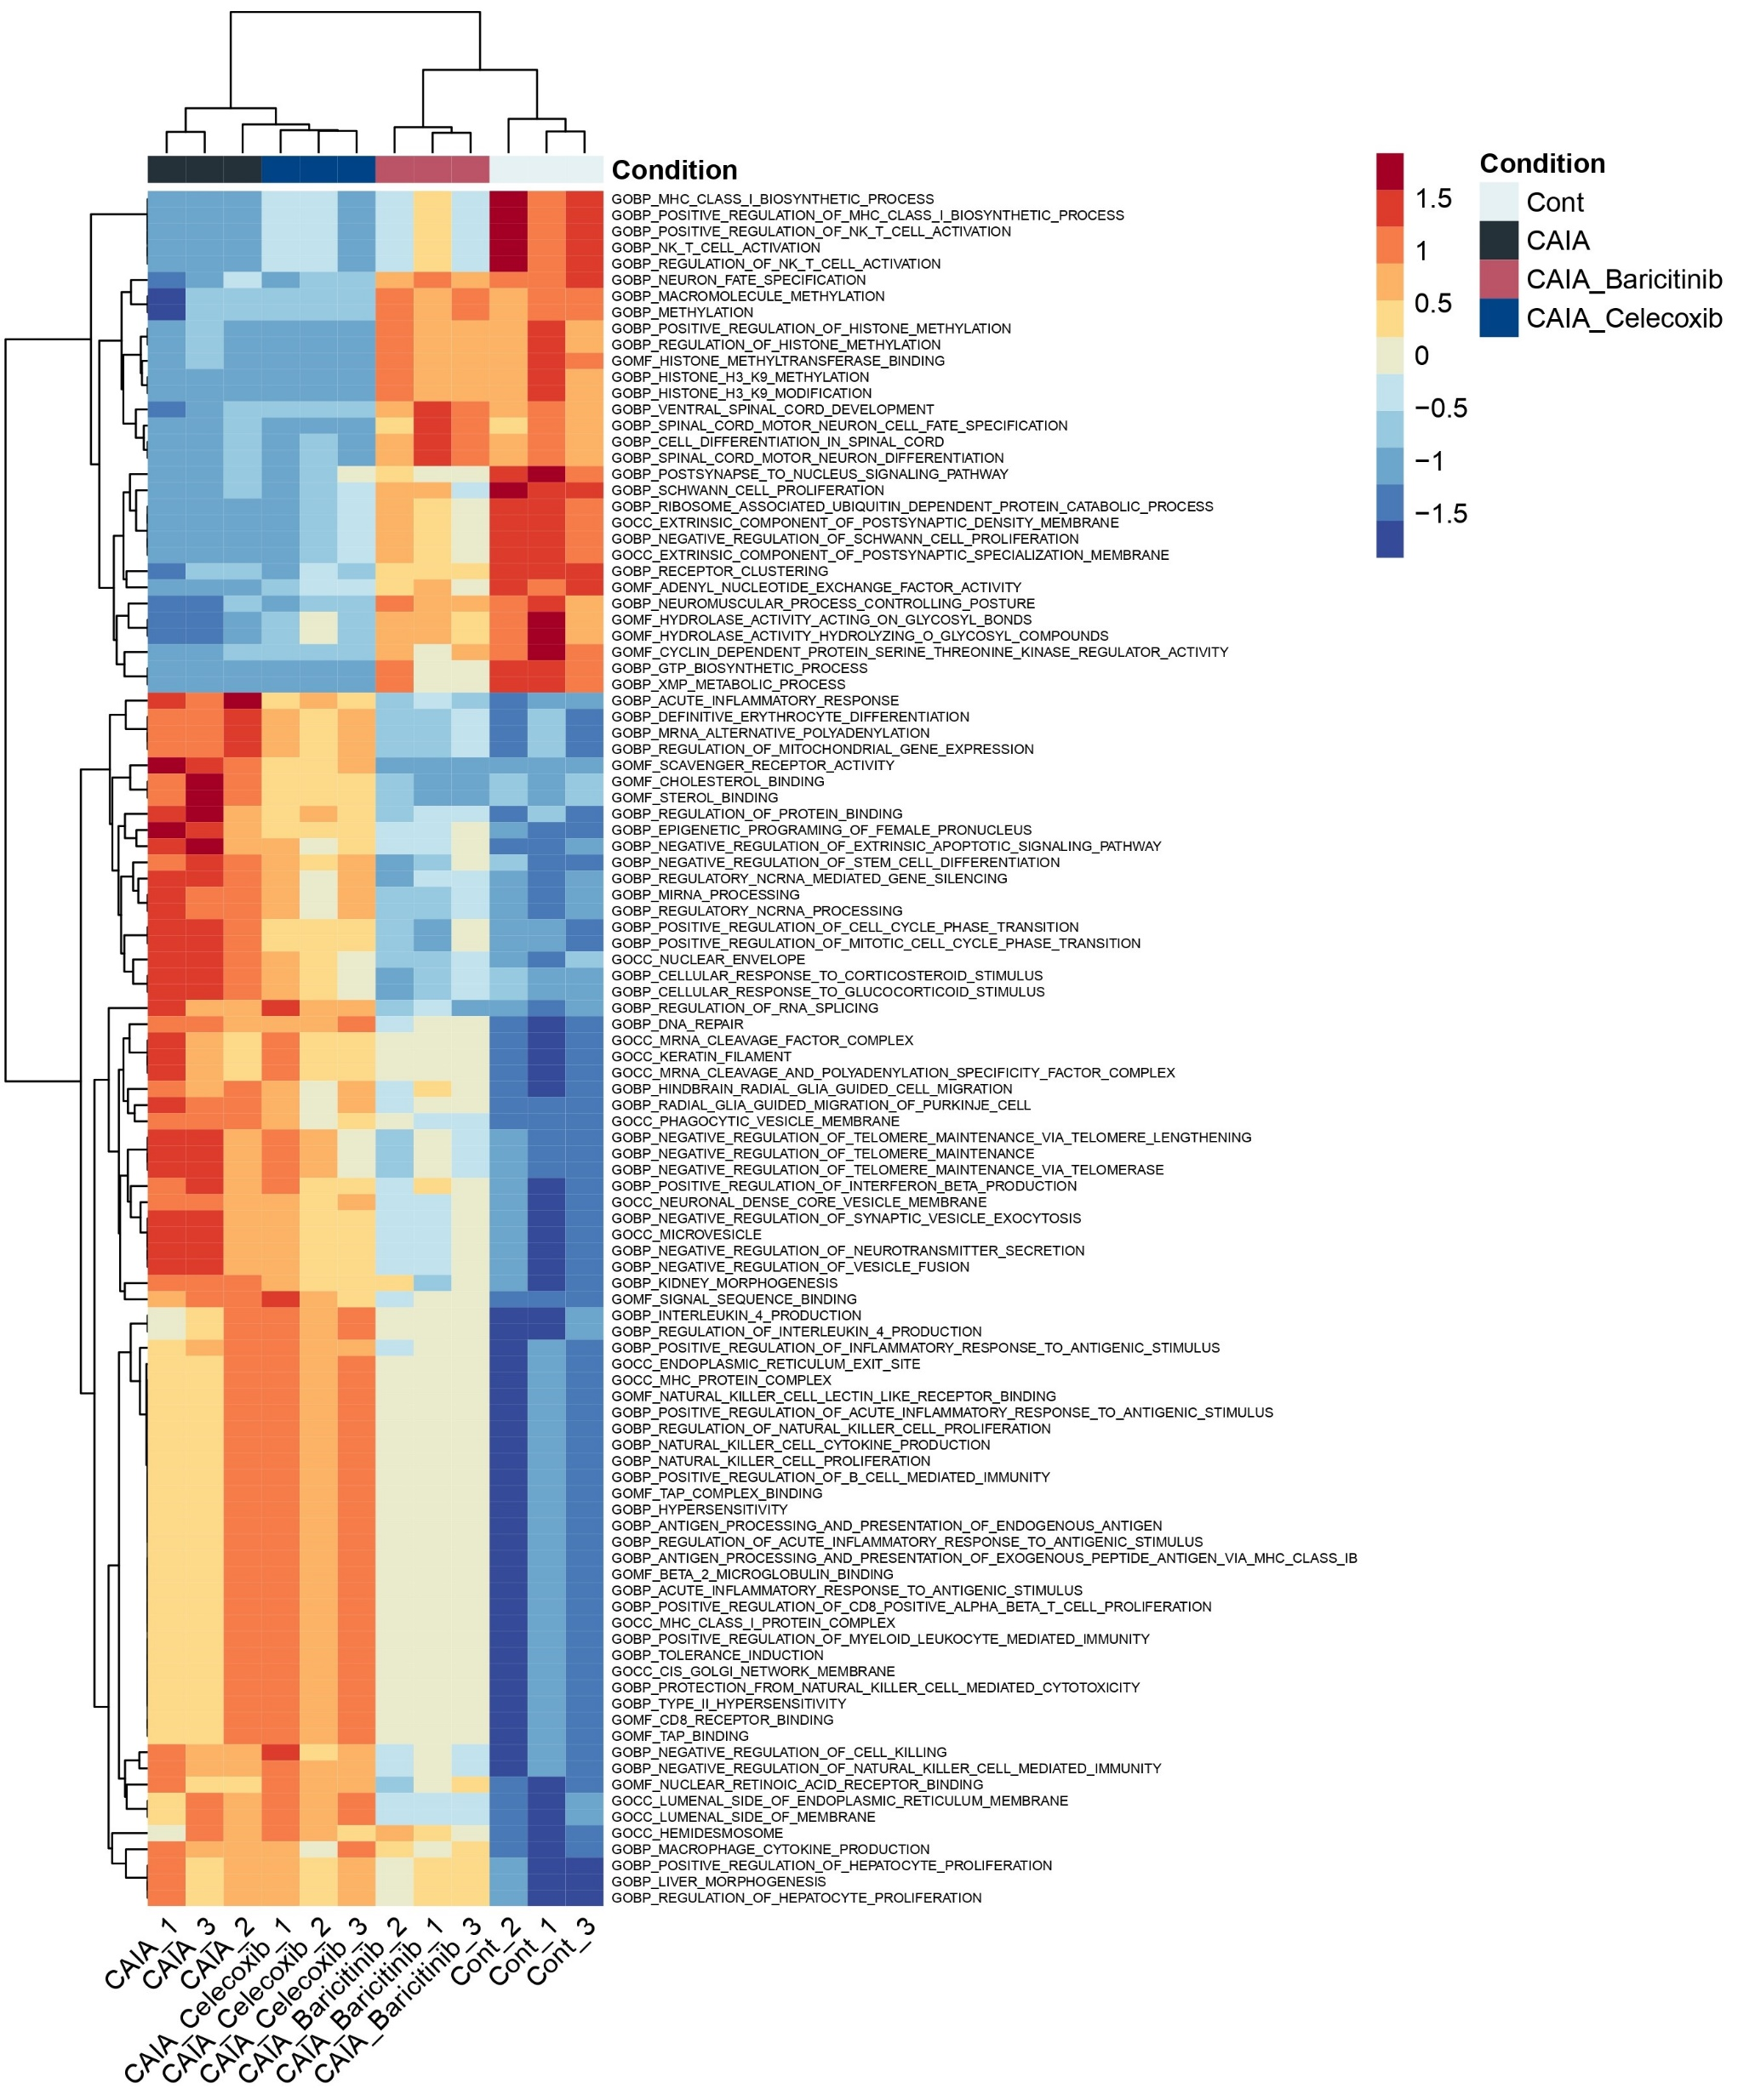
Supplementary Figure 2. Heatmap of top-106 significantly altered GO biological process terms among the four groups. The heatmap without term names was shown in Fig. 3D.

