Slide 1
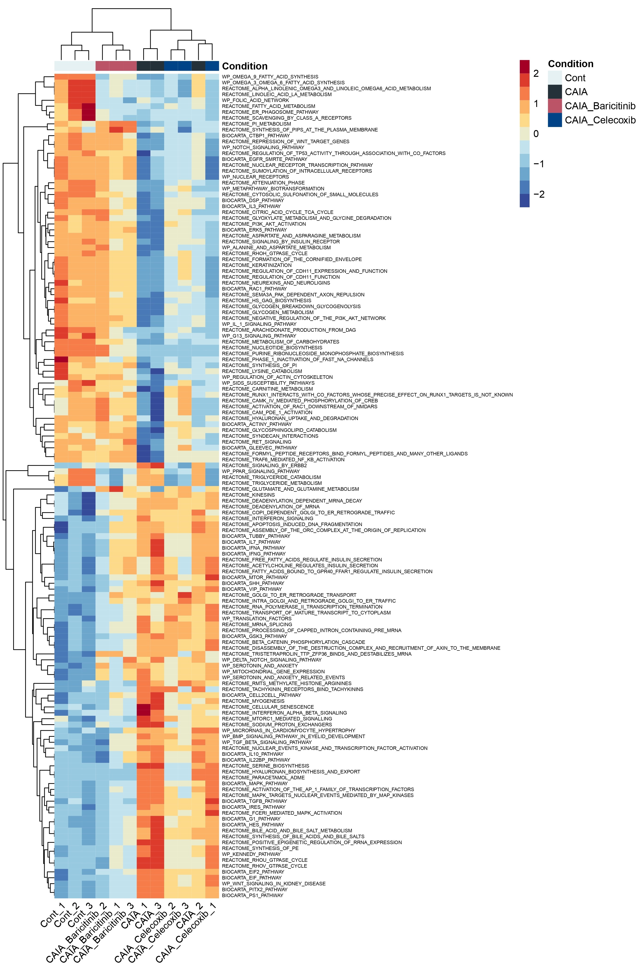
Supplementary Figure 3. Heatmap of top-140 significantly altered pathways among the four groups. The heatmap without pathway names was shown in Fig. 3F.

