Slide 1
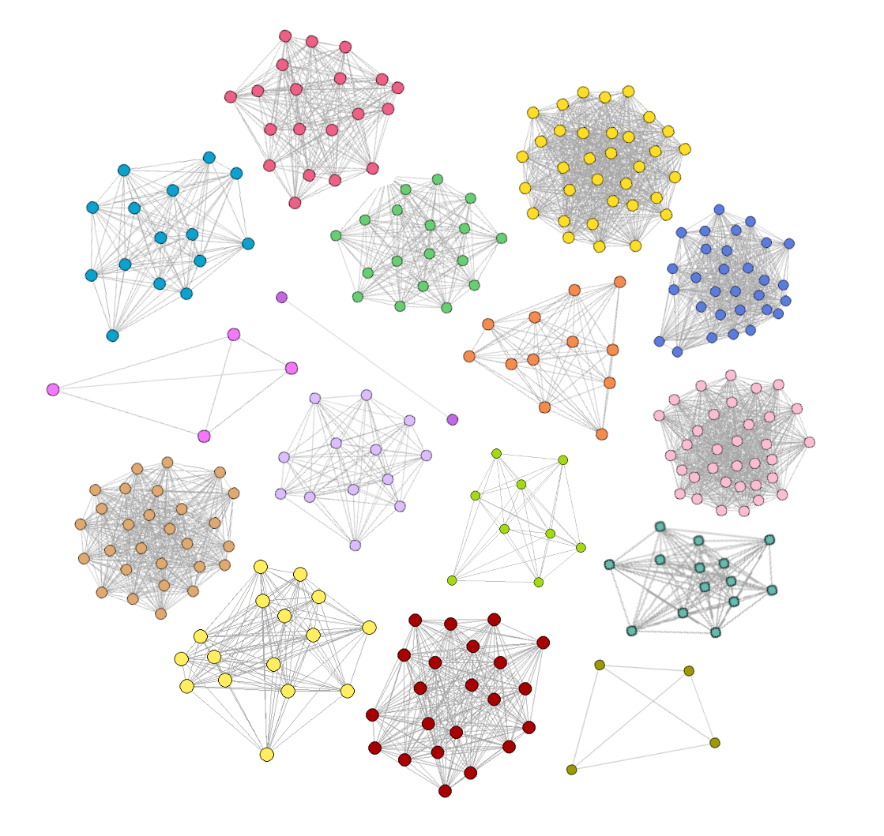
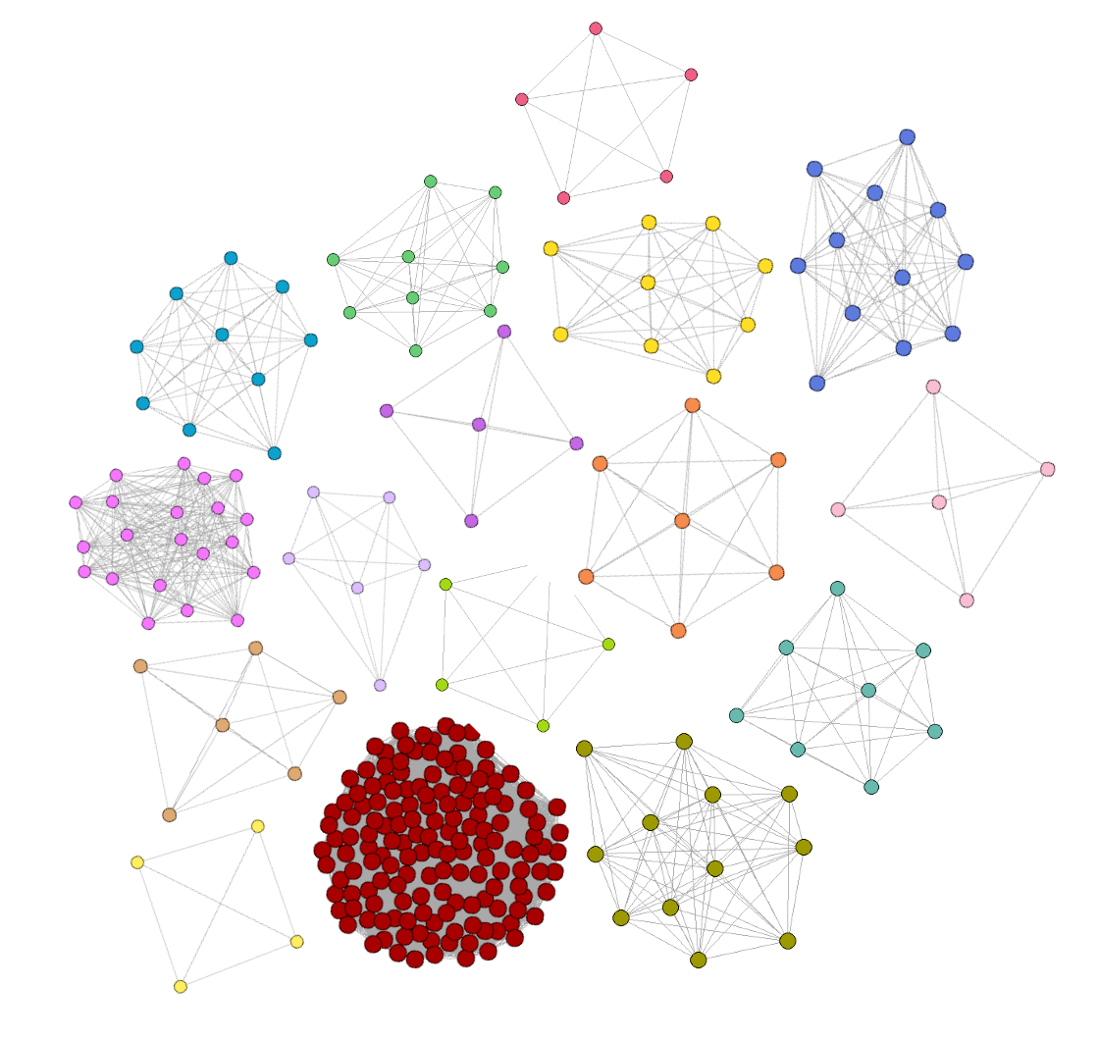
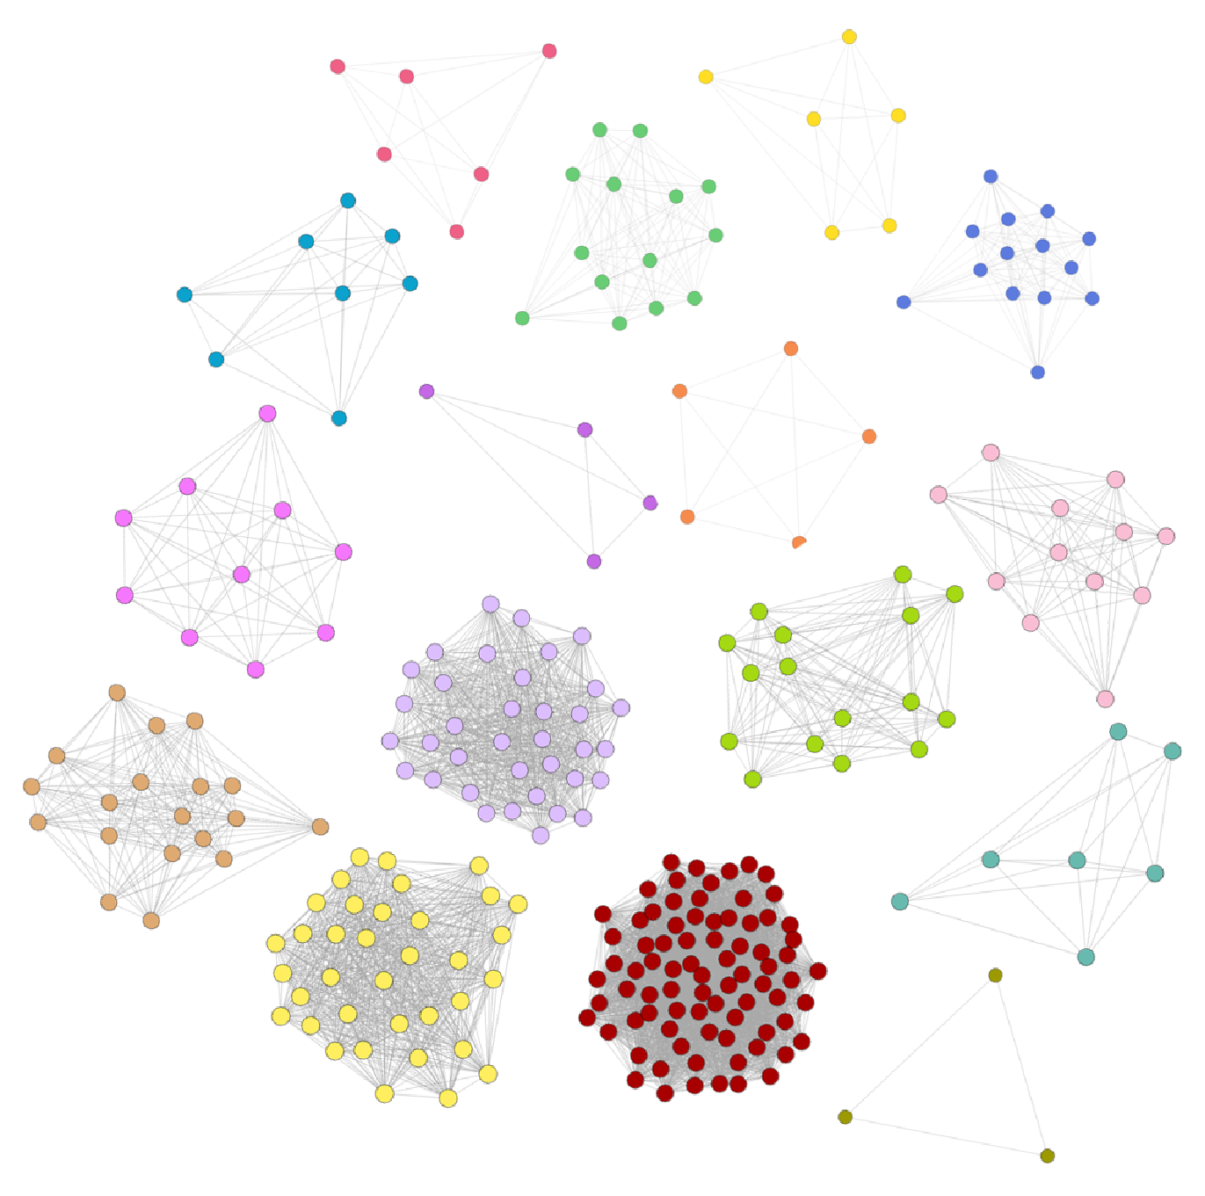
A. Chem-DSN
B. Pharm-DSN
C. Drug similarity fusion network
DSN cluster
Supplementary Figure1. Spectral clustering of drug fusion networks.

Slide 2
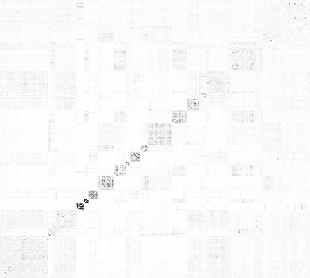
Supplementary Figure2. Heatmaps of IC50-SN by spectral clustering

