Slide 1
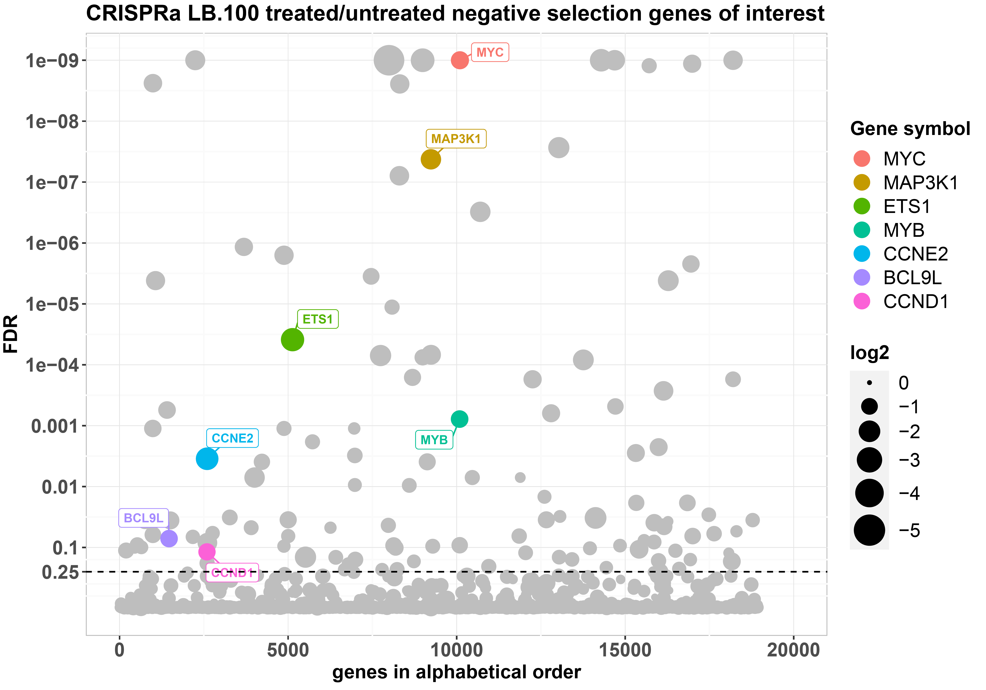
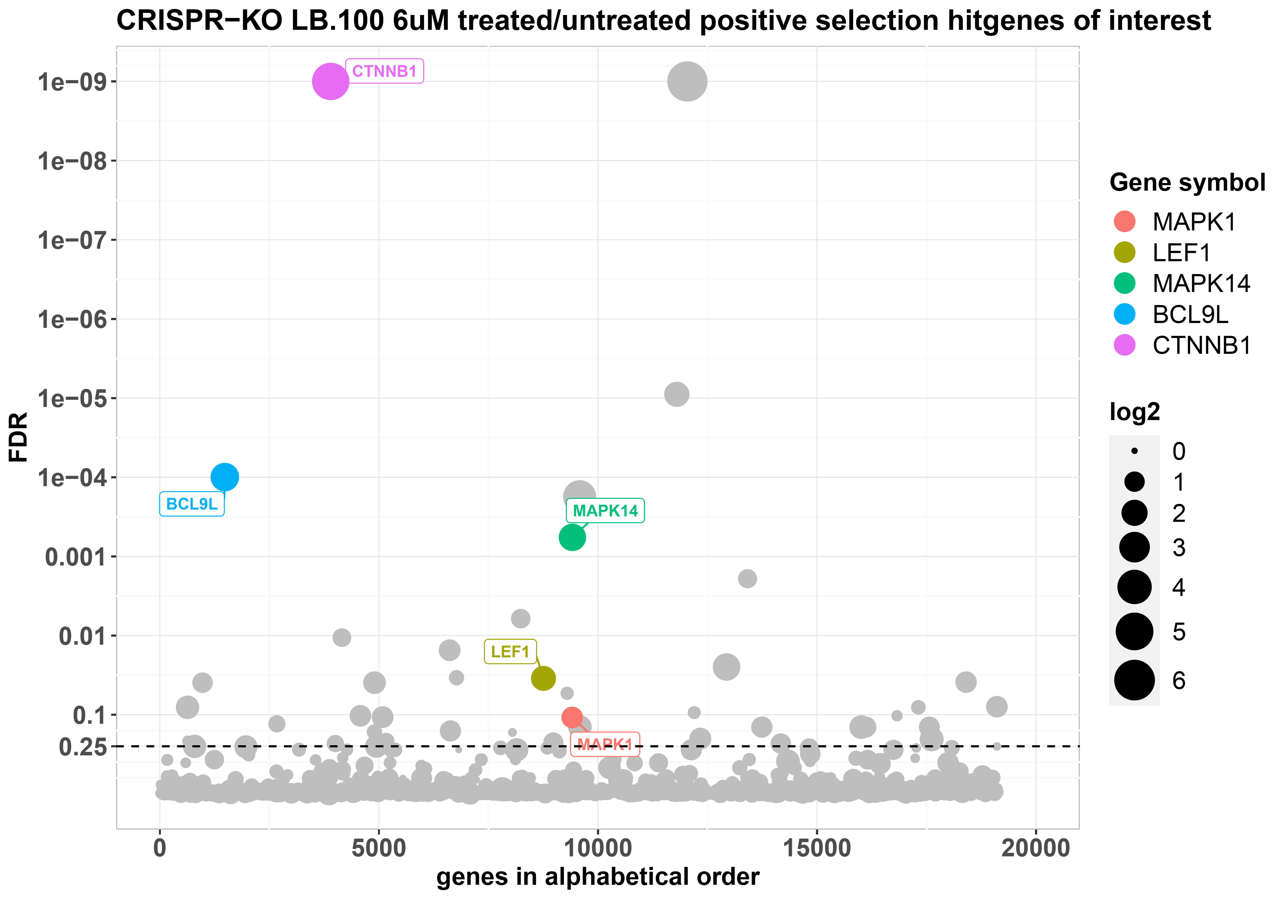
Supplementary figure S2
A
HT-29 CRISPRa: negative selection in the presence of LB-100
B
SW-480 CRISPR-KO: positive selection in the presence of LB-100

Slide 2
Figure S2: Genome-wide CRISPR screens identify genes modulating LB-100 toxicity in CRC cells
(A) The bubble plot shows genes whose overexpression in the CRISPRa screen was selectively toxic for LB-100-treated (5 µM) cells comparing to untreated controls. 6 different gRNAs per gene were tested in 3 independent replicates. Cells on both conditions were grown for 12 population doublings before DNA harvesting and sequencing. Hits were called based on 0.25 false discovery rate (FDR) and at least 1 log2 fold-change difference between treated and untreated samples. FDR values < 10e-10 are truncated to 10e-10. Only the hits mentioned on the main text are named and colored, the full list of hits is presented on the supplementary table S2. (B) The bubble plot shows genes whose knockout in the CRISPR-KO screen was enriched in LB-100 (6 µM) treated cells comparing to untreated (DMSO) controls. 4 different gRNAs per gene were tested in 3 independent replicates. Cells on both conditions were grown for at least 6 population doublings before DNA harvesting and sequencing. Hits were called based on 0.25 false discovery rate (FDR) and at least 1 log2 fold-change difference between treated and untreated samples. FDR values < 10e-10 are truncated to 10e-10. Only the hits mentioned on the main text are named and colored, the full list of hits is presented on the supplementary table S3.

