Slide 1
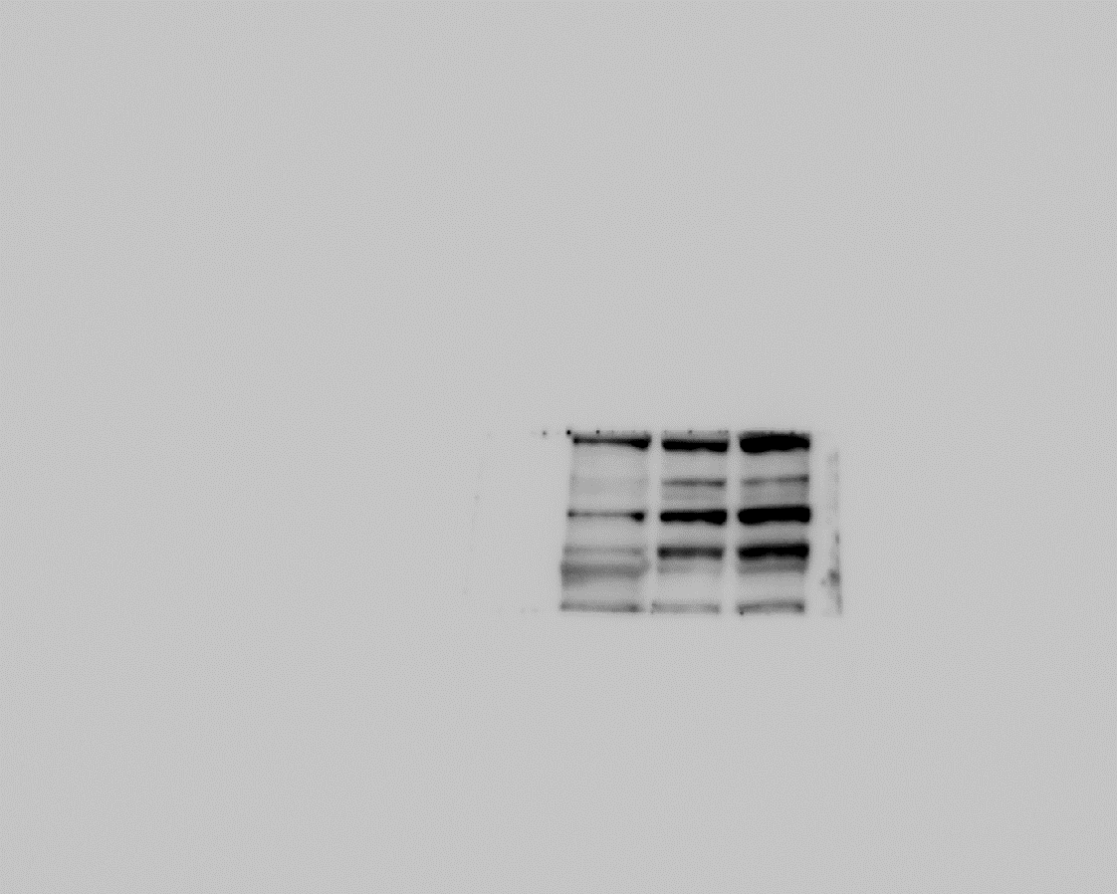
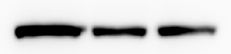
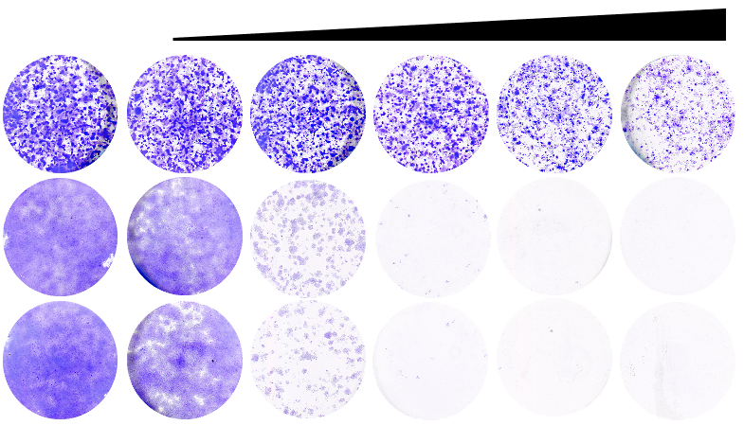
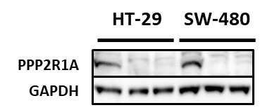
Supplementary figure S3
A
E
B104 N-Myc C78
B104 N-Myc C6A
B104 Parental
N-Myc
GAPDH
B
LB-100 (µM)
1
2
3
4
5
B104 Parental
B104 N-Myc C78
B104 N-Myc C6A
C
D
(µM)
(µM)

Slide 2
Figure S3: High N-Myc levels sensitize neuroblastoma cells to LB-100, and PP2A knockdown sensitizes CRC cells to WEE1 inhibition
(A) Western blots comparing N-Myc levels in isogenic neuroblastoma models. GAPDH was used as a loading control. (B) long-term viability assays compares the toxicity of LB-100 across these neuroblastoma models. LB-100 was refreshed every 2-3 days, and the cells were grown for 10 days before fixing, staining, and imaging. (C) Western blots show the knockdown of PPP2R1A in HT-29 and SW-480 cells. GAPDH was used as a loading control. (D) Dose-response assays show the effect of Adavosertib after PPP2R1A knockdown compared to a control shRNA in HT-29 and SW-480 cells. Cell viability was estimated by resazurin fluorescence after 5 days in the presence of the drug or DMSO control. The normalized values are plotted. (E) The heat map shows all “Hallmarks” and “KEGG” molecular signatures significantly enriched by LB-100 (4 µM), calyculin A (5 nM), or okadaic acid (10 nM) in HT-29 and SW-480 cells after 8 hours. Asterisks indicate significance level (* p-value <0.05, ** p-value <0.01, *** p-value <0.001).

