Slide 1
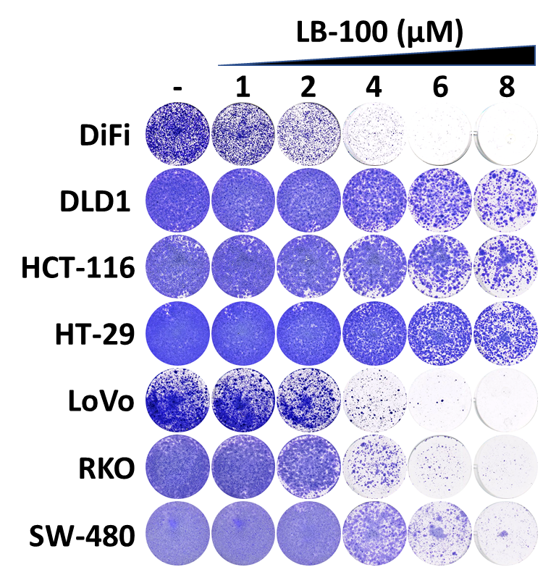
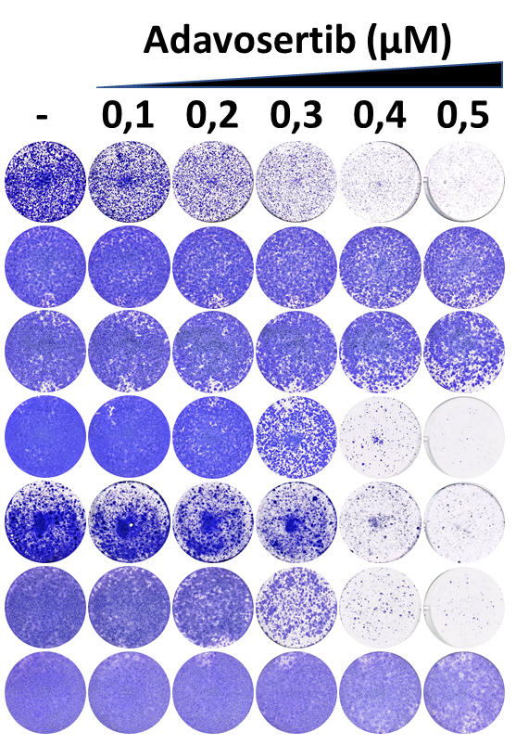
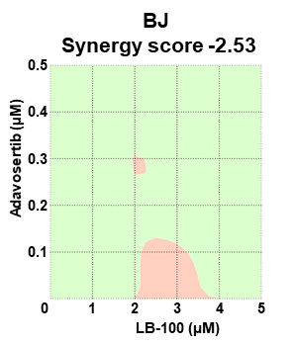
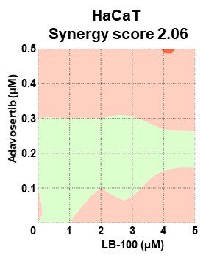
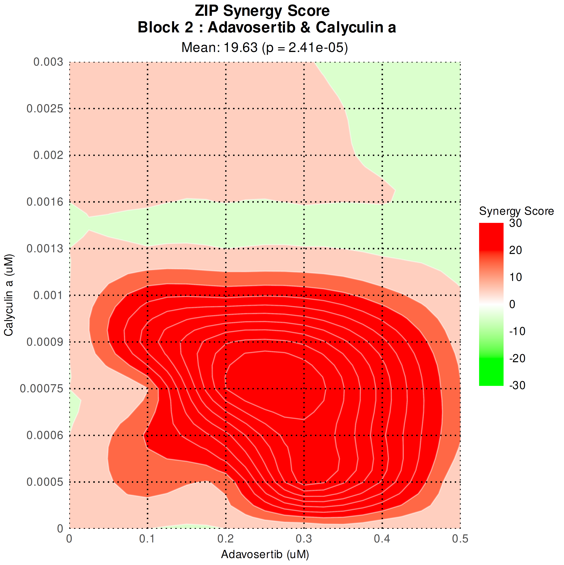
Supplementary figure S4
CRC
A
B
(µM)
C
D
E
30
20
10
0
-10
-20
(µM)
(µM)
-30

Slide 2
Figure S4: Combined toxicity of LB-100 and Adavosertib in CRC models
(A) Dose-response assays show the effect of Adavosertib in 7 CRC models. Cell viability was estimated by resazurin fluorescence after 5 days in the presence of the drug or DMSO control. The normalized values are plotted. (B) Long-term viability assays show 7 CRC models treated with LB-100 or Adavosertib at the indicated concentrations. Treatments were refreshed every 2-3 days, and the cells were grown for 10-14 days before fixing, staining, and imaging. (C) IncuCyte-based proliferation assays from 7 CRC models in the absence or presence of LB-100, Adavosertib, or the combination at the indicated concentrations. (D) Dose-response assays show the toxicity of LB-100 and Adavosertib in BJ and HaCaT cells compared to the average across the 7 CRC cell lines listed in the supplementary table S1. Cell viability was estimated by resazurin fluorescence after 5 days in the presence of the drug or DMSO control. The normalized values are plotted. (E) Synergy matrices and scores for the combination of LB-100 and Adavosertib in BJ and HaCaT cells. Cells were treated with 5 concentrations of LB-100 (1, 2, 3, 4, and 5 µM) or Adavosertib (100, 200, 300, 400, and 500 nM) and all respective permutations for 4 days. The percentage of cell viability for each condition was estimated by resazurin fluorescence and normalized to DMSO controls. Synergyfinder.org web tool was used to calculate the ZIP synergy scores and generate the plots.

