Slide 1
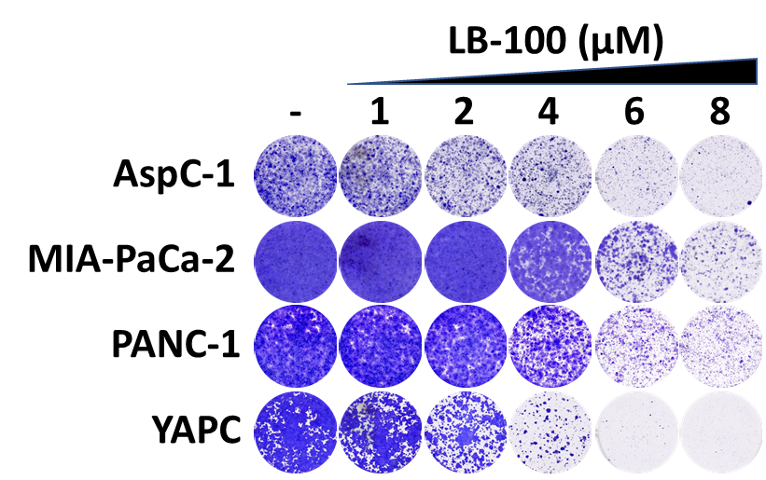
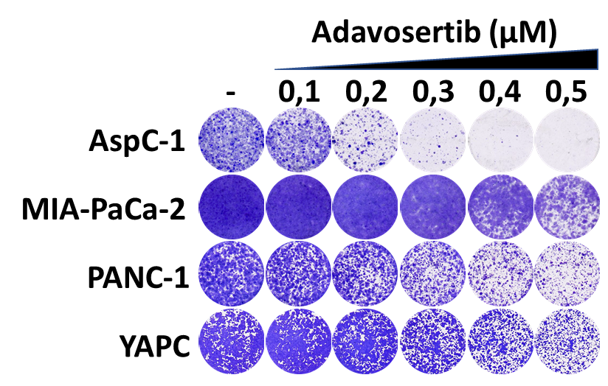
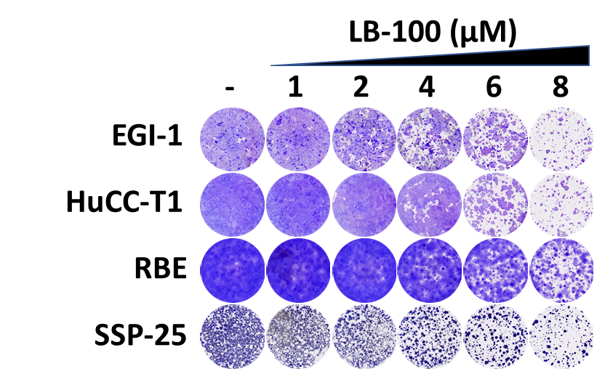
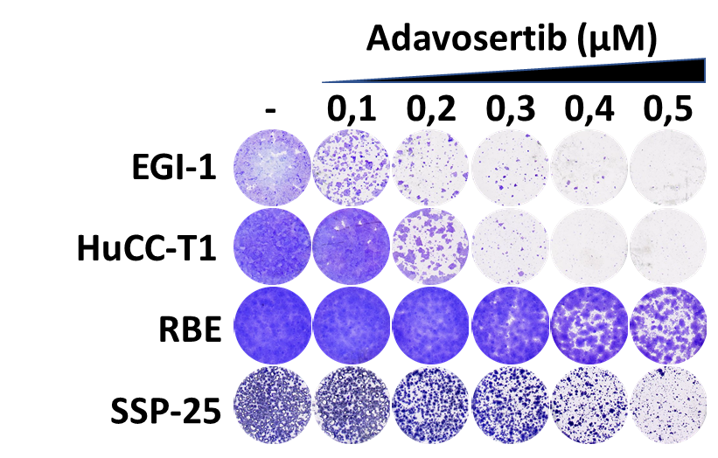
Supplementary figure S5
PDAC
A
C
E
(µM)
(µM)
CCA
B
D
F
(µM)
(µM)

Slide 2
Figure S5: Combined toxicity of LB-100 and Adavosertib in PDAC and CCA models
(A) and (B) Dose-response assays show the effect of LB-100 or Adavosertib in 4 PDAC and 4 CCA models, respectively. Cell viability was estimated by resazurin fluorescence after 5 days in the presence of the drug or DMSO control. The normalized values are plotted. (C) and (D) Long-term viability assays show 4 PDAC and 4 CCA models, respectively, treated with LB-100 or Adavosertib at the indicated concentrations. Treatments were refreshed every 2-3 days, and the cells were grown for 10-14 days before fixing, staining, and imaging. (E) and (F) IncuCyte-based proliferation assays from 4 PDAC and 4 CCA models, respectively, in the absence or presence of LB-100, Adavosertib, or the combination at the indicated concentrations.

