Slide 1
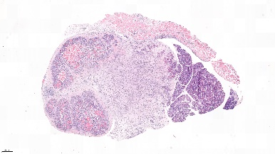
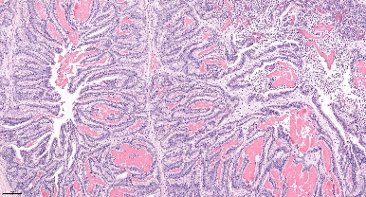
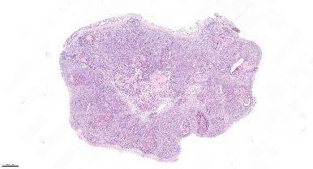
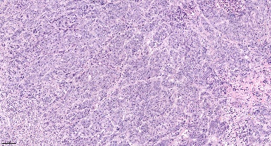
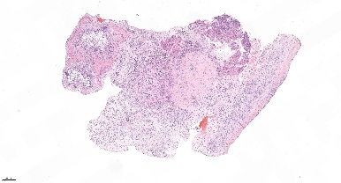
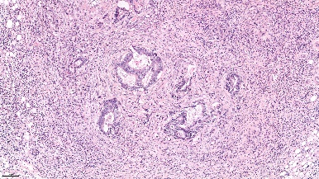
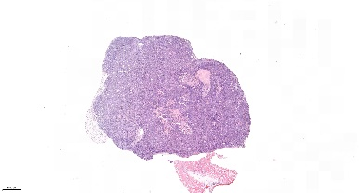
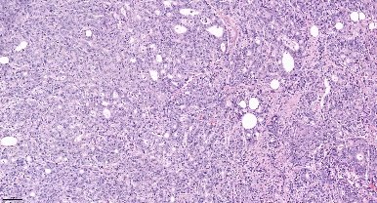
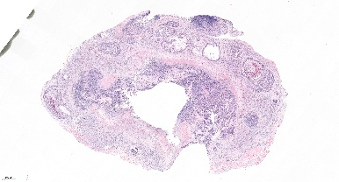
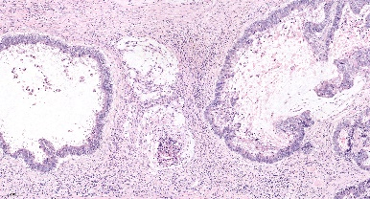
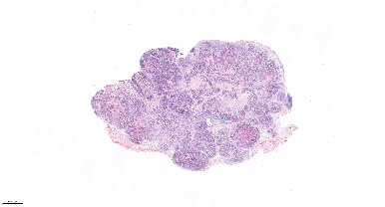
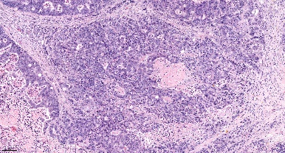
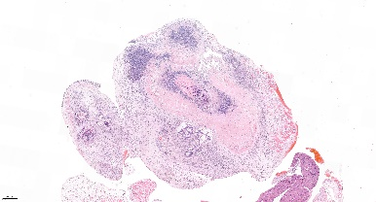
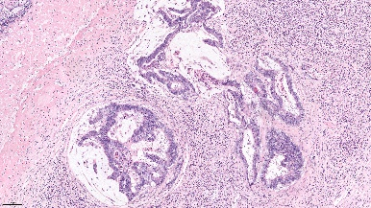
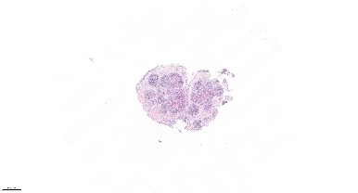
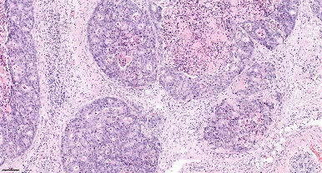
Supplementary figure S6
A
PDOX2
PDOX3
Vehicles
LB-100
Adavosertib
s
s
s
TC
s
TC
LB-100 + Adavosertib
B
PDOX1
PDOX2
PDOX3

Slide 2
Figure S6: LB-100 and adavosertib induce histological response in orthotopic CRC PDXs
(A) Representative Hematoxylin & Eosin (H&E) stainings at endpoint from PDOX2 and PDOX3 treated as indicated. Original magnification middle images: 15x, scale bar 1000 µm; right images: 200x. S indicates stroma, and the arrows point to the tumor-cell component. (B) Mice body weight variation of the 3 CRC PDXs across the experiments.

