Slide 1
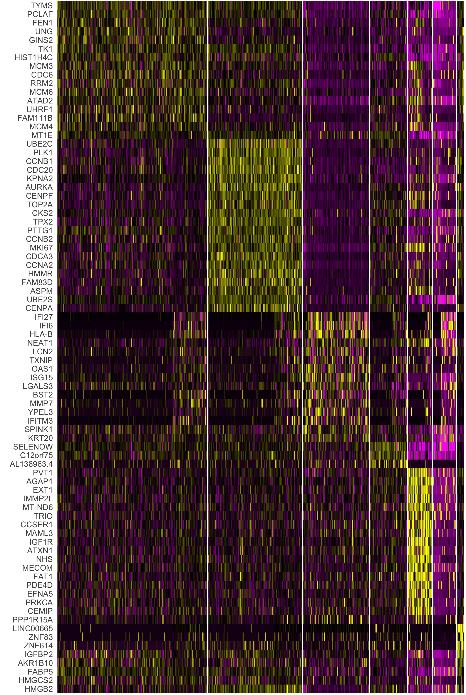
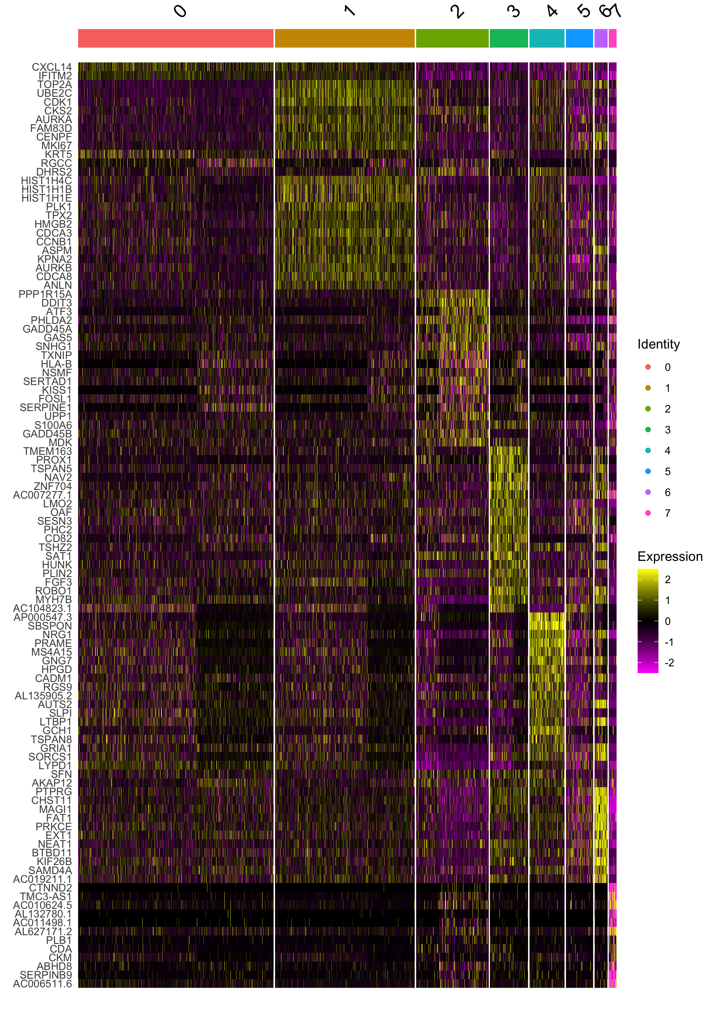
Supplementary figure S8
A
B
HT-29
SW-480
HT-29-R
SW-480-R
C
Marker genes HT-29
Marker genes SW-480
0
1
2
3
4
5
6
0
1
2
3
4
5
6
7
Expression
2
1
0
-1
-2

Slide 2
Figure S8: Acquired resistance to the combination of LB-100 and adavosertib suppressed malignant traits in CRC models
(A) IncuCyte-based proliferation assays from HT-29 and SW-480 parental and resistant cells in the absence or presence of the combination (LB-100 4 µM + adavosertib 400 nM). (B) Chromosome counting and representative chromosome spreads from HT-29 and SW-480 parental and resistant cells. Nocodazole was added for 3h to block cells in mitosis. Cells were harvested by mitotic shake-off for spreading. Over 40 (HT-29 and HT-29-R) or 50 (SW-480 and SW-480-R) spreads were counted per cell line. Asterisks indicate significance level (**** p-value <0.0001) by two-tailed Mann-Whitney test. (C) Heatmaps showing the marker genes of each cluster from the scRNAseq analyses of HT-29 and SW-480 cells.

