Slide 1
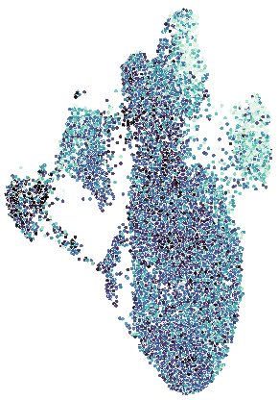
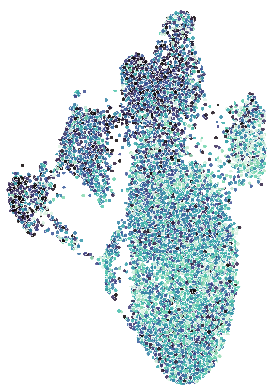


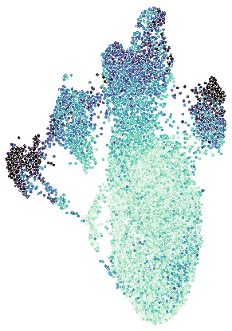
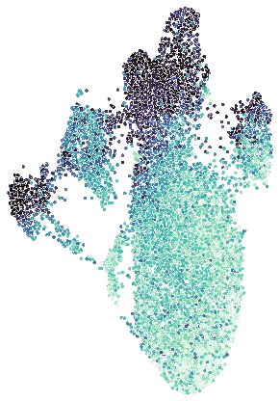


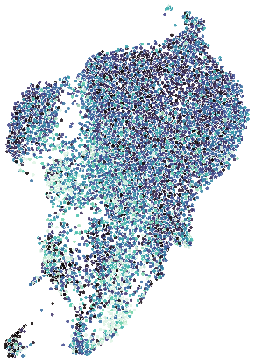
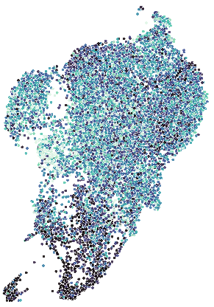


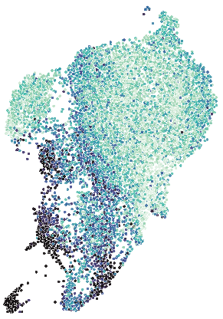
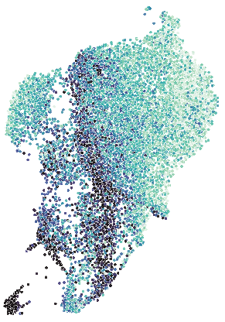


Supplementary figure S9
A
MAPK signaling
β-Catenin signaling
HT-29
HT-29-R
Myc targets
E2F targets
UMAP 2
UMAP 1
B
MAPK signaling
β-Catenin signaling
SW-480
SW-480-R
Myc targets
E2F targets
UMAP 2
UMAP 1

Slide 2
Figure S9: Single-cell RNAseq identify transcriptional signatures downregulated in CRC cells after acquired resistance to the combination of LB-100 and adavosertib
UMAP representations of HT-29 (A) and SW-480 (B) cells colored by the activity scores for the indicated pathways. UMAPs colored by sample of origin from both cell lines are present of the left for reference. The boxen plots show the pathway activity scores for parental (red) and resistant (blue) cells.

