Slide 1
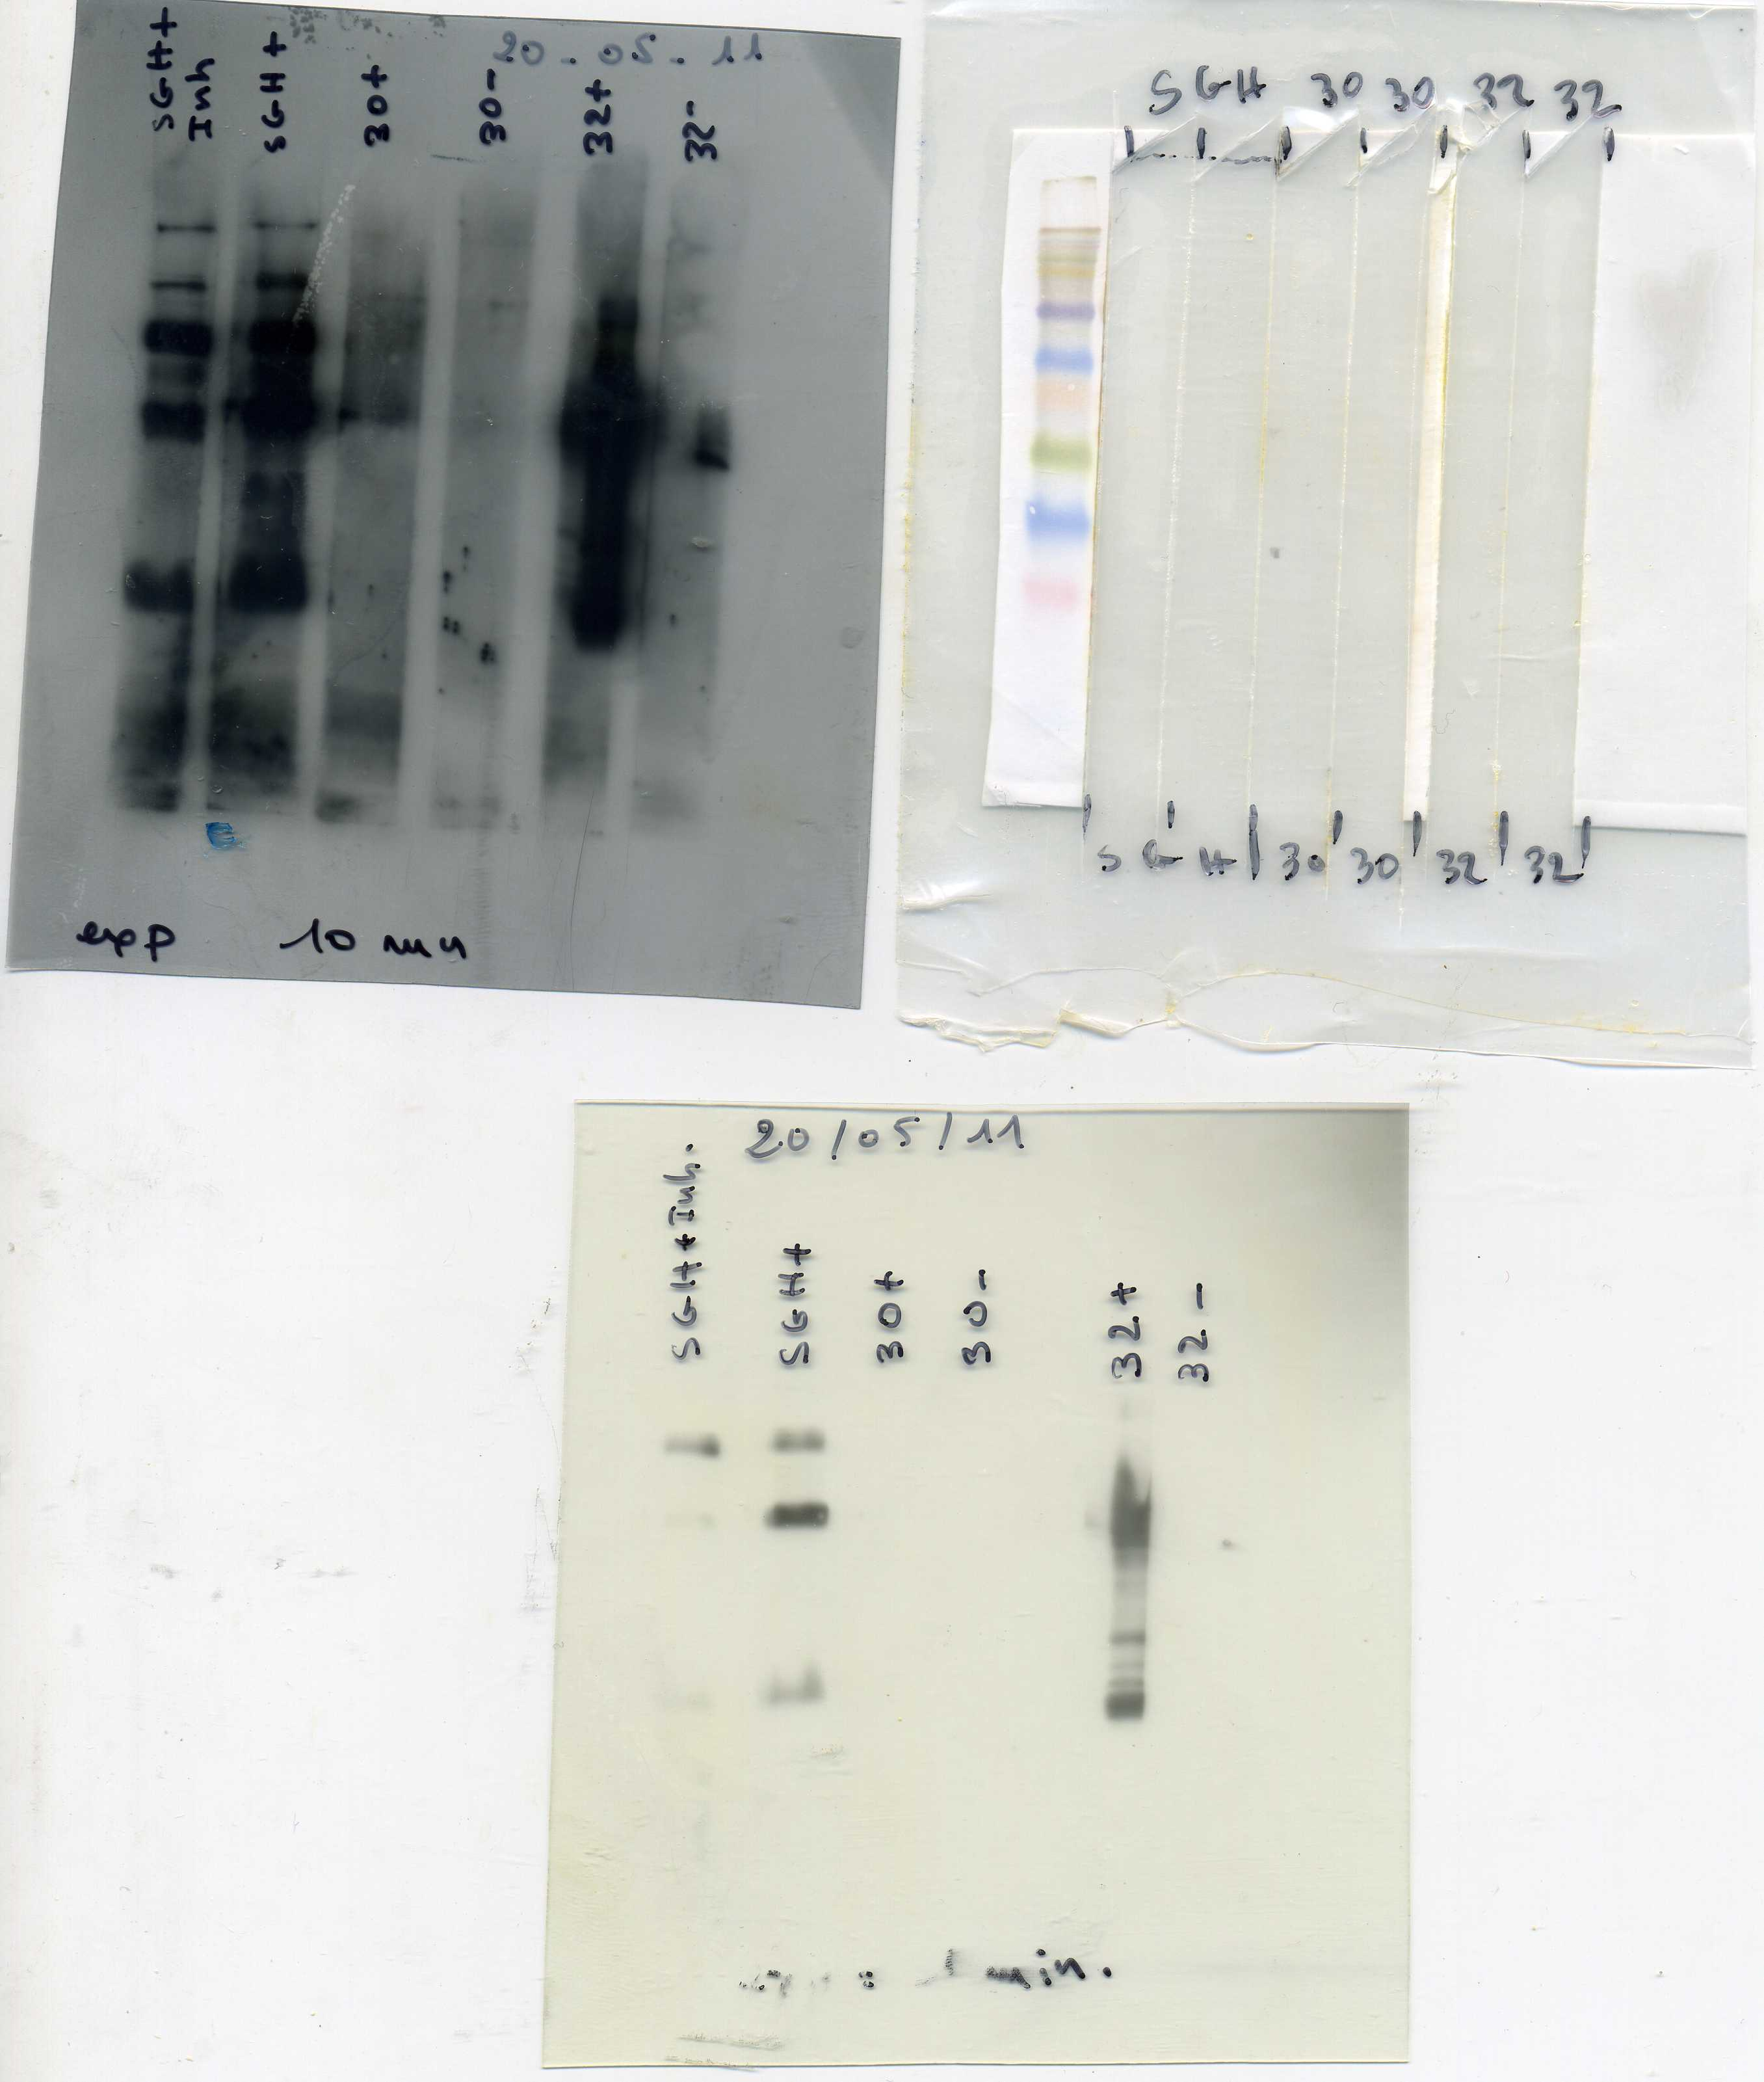
Original blot for Figure 7A

Slide 2
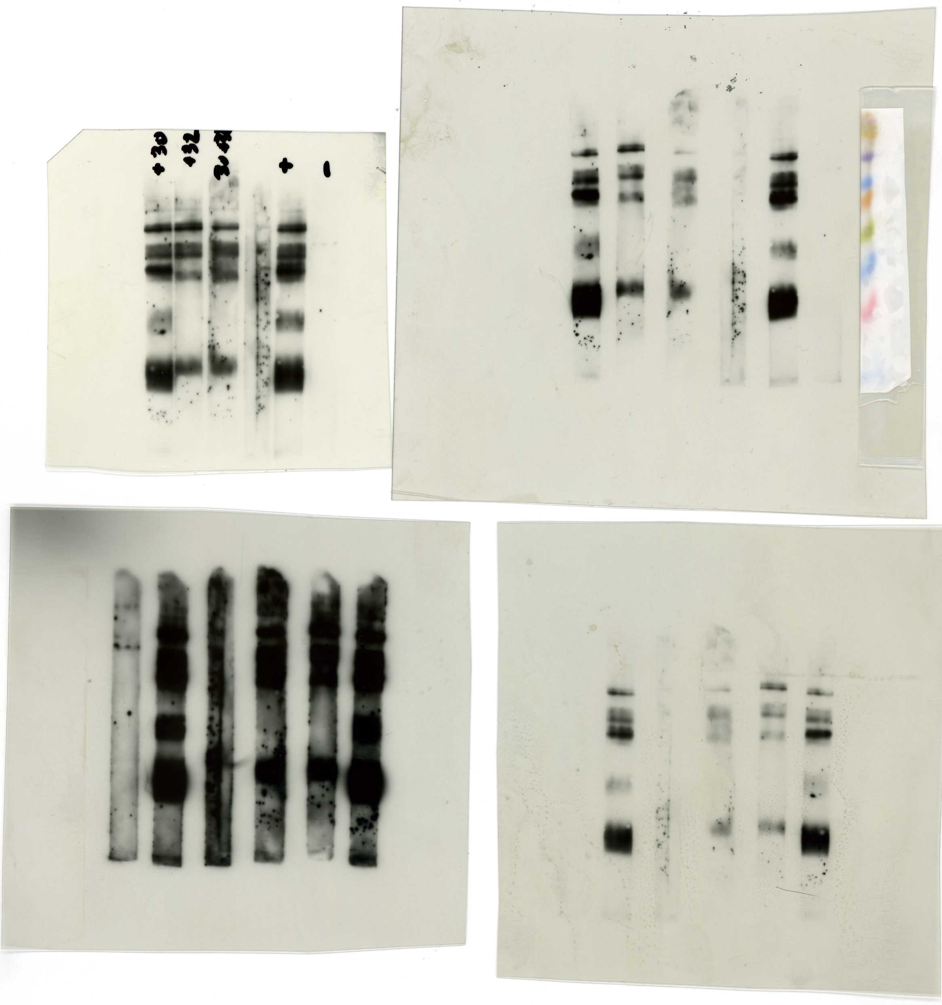
SGE S- and S+ measured on other blots
SGE S-
SGE S+
SGE S-
SGE S+

Slide 3
Original blot for Figure 7B

