Slide 1

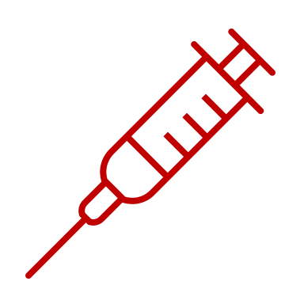
Repurposing Drugs as Countermeasures Against Chemical Weapon Toxicity

Slide 2



Examples of Threats
Terrorist Attack
World Trade Center and Pentagon Attacks
Sept 11, 2001
Biological Threat
Anthrax Exposure on Capital Hill
Oct 18, 2001
Radiation Threat
Chernobyl Nuclear Reactor Accident
April 26, 1986

Slide 3

Project Bioshield
President George W. Bush signed the Project BioShield Act of 2004 into law as part of a broader strategy to defend America against the threat of weapons of mass destruction.
Purpose: to accelerate the research, development, purchase, and availability of effective medical countermeasures against biological, chemical, radiological, and nuclear (CBRN) agents.
Research funding for NIH

Slide 4


Biomedical Advanced Research and Development Authority (BARDA)
Responsible for procurement and development of medical countermeasures, principally against chemical, biological, radiological and nuclear threats, as well as pandemic influenza, SARS-CoV2 and emerging diseases

Slide 5
Pandemic and All-Hazards Preparedness Reauthoization Act (2013)
Funding for public health and medical preparedness programs and buying medical countermeasures
Increases flexibility of Project BioShield to support advanced research and development of potential medical countermeasures.
Enhances authority of the U.S. FDA to support rapid responses to public health emergencies
Increases funding for BARDA
Increases strategic national stockpiles

Slide 6
COUNTERACT Program
COUNTER
ACT
A Trans-NIH Initiative in Translational Research
Goal: Development of new and improved medical countermeasures to prevent and treat the acute and long-term pathologies caused by chemical threat agents
Partnership of Government (NIH, BARDA), Universities, and Pharmaceutical Companies

Slide 7
COUNTERACT Program and Chemical Threats
Vesicating or Blistering Agents (mustards, lewisite)
Respiratory Agents (chlorine, phosgene, diphosgene)
Nerve Agents
(sarin, soman, VX, tabun)
Cyanides
Antimuscarinic Agents (anticholinergics)
COUNTER
ACT

Slide 8
COUNTERACT Program and Chemical Threats
Identification of Lead Compounds
Confirm Molecular Targets
Show In Vitro Activity
In Vivo Proof-of-Concept Efficacy
Preliminary Drug Disposition Studies
Optimization of Lead Compounds
Develop Human-Relevant Animal Models
Generate In Vivo Efficacy Data
Develop Bioanalytical Assays
Scale Up Manufacturing
Toxicity Studies
Transition to Funding for Advanced Development
Partnership with Pharmaceutical Company
File Investigational New Drug Application
Not Supported by NIH; Requires Outside Funding

Slide 9


Applying Basic Pharmacology Principles to Repurpose FDA-Approved Drugs

Slide 10

What Properties Does an Effective Drug Possess?

Slide 11




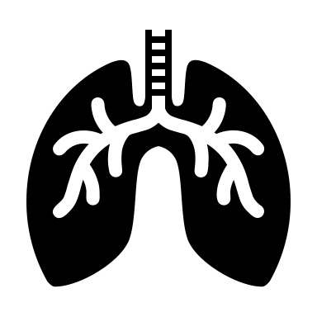

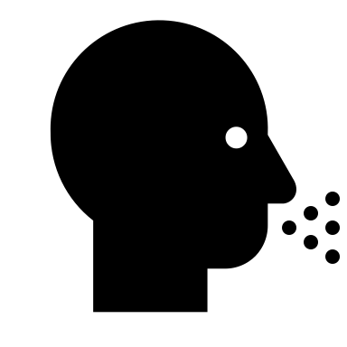
Pathogenesis of Toxicity and Disease
Dysfunction of Multiple Cellular Functions and Cell Integrity as well as Inflammation
Tissue Damage and Symptoms
Disruption of a Cellular Process

Slide 12
Which Stage Will Be Best to Intervene With a Drug?
Dysfunction of Multiple Cellular Functions and Cell Integrity as well as Inflammation
Tissue Damage and Symptoms
Disruption of a Cellular Process

Slide 13
General Mechanisms of Drug Action
AGONIST
METABOLISM
Drug
ANTAGONIST
Receptor
Cell
Increase Cellular Activity
Reduce Cellular Activity
Reduce Cellular Activity

Slide 14




Different Exposure Scenarios
Civilian Exposure Outside Medical Facility
(Subway, Park)
Battlefield
En Route to Medical Facility
In a Medical Facility

Slide 15
Drugs That Require Refrigeration Would Be LEAST Helpful in Which Scenario?
Civilian Exposure Outside Medical Facility (School, Subway, Park)
Battlefield
En Route to Medical Facility
In a Medical Facility

Slide 16



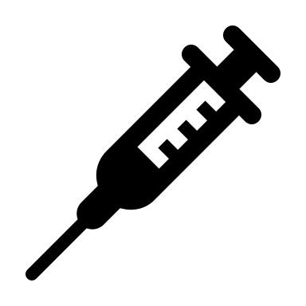

Different Routes of Administration
On the Skin
To the Eyes
To the Lungs
By Mouth
To the Blood

Slide 17
If You Are At Indoor Concert and a Chemical Weapon is Released,
Which Route Can You LEAST Likely Administer A Drug?
On the Skin
To the Eyes
To the Lungs
By Mouth
To the Blood

