Slide 1
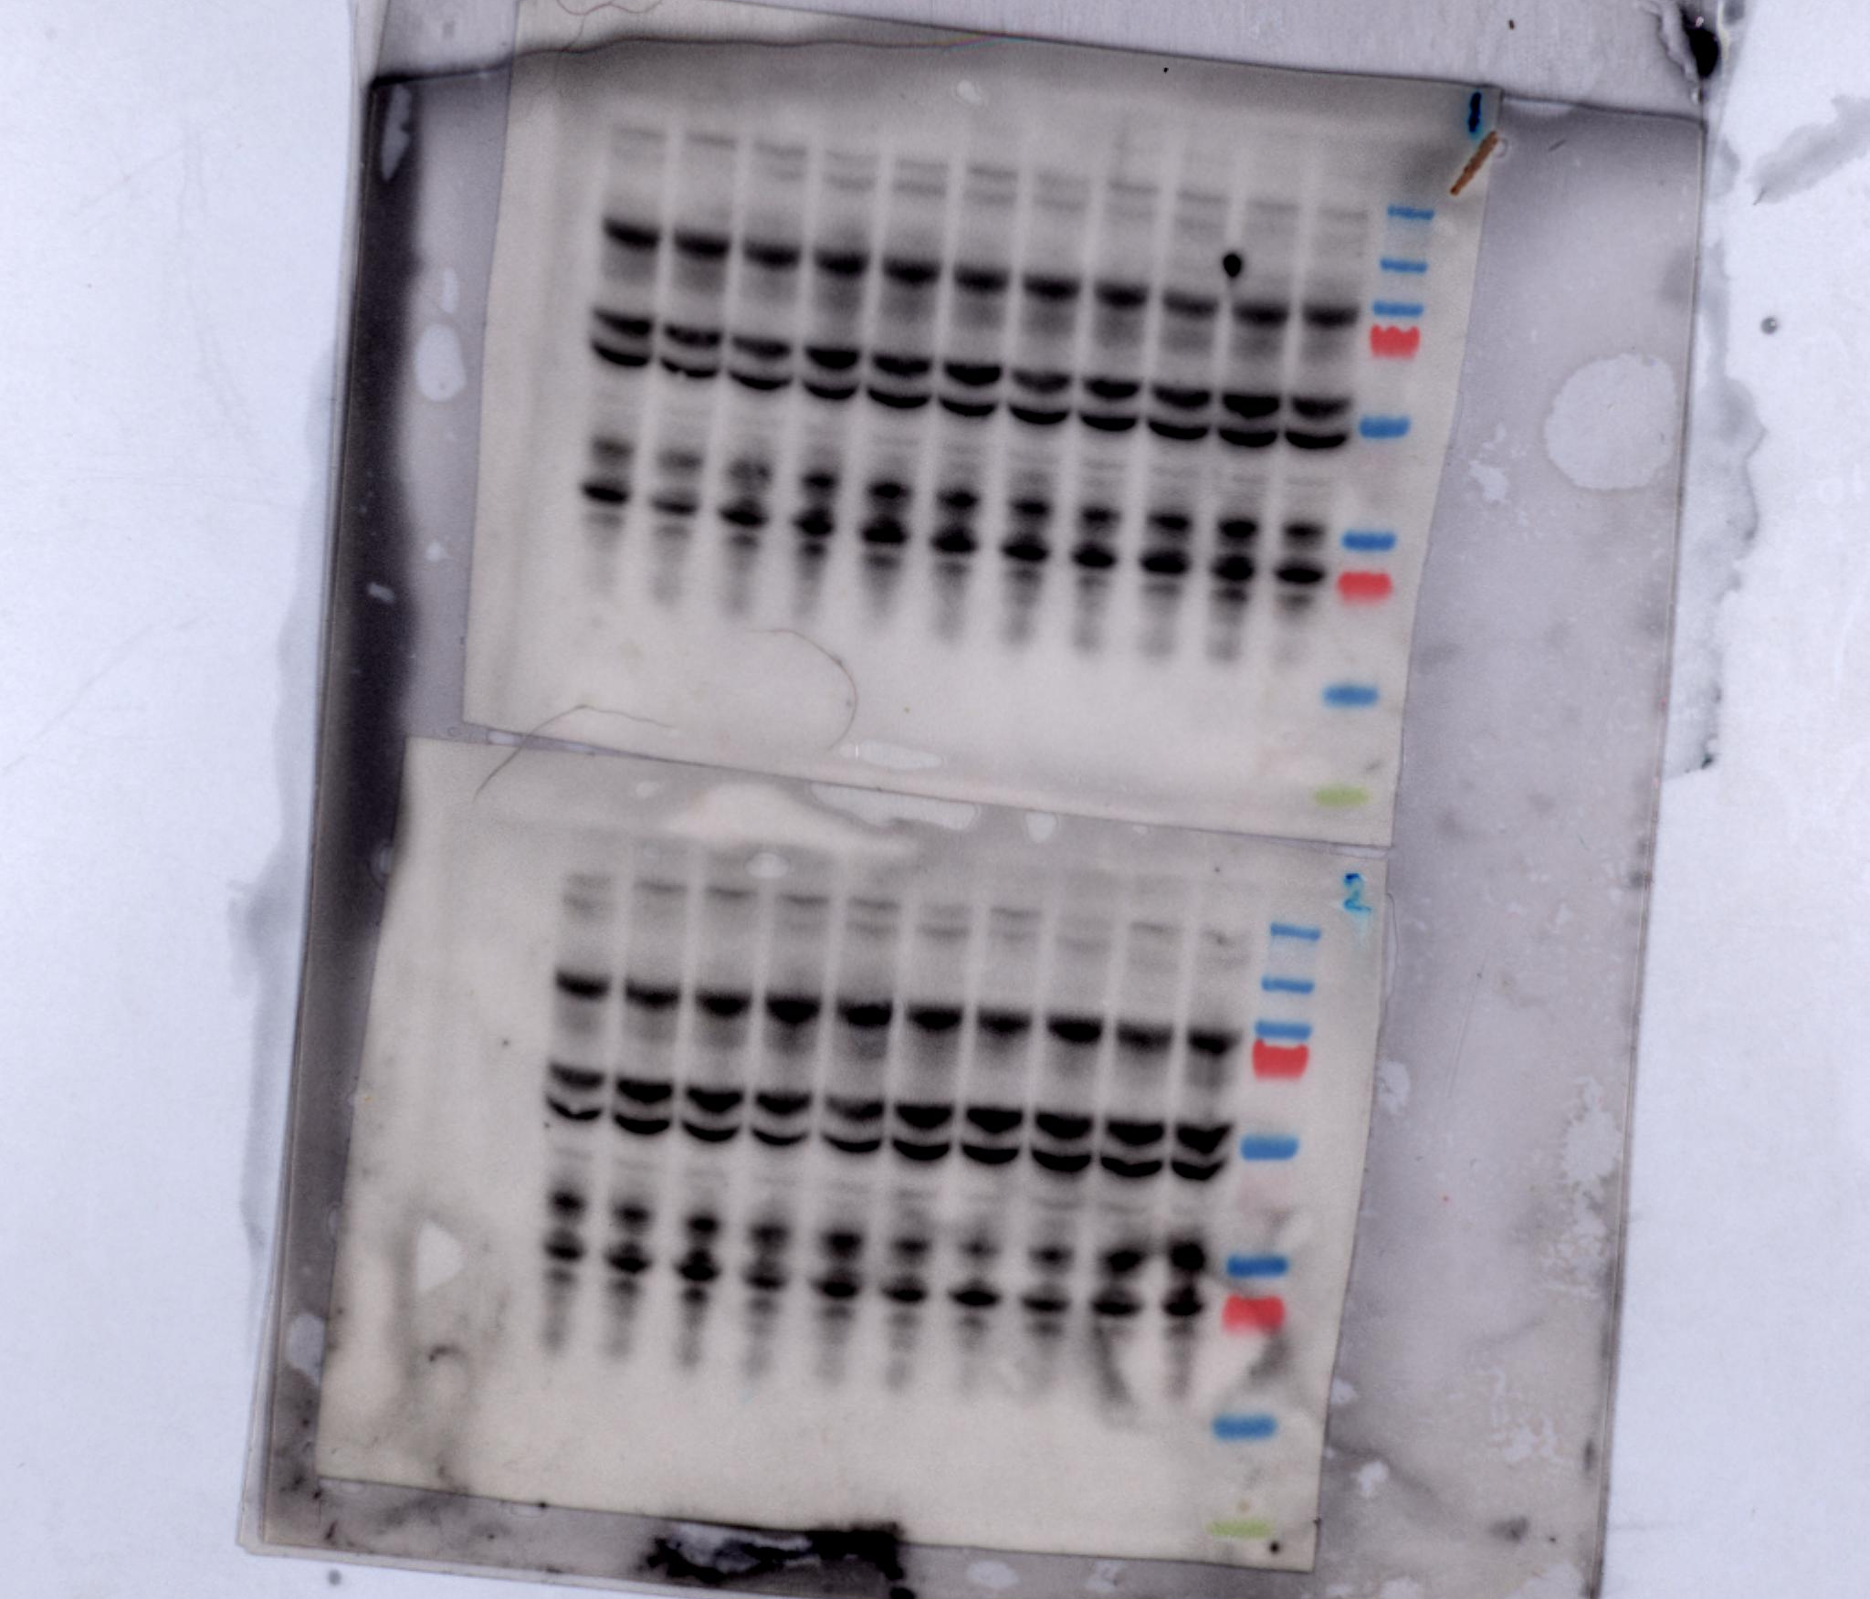
BK40143 5mg/kg
DMSO
p-c-KIT 170kDa
BK40197 45mg/kg
BK40143 5mg/kg
p-c-KIT 170kDa

Slide 2
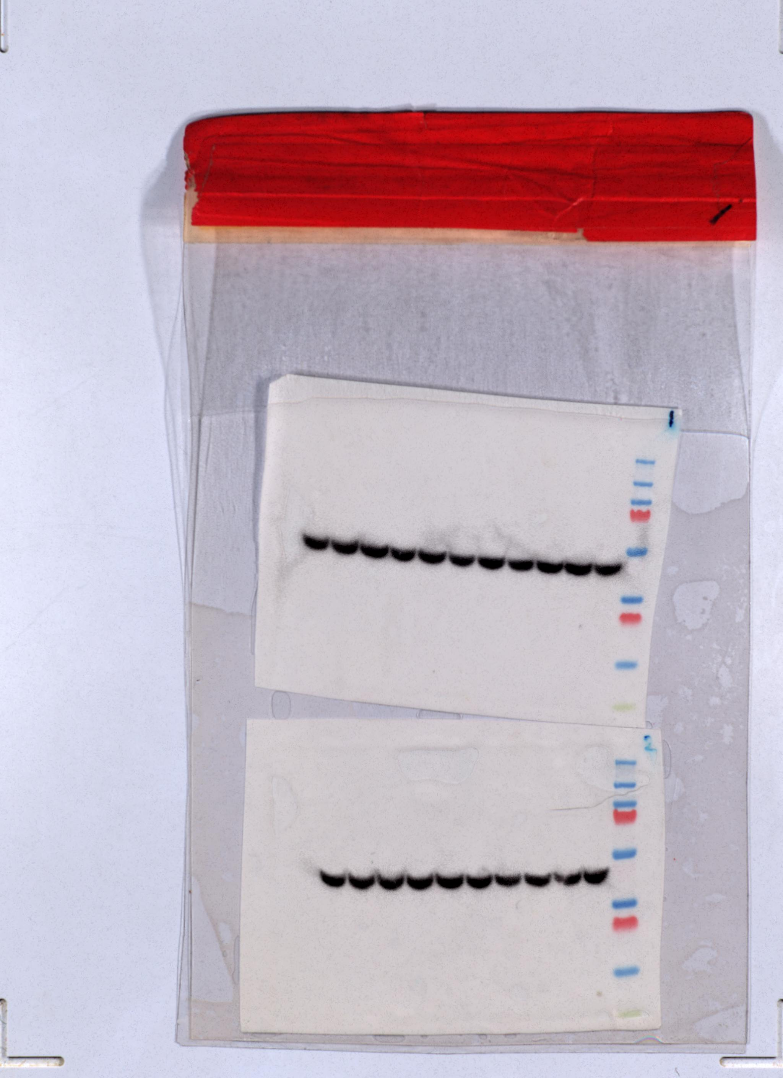
BK40143 5mg/kg
DMSO
BK40197 45mg/kg
BK40143 5mg/kg

