Slide 1
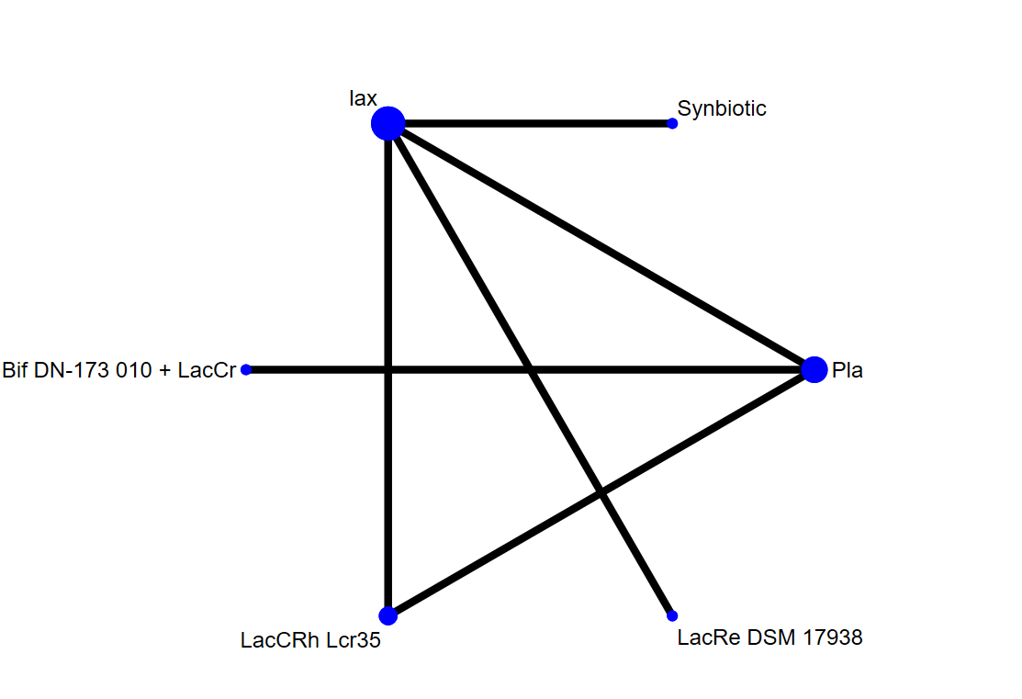
eFigure 1A network structure of primary outcome: bowel movement or stool frequency: subgroup of treatment arm with only probiotics vs placebo or laxatives

Slide 2
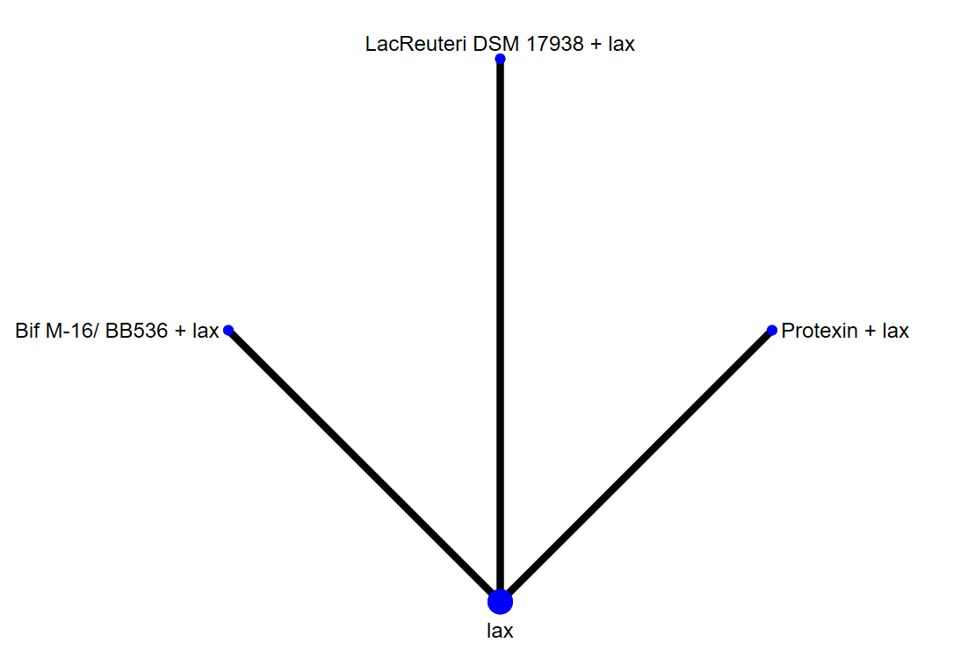
eFigure 1B network structure of safety: fecal incontinency

Slide 3
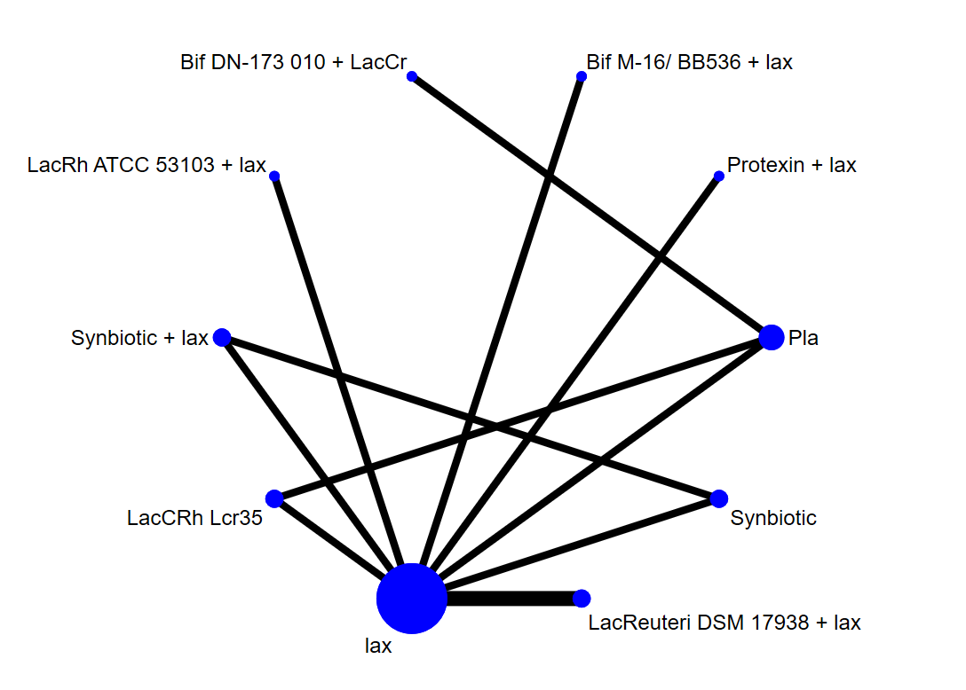
eFigure 1C network structure of acceptability: drop-out

Slide 4
Figure legend of eFigure 1A-1C
The lines between nodes represent direct comparisons in various trials, and the size of each circle is proportional to the number of participants receiving each specific treatment. The thickness of the lines is proportional to the number of trials connected to the network.
Abbreviation: 95% CI: 95% confidence interval; Bif DN-173 010 + LacCr: Probiotic (Bifidobacteria lactis DN-173 010 + Lactococcus cremoris); Bif M-16/ BB536 + lax: probiotic mixture (Bifidobacteria breve + longum) + laxative; ES: effect size; LacCRh Lcr35: Lactobacillus casei rhamnosus Lcr35; LacRe DSM 17938: Lactobacillus reuteri DSM 17938; LacReuteri DSM 17938 + lax: Lactobacillus reuteri DSM 17938 + laxative; LacRh ATCC 53103 + lax: Lactobacillus rhamnosus GG (ATCC 53103) + laxative; lax: laxative; NMA: network meta-analysis; OR: odds ratio; Pla: Placebo/control; Protexin + lax: Protexin (Lactobacillus casei PXN 37, Lactobacillus rhamnosus PXN 54, Streptococcus thermophiles PXN 66, Bifidobacterium breve PXN 25, Lactobacillus acidophilus PXN 35, Bifidobacterium infantis (child specific) PXN 27, and Lactobacillus bulgaricus PXN 39) + laxative; RCT: randomized controlled trial; SMD: standardized mean difference; SUCRA: surface under the cumulative ranking curve; Synbiotic + lax: Synbiotic (L. casei, L. rhamnosus, S. thermophilus, B. breve, L. acidophilus, B. infantis, fructooligosaccharide) + laxative

Slide 5
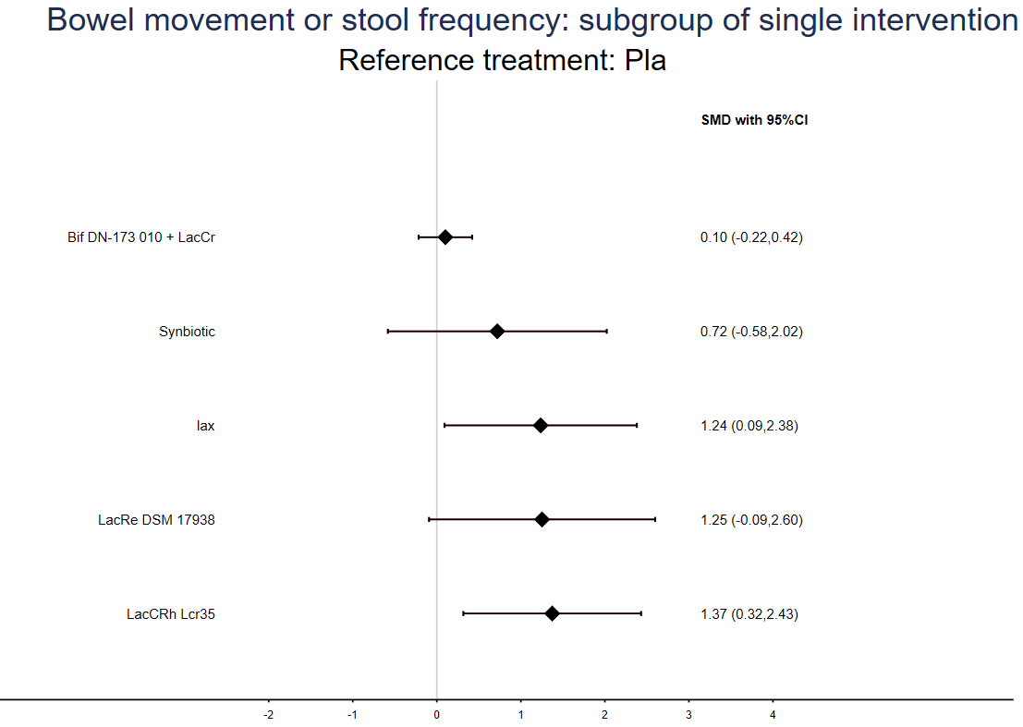
Better by placebo/control
Better by treatment
eFigure 2A forest plot of primary outcome: bowel movement or stool frequency: subgroup of treatment arm with only probiotics vs placebo or laxatives

Slide 6
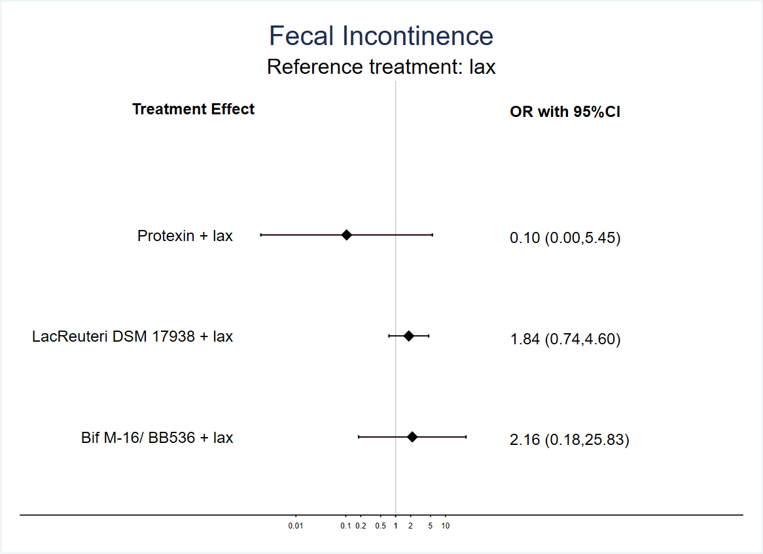
Better by treatment
Better by placebo/control
eFigure 2B forest plot of safety: fecal incontinency

Slide 7
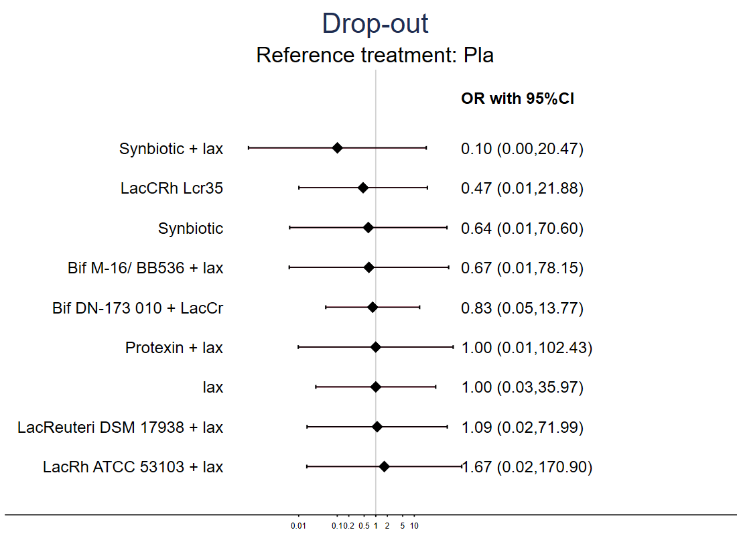
Better by treatment
Better by placebo/control
eFigure 2C forest plot of acceptability: drop-out rate

Slide 8
Figure legend of eFigure 2A-2C
Abbreviation: 95% CI: 95% confidence interval; Bif DN-173 010 + LacCr: Probiotic (Bifidobacteria lactis DN-173 010 + Lactococcus cremoris); Bif M-16/ BB536 + lax: probiotic mixture (Bifidobacteria breve + longum) + laxative; ES: effect size; LacCRh Lcr35: Lactobacillus casei rhamnosus Lcr35; LacRe DSM 17938: Lactobacillus reuteri DSM 17938; LacReuteri DSM 17938 + lax: Lactobacillus reuteri DSM 17938 + laxative; LacRh ATCC 53103 + lax: Lactobacillus rhamnosus GG (ATCC 53103) + laxative; lax: laxative; NMA: network meta-analysis; OR: odds ratio; Pla: Placebo/control; Protexin + lax: Protexin (Lactobacillus casei PXN 37, Lactobacillus rhamnosus PXN 54, Streptococcus thermophiles PXN 66, Bifidobacterium breve PXN 25, Lactobacillus acidophilus PXN 35, Bifidobacterium infantis (child specific) PXN 27, and Lactobacillus bulgaricus PXN 39) + laxative; RCT: randomized controlled trial; SMD: standardized mean difference; SUCRA: surface under the cumulative ranking curve; Synbiotic + lax: Synbiotic (L. casei, L. rhamnosus, S. thermophilus, B. breve, L. acidophilus, B. infantis, fructooligosaccharide) + laxative

Slide 9
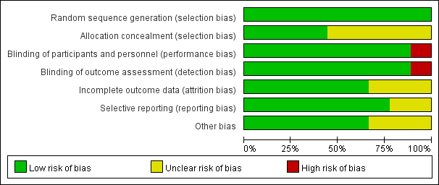
eFigure 3A overview of risk of bias

Slide 10
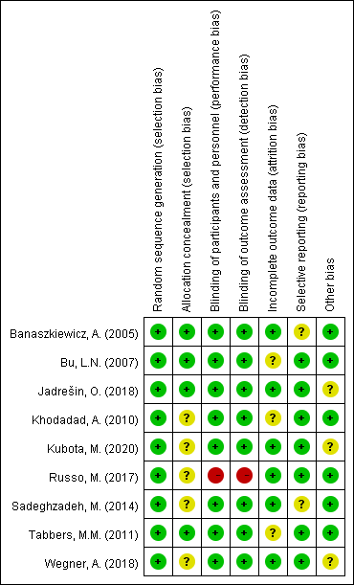
eFigure 3B detailed risk of bias in each study

Slide 11
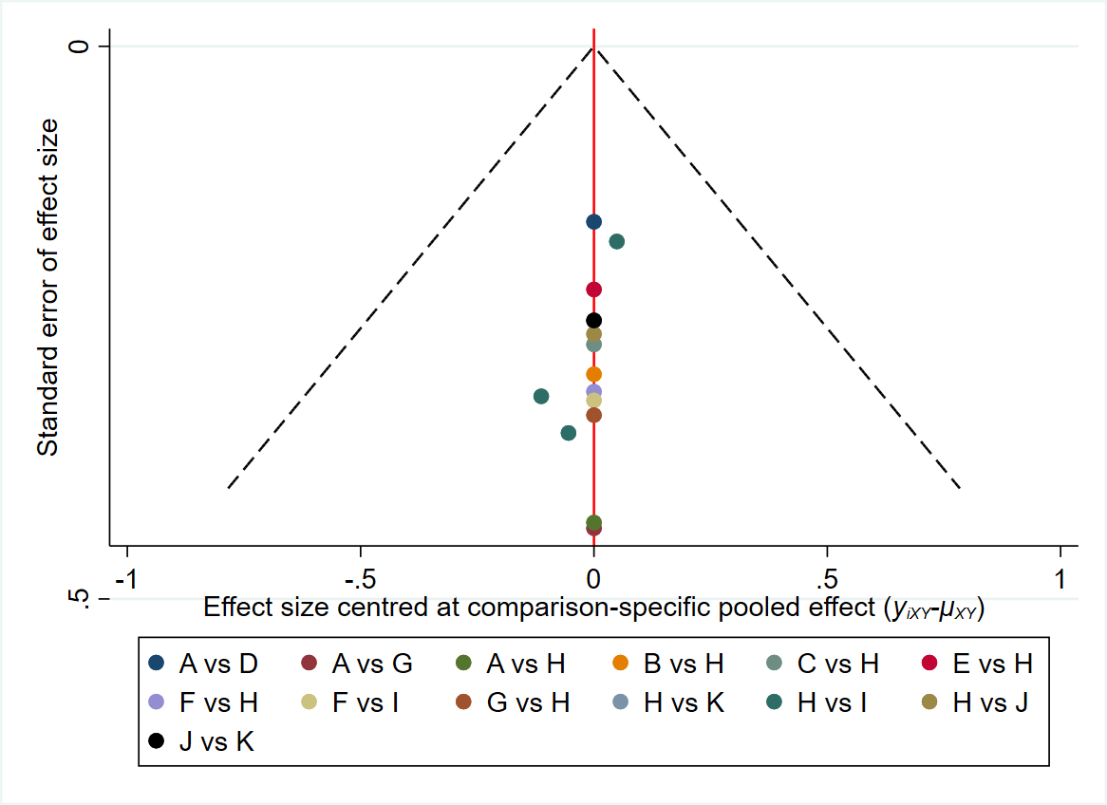
eFigure 4A Funnel plot of primary outcome: bowel movement or stool frequency

Slide 12
Treatments used in eFigure 4A
A: | Pla
B: | Protexin + lax
C: | Bif M-16/ BB536 + lax
D: | Bif DN-173 010 + LacCr
E: | LacRh ATCC 53103 + lax
F: | LacRe DSM 17938
G: | LacCRh Lcr35
H: | lax
I: | LacReuteri DSM 17938 + lax
J: | Synbiotic
K: | Synbiotic + lax

Slide 13
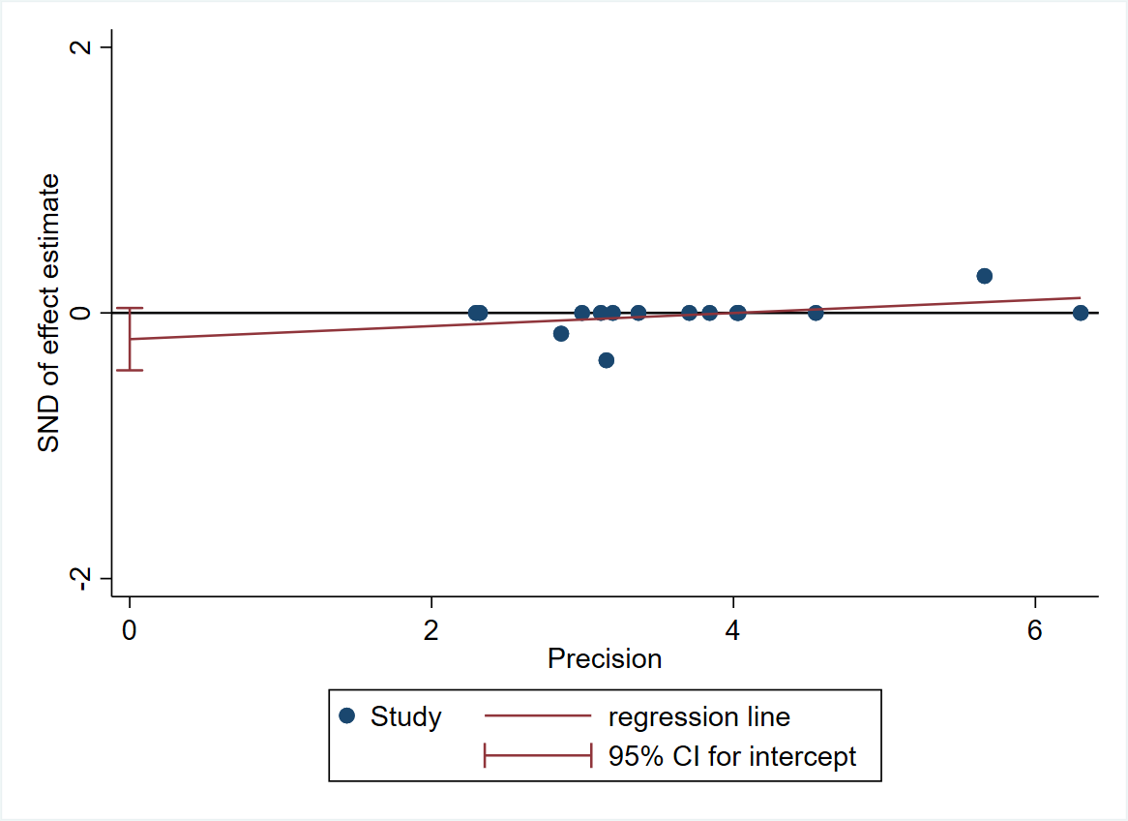
eFigure 4B Egger’s regression of primary outcome: bowel movement or stool frequency

Slide 14
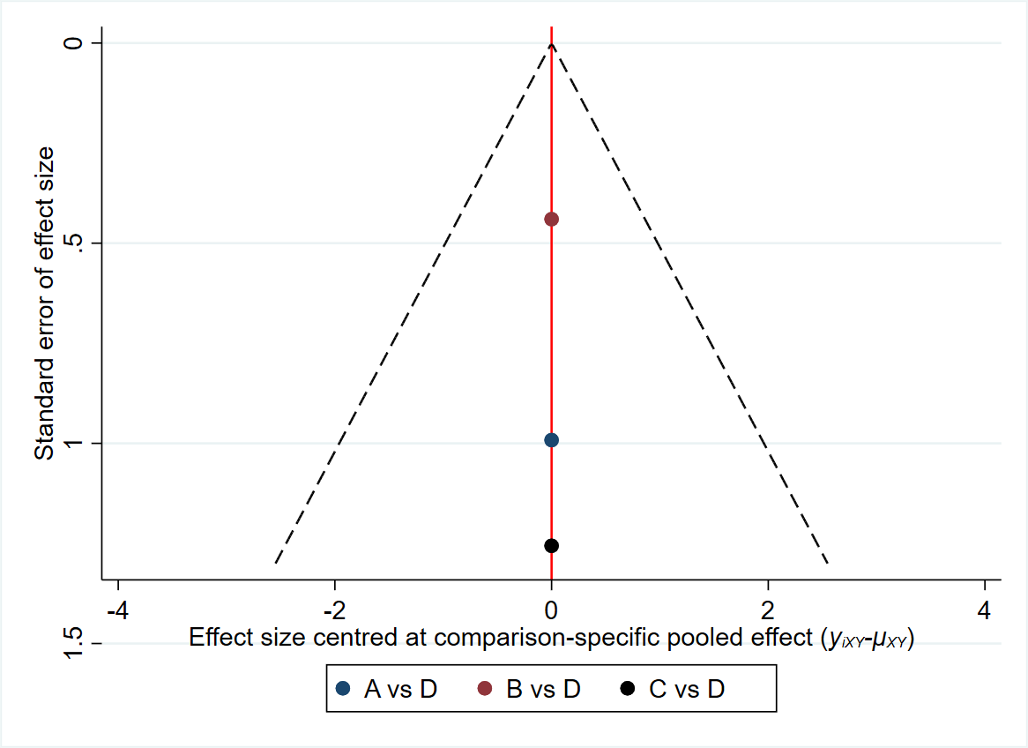
eFigure 4C Funnel plot of safety: fecal incontinency

Slide 15
Treatments used in eFigure 4C
A: | Protexin + lax
B: | LacReuteri DSM 17938 + lax
C: | Bif M-16/ BB536 + lax
D: | lax

Slide 16
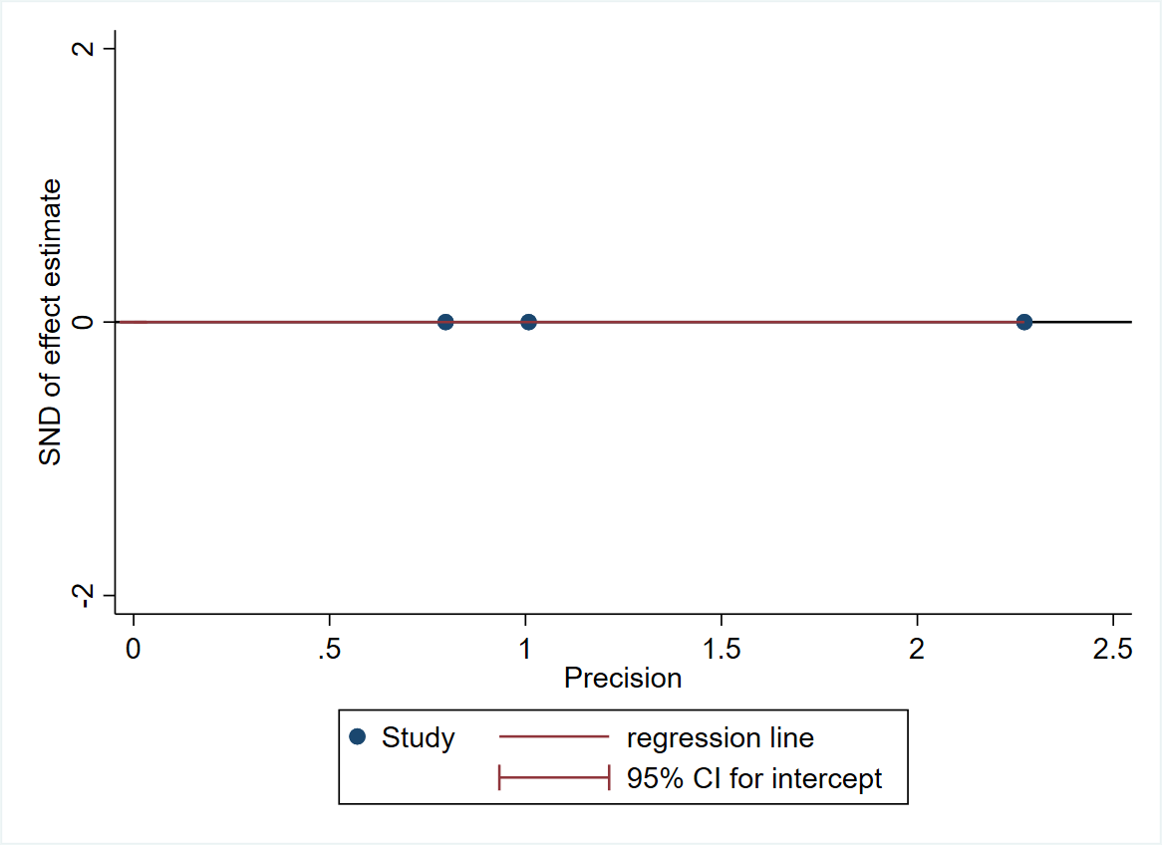
eFigure 4D Egger’s regression of safety: fecal incontinency

Slide 17
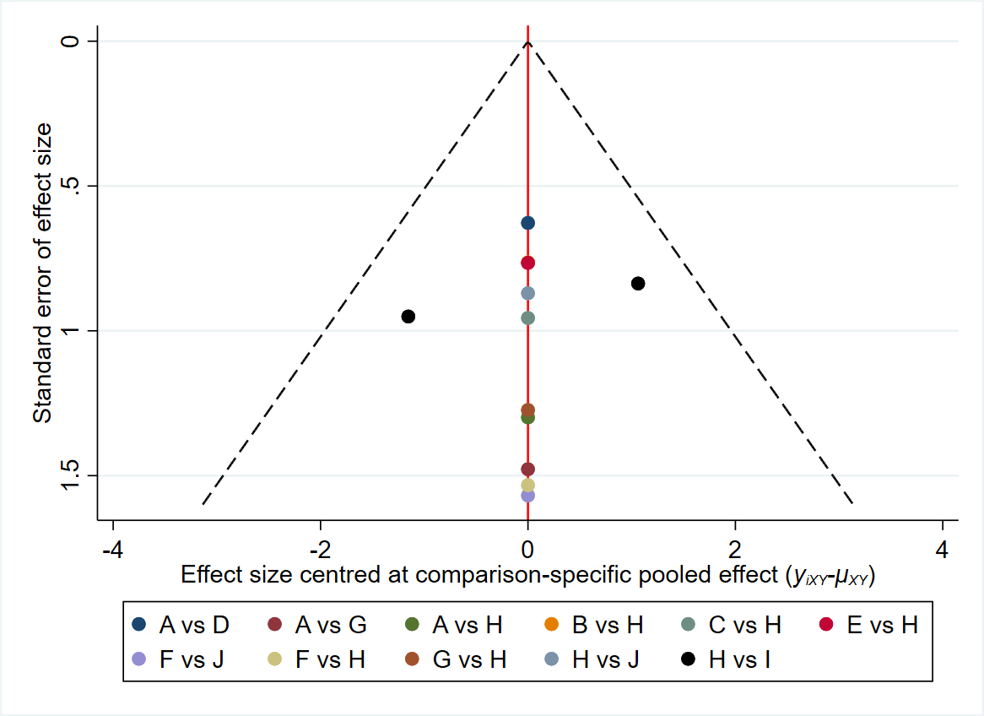
eFigure 4E Funnel plot of acceptability: drop-out rate

Slide 18
Treatments used in eFigure 4E
A: | Pla
B: | Protexin + lax
C: | Bif M-16/ BB536 + lax
D: | Bif DN-173 010 + LacCr
E: | LacRh ATCC 53103 + lax
F: | Synbiotic + lax
G: | LacCRh Lcr35
H: | lax
I: | LacReuteri DSM 17938 + lax
J: | Synbiotic

Slide 19
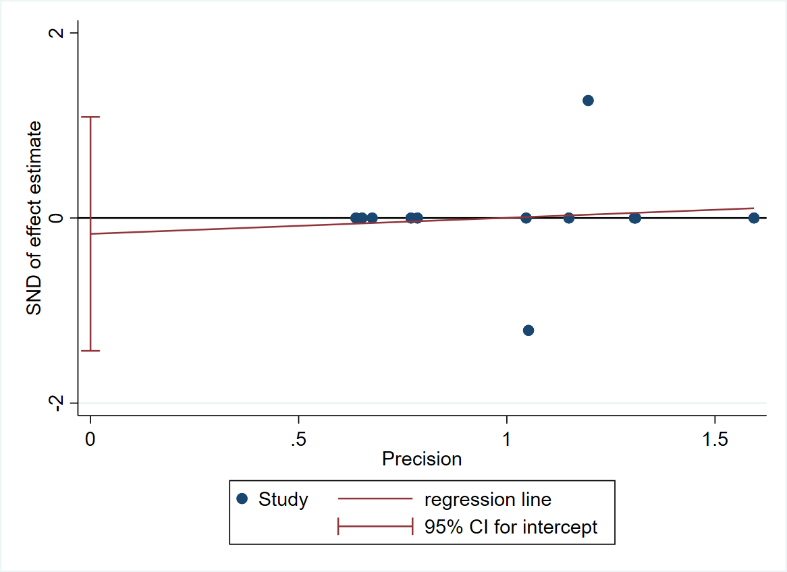
eFigure 4F Egger’s regression of acceptability: drop-out rate

Slide 20
Figure legend of eFigure 4A-4F
Abbreviation: 95% CI: 95% confidence interval; Bif DN-173 010 + LacCr: Probiotic (Bifidobacteria lactis DN-173 010 + Lactococcus cremoris); Bif M-16/ BB536 + lax: probiotic mixture (Bifidobacteria breve + longum) + laxative; ES: effect size; LacCRh Lcr35: Lactobacillus casei rhamnosus Lcr35; LacRe DSM 17938: Lactobacillus reuteri DSM 17938; LacReuteri DSM 17938 + lax: Lactobacillus reuteri DSM 17938 + laxative; LacRh ATCC 53103 + lax: Lactobacillus rhamnosus GG (ATCC 53103) + laxative; lax: laxative; NMA: network meta-analysis; OR: odds ratio; Pla: Placebo/control; Protexin + lax: Protexin (Lactobacillus casei PXN 37, Lactobacillus rhamnosus PXN 54, Streptococcus thermophiles PXN 66, Bifidobacterium breve PXN 25, Lactobacillus acidophilus PXN 35, Bifidobacterium infantis (child specific) PXN 27, and Lactobacillus bulgaricus PXN 39) + laxative; RCT: randomized controlled trial; SMD: standardized mean difference; SUCRA: surface under the cumulative ranking curve; Synbiotic + lax: Synbiotic (L. casei, L. rhamnosus, S. thermophilus, B. breve, L. acidophilus, B. infantis, fructooligosaccharide) + laxative

