Slide 1
A
B
IC₅₀ (µM) ID8 F3 | OLA | ONV 5nM | ONV 10nM | ONV 20nM
 | 7.21 | 7.01 | 5.40 | 3.08
Onv effect (%) | - | 0 | 20 | 35
IC₅₀ (µM) ID8 BRCA1-/- | OLA | ONV 5nM | ONV 10nM | ONV 20nM
 | 0.26 | 0.23 | 0.24 | 0.09
Onv effect (%) | - | 0 | 10 | 27
IC₅₀ (µM) ID8 F3 OlaR | OLA | ONV 5nM | ONV 10nM | ONV 20nM | ONV 40nM
 | 14.37 | 15.24 | 15.07 | 12.99 | 10.15
Onv effect (%) | - | 0 | 10 | 15 | 28
IC₅₀ (µM) ID8 BRCA1-/-OlaR | OLA | ONV 5nM | ONV 10nM | ONV 20nM | ONV 40nM
 | 2.67 | 3.33 | 2.89 | 1.99 | 1.34
Onv effect (%) | - | 0 | 5 | 20 | 27
Supplementary Figure S1

Slide 2
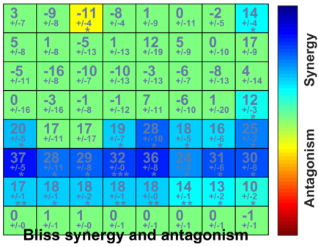
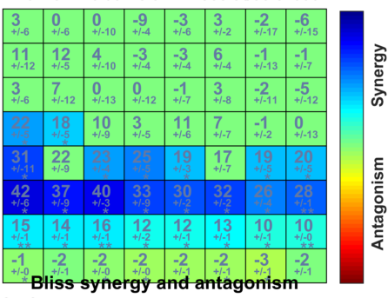
Niraparib (nM)
AZD5305 (nM)
21 35 58 96 161 239 449 750
28 46 77 129 215 359 599 1000
1.4
2.3
3.9
6.4
10.7
17.9
29.9
50
1.4
2.3
3.9
6.4
10.7
17.9
29.9
50
Onvansertib (nM)
Onvansertib (nM)
Supplementary Figure S2

Slide 3
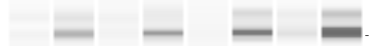
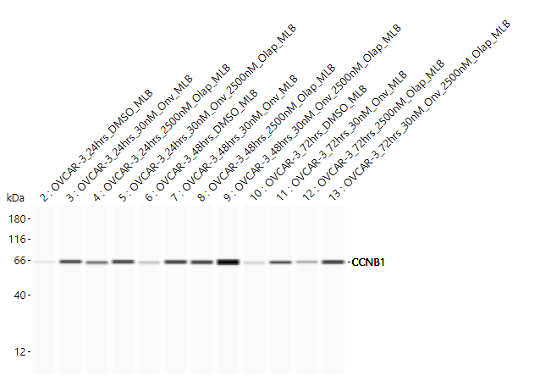
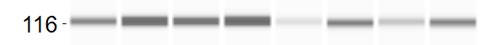

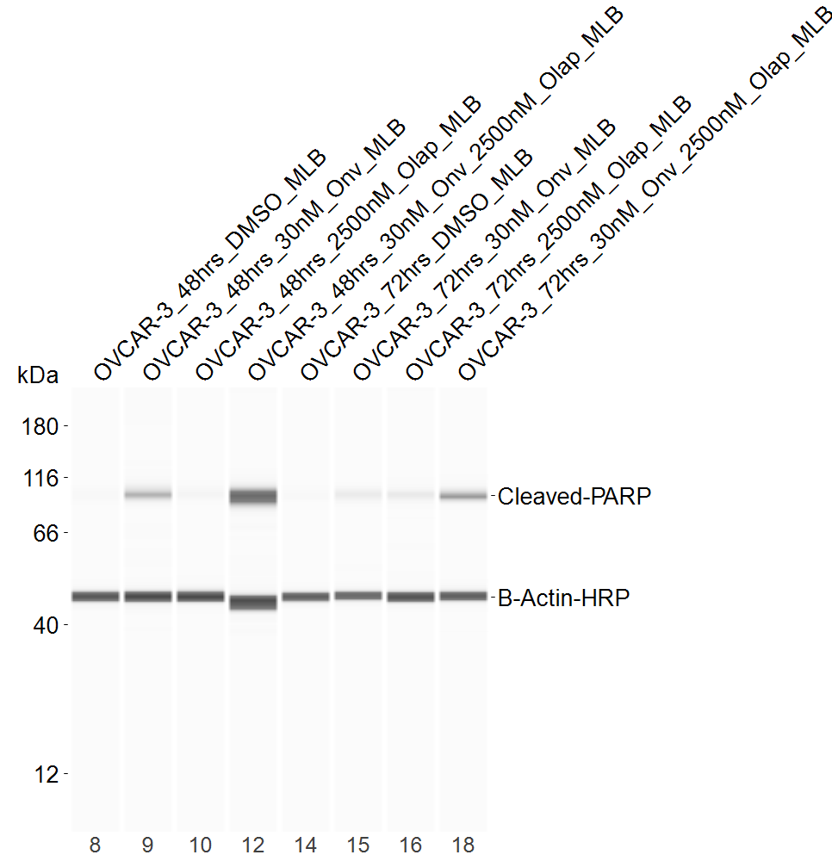
A
Ovcar-3
ES-2
B
C
Ovcar-3
Ovcar-3
48h
72h
24h
48h
72h
Onvansertib
- + - +
- + - +
Onvansertib
- + - +
- + - +
- + - +
Olaparib
- - + +
- - + +
Olaparib
- - + +
- - + +
- - + +
cl-casp3
cyclin-B1
Vinculin
Cl-casp3/Vinculin/DMSO
1.0 2.2 1.0 3.0 1.0 6.7 6.3 10.3
β-Actin
cl-PARP
cyclin-B1/β-Actin/DMSO
0.1 3.9 1.4 3.0 0.1 3.4 2.6 5.8 0.1 3.5 2.5 6.6
β-Actin
Cl-PARP/ β-actin /DMSO
1.0 3.9 1.3 7.0 1.0 2.5 1.9 4.6
Supplementary Figure 3

Slide 4
Supplementary Figure S4

Slide 5
A
p=0.0002
p<0.0001
p=0.0139
p=0012
p=0.0349
p=0.0467
Supplementary Figure S5

Slide 6
A
B
Supplementary Figure S6

Slide 7
A
B
Supplementary Figure S7

Slide 8
Supplementary Figure S8

Slide 9
Supplementary Figure S9

Slide 10
A
B
C
Supplementary Figure S10

Slide 11
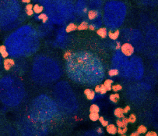
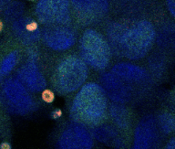
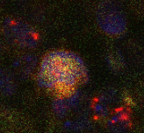
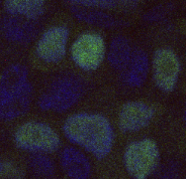
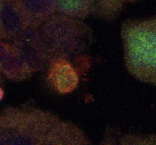
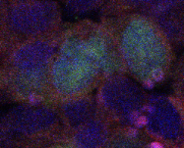
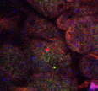
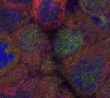
MNHOC#22
MNHOC#266
Positive cells
Negative cells
Positive cells
Negative cells
RAD51 foci
BRCA1 foci
Supplementary Figure S11

Slide 12
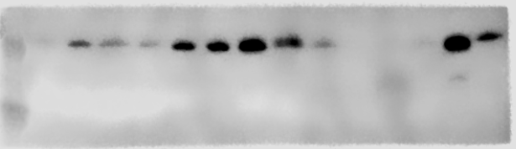
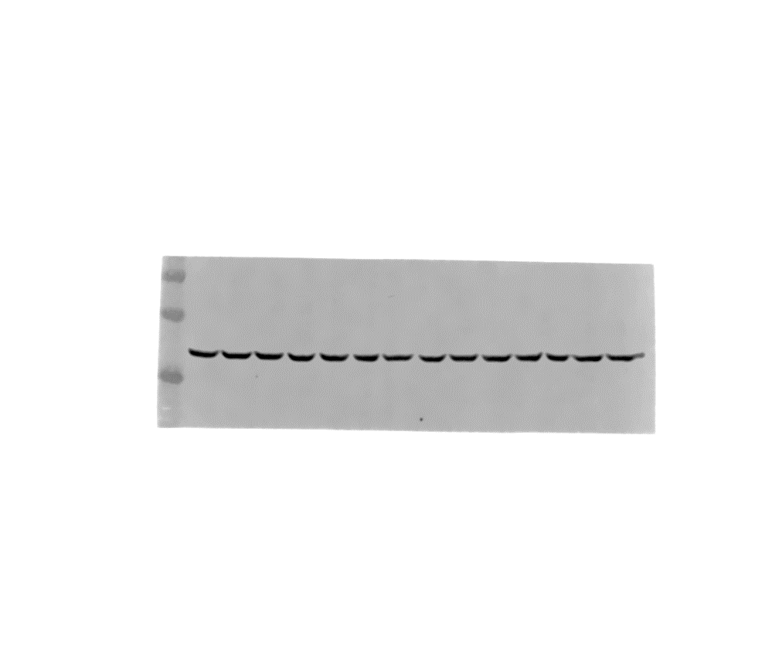
MNHOC#22_ pSer10 H3
MNHOC#266_pSer10 H3
MNHOC#22_pSer139 γH2AX
MNHOC#266_pSer139 γH2AX
MNHOC#22_GAPDH
MNHOC#266_GAPDH
Supplementary Figure S12

