Slide 1
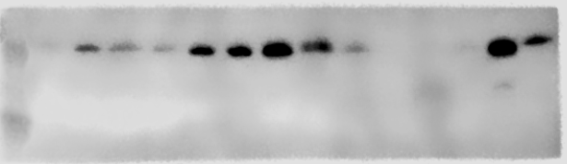
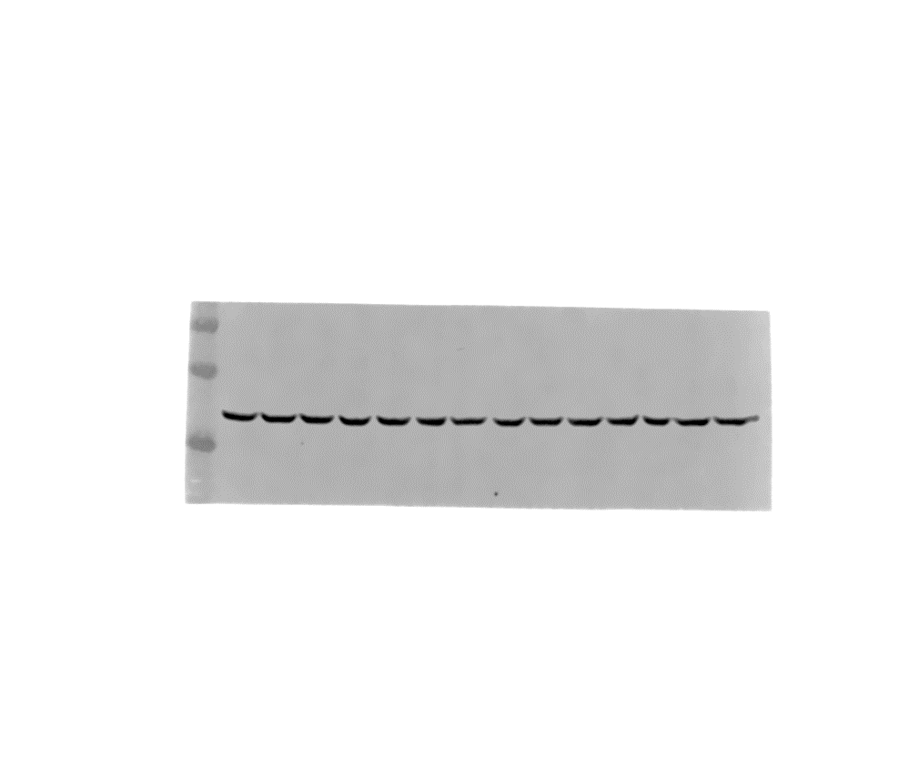
MNHOC#22_ pSer10 H3
MNHOC#266_pSer10 H3
MNHOC#22_pSer139 γH2AX
MNHOC#266_pSer139 γH2AX
MNHOC#22_GAPDH
MNHOC#266_GAPDH
Supplementary Figure S12

