Slide 1
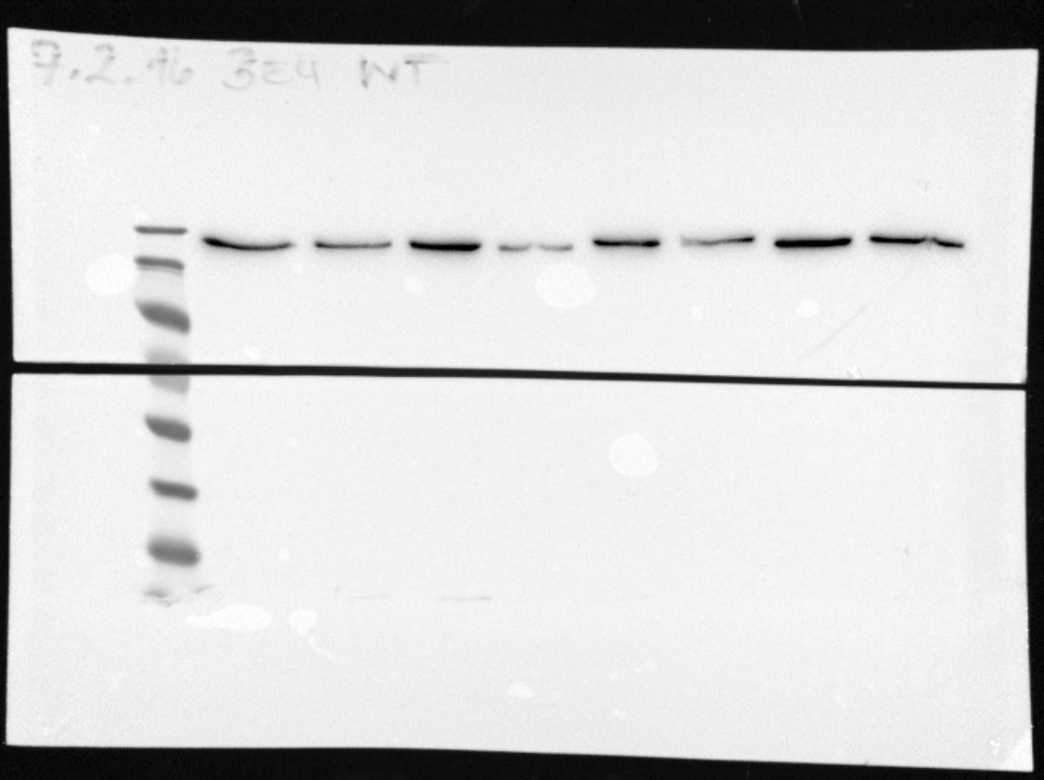
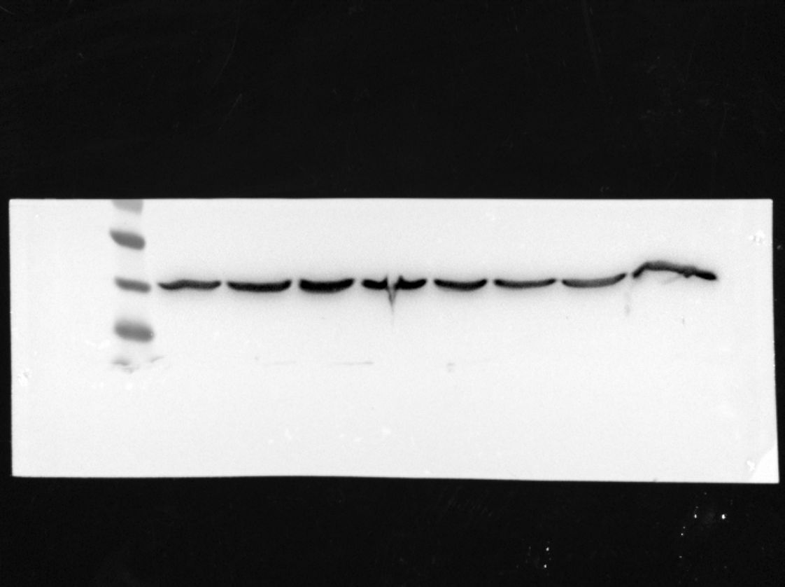
Source Fig. S1B
PANC-1
Patu8989
Pan02
Normoxia
Hypoxia
Normoxia
Hypoxia
Normoxia
Hypoxia
KDa
170
BAG6
130
100
55
40
β-actin
35

Slide 2
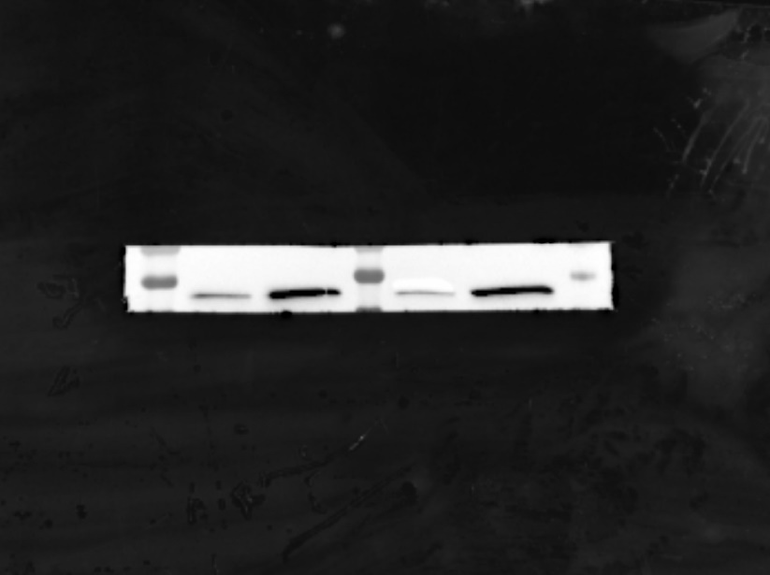
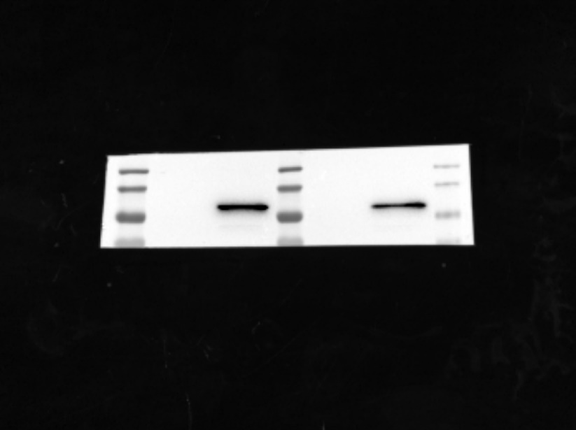
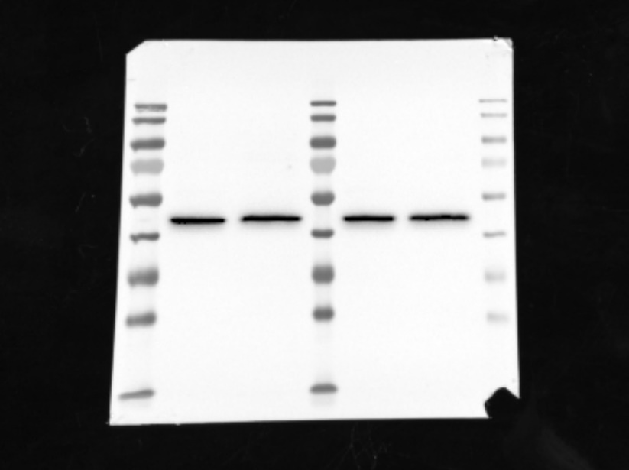
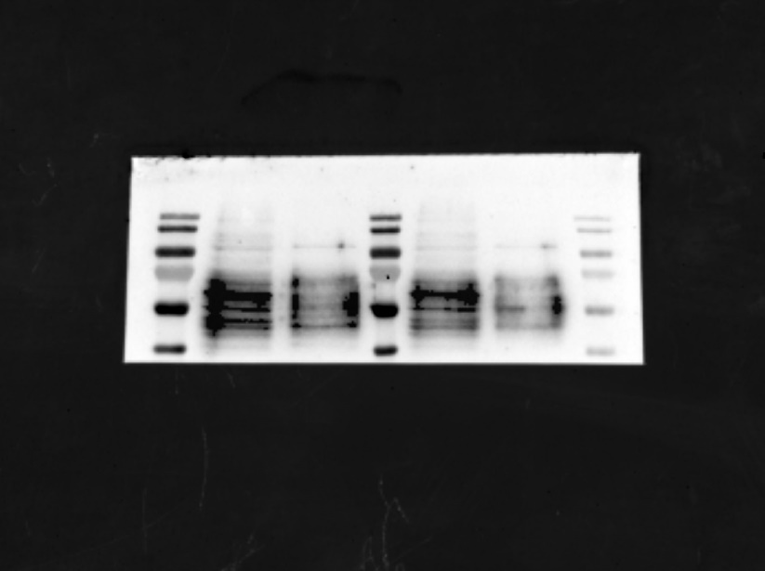
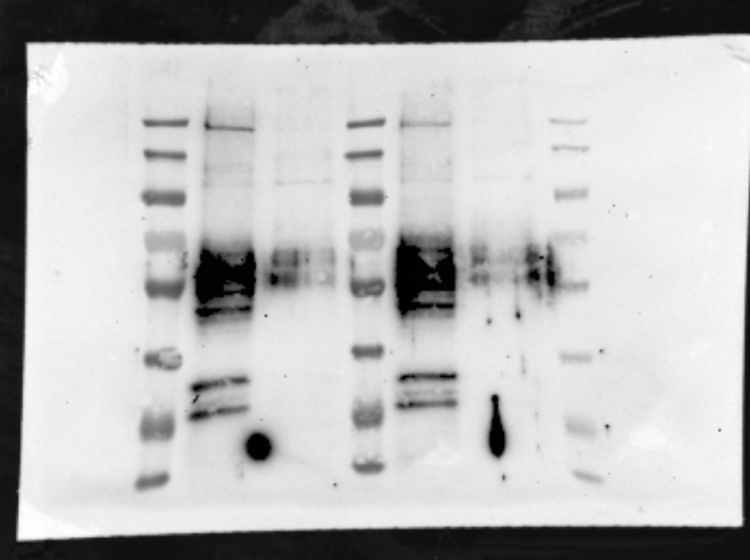
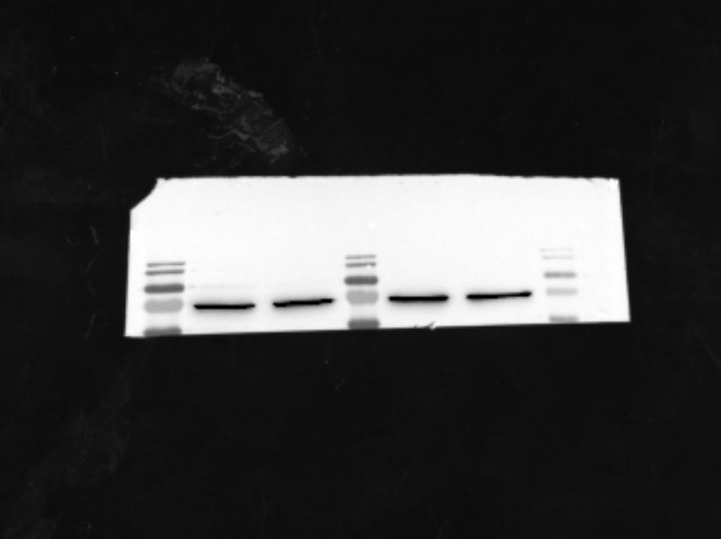
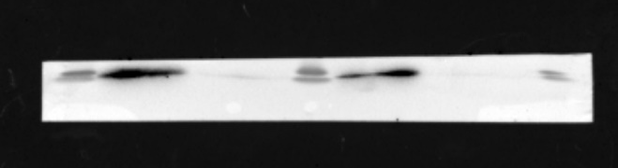
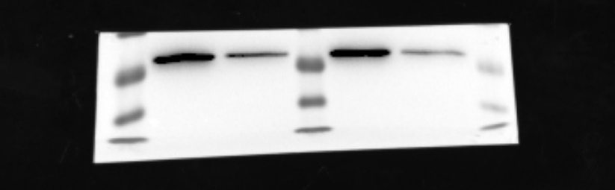
Source Fig. S2D
100
Alix
55
Flotillin-1
55
Tsg101
70
40
170
130
130
100
100
70
70
Cd9
55
Cd63
55
70
Hsp70
40
55
40
40
35
25
40
Gapdh
25
H2a
35
25

Slide 3
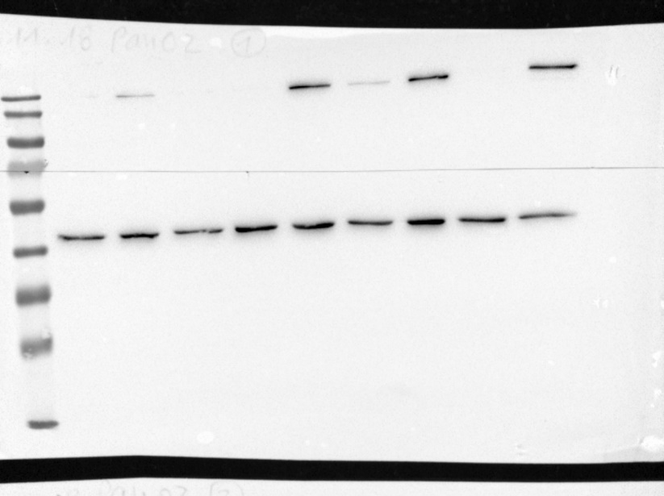
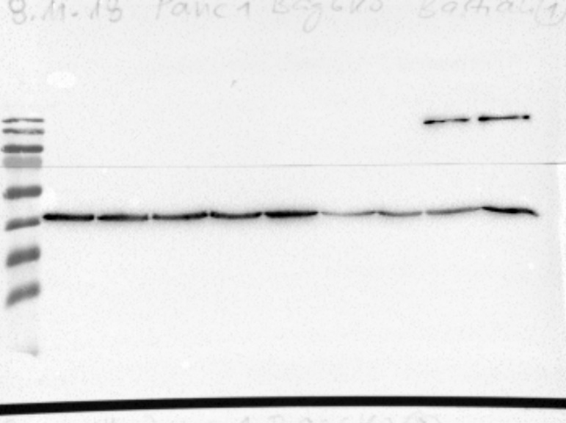
Source Fig. S3C
Pan02
KO clones
PANC-1
KO clones
#1
#2
#3
#4
#5
#6
#7
#8
WT
Bag6
#1
#2
#3
#4
#5
#6
#7
#8
WT
170
130
100
170
BAG6
130
55
β-actin
100
35
55
β-actin
25
35
25
15
15

Slide 4
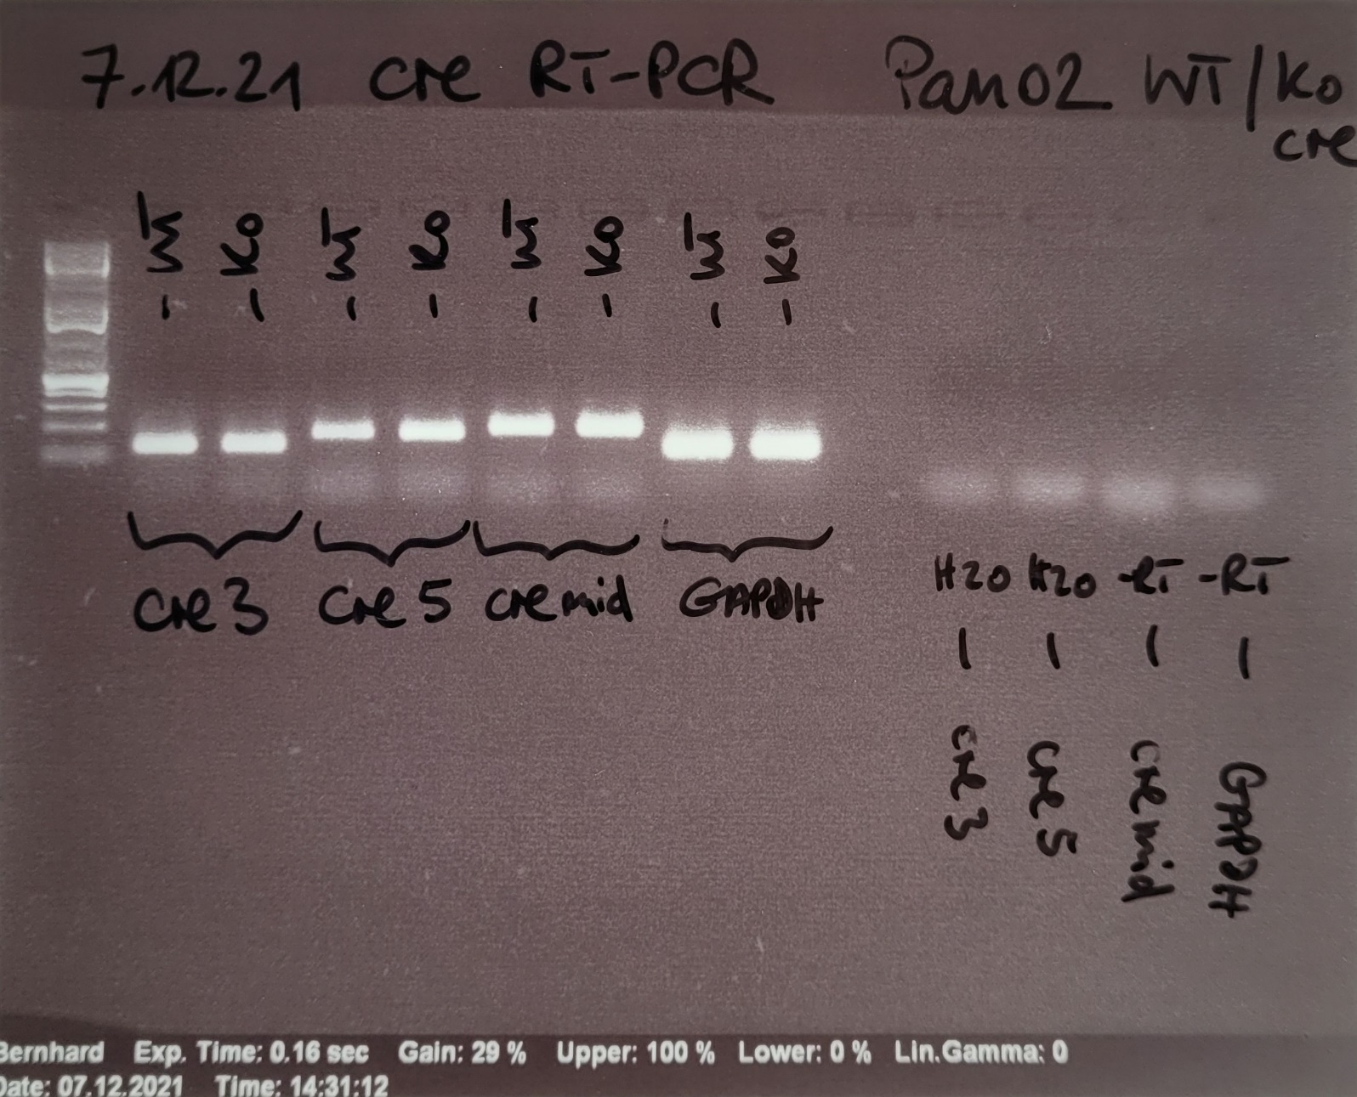
Source Fig. S3E
bp
500
300
200
100

Slide 5
Source Fig. S6A
Pan02 Cells
Bag6 WT-IL33KO
Bag6 KO-IL33KO
Bag6 WT
Bag6 KO
130
M
100
90
Calnexin
70
55
40
35
25
130
M
100
90
70
55
40
IL33
35
25

