Slide 1
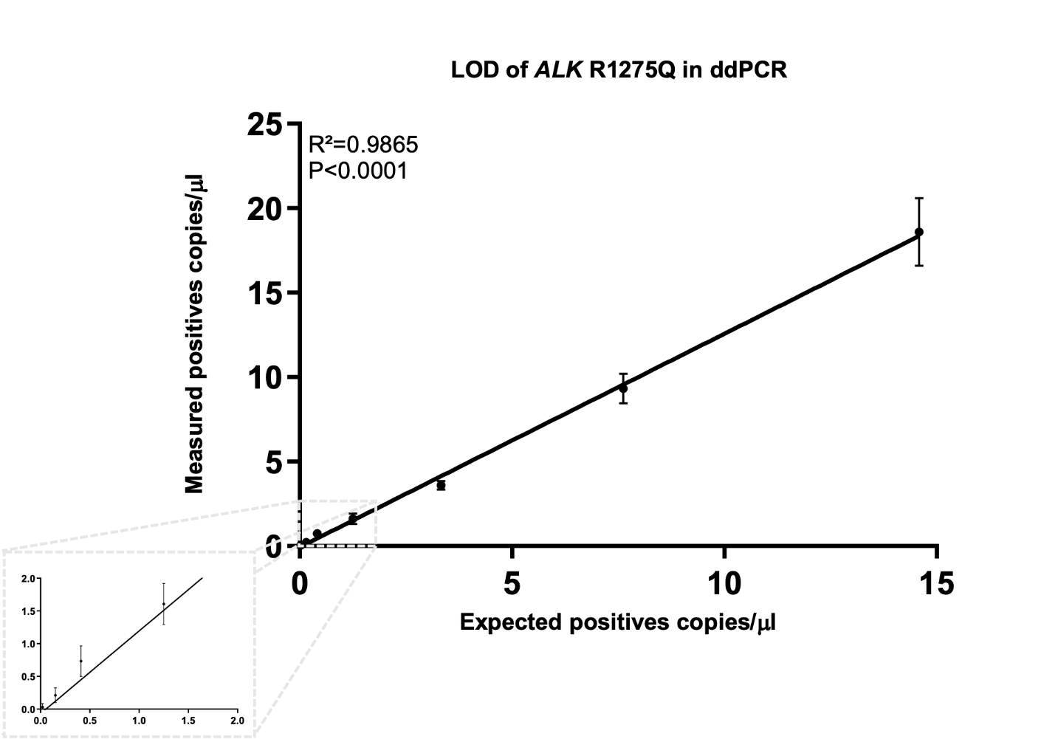

Supplementary Figure 1
A
B
 |  | cp/µL (mean) | ng/mL (mean) | VAF (mean)
ALK R1275Q | dil1 | 18.59 | 64.00 | 10.81%
 | dil2 | 9.32 | 32.00 | 5.19%
 | dil3 | 3.60 | 13.00 | 2.29%
 | dil4 | 1.61 | 5.50 | 1.35%
 | dil5 | 0.73 | 2.50 | 0.94%
 | dil6 | 0.21 | 0.75 | 0.36%
 | dil7 | 0.03 | 0.10 | 0.19%
 |  | cp/µL (mean) | ng/mL (mean) | VAF (mean)
ALK F1174L | dil1 | 15.81 | 55.00 | 9.69%
 | dil2 | 6.24 | 21.50 | 4.08%
 | dil3 | 2.97 | 10.30 | 1.92%
 | dil4 | 1.26 | 4.40 | 0.99%
 | dil5 | 0.59 | 2.04 | 0.62%
 | dil6 | 0.38 | 1.30 | 0.58%
 | dil7 | 0.17 | 0.59 | 0.38%
 | dil8 | 0.08 | 0.28 | 0.22%
 | dil9 | 0.03 | 0.10 | 0.12%

Slide 2
Supplementary figure 1: Sensitivity and limit of detection of ALK mutations by ddPCR
(A) Calculated number of copies (column A) and mean (of triplicate measurements) for measured copies/µl for ALK R1275Q and F1174L serial dilutions. For this experiment, genomic DNA harboring an ALK mutation was serially diluted in ALK wt genomic DNA.
(B) Correlation analysis of theoretically calculated ALK R1275Q copies/µl (x-axis) and copies/µl measured in ddPCR by diluting Mutated ALK R1275Q DNA from CLB-GA cell line with wild type DNA from SJNB1 cell line (y-axis, as mean ± SD; n ≥ 3).
Pearson’s correlation coefficient (r) and p-value are indicated, consistent with a strong correlation (R²= 0.9865, P value <0.0001)
(C) Correlation analysis of theoretically calculated ALK F1174L copies/µl (x-axis) and copies/µl measured in ddPCR by diluting Mutated ALK F1174L DNA from SK-SY5Y cell line with wild type DNA from SJNB1 cell line (y-axis, as mean ± SD; n ≥ 3).
Pearson’s correlation coefficient (r) and p-value are indicated, consistent with a strong correlation (R²=0.9827, P value <0.0001)

Slide 3
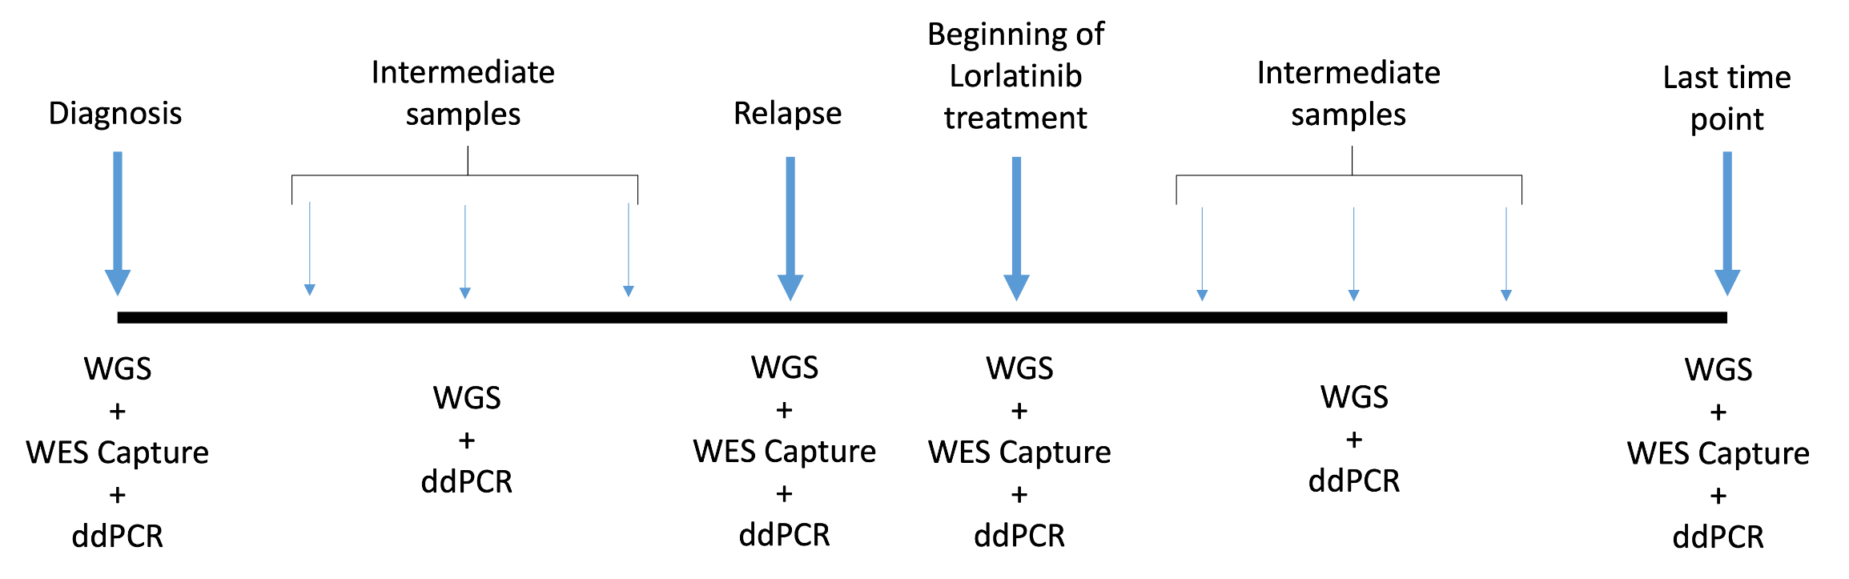
Supplementary Figure 2

Slide 4
Supplementary figure 2: Overall study organization
cfDNA was extracted from sequential plasma samples (bone/bone marrow), WGS sequencing libraires were constructed and then were subjected to different analytical techniques: 1) ddPCR targeting the known ALK hotspot mutation hotspots (F1174L, R1275Q, I1170N) for evaluation of disease burden at all available timepoints; 2) cfDNA WES for study of clonal evolution, following comparison with tumor/germline WES, at diagnosis (if available, relapse, at the begin of Lorlatinib treatment and at a last available timepoint.

Slide 5
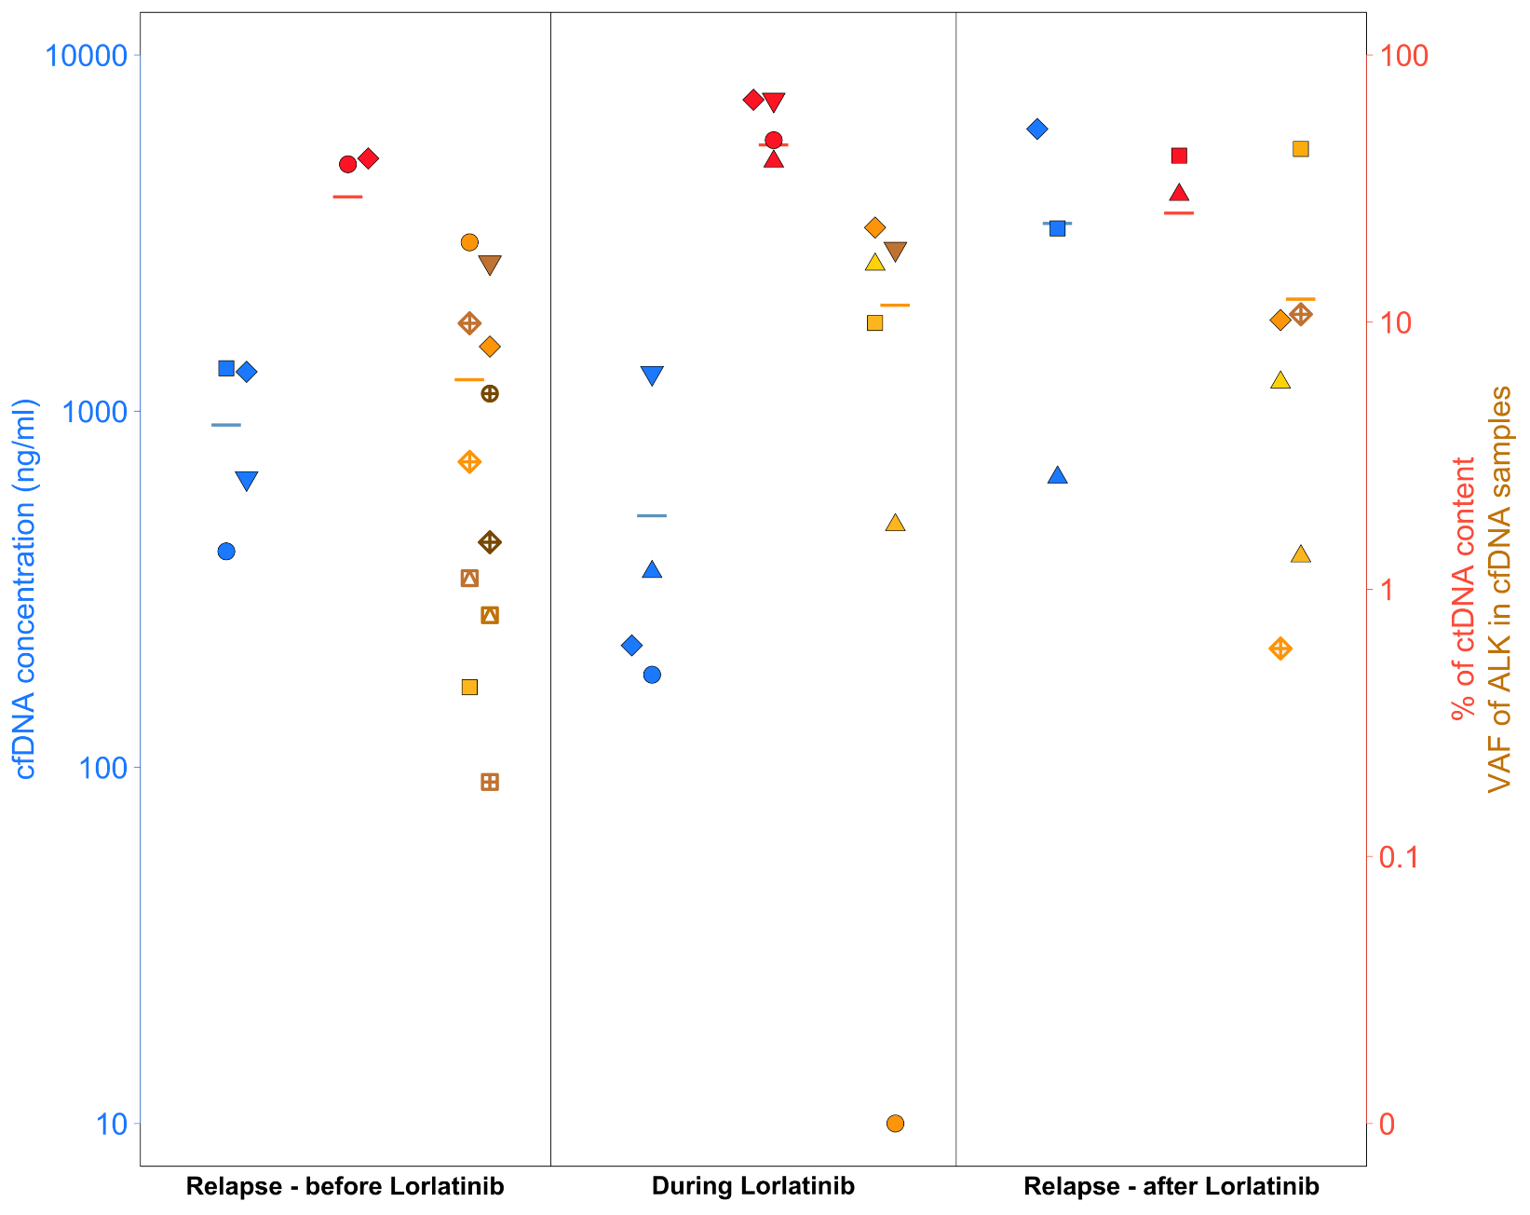
Supplementary Figure 3

Slide 6
Supplementary figure 3: cfDNA concentration, ctDNA content and VAF of ALK alterations in cfDNA samples of patients according to treatment phases (Relapse-Before Lorlatinib treatment (8 patients), During Lorlatinib (5 patients), Relapse - after Lorlatinib treatment (4 patients)). The shape of the points indicates different patients. The colors of the points indicate the values for: cfDNA in blue, ctDNA in red, each type of ALK SNV in a shade of orange. The bars represent the mean values for each category of data.

Slide 7
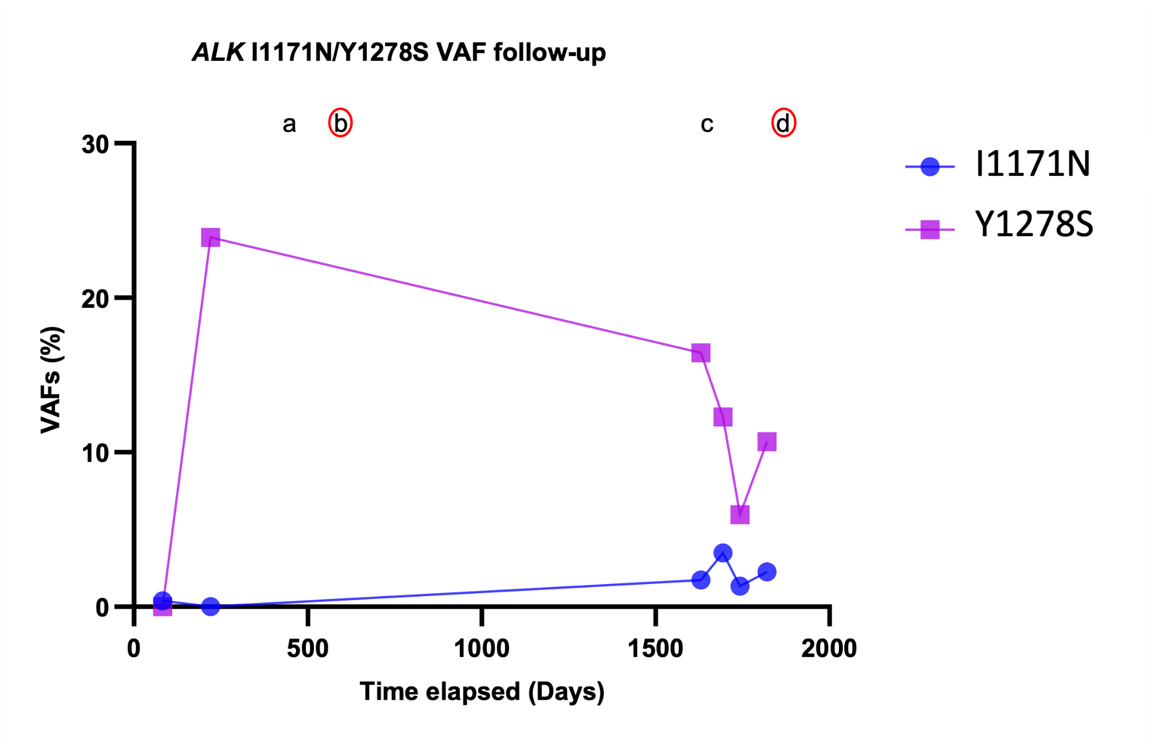
Supplementary Figure 4

Slide 8
Supplementary figure 4: cfDNA ALK VAF in patient 18 (38 years, metastatic neuroblastoma without identified primary tumor, no MYCN amplification, ALK R1278 at diagnosis). Treatment is indicated by letters and consisted in rapid COJEC at diagnosis (stable disease), topotecan cyclophosphamide (stable disease), (a) crizotinib (stable disease), (b) lorlatinib resulting in partial response followed by progression, (c) ceritinib (progressive disease), (d) lorlatinib.

Slide 9
Supplementary Figure 5
Mann Withney, p = 0.62

Slide 10
Supplementary figure 5: Comparison of ALK VAF determined by WES and ddPCR in cfDNA WGS libraries. In cfDNA WGS libraries analyzed by ddPCR and WES, no statistically significant difference between cfDNA ALK VAF measured by WES and ddPCR was observed (Mann-Whitney text, p=0.62).

Slide 11


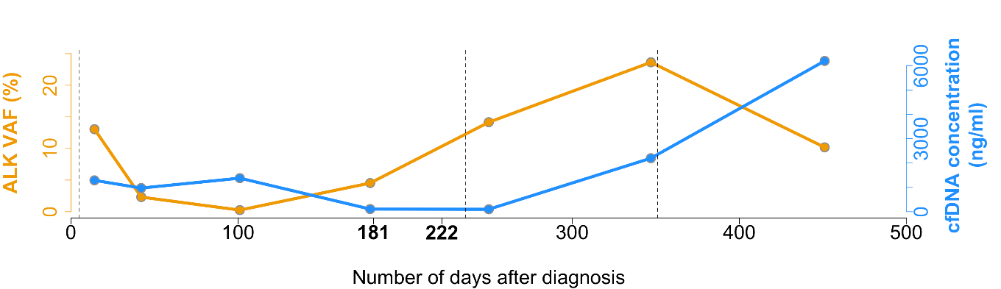
Supplementary Figure 6
SIOPEN score
5
23
Patient 7
a
b
c

Slide 12
Supplementary Figure 6: Clinical evaluation and cfDNA analysis in patient 7 : The patient had a prerenal neuroblastoma with osteomedullary metastatis at diagnosis, stage INRG M, with MYCN amplification and ALK F1174L mutation, SIOPEN score 62 at diagnosis. Following induction treatment (rapid COJEC), overall partial response was observed on day 181 after diagnosis, with local partial response (> 50%) and metastatic partial response (SIOPEN score 5; >50% reduction in MIBG absolute bone score)³³. cfDNA ALK VAF showed an increase from 0.25% (day 101) to 4.5% (day 179). The patient underwent surgery for resection of the primary tumor, according to protocol. Metastatic progressive disease was then confirmed by imaging on day 222, following appearance of clinical symptoms (pain), with an increase of the SIOPEN score to 23. Lorlatinib treatment was begun on day 236, without response.

