Slide 1
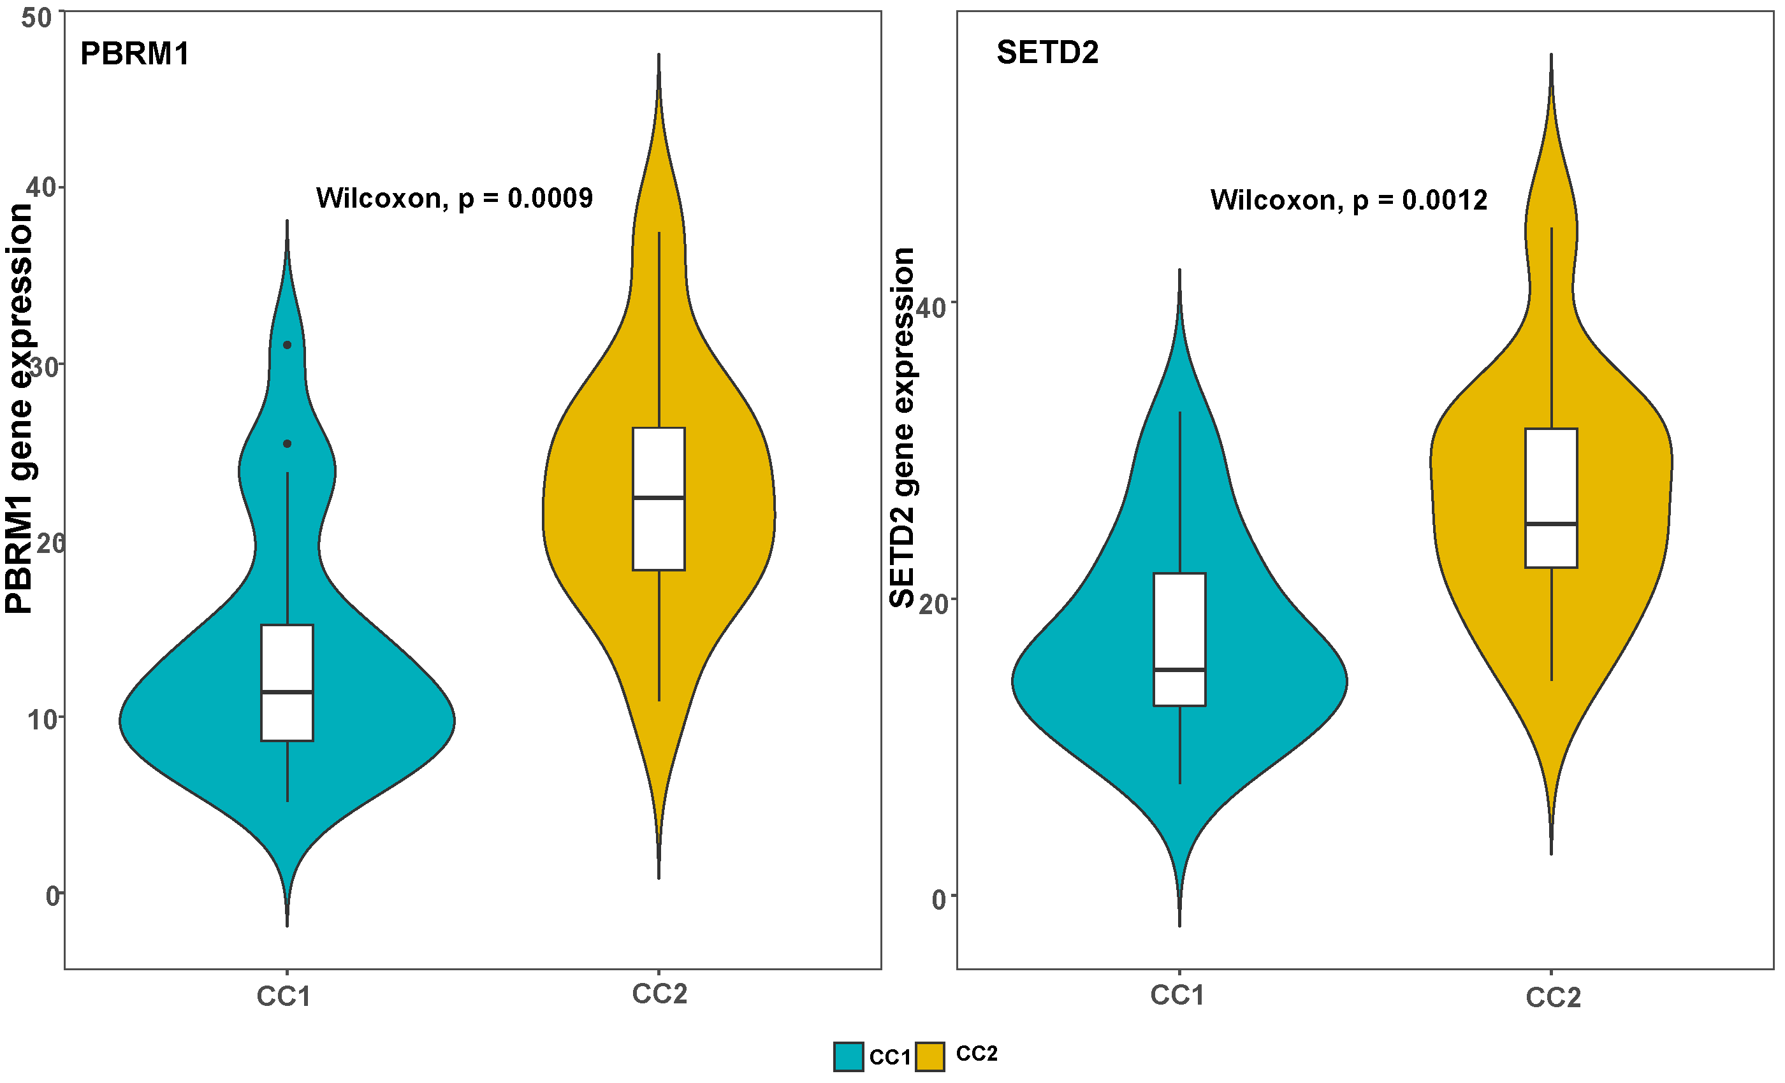
Figure S1A: PBRM1 and SETD2 expression between CC1 and CC2

Slide 2
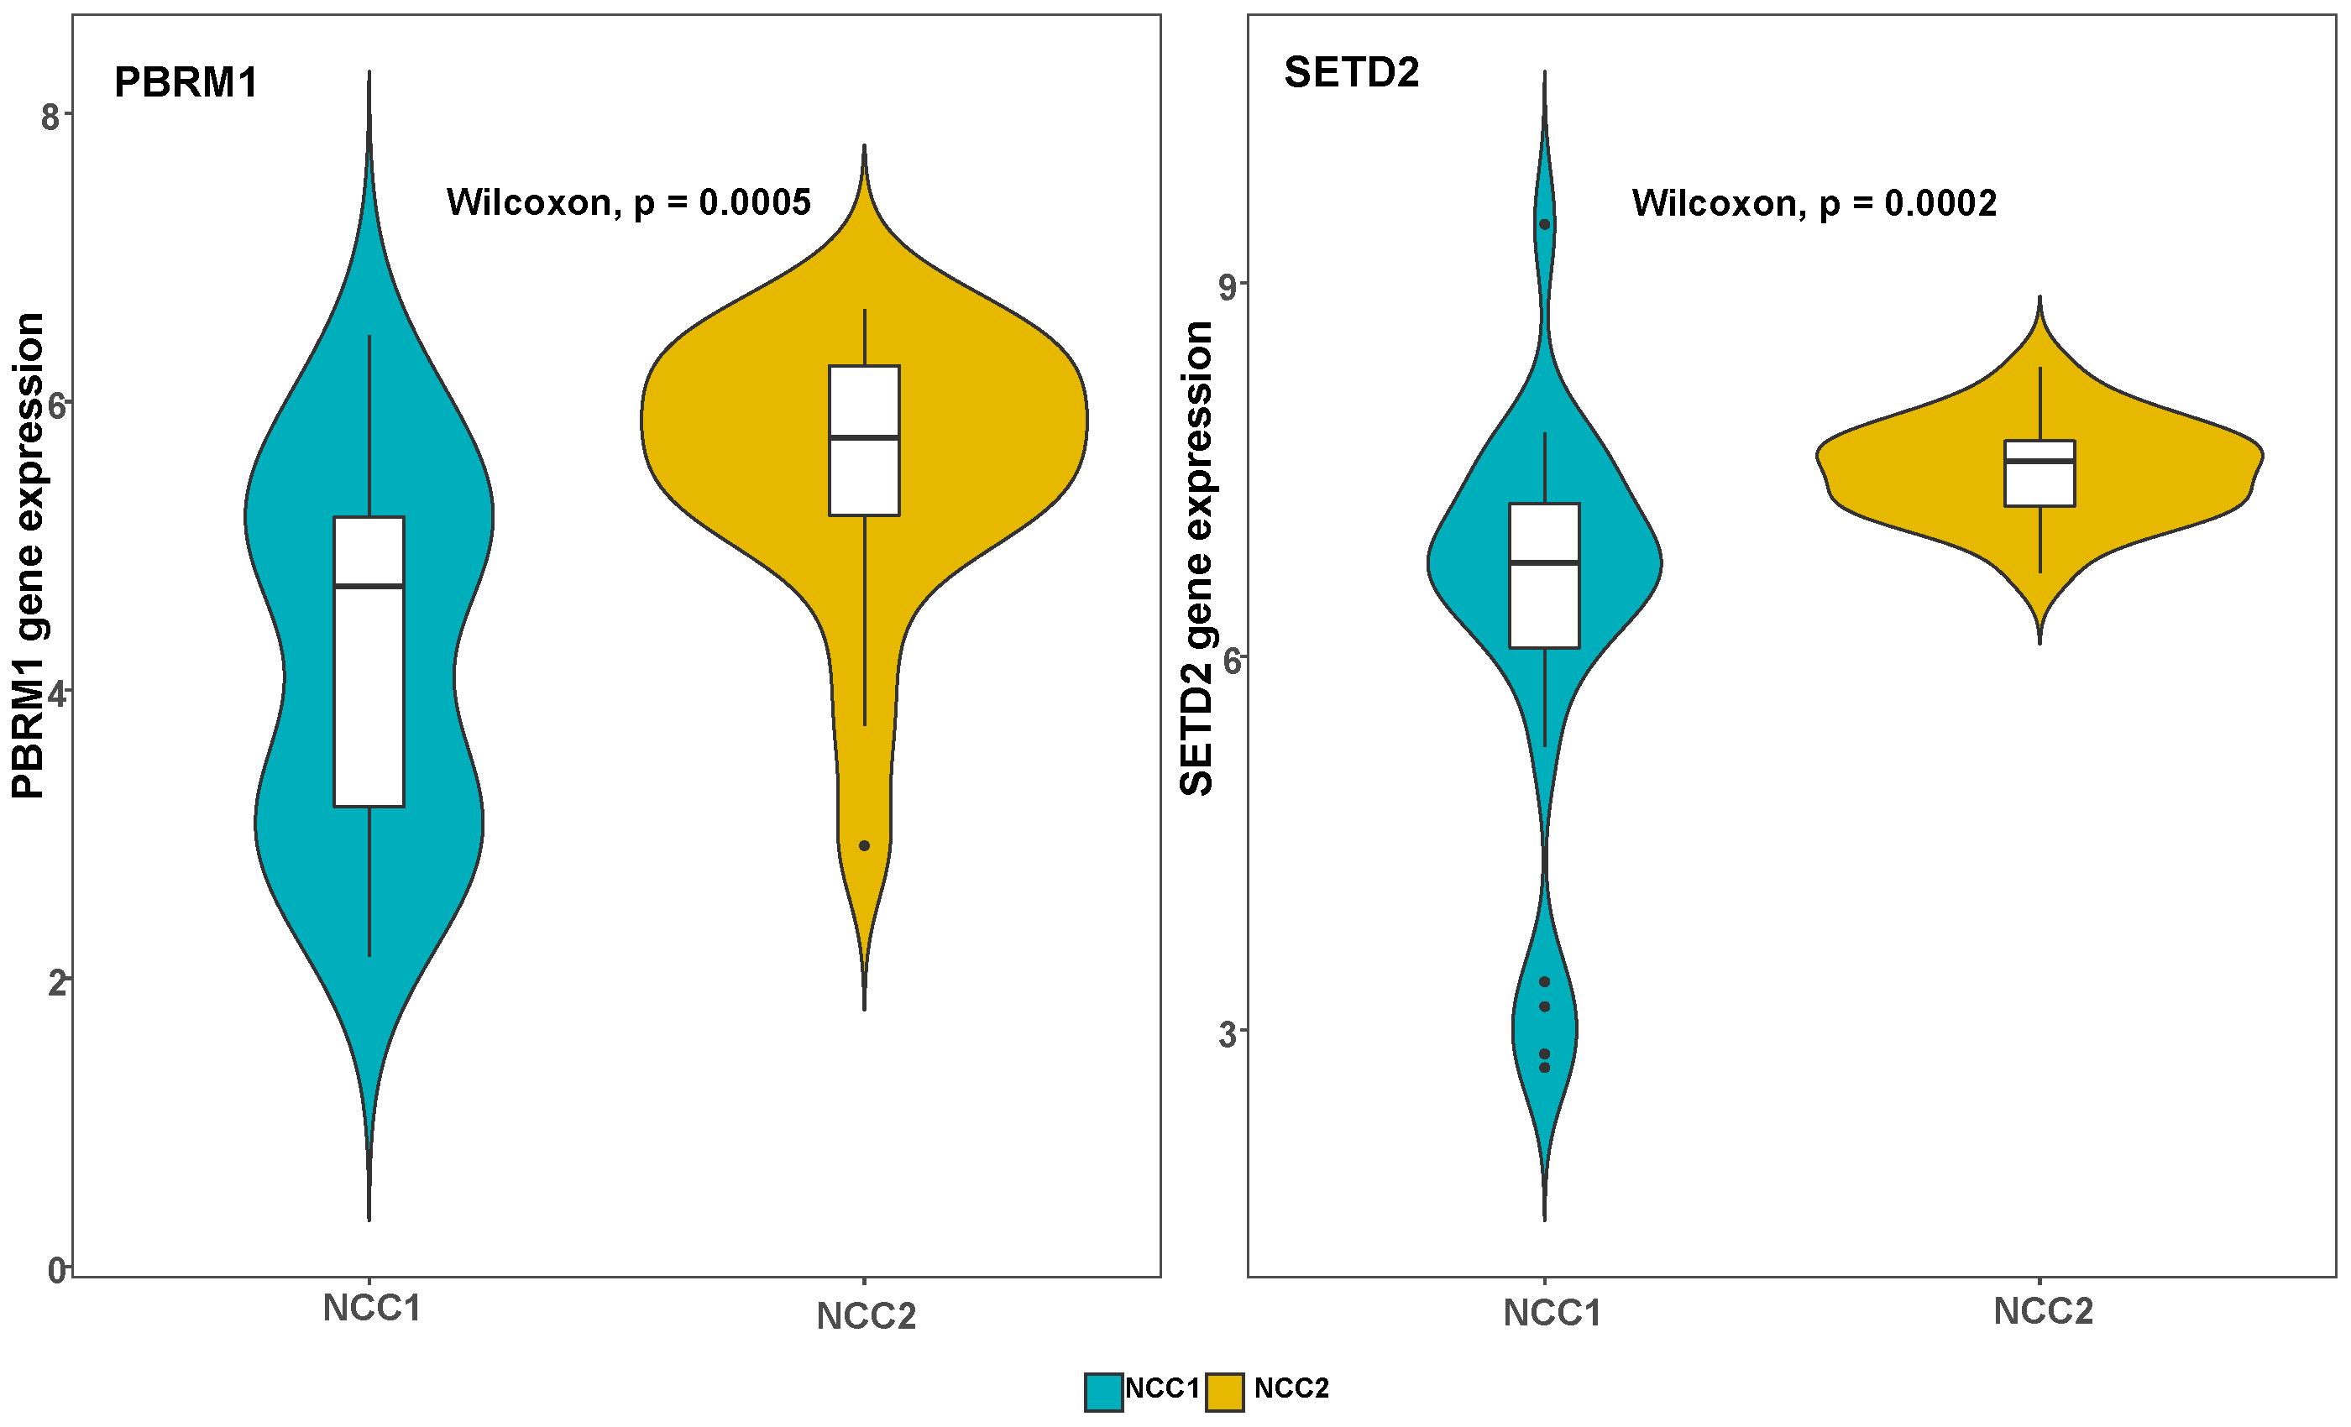
Figure S1B: PBRM1 and SETD2 expression between NCC1 and NCC2

Slide 3
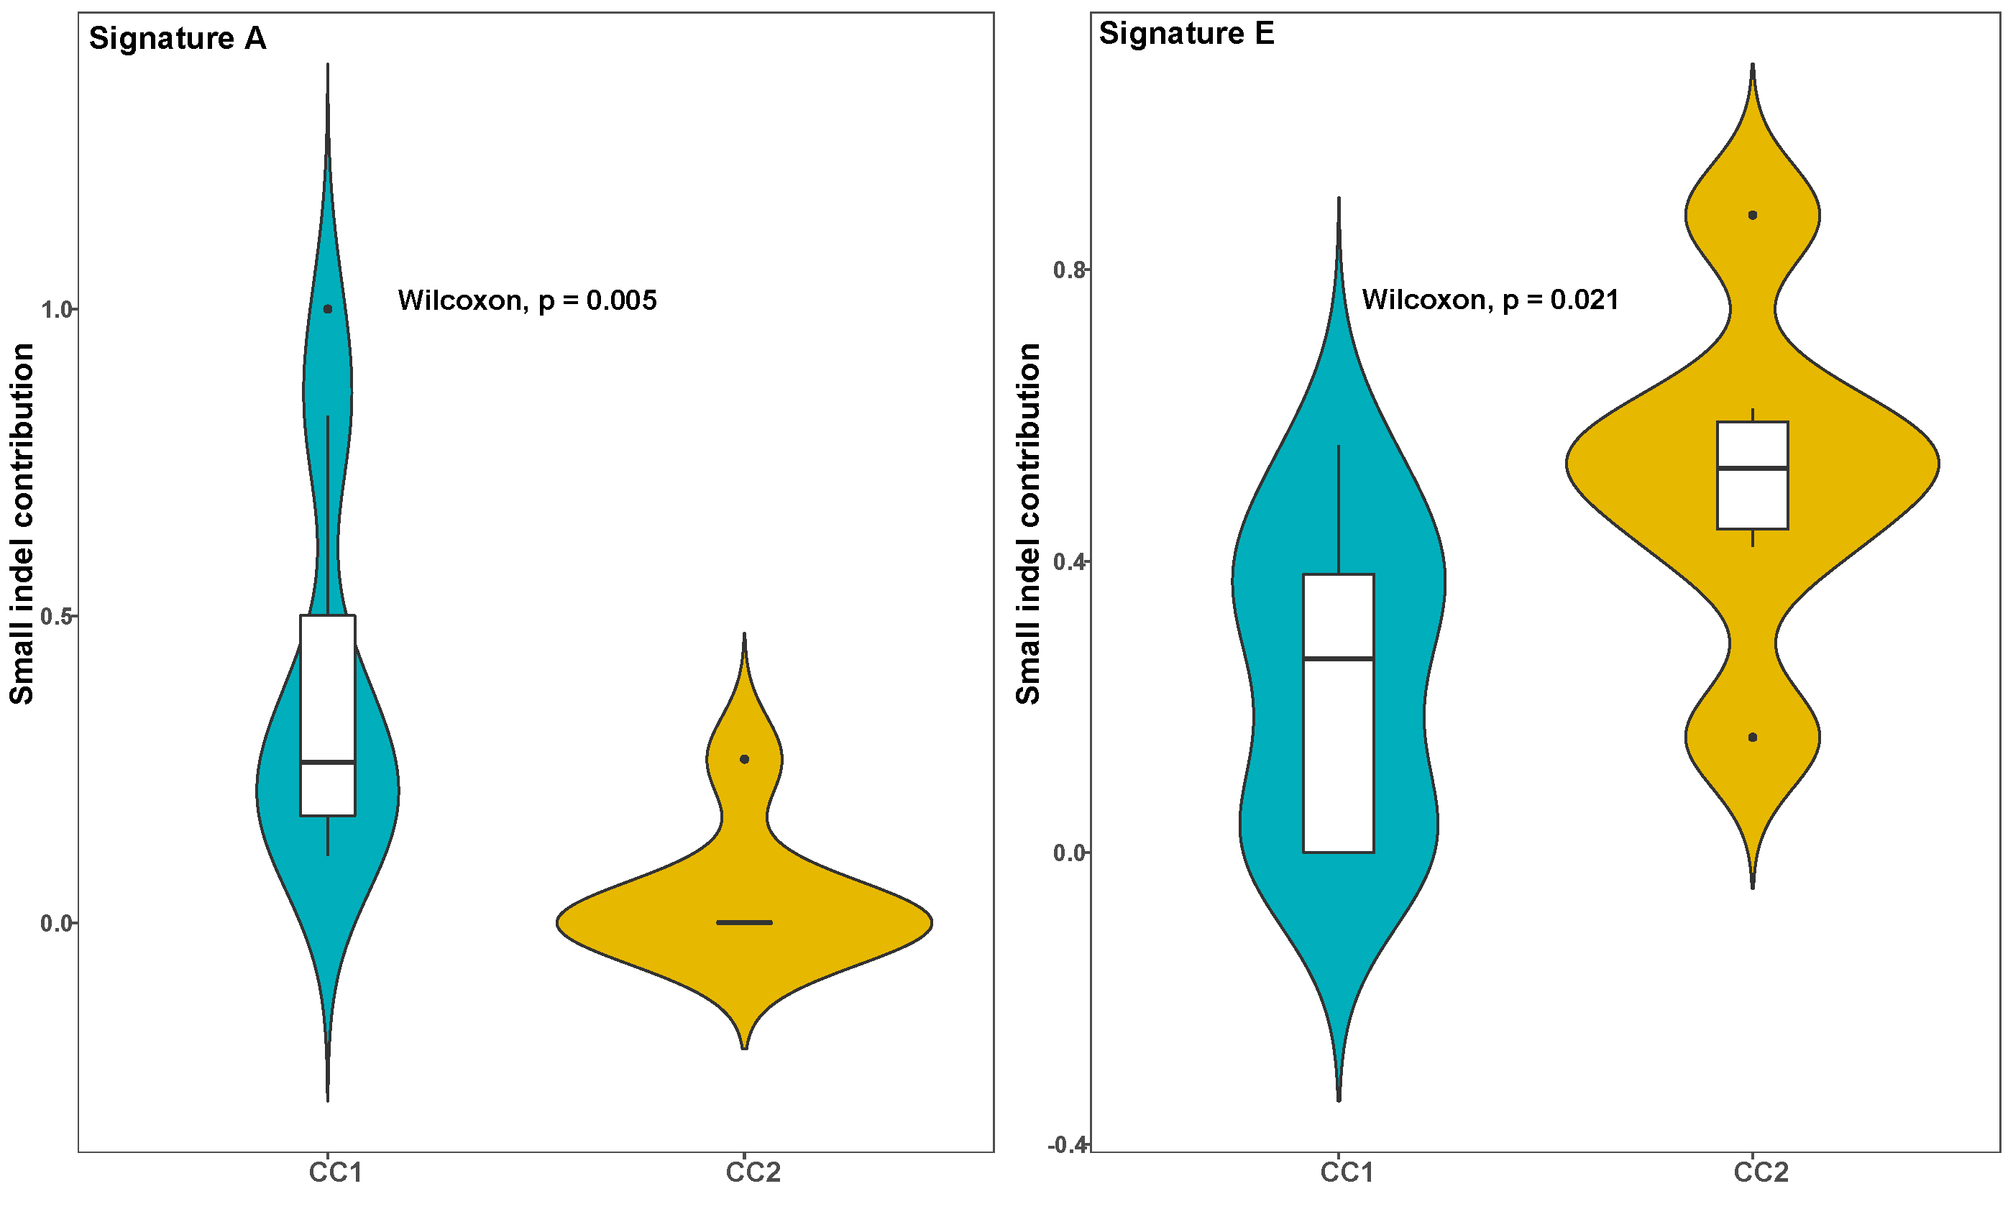
Figure S2A: Contributions of small indel (ID) signatures (A and E) between CC1 and CC2

Slide 4
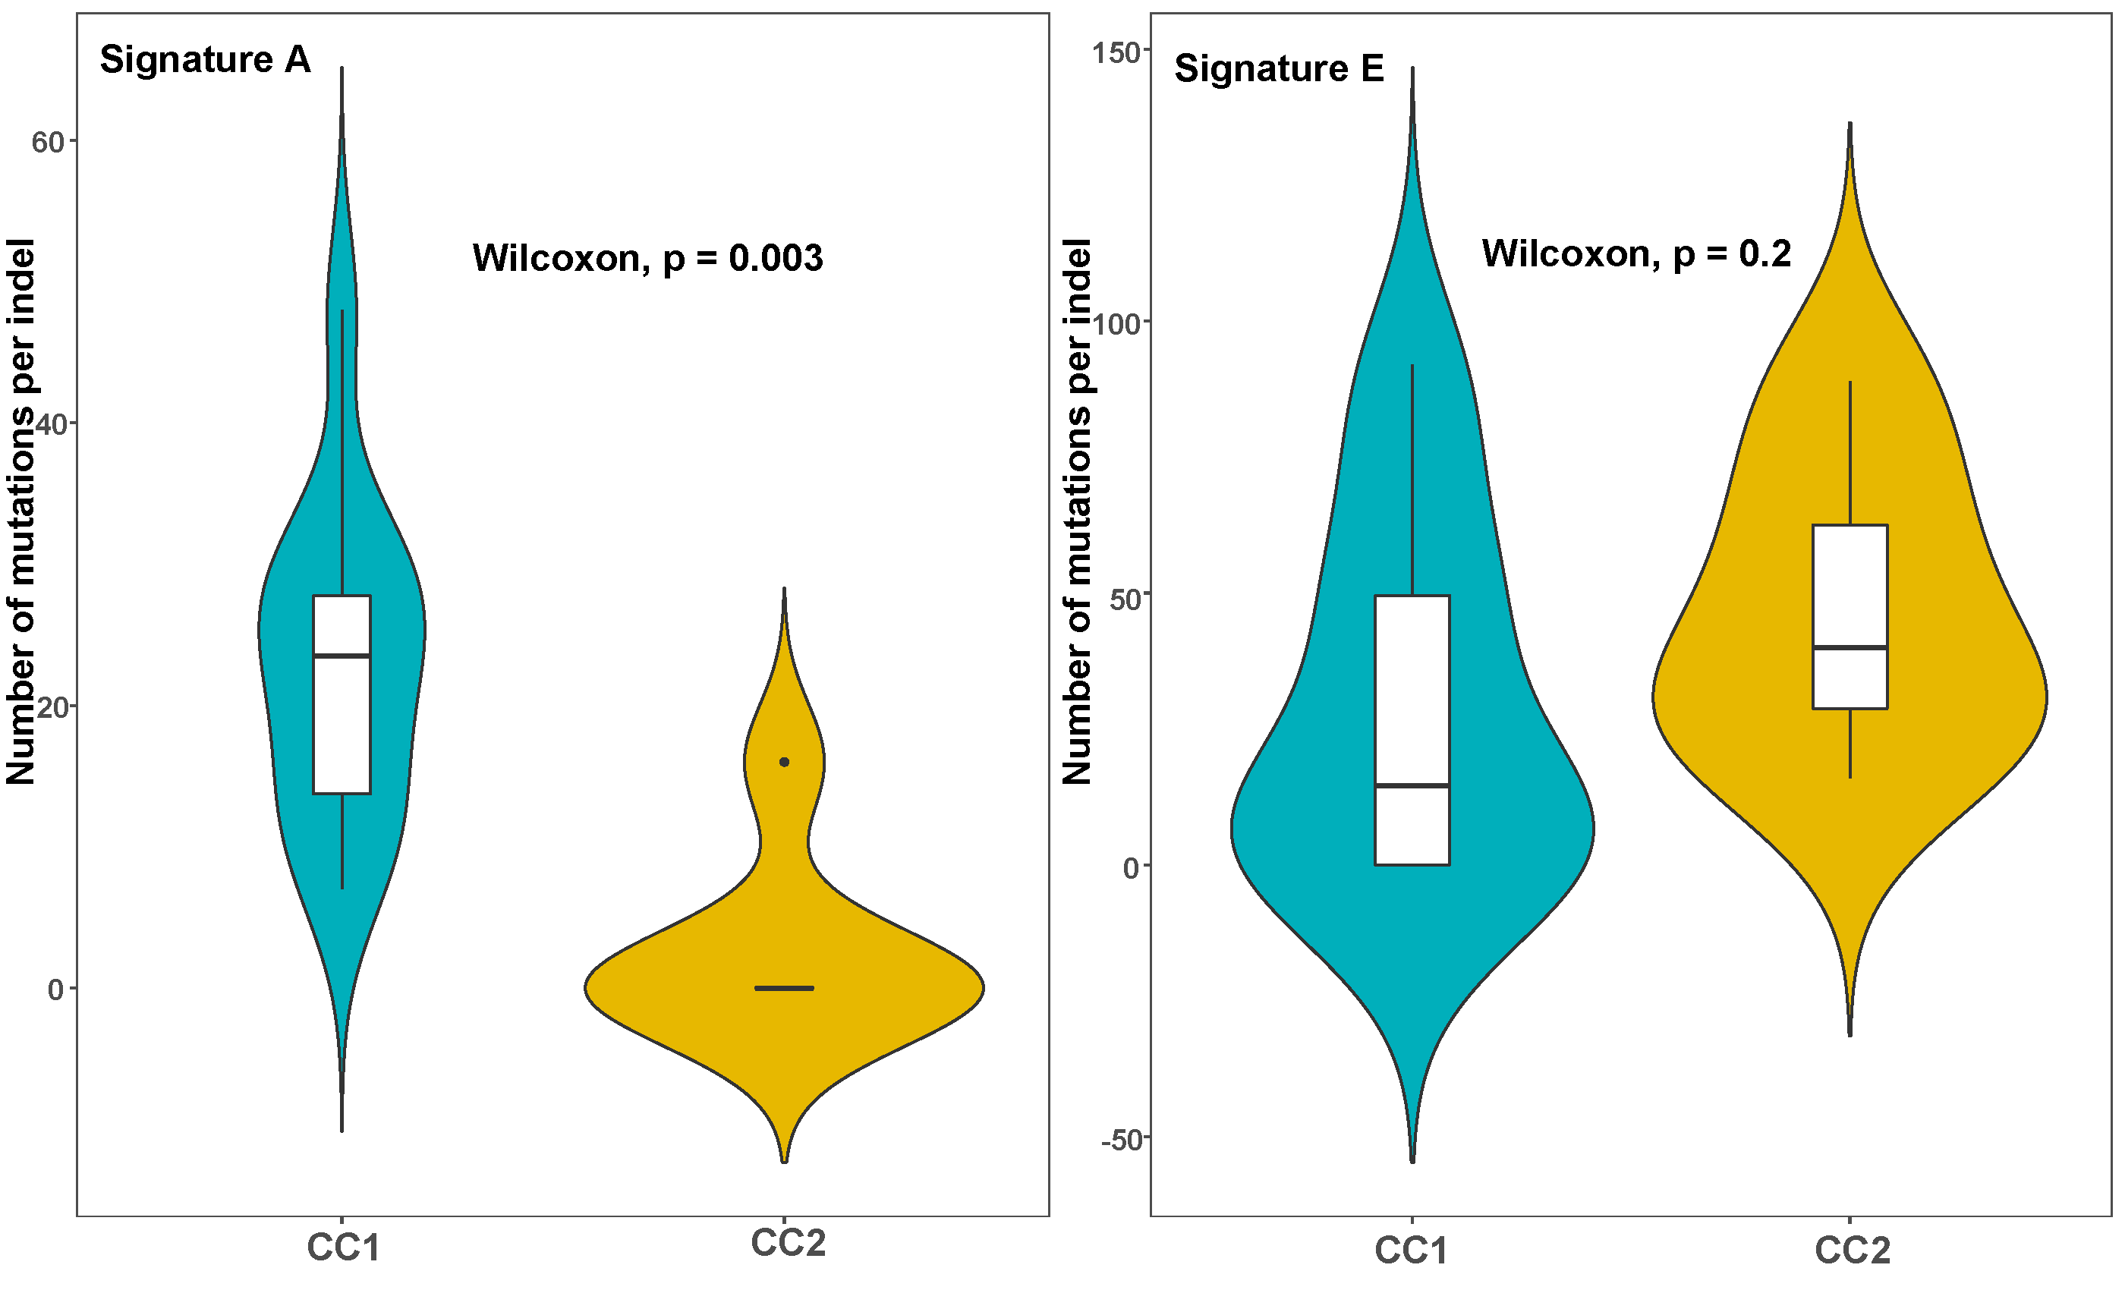
Figure S2B: Number of mutations in small indel (ID) signatures (A and E) between CC1 and CC2

Slide 5
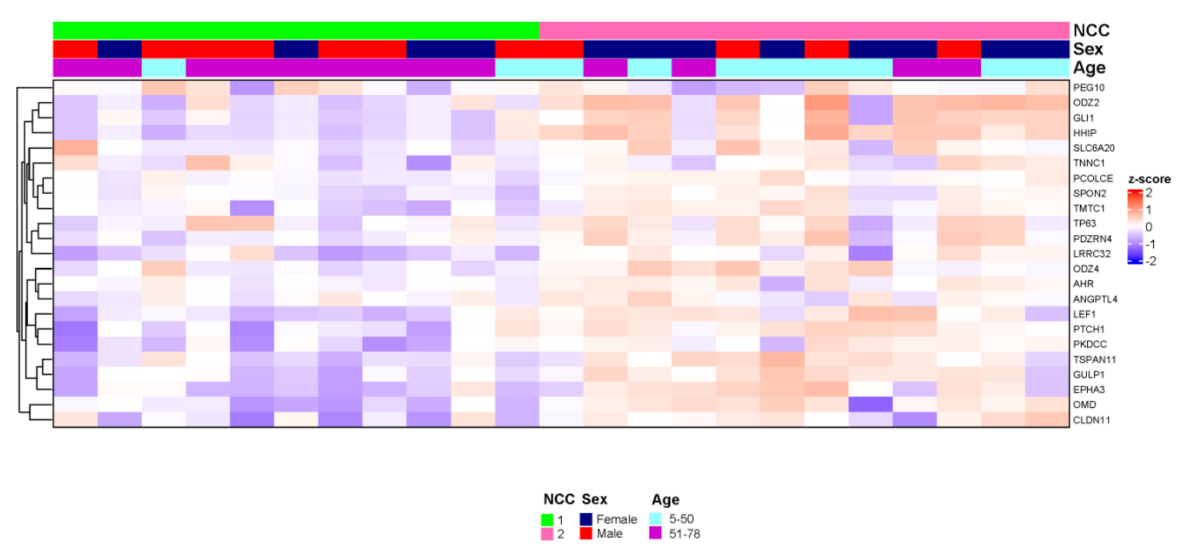
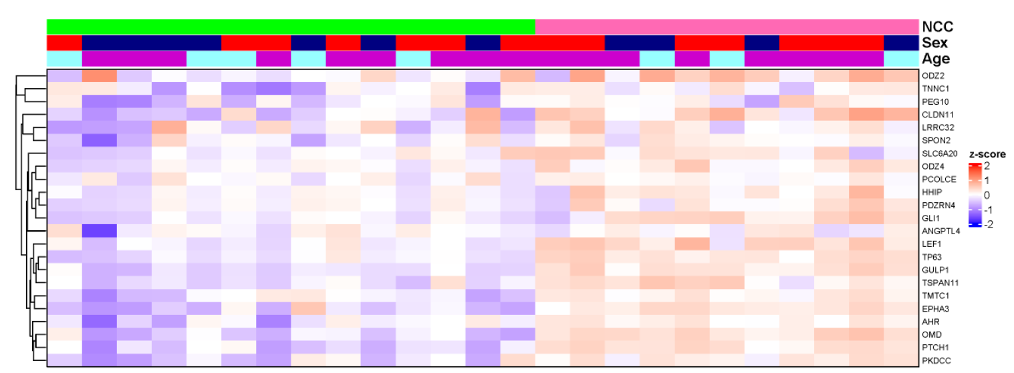
Figure S3: Gene expression profiling based on the NanoString panel in 23 skull-base (top) and 25
non-skull-base (bottom) chordoma patients from North America

Slide 6
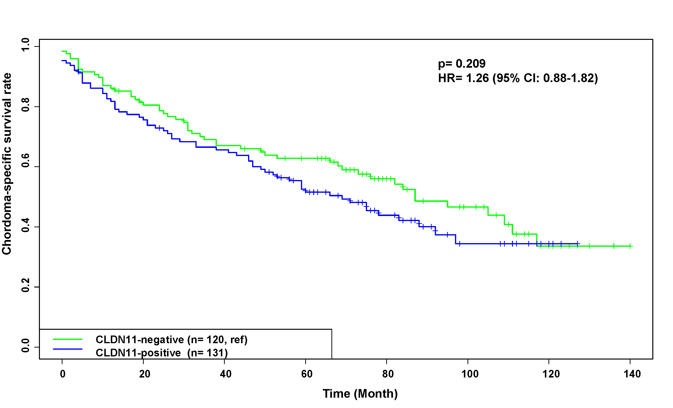
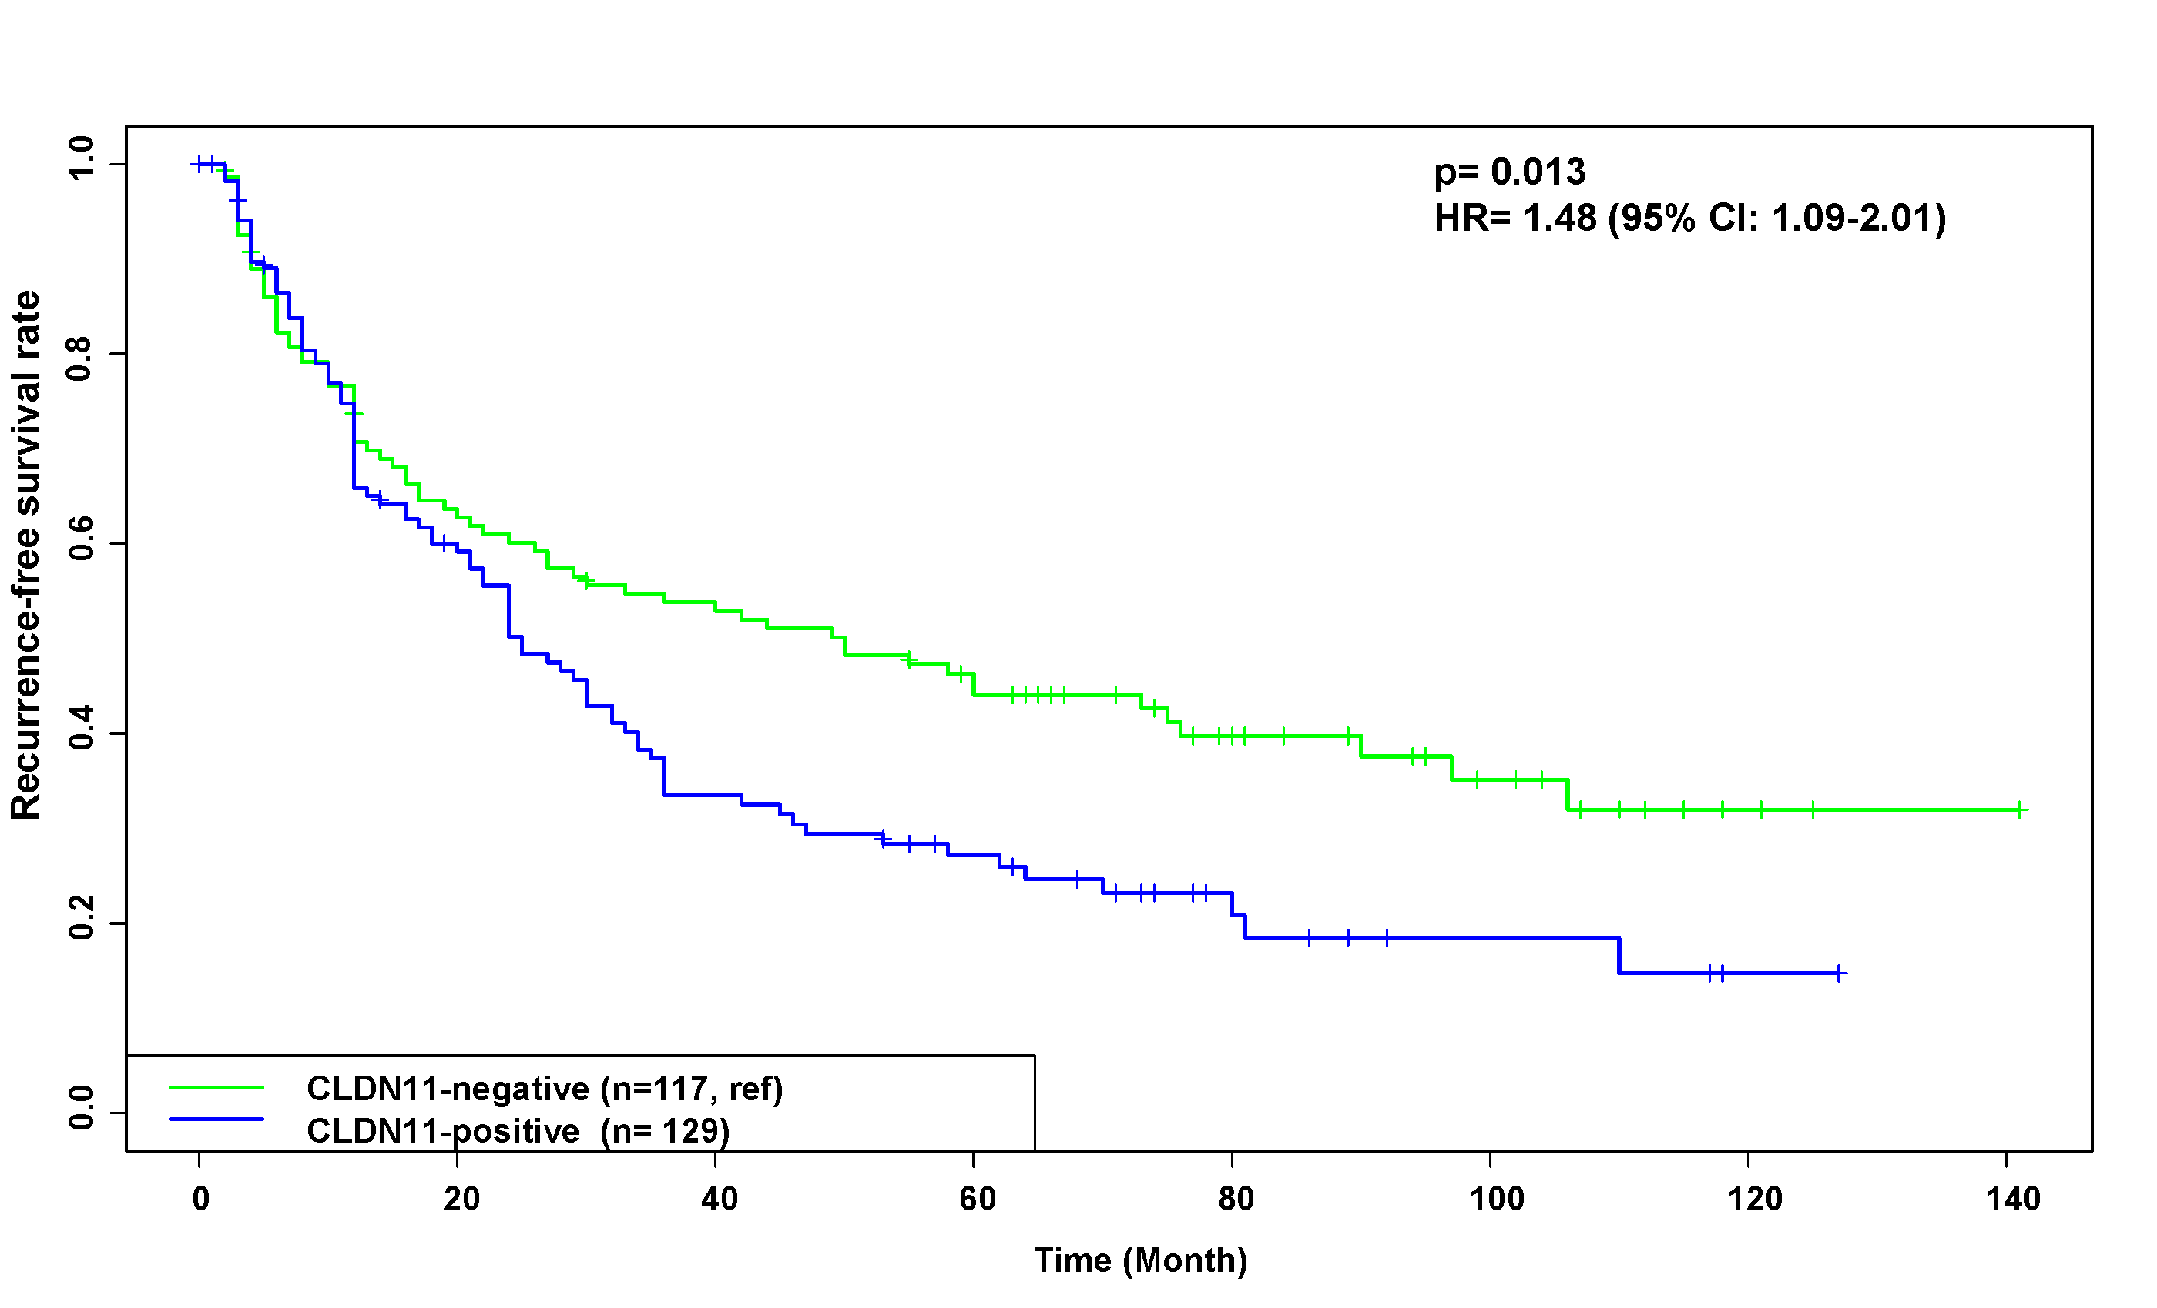
Figure S4: Expression of selected markers in relation to overall survival (left) and recurrence-free survival
(right) in Chinese chordoma patients with long-term follow-up data
CLDN11

Slide 7
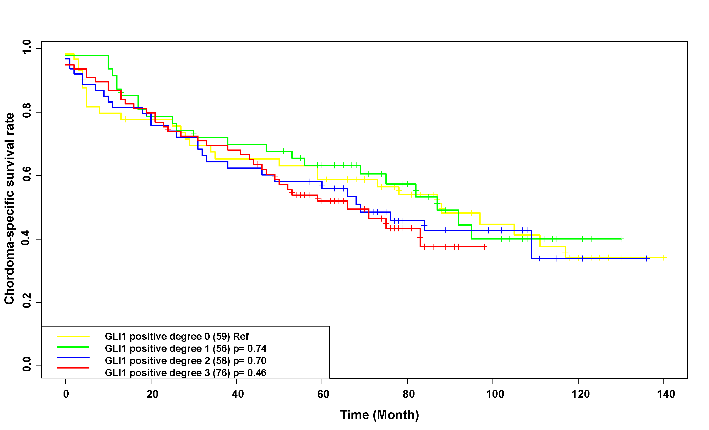
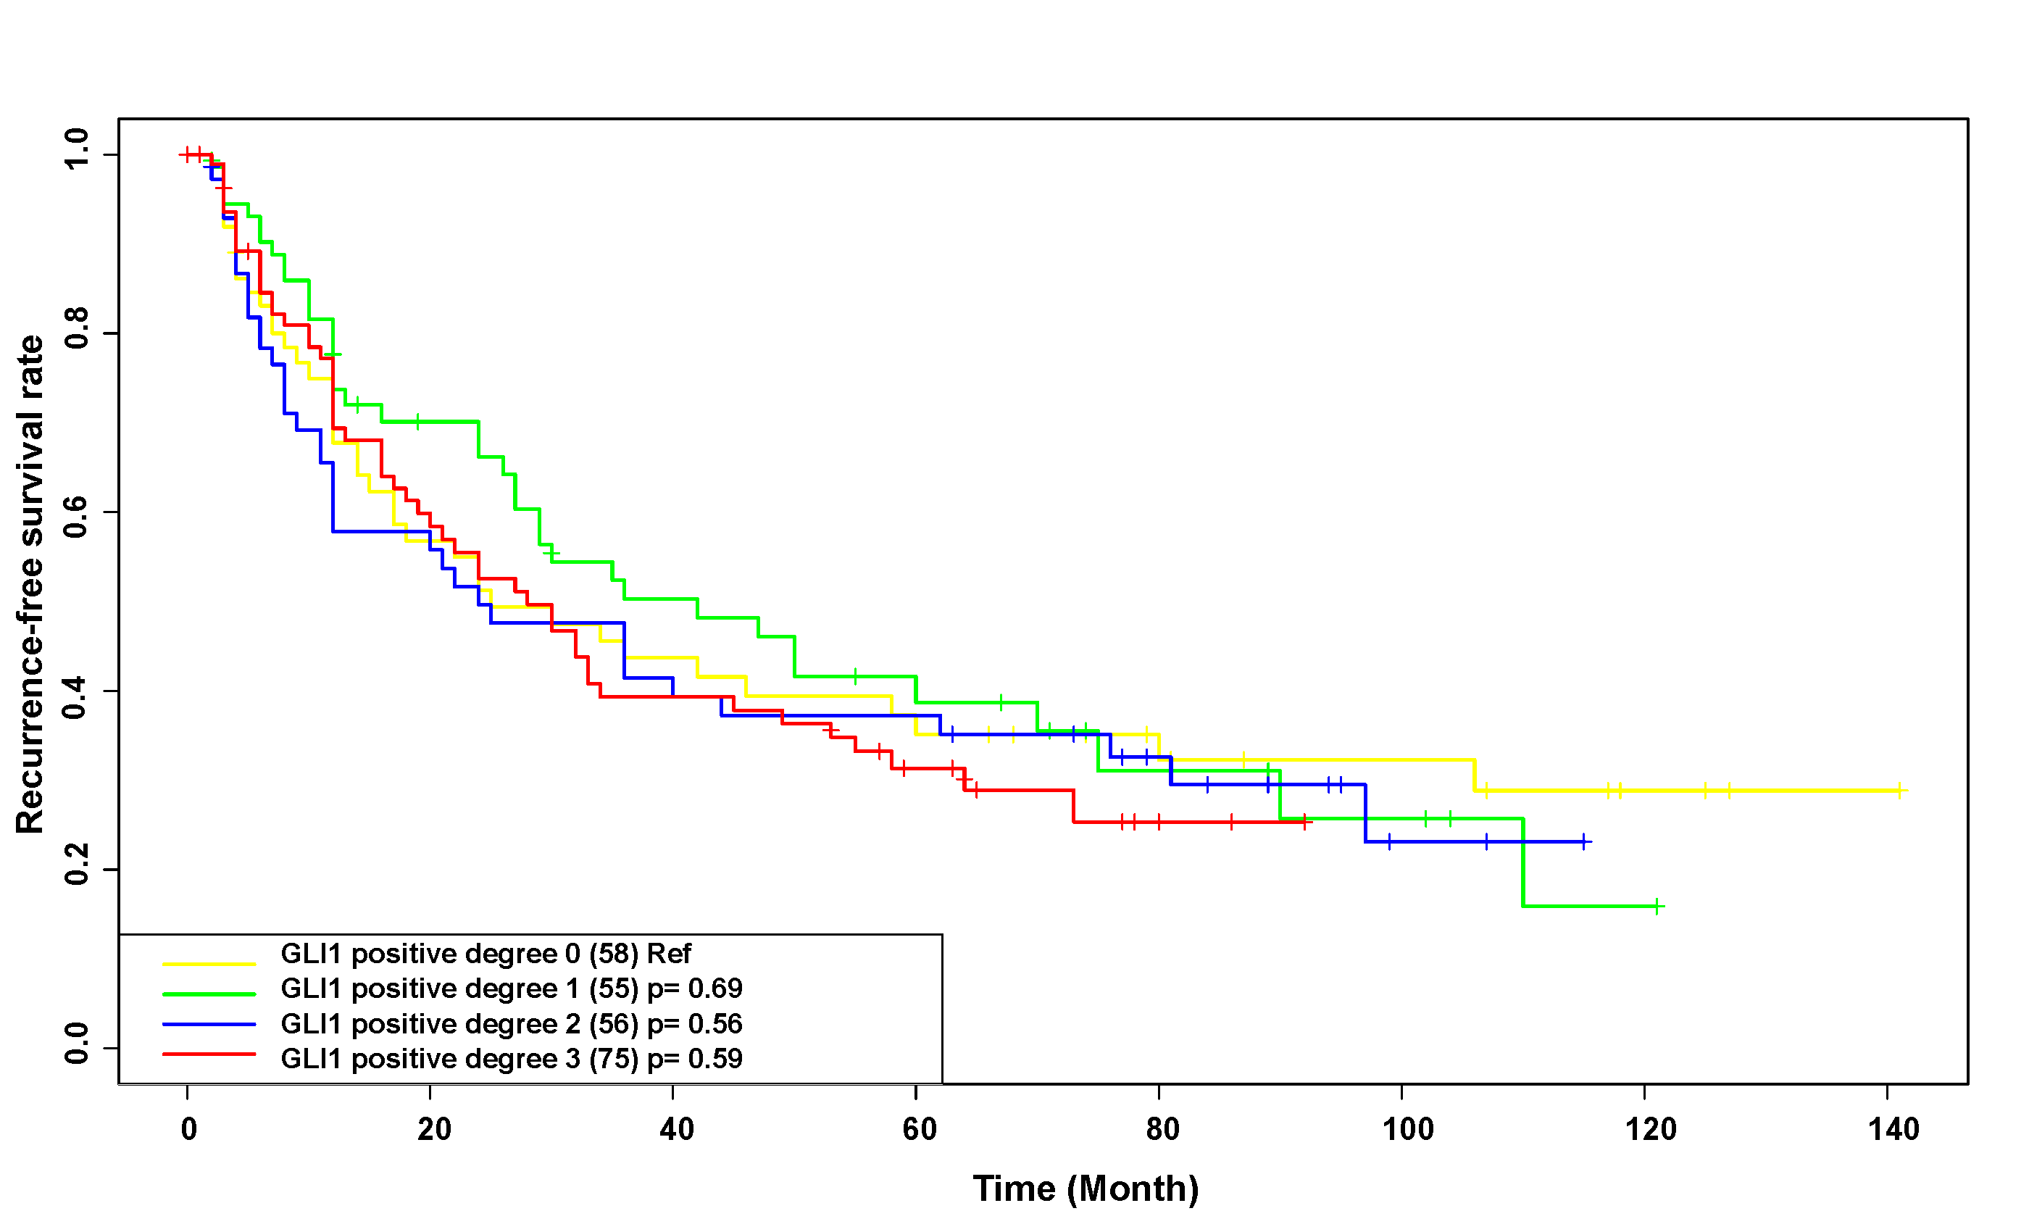
Figure S4: Expression of selected markers in relation to overall survival (left) and recurrence-free survival
(right) in Chinese chordoma patients with long-term follow-up data
GLI1

Slide 8
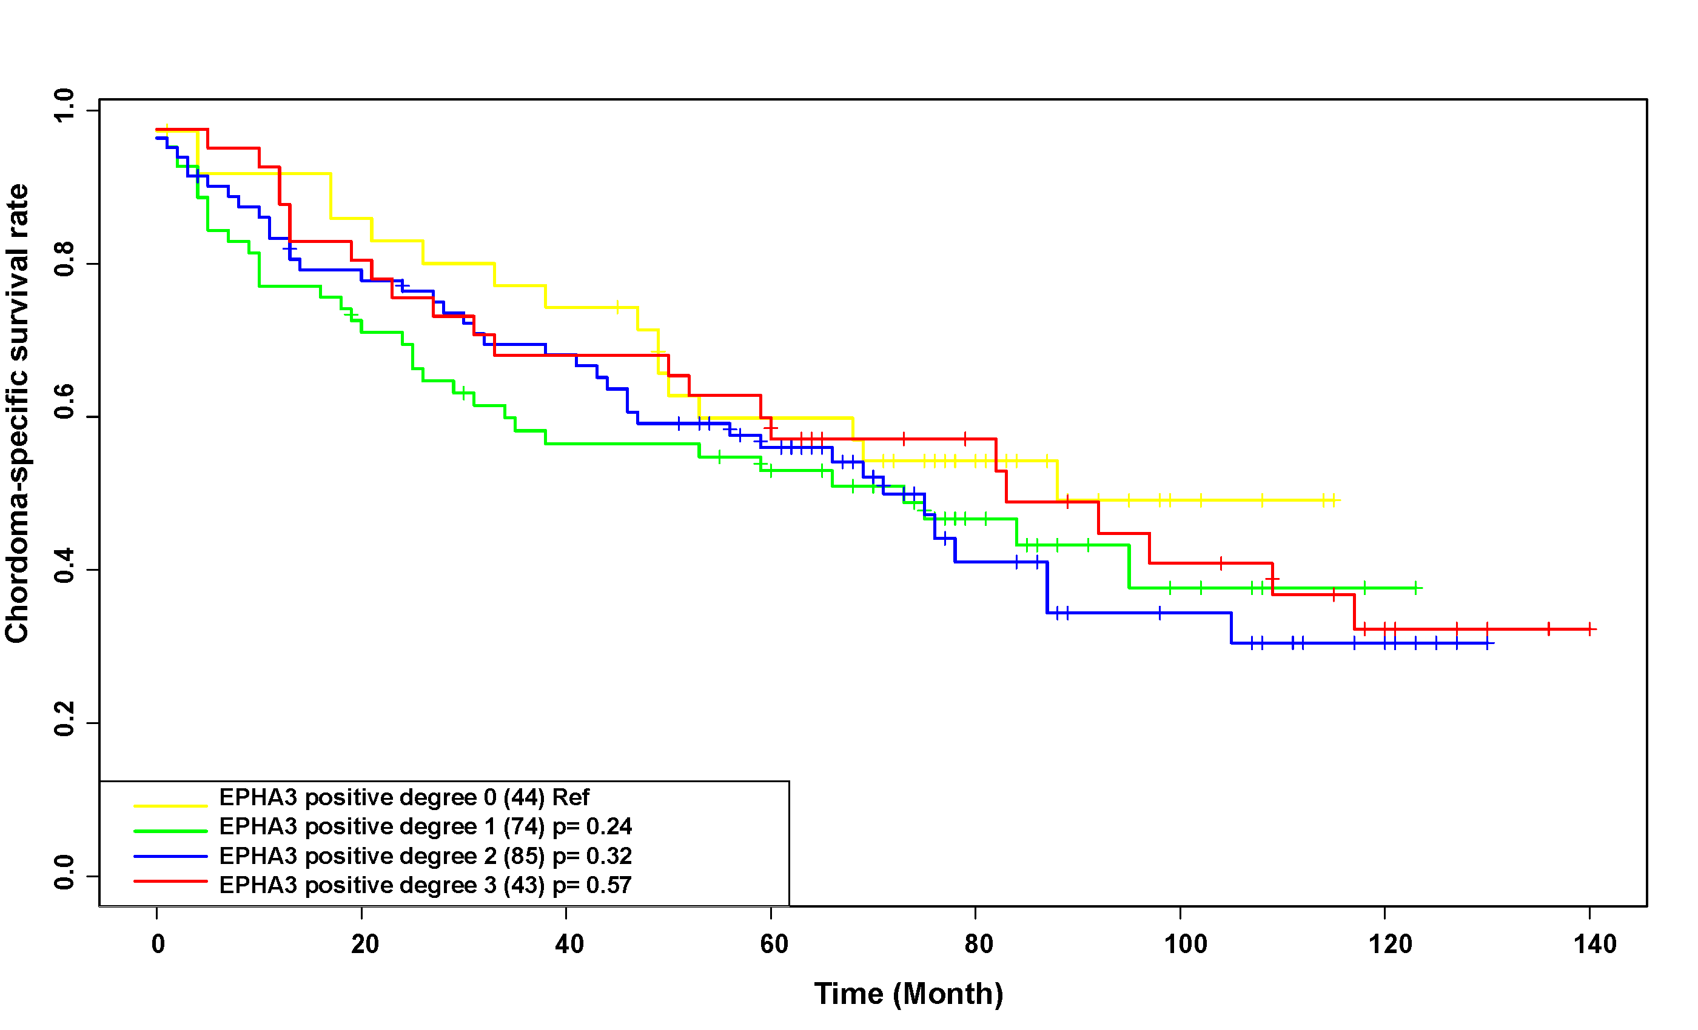
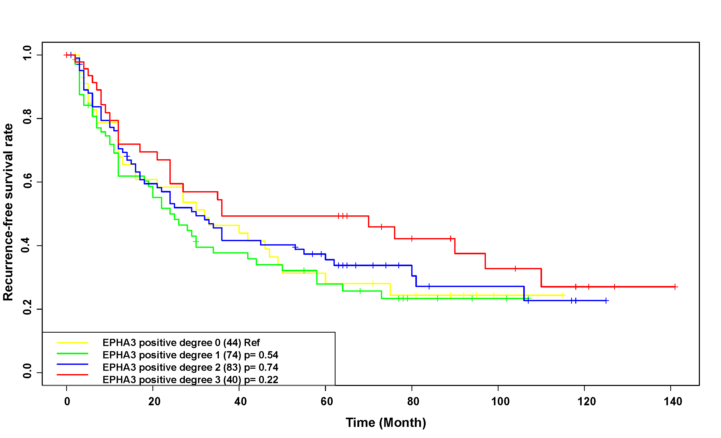
Figure S4: Expression of selected markers in relation to overall survival (left) and recurrence-free survival
(right) in Chinese chordoma patients with long-term follow-up data
EPHA3

Slide 9
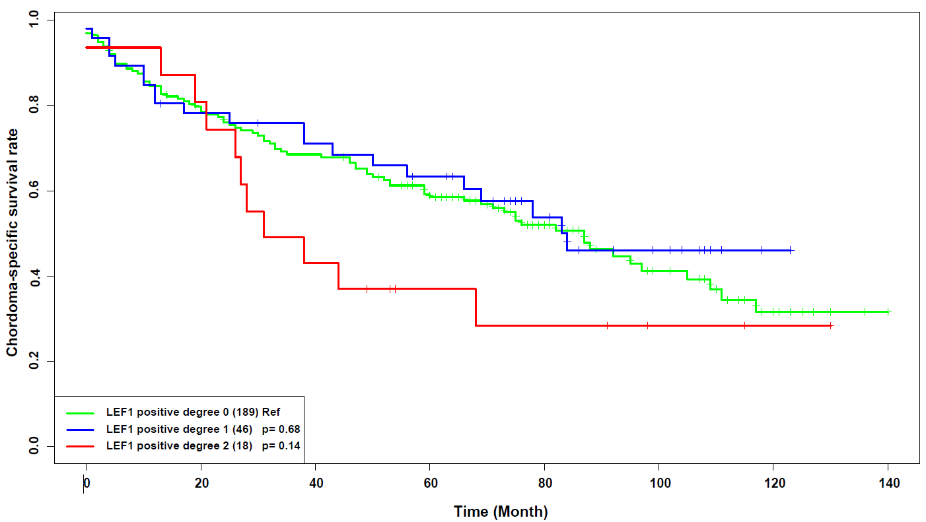
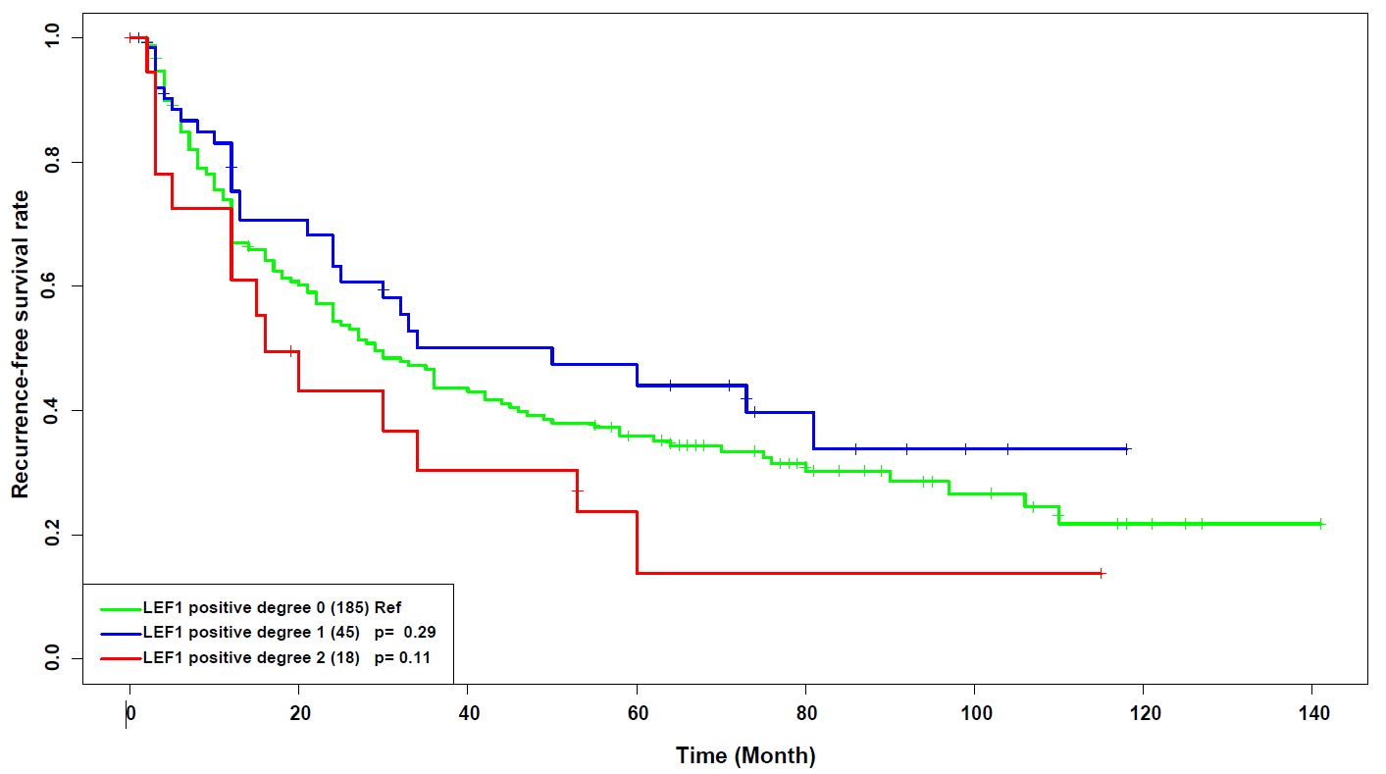
Figure S4: Expression of selected markers in relation to overall survival (left) and recurrence-free survival
(right) in Chinese chordoma patients with long-term follow-up data
LEF1

Slide 10
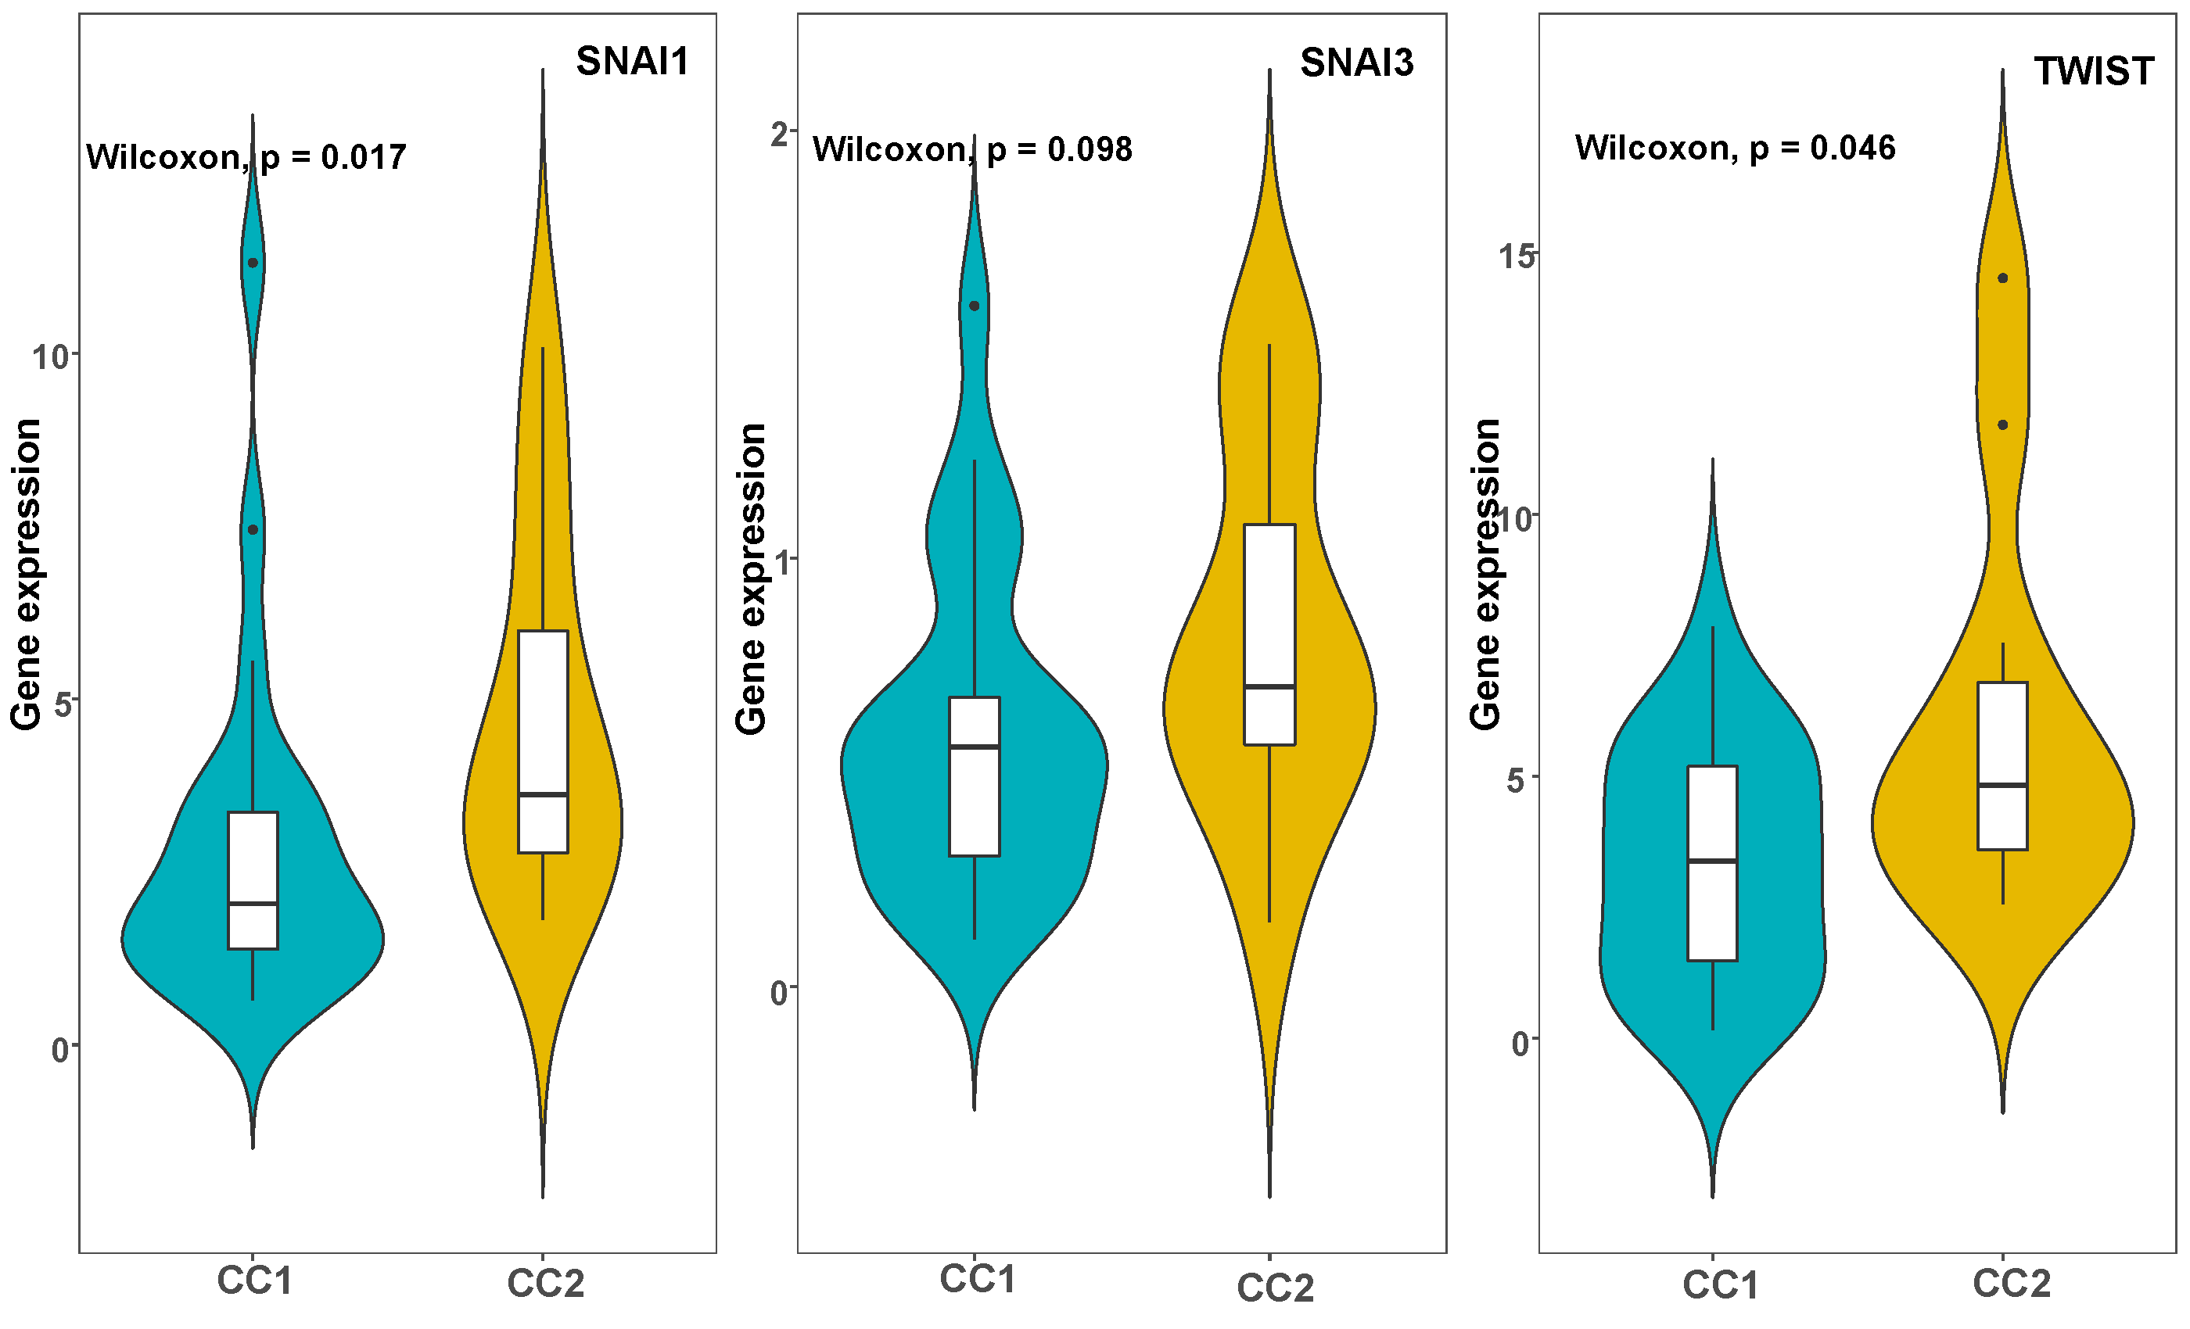
Figure S5: SNAI1, SNAI3, and TWIST expression in CC1 and CC2 tumors

