Slide 1
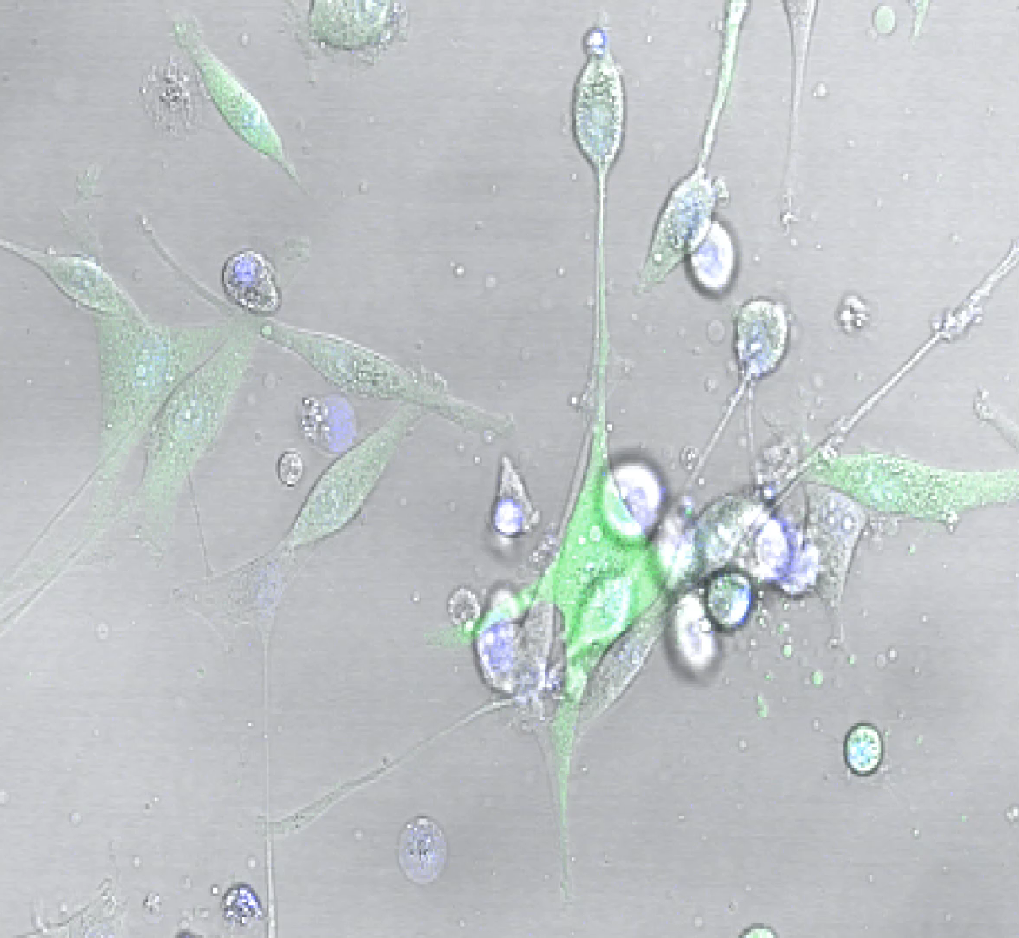
GFP-green: U87MG;
Blue: Hoechst-stained NK-92

