Slide 1
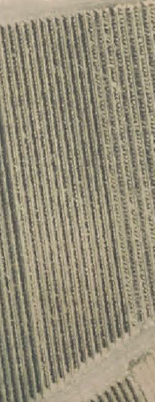
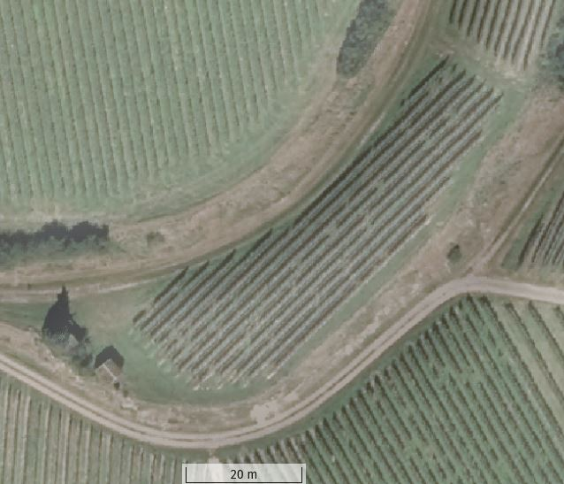
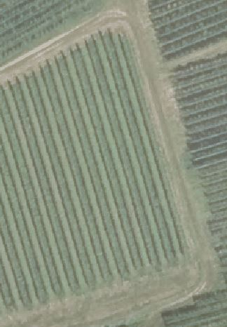
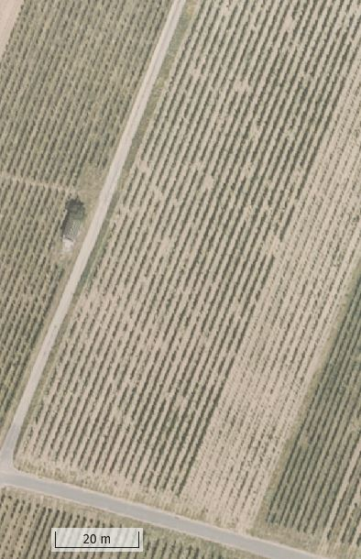

A
B
C
D
1
2
3
4
5
6
7
8
9
10
11
12
1
3
4
5
6
2
7
8
9
1
3
5
N
4
7
8
2
6
9
10
6
11
5
4
3
2
1
W
E
S
Additional file 1 Experimental sites.
Aerial images of the four vineyards of this study GEM (A), HEC (B), NIM (C) and REI (D). The blue colored areas represent the vines that were observed. The numbering of the vine rows can be seen in the figure, the counting direction of the individual vines is marked by arrows.
GPGV spreads in infected vineyards with negative impact on yields
Noemi Meßmer^{1,2}, Patricia Bohnert¹, Lars Askani¹, Stefan Schumacher¹, Ralf T. Voegele², René Fuchs^{1†}
¹ State Institute of Viticulture and Enology (WBI), Department of Biology, Merzhauser Strasse 119, 79100 Freiburg, Germany
² University of Hohenheim, Department of Phytopathology, Otto-Sander-Strasse 5, 70593 Stuttgart, Germany
†Corresponding author rene.fuchs@wbi.bwl.de

