Slide 1
Figure 1D
Figure 1D
Opsin
Shp2

Slide 2
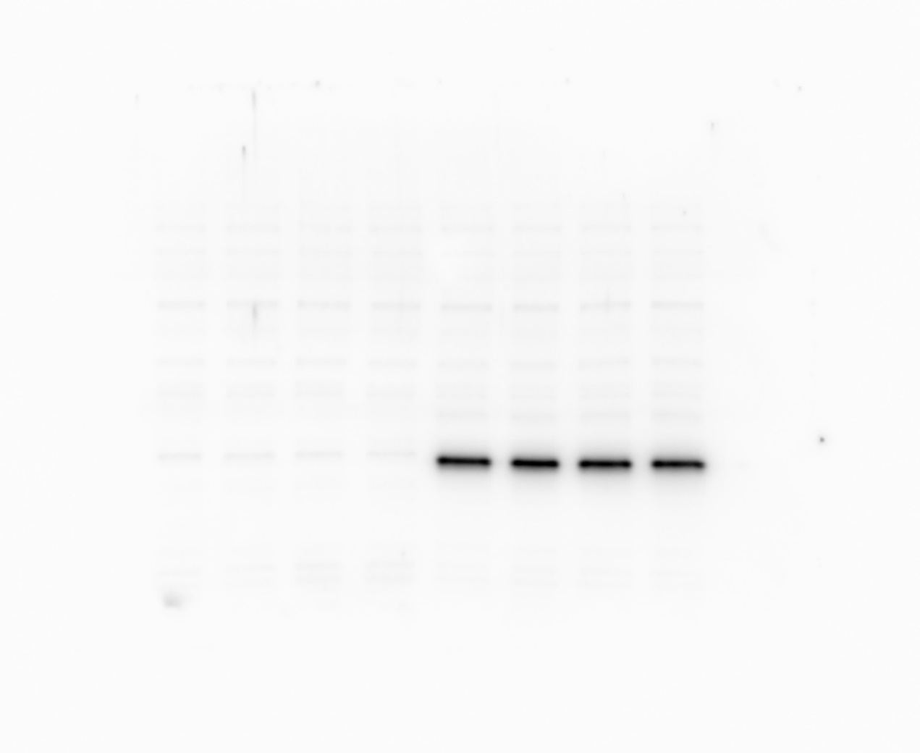
Figure 2C
Figure 2C
Figure 2C
Cre
Shp2
Actin (reprobe of Shp2 blot)

Slide 3
Figure 2Q
Figure 2Q
Rhodopsin
Actin

Slide 4
Figure 2R
Figure 2R
Rhodospin
Actin

Slide 5
Figure 2S
Figure 2S
Actin
Rhodopsin

Slide 6
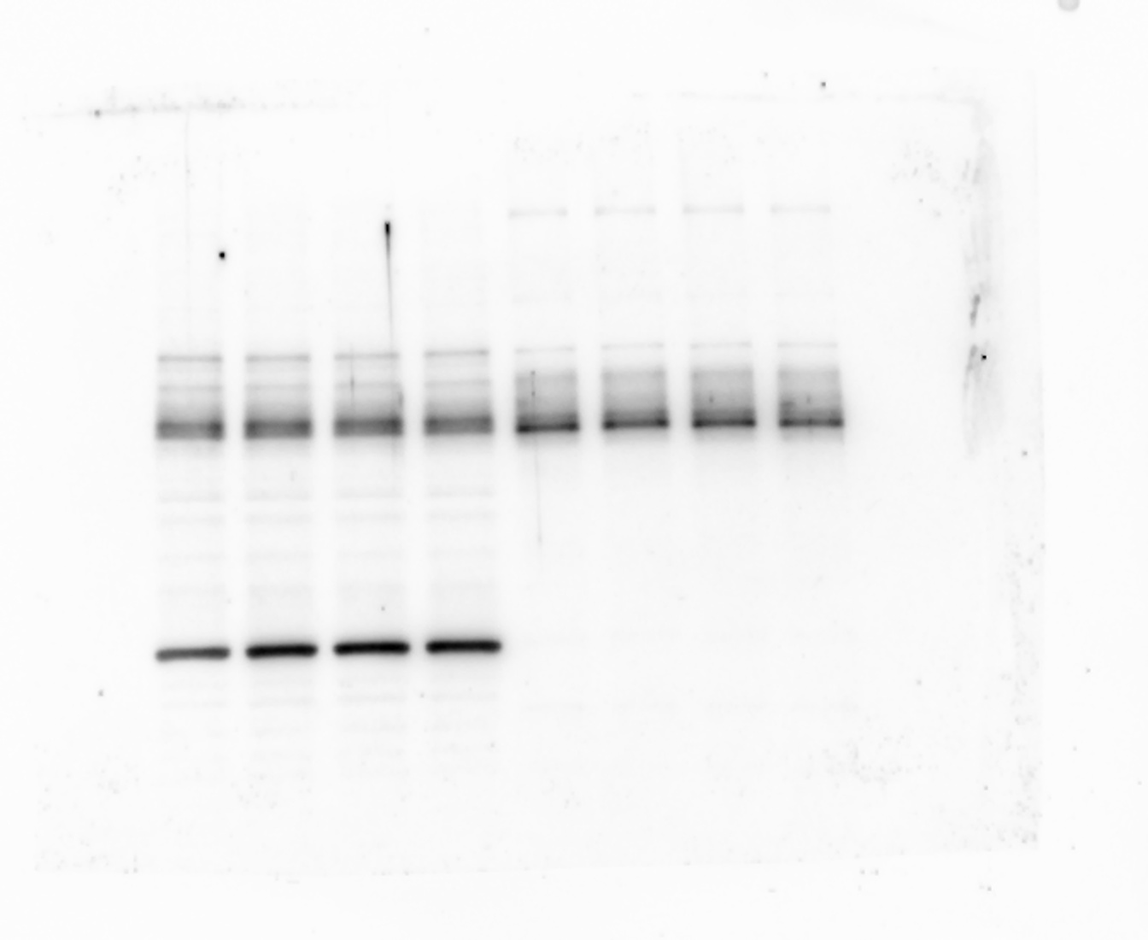
Figure 3B
Figure 3B
Occludin
Rhodopsin

Slide 7
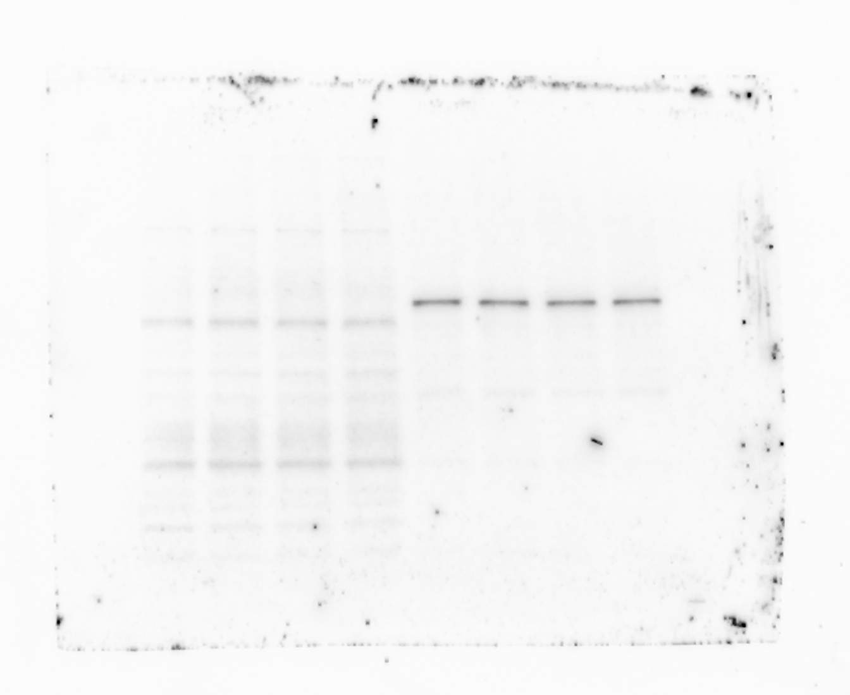
Figure 3B
Figure 3B
Rpe65
Actin

Slide 8
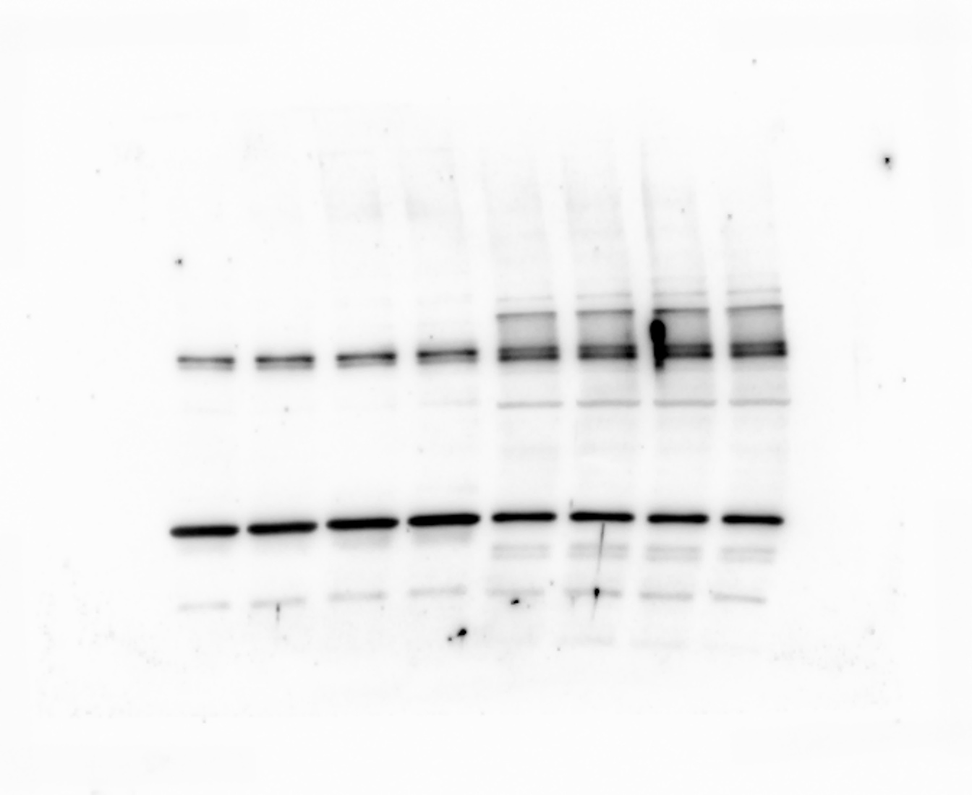
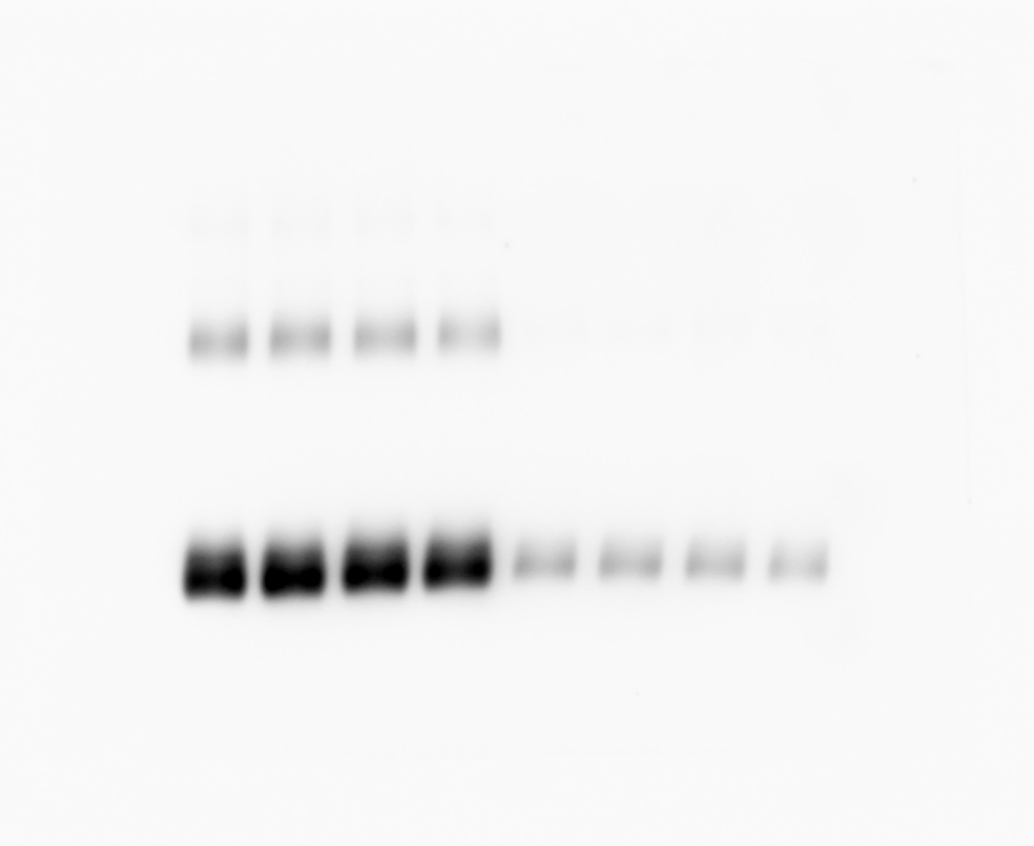
Figure 3C
Figure 3C
Occludin
Rhodopsin

Slide 9
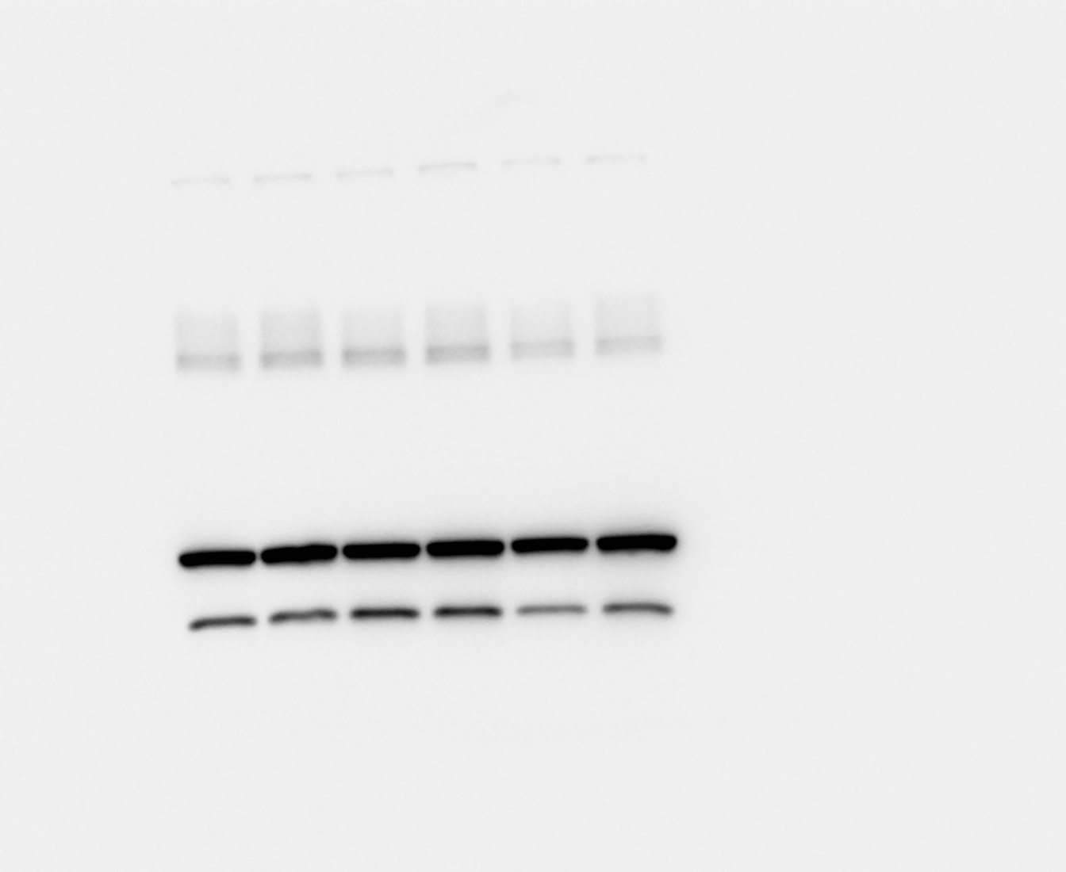
Figure 3D
Figure 3D
Occludin
Actin

Slide 10
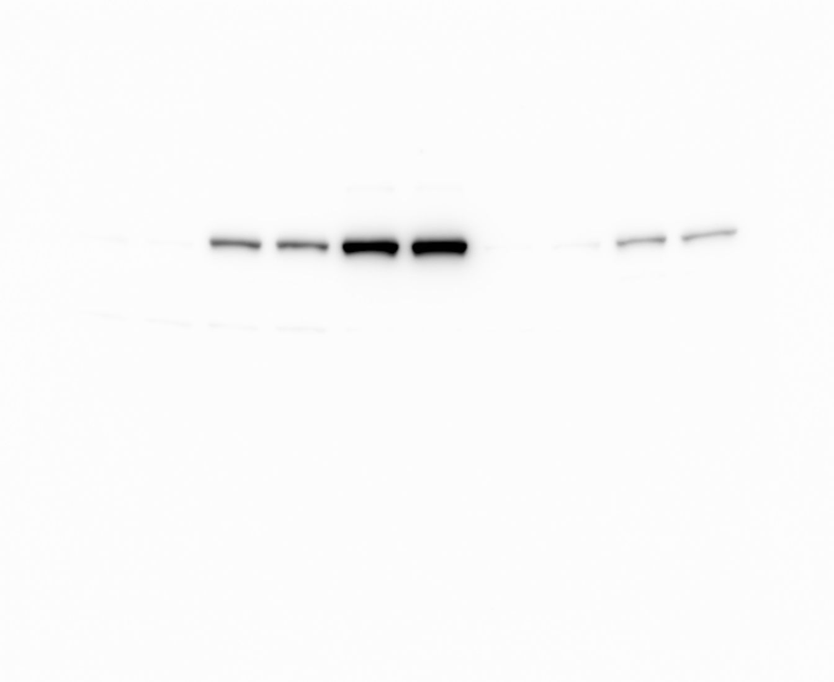
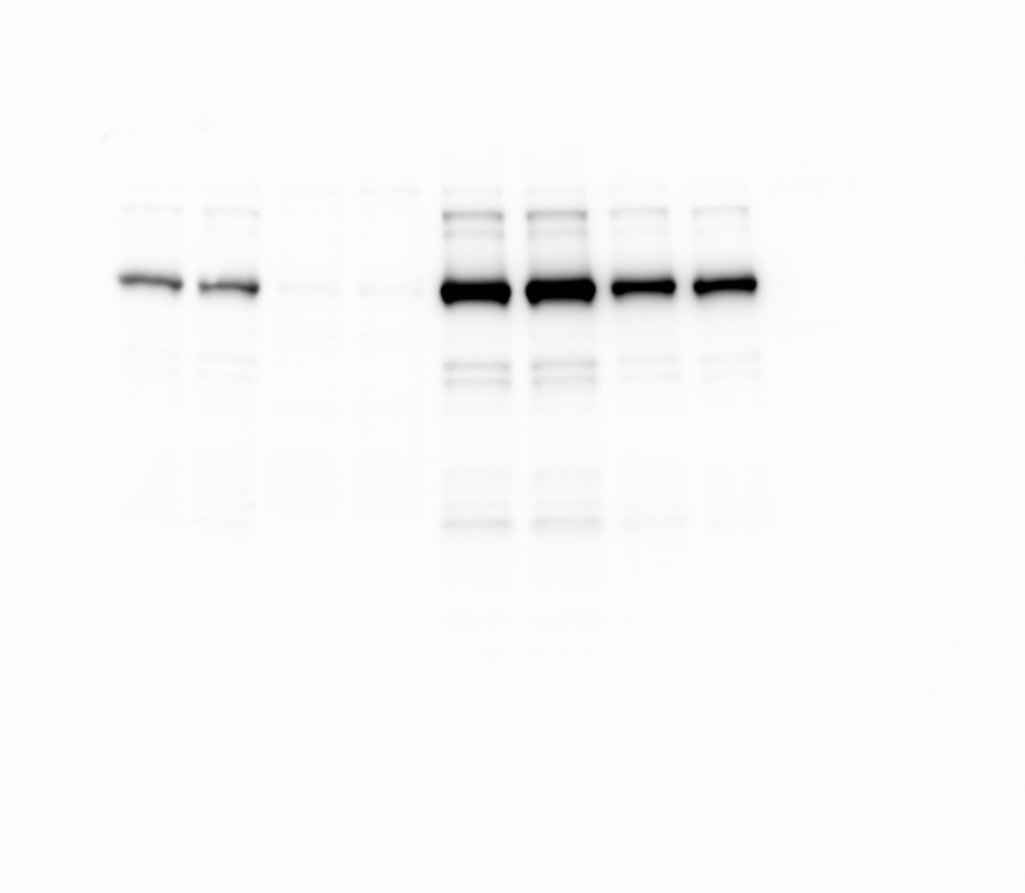
Figure 3H
Figure 3H
Figure 3H
Actin
HA blot
Shp2 blot

Slide 11
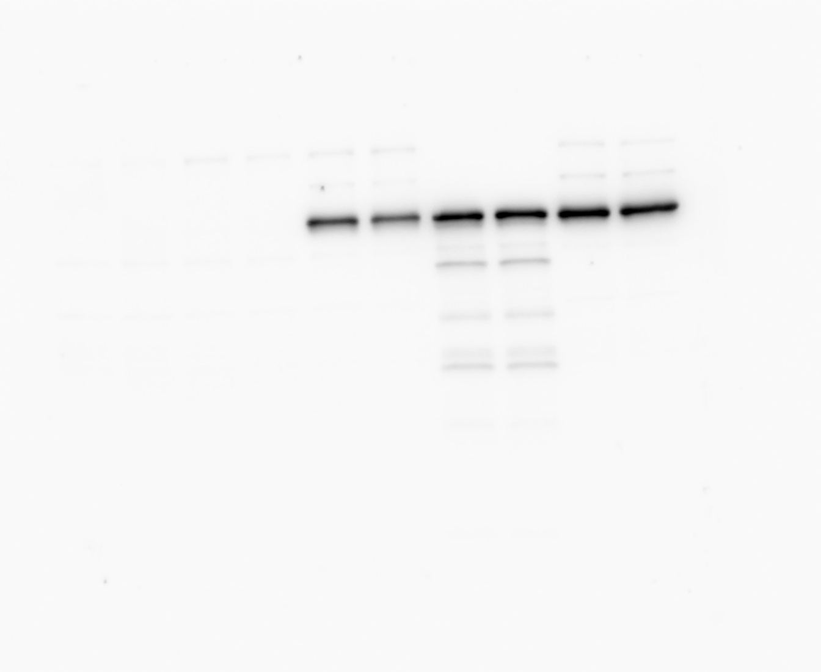
Figure 3I
Figure 3I
HA blot
Flag blot

Slide 12
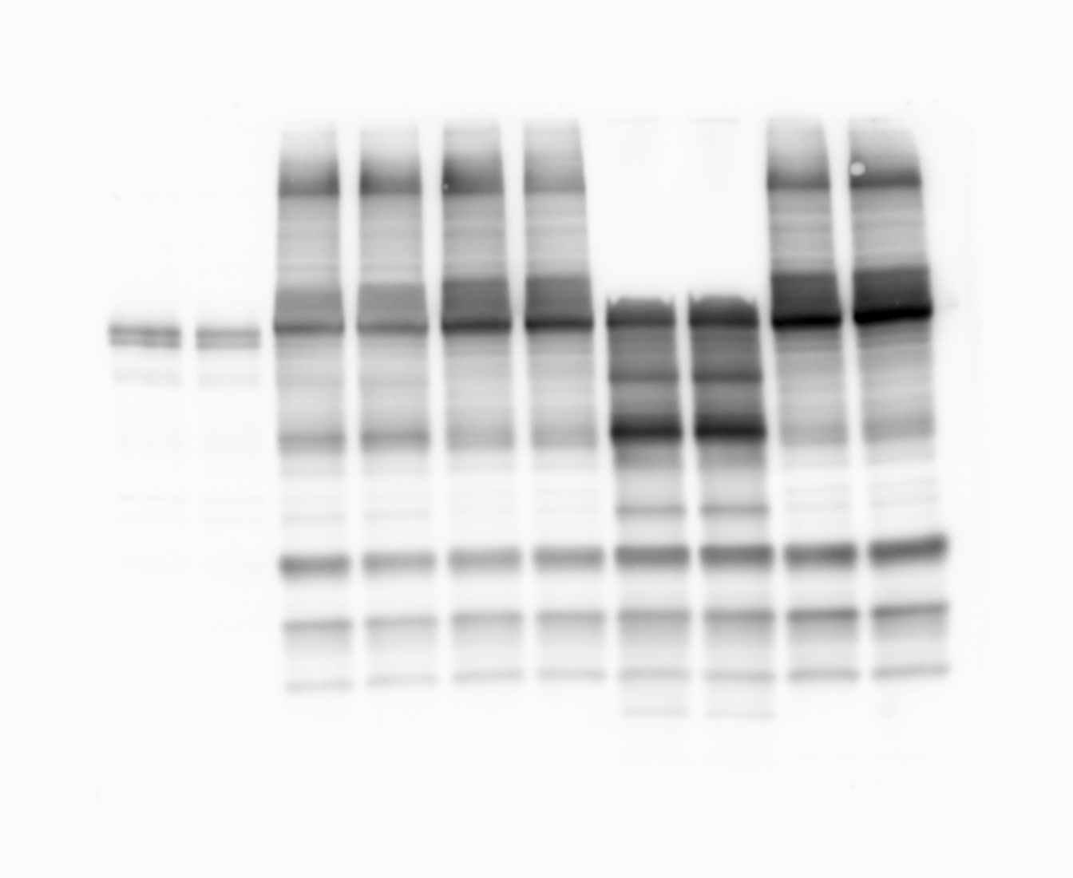
Figure 3I
Figure 3I
Occludin
Actin

Slide 13
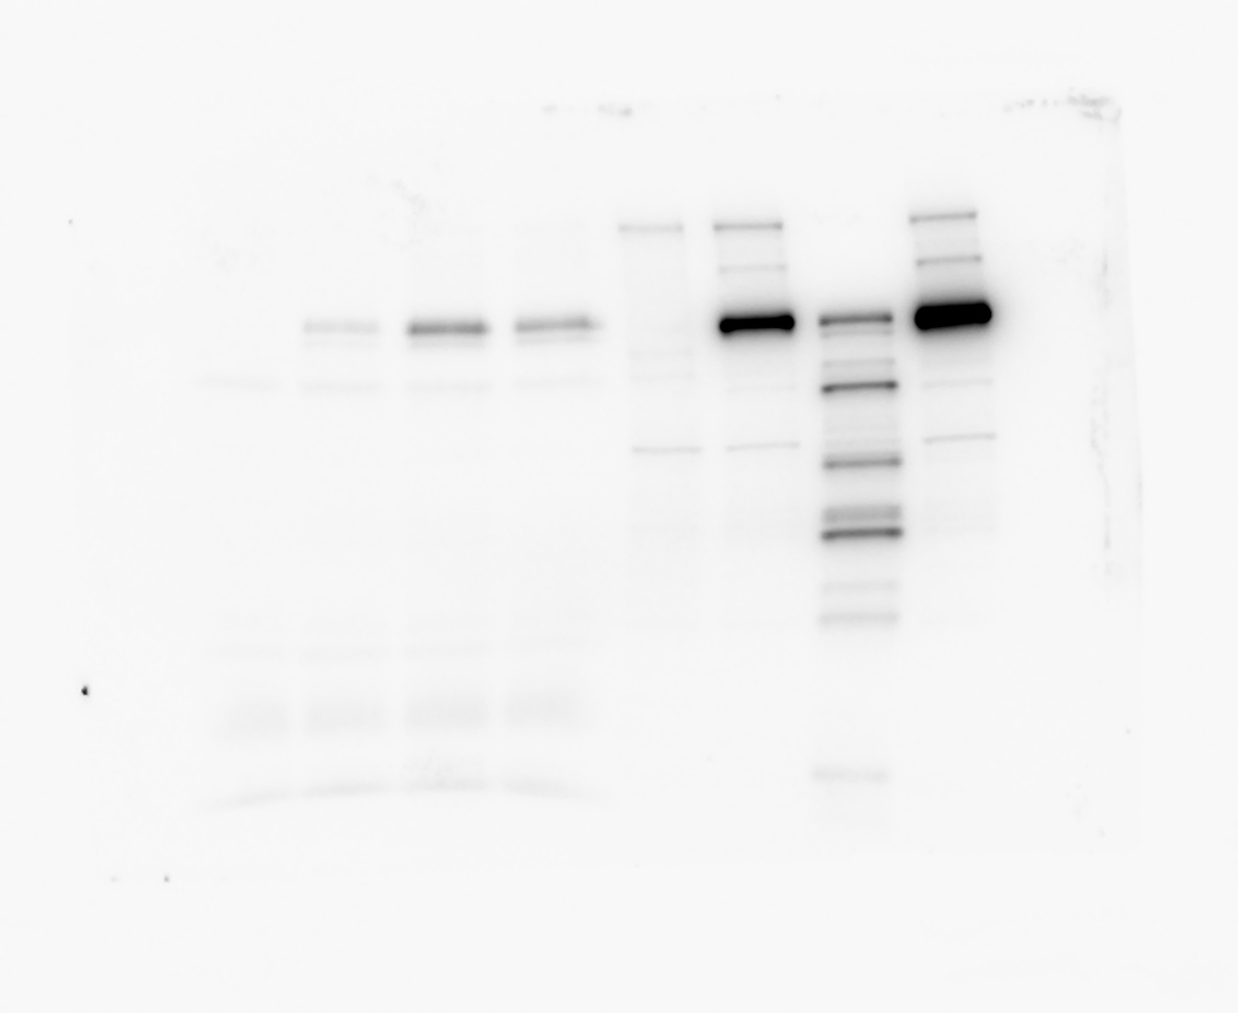
Figure 3J
Figure 3K
HA blot: Flag IP
Flag blot” HA IP

Slide 14
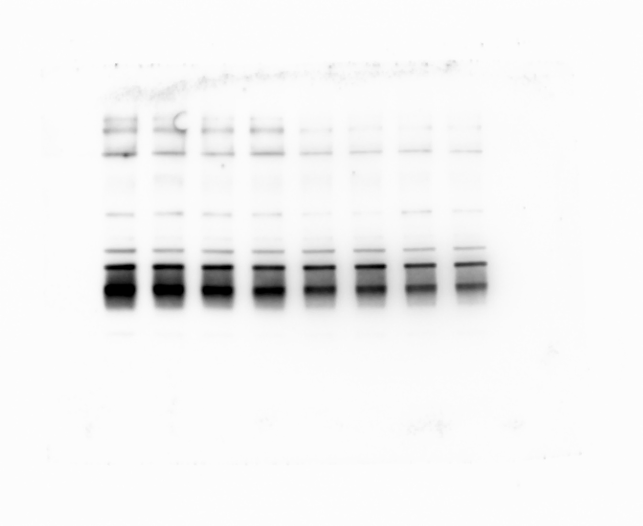
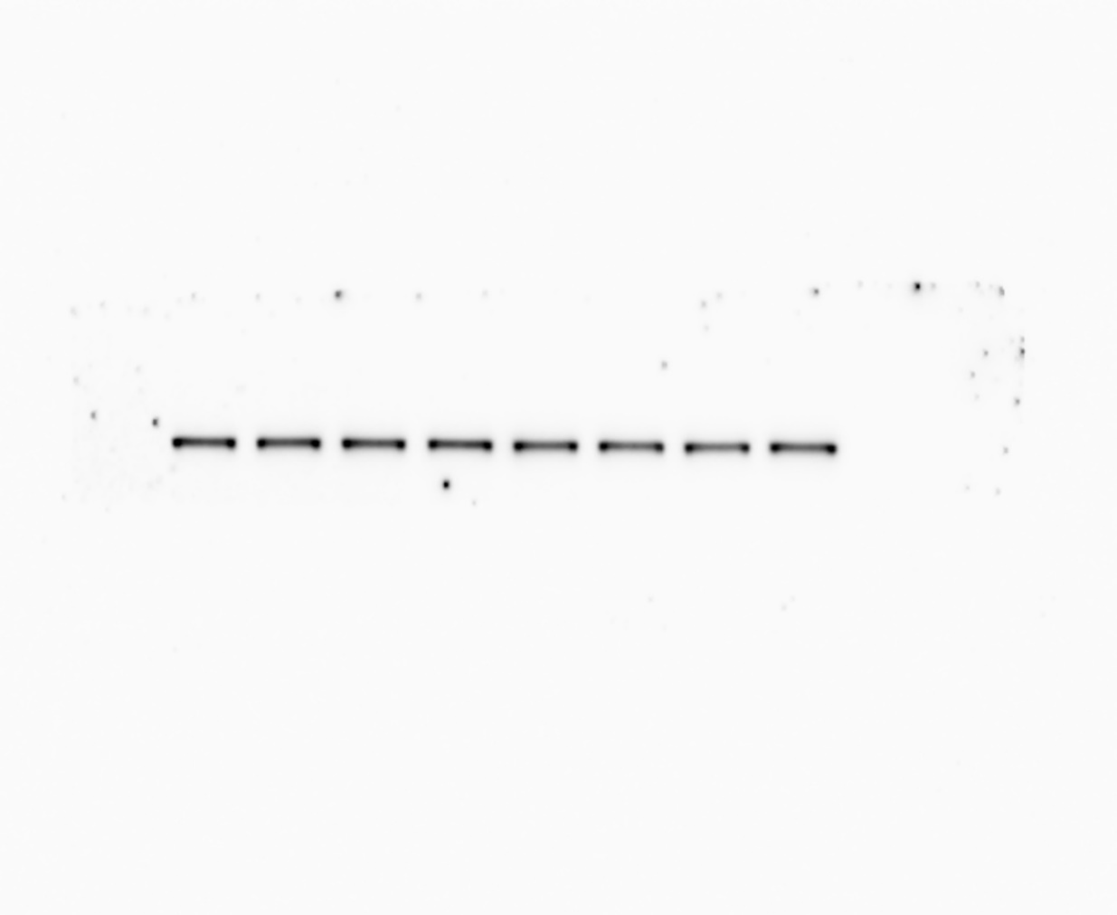
Figure 6
Figure 6
Figure 6
Glut1
HK-1
HK-2

Slide 15
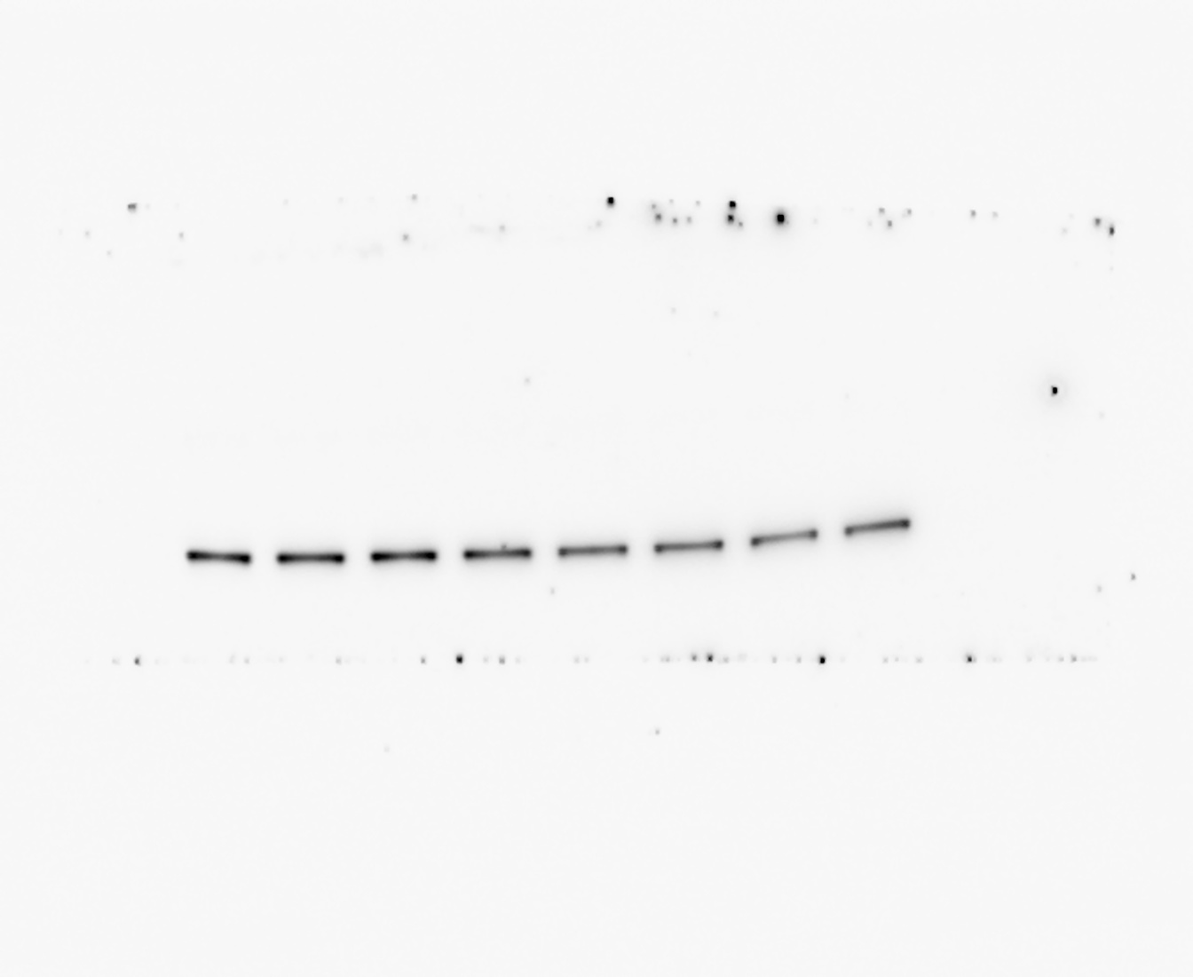
Figure 6
Figure 6
Figure 6
PKM1
PKM2
ALDOC

Slide 16
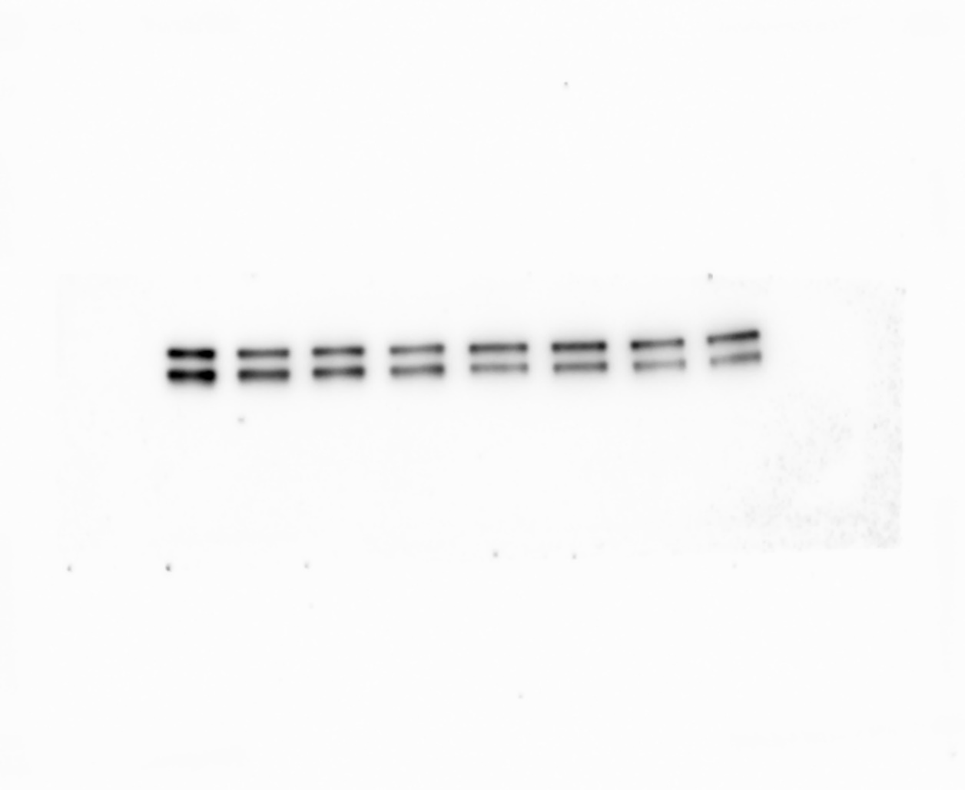
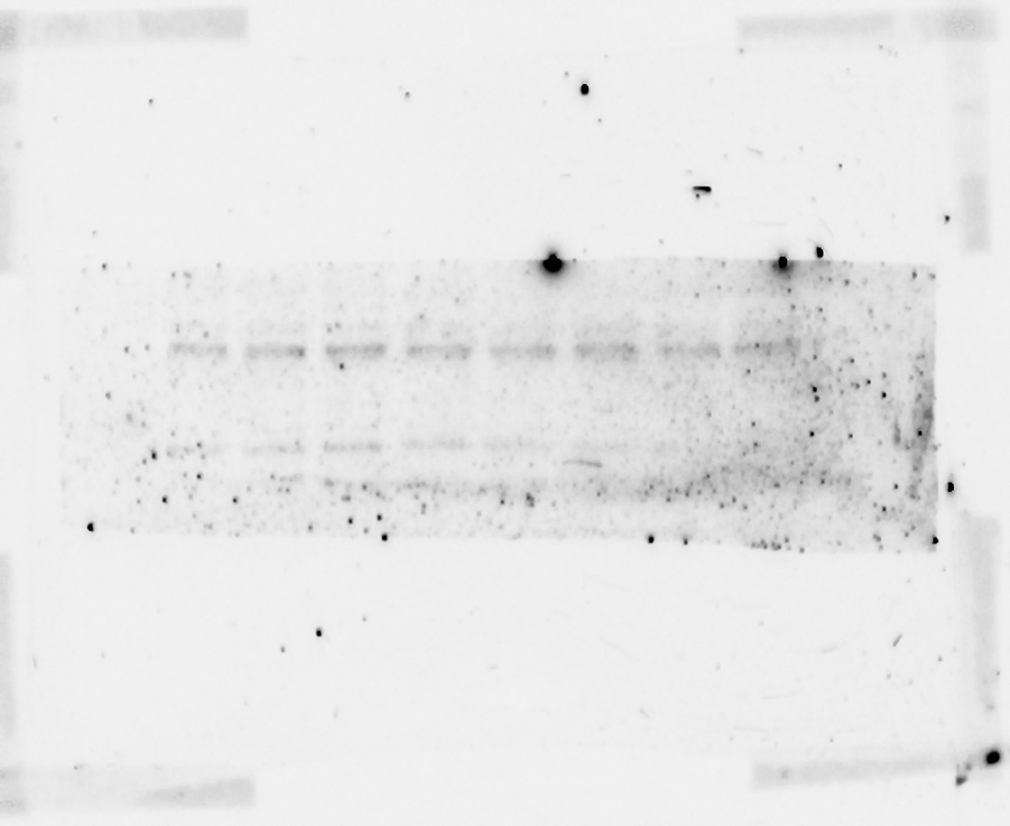
Figure 6
Figure 6
Figure 6
P-PKM2
LDHB/LDHA
p-LDHA

Slide 17
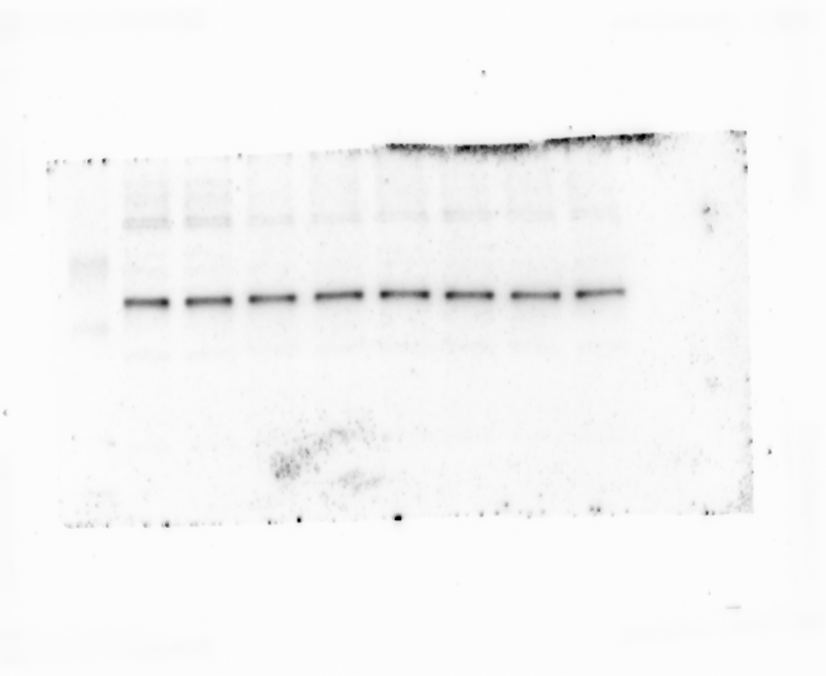
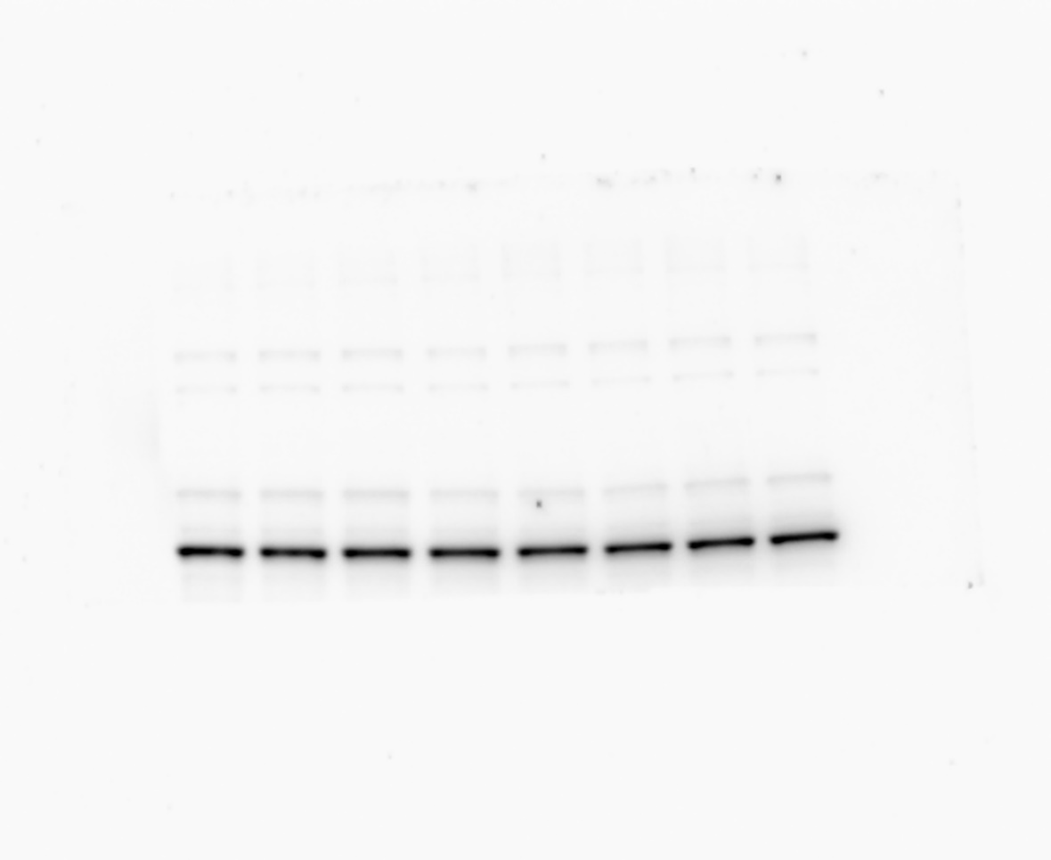
Figure 6
Figure 6
PDH
P-PDH
Figure 6
GFAP

Slide 18
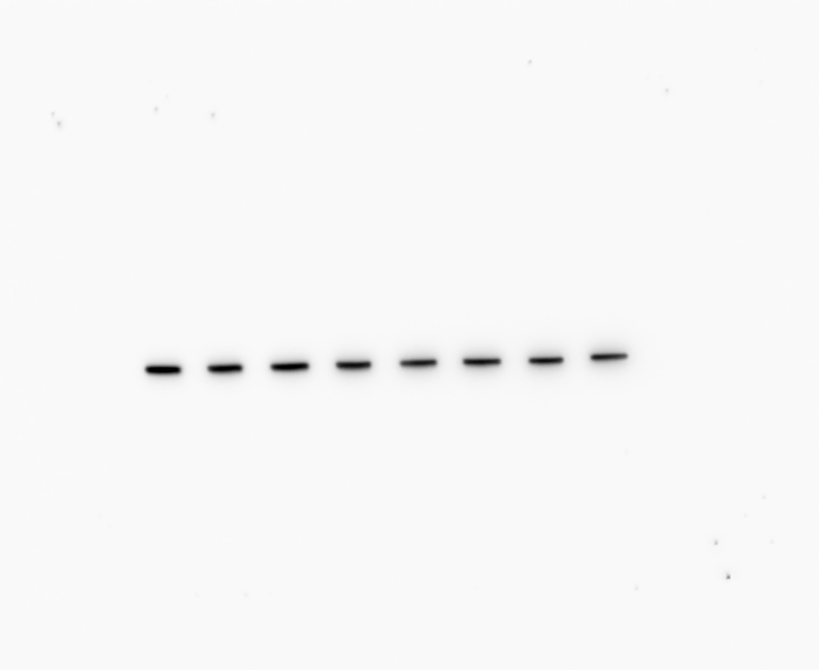
Figure 6
Actin

