Slide 1
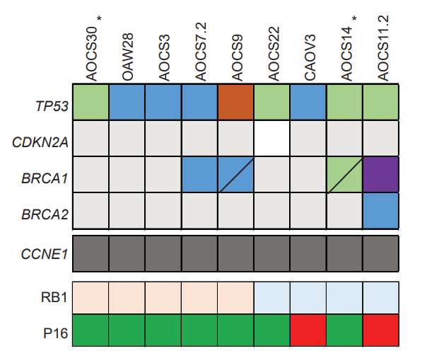
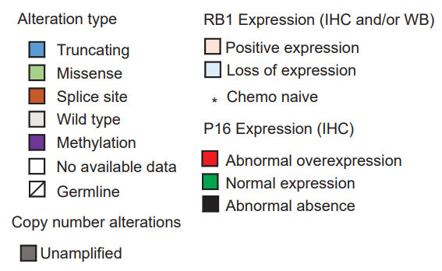
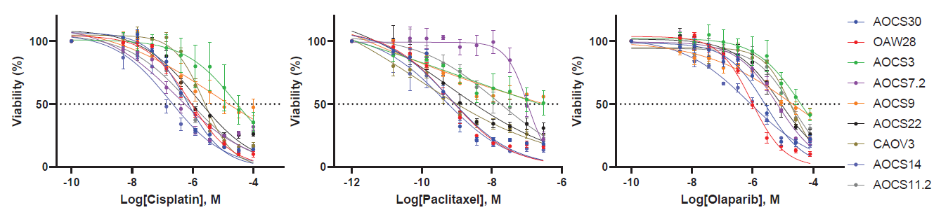
A
B
Supplementary Figure S4. HGSC cell lines with innate RB1 and/or BRCA1 alterations. (A) Summary of the molecular features of innate HGSC cell models, including alterations in key genes (TP53, CDKN2A, BRCA1, BRCA2), copy number alterations in CCNE1, and protein expression of RB1 and p16. (B) Viability of high-grade serous ovarian cancer cell lines after treatment with cisplatin (72 hours), paclitaxel (72 hours), or olaparib (120 hours). Data are expressed as mean (n = 3 replicates) ± standard error of the mean (SEM). For some points, error bars are shorter than the height of the symbol and are not visible.

