Slide 1
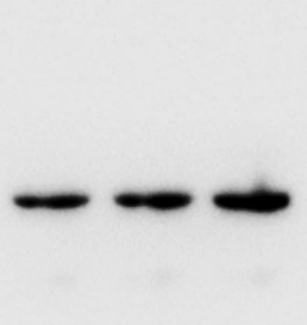
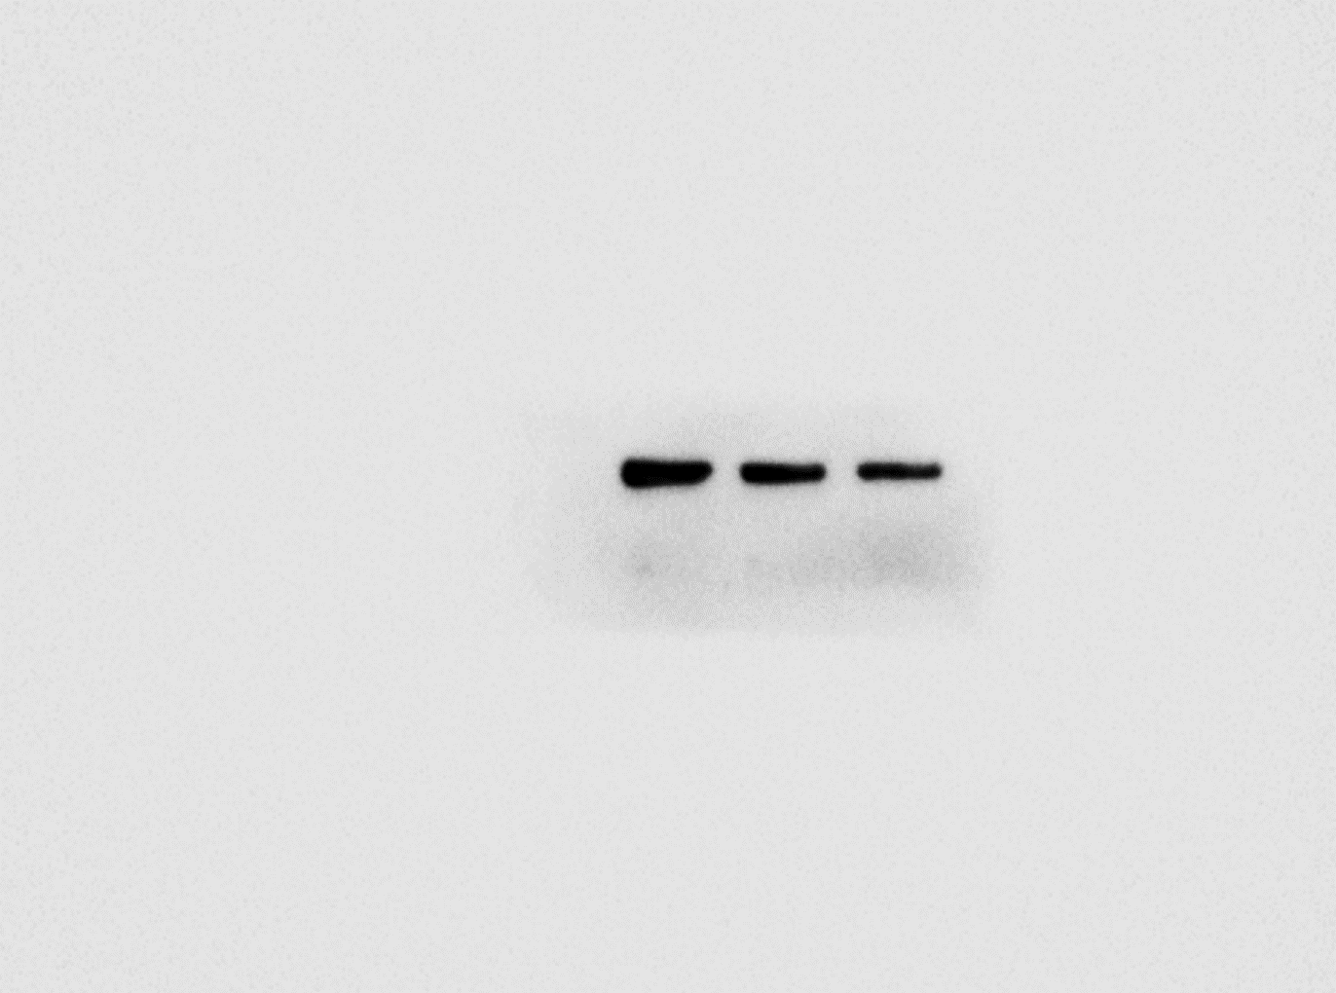
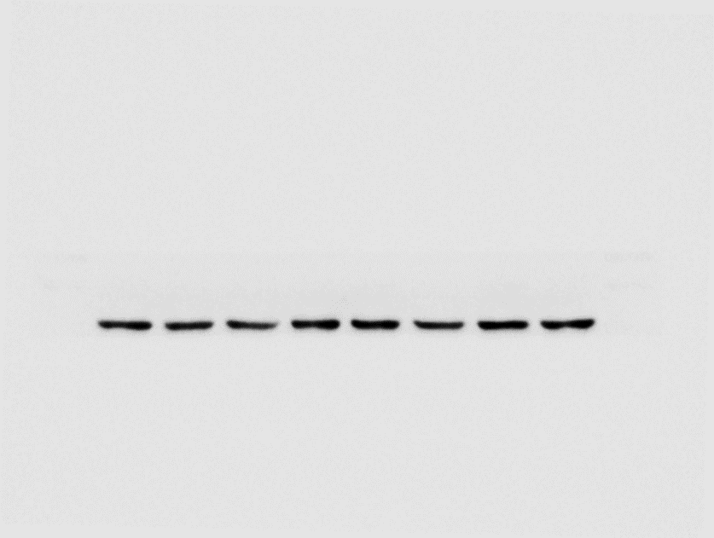
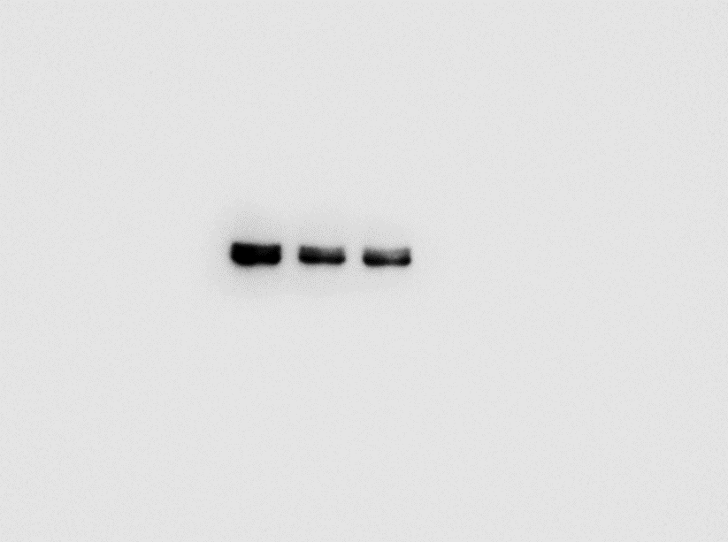
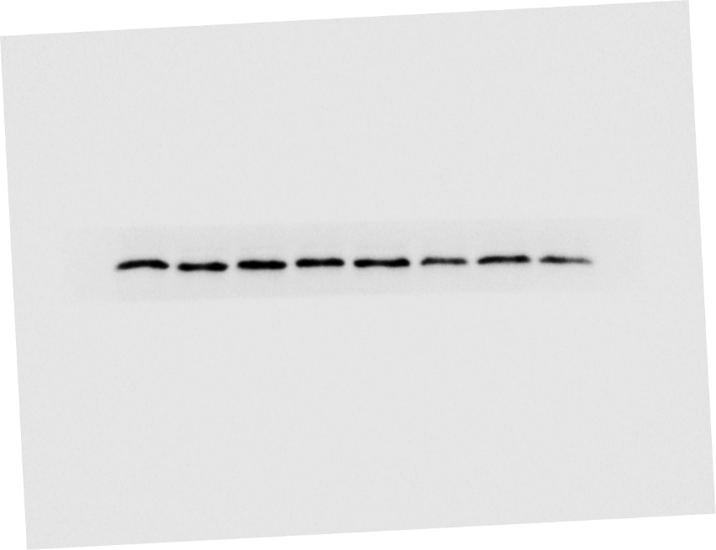
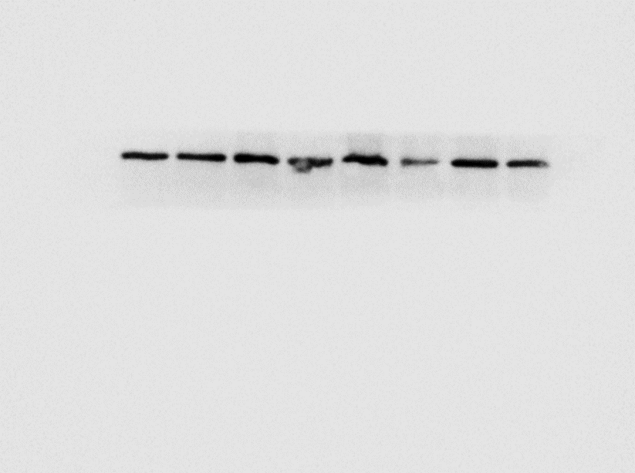
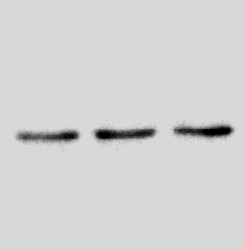
Supplementary figure 1: Original blots for Figure 2.
A
B
C
D
NaÏve
Sham
BCP
NaÏve
Sham
BCP
NaÏve
Sham
BCP
Naïve
Sham
BCP
70-
55-
100-
40-
130-
180-
35-
70-
100-
130-
55-
TGFβRI
70-
TGFβRII
100-
TRPV1
25-
TGFβ1
55-
70-
40-
55-
15-
35-
40-
35-
40-
70-
70-
70-
70-
55-
55-
55-
55-
40-
GAPDH
40-
GAPDH
40-
40-
35-
35-
GAPDH
GAPDH
35-
35-
25-
25-
25-
25-

Slide 2
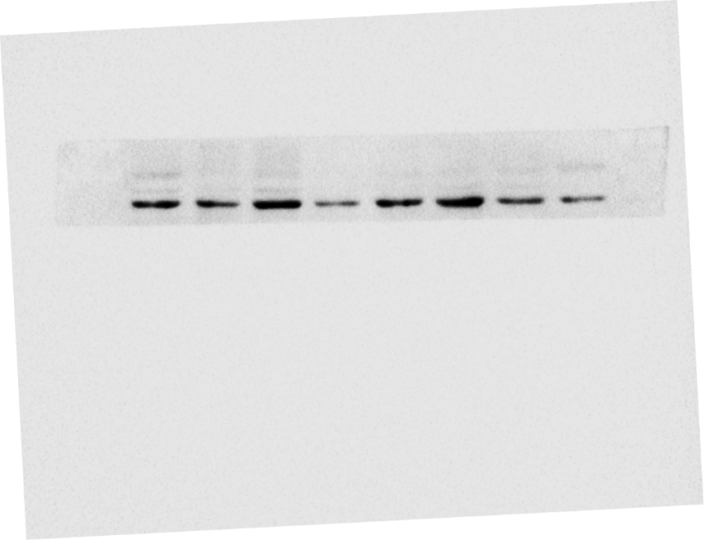
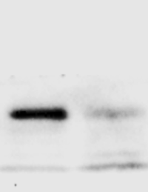
Supplementary figure 2: Original blots for Figure 5.
A
B
C
D
BCP + NS
BCP + Metformin
BCP + NS
BCP + Metformin
BCP + NS
BCP + Metformin
BCP + NS
BCP + SD208
55-
180-
180-
40-
100-
130-
130-
35-
70-
100-
TRPV1
100-
TRPV1
25-
TGFβ1
55-
TGFβRI
70-
70-
40-
55-
55-
15-
35-
40-
40-
70-
70-
70-
70-
55-
55-
55-
55-
40-
40-
40-
GAPDH
40-
GAPDH
35-
GAPDH
35-
GAPDH
35-
35-
25-
25-
25-
25-

