Slide 1
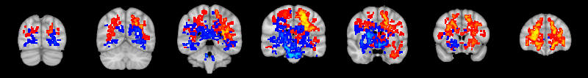
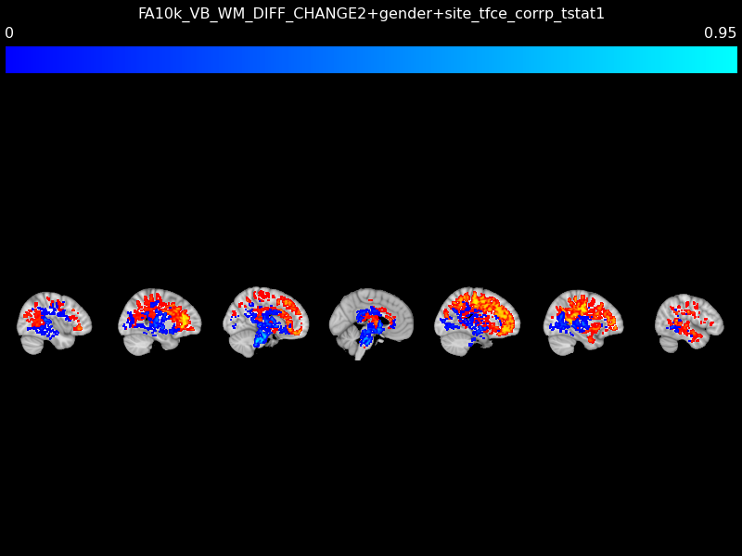
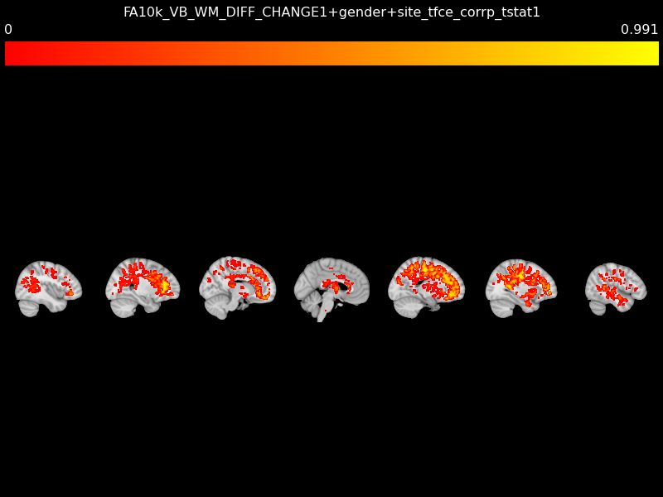
Fractional anisotropy
Y = -78
Y = -60
Y = -40
Y = -22
Y = -2
Y = 17
Y = 36
R L
R L
X = 40
X = 26
X = 12
X = -2
X = -18
X = -32
X = -46
P A
P A
0.009
1
0.050
1
P-value (FWE-corrected)

