Slide 1
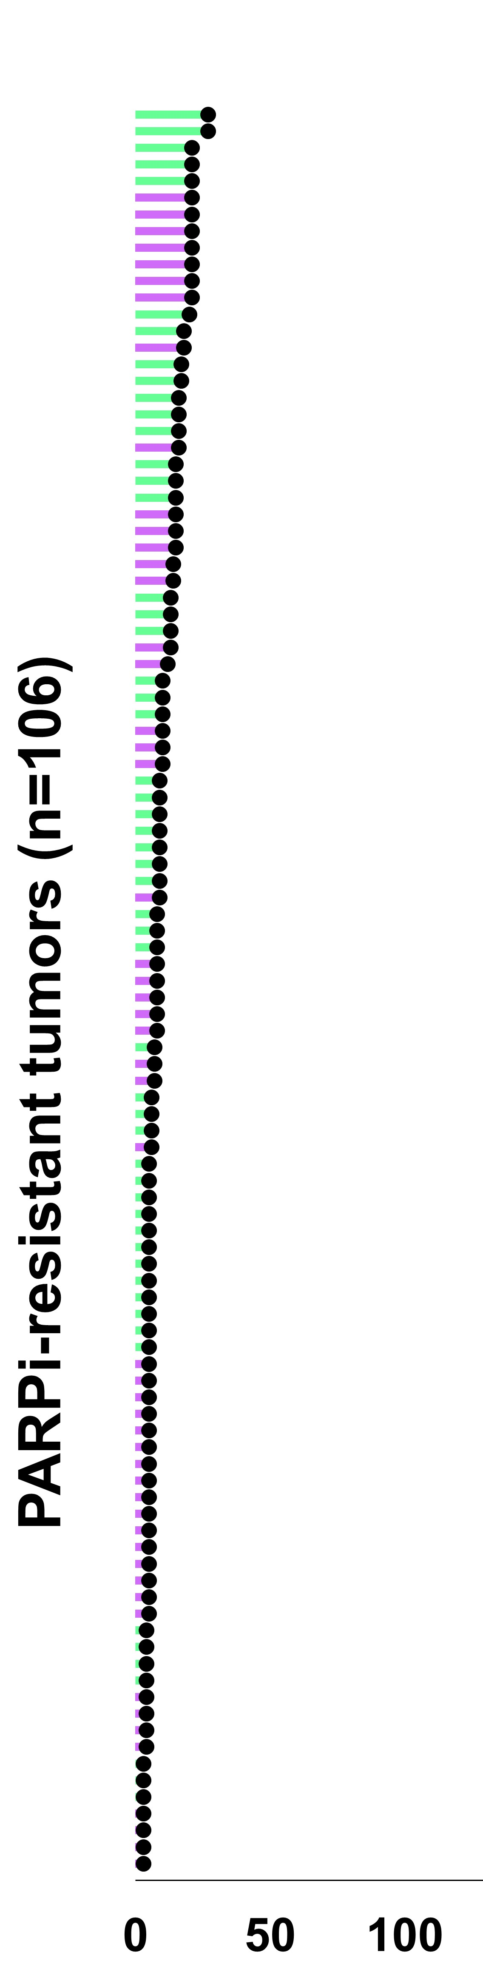
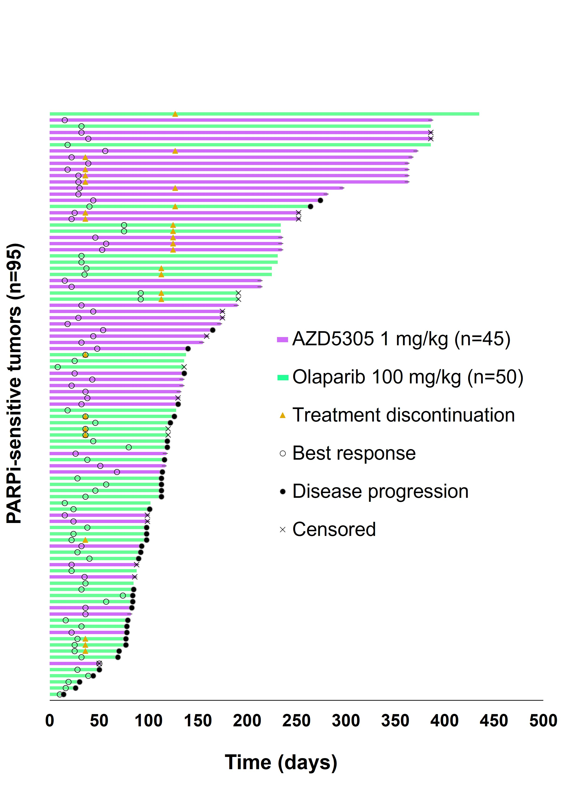
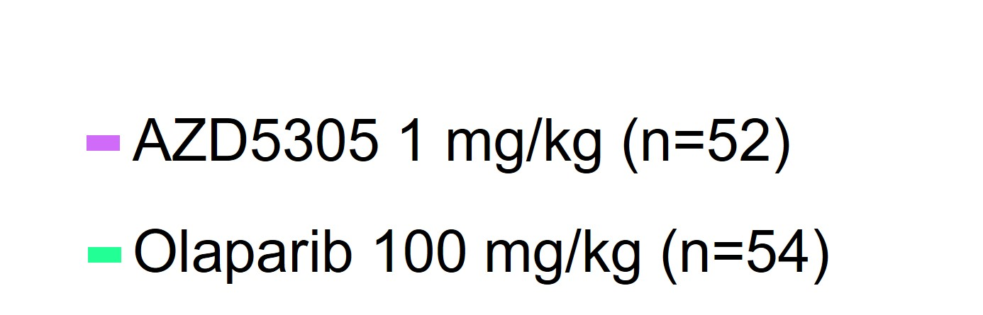
Fig. S2
A
B
C
Fig. S2. Analysis of response to AZD5305 and olaparib in PDXs. Swimmer plot showing the timeline of the in vivo experiments with individual A. PARPi-sensitive tumors and B. PARPi-resistant tumors. C. Tumor volume (mm³) of control tumors and PARPi-treated tumors with acquired resistance along time. The mean of at least three replicates per PDX was included in the control arm.

