Slide 1
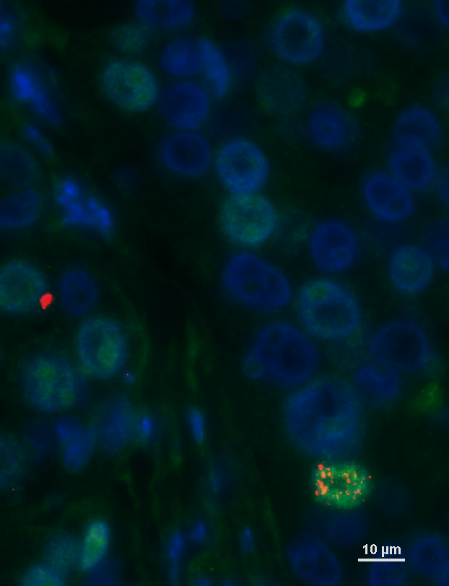
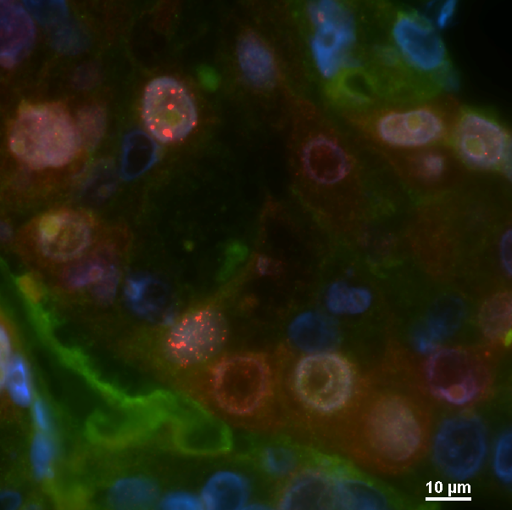
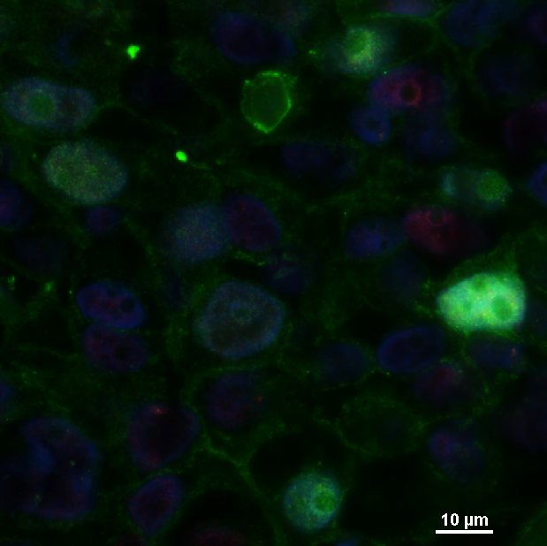

Fig. S4
A
PDX474.2
B
Control
Progression #28 with
BRCA2 reversion mut.
Low
High
RAD51/
Geminin
PDX124
Control
Progression #32 with
53BP1 loss
Low
High
RAD51/
Geminin
High
Low
53BP1/
Geminin
C
PDX124 - Progression #3
BRCA1: c.1961delA
PDX474.2 - Progression #26
BRCA2: c.3922G>T
PDX474.2 - Progression #28
PDX474.2 - Progression #29
Notes:
Comparación 1: reversion vs no reversion
Comparación 2: olaparib vs 5305 (olaparib revierten más que en 5305)

Slide 2
Fig. S4. Characterization of genetic-based mechanisms of resistance to PARPi in PDXs. A. Representative immunofluorescence images of two tumors after progression to olaparib or AZD5305. PDX474.2 (progression #28) harbors a BRCA2 reversion mutation and PDX124 (progression #32) shows 53BP1 loss. RAD51 and 53BP1 nuclear foci in geminin-positive cells are shown. All pictures were taken at 600x magnification. Scale bar = 10 µm. B. Number of mutations detected in BRCA1 or BRCA2 vs. total number of mutations detected by whole exome sequencing. Untreated controls, AZD5305- and olaparib-progressing tumors of each PDX are depicted (AZD5305, n = 9; olaparib, n = 30). PARPi-progressing tumors harboring a reversion mutation are highlighted. C. Illustrations of the reversion mutations detected associated with the usage of microhomology as a backup mechanism to repair DSBs detected in PARPi-progressing tumors. The reference (Ref) and the sequence with the deletion (Del) are shown. Deleted sequences are labelled in red, and dashes indicate deleted base pairs. Microhomology regions are labelled in green.

