Slide 1
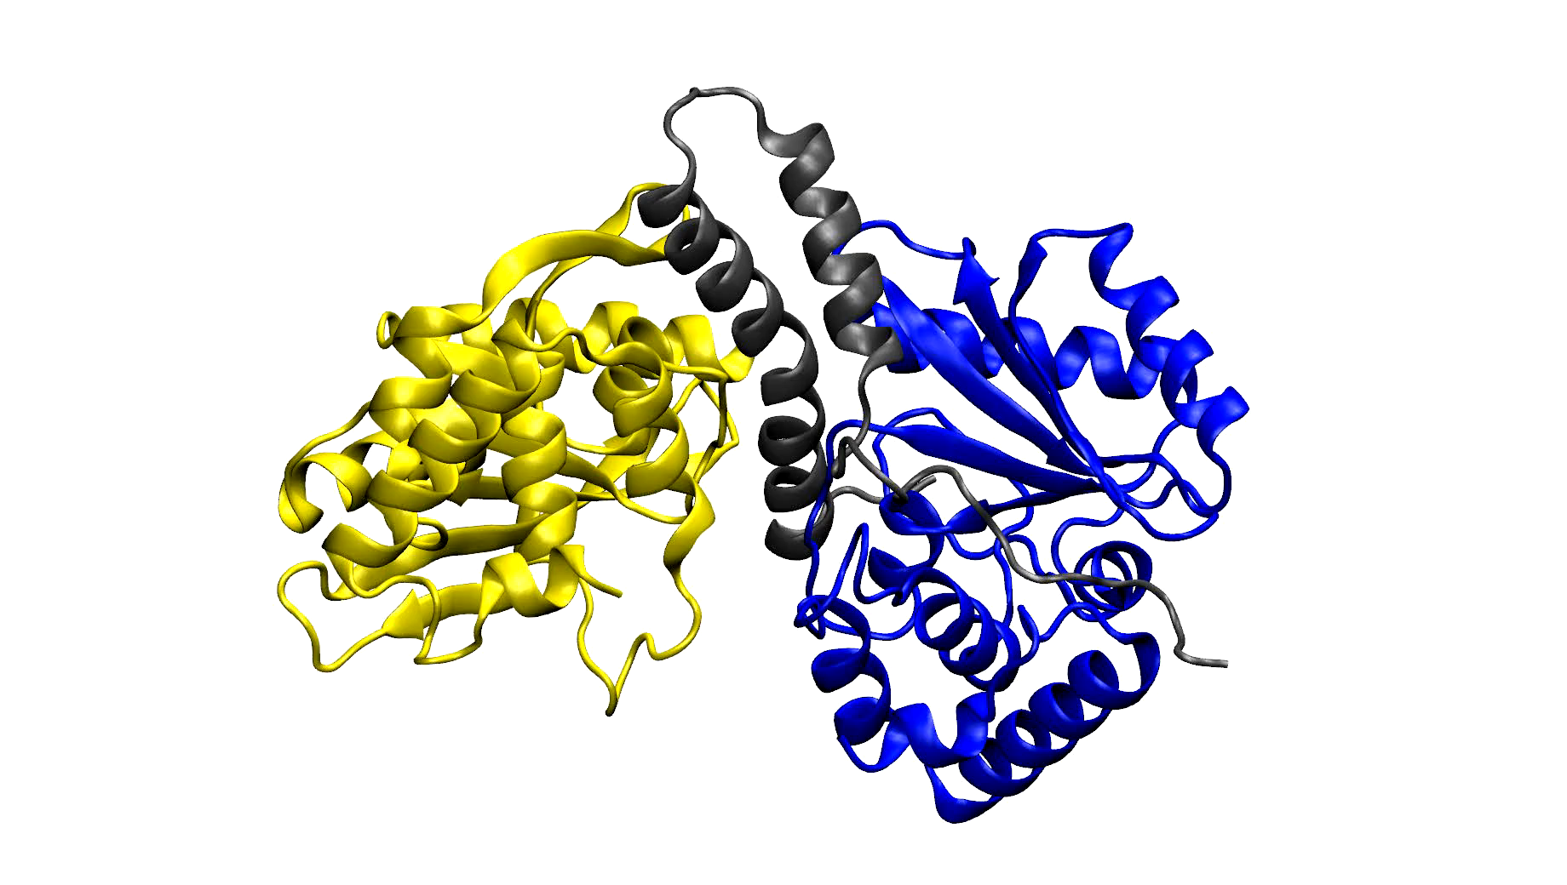
Supplementary Movie 1. Well-tempered metadynamics simulation showing dissociation of the MenT₁α-p:MenA₁:MenT₁β-p heterotrimer following phosphorylation of both toxin protomers, and the trend towards dissociation into a MenA₁:MenT₁α-p heterodimer and MenT₁β-p monomer. Structures are shown as cartoons colored dark grey (MenA₁), blue (MenT₁α-p), and yellow (MenT₁β-p). The animation is aligned with the data shown in Figure 6H and Supplementary Figure 9D. The distance between the Centre of Mass (COM) of MenT₁β-p and the COM of MenA₁ + MenT₁α-p was selected as the collective variable (CV).

